Slide 1
Beam diagnostics for high brightness beams at FACET-II
Laser-Plasma Accelerator Workshop 2019 – Diagnostics WG
May 8, 2019
Doug Storey
SLAC National Accelerator Laboratory

Slide 2





















Acknowledgements
SLAC: C. Emma, M. Hogan, B. O’Shea, G. White, V. Yakimenko

Slide 3
FACET-II: A National User Facility Based on High-energy Beams and Their Interaction with Plasmas and Lasers
10 GeV e⁻ & e⁺ beams, 2nC/1nC @ 30/5Hz, ~µm emittance, Ipk > 10kA

Slide 4
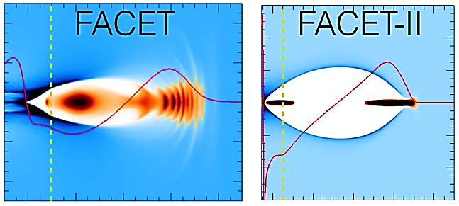
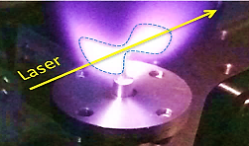
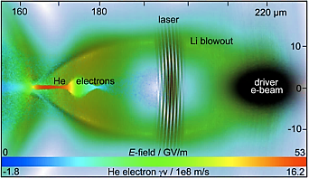
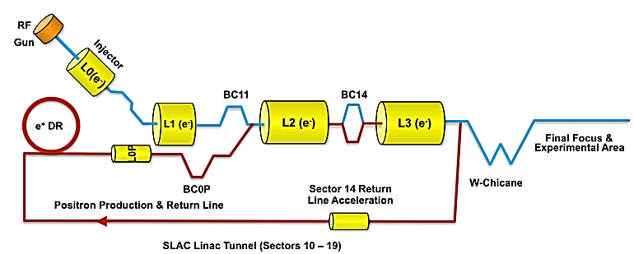
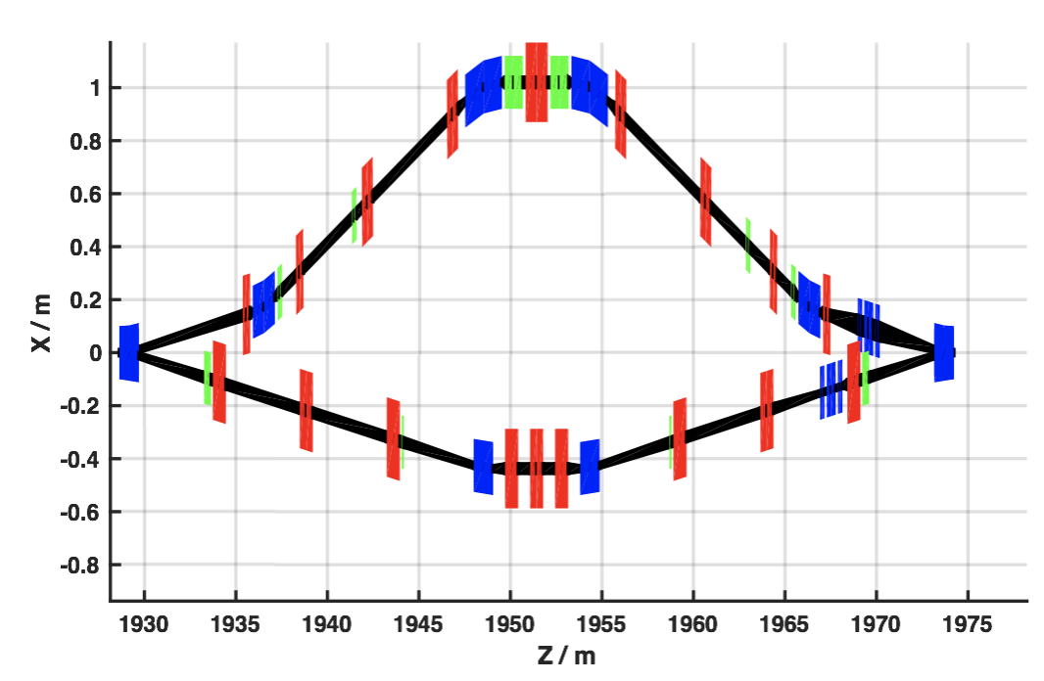
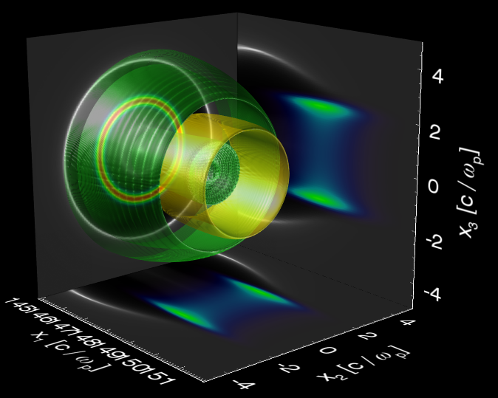
PWFA Research Priorities at FACET-II
Emittance Preservation with Efficient Acceleration
FY19-21
High Brightness Beam Generation & Characterization
FY20-22
High-gradient high-efficiency (instantaneous) acceleration has been demonstrated @ FACET
10’s nm emittance preservation is necessary for collider apps
Ultra-high brightness plasma injectors may lead to first apps
Full pump-depletion and emittance preservation at µm level planned as first experiment
Stage 1
Stage 1
Positron Acceleration
FY22-24
Simultaneous Delivery of Electrons & Positrons
FY22-25
Only high-current positron capability in the world for PWFA research will be enabled by Phase II
Positron Acceleration on Electron Beam Driven Wakefields
Develop techniques for positron acceleration in PWFA stages
Stage 3
Stage 2

Slide 5
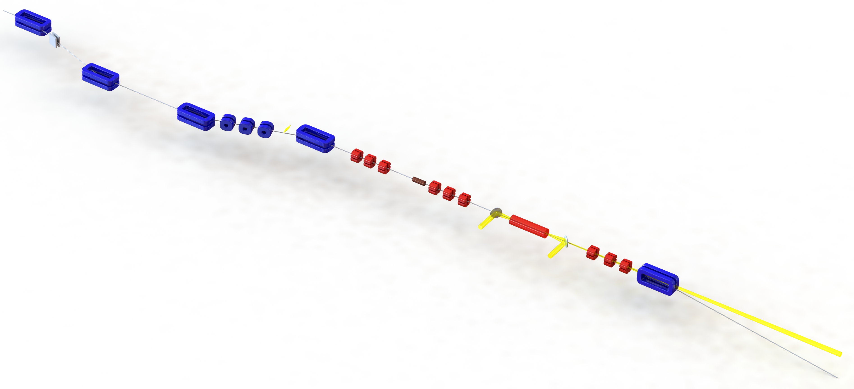
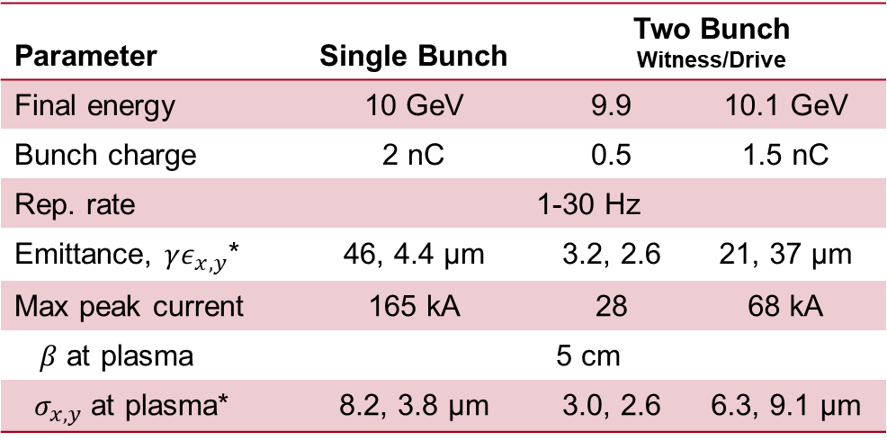
FACET-II Experimental Area – Beam Parameters
Final bunch compressor
The FACET-II experimental area is configurable to meet the needs of many experiments, including the delivery of:
single and double bunch, high peak current beams.
Notch collimator
Wiggler Spectrometer
Final focus quadrupoles
Transverse deflector
Beam parameters after final compression:
Experimental laser
Plasma source
Parameter | Single Bunch | Two Bunch Witness/Drive
Final energy | 10 GeV | 9.9 | 10.1 GeV
Bunch charge | 2 nC | 0.5 | 1.5 nC
Rep. rate | 1-30 Hz
Emittance, $γε_{x,y}$* | 46, 4.4 µm | 3.2, 2.6 | 21, 37 µm
Max peak current | 165 kA | 28 | 68 kA
$β$ at plasma | 5 cm
$σ_{x,y}$ at plasma* | 8.2, 3.8 µm | 3.0, 2.6 | 6.3, 9.1 µm
Spectrometer quadrupoles
Spectrometer dipole
Electron and gamma diagnostics
For more details see: FACET-II Technical Design Report SLAC-R-1072
* = core values

Slide 6
FACET-II Experimental Area – Diagnostic Devices
Final bunch compressor
Notch collimator
Wiggler Spectrometer
Energy Spectrum
Momentum
Final focus quadrupoles
Longitudinal
Transverse deflector
Experimental laser
Experimental diagnostics devices include:
Wiggler spectrometer to measure pre-plasma energy spectrum
X-band TCAV and EOS for longitudinal profile measurements
BPMs, OTRs, Wirescanner, Toroids, Pyro-bunch length monitor
Imaging spectrometer diagnostics:
  Both high resolution and large FOV electron profile monitors
  Gamma ray radiation diagnostics
Plasma source
Spectrometer quadrupoles
Spectrometer dipole
Electron and gamma diagnostics

Slide 7
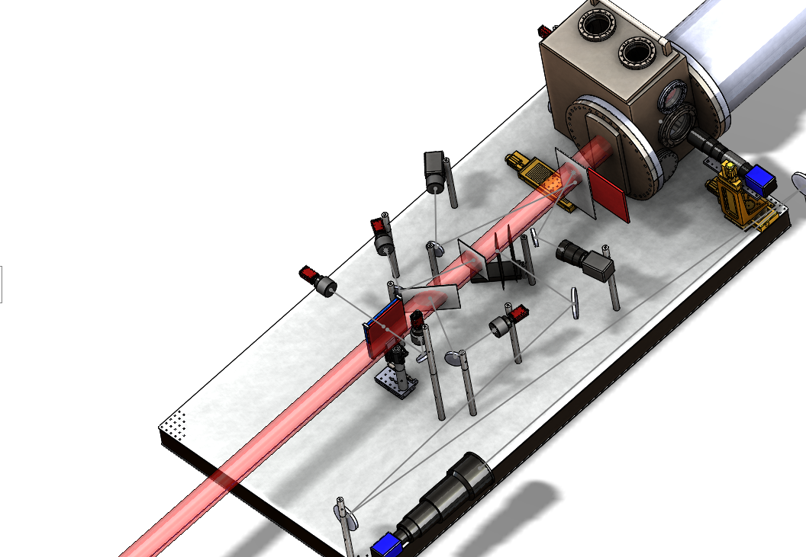
Imaging Spectrometer Diagnostics
Well equipped spectrometer with both electron and gamma radiation diagnostics:
  Electron diagnostics:
    High resolution profile monitor
    Large FOV profile monitors
    Cherenkov light camera
  Gamma radiation diagnostics**:
    High resolution phosphor screens
    Stack calorimeter
    High precision diagnostics:
      Bent crystal spectrometer
      Compact Compton spectrometer
      Pair spectrometer
** Recall Pablo San Miguel’s talk from Tuesday at 15:20

Slide 8
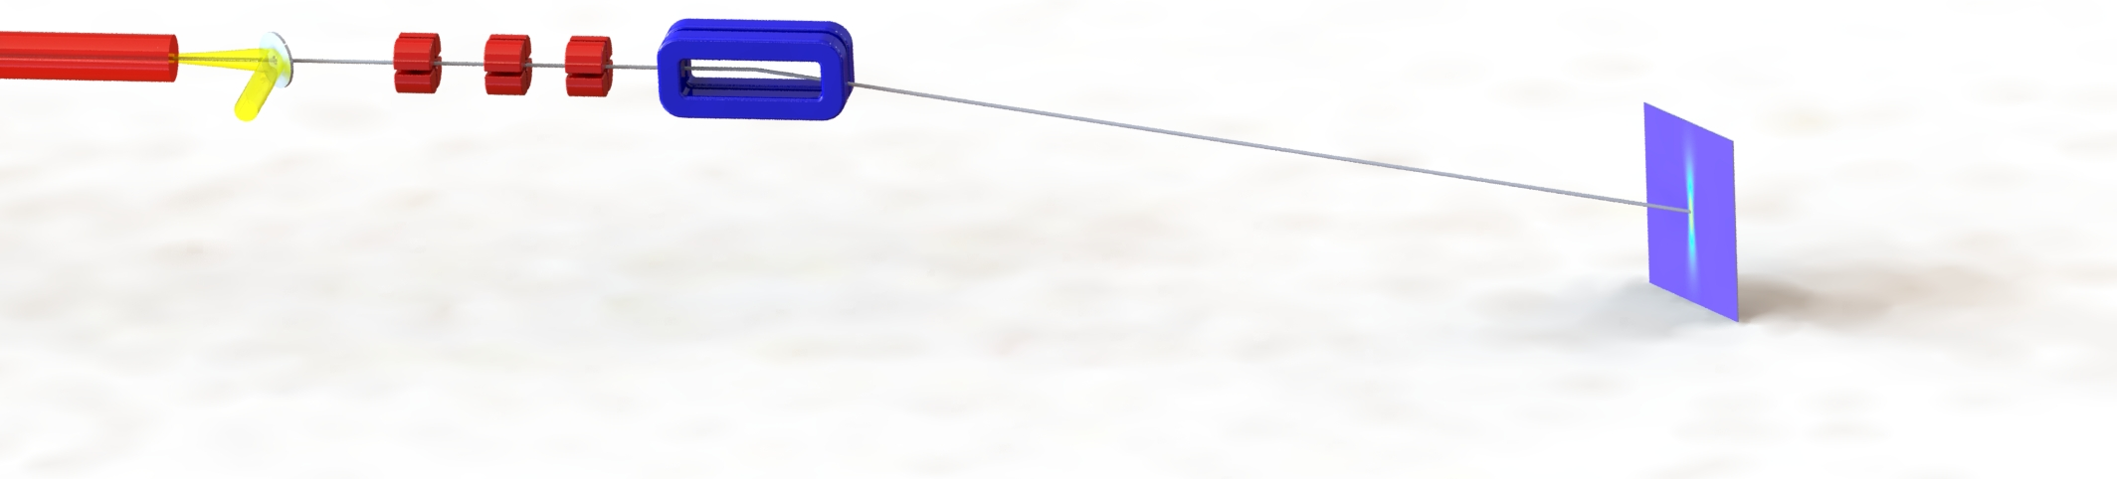
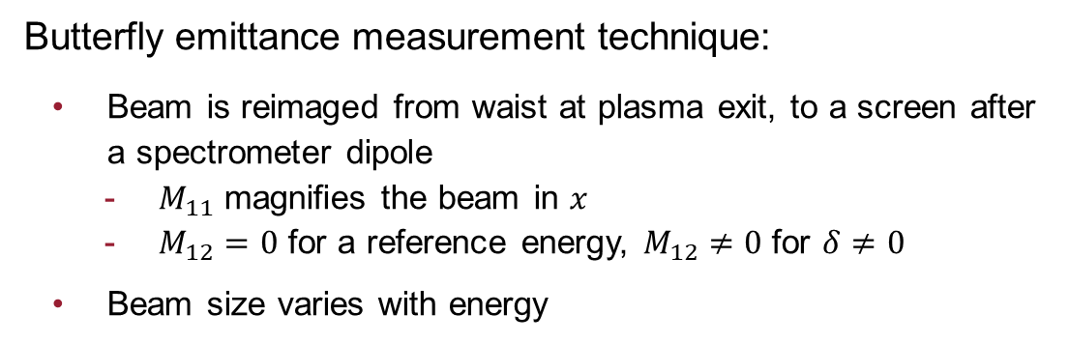
Butterfly Emittance Diagnostic
Plasma Source
Reimaging Triplet
Spectrometer Dipole
In-vacuum OTR
Profile Monitor
Transverse Beam Profile
Distance from plasma [m]
Butterfly emittance measurement technique:
  Beam is reimaged from waist at plasma exit, to a screen after a spectrometer dipole
    $M_{11}$ magnifies the beam in $x$
    $M_{12}=0$ for a reference energy, $M_{12}≠0$ for $δ≠0$
  Beam size varies with energy
Weingartner et. al, PRST AB 15, 111302 (2012)

Slide 9
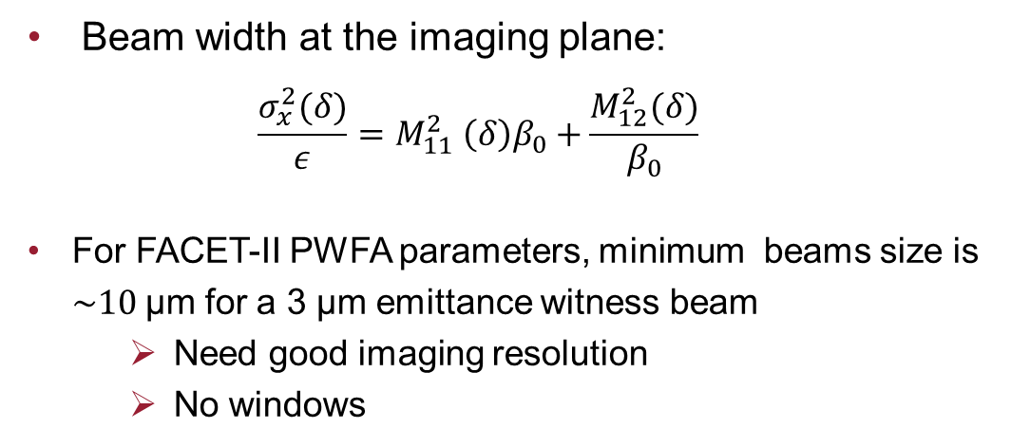

Butterfly Emittance Measurement
Butterfly Image: $ε_{N}=3$µm, $β_{0}=5$cm
  Beam width at the imaging plane:
  $$\frac{σ_{x}^{2}(δ)}{ε}=M_{11}^{2} \left(δ\right)β_{0}+\frac{M_{12}^{2}(δ)}{β_{0}}$$
  For FACET-II PWFA parameters, minimum beams size is $\sim 10$µm for a 3 µm emittance witness beam
      Need good imaging resolution
      No windows
Emittance Resolution Estimate

Slide 10



Extreme beams at FACET-II
FACET-II beams will provide unprecedented beam intensities:
  Sub-10 µm spot sizes and >100 kA peak current
    Heating caused by image currents increases the temperature within the skin depth (G. Stupakov, SLAC-PUB-15729)
No beam windows → Differential pumping required
No diagnostics near the IP → Need new diagnostic techniques
Virtual diagnostic: machine learning based phase space reconstruction
  C. Emma (SLAC)
Edge radiation diagnostic: interference pattern quantifies emittance
  B. O’Shea (SLAC)
Quadrant EOS: measure r-t beam correlations
  M. Litos (CU Boulder)
Ti heating by 2 nC bunch
$$T_{melt}$$
$σ_{r}=20$µm
$σ_{r}=30$µm
New non-intercepting diagnostics are being developed to provide diagnostics of the beam in a challenging environment
Damage to OTR
60 µm

Slide 11
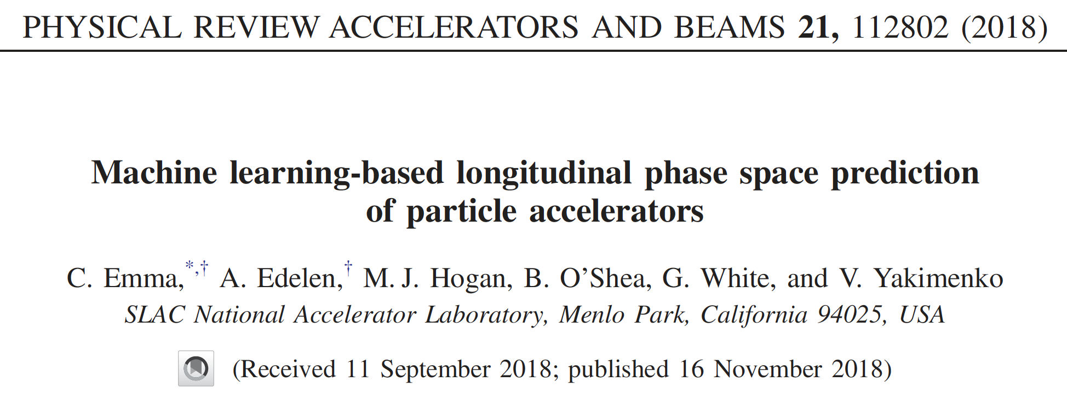
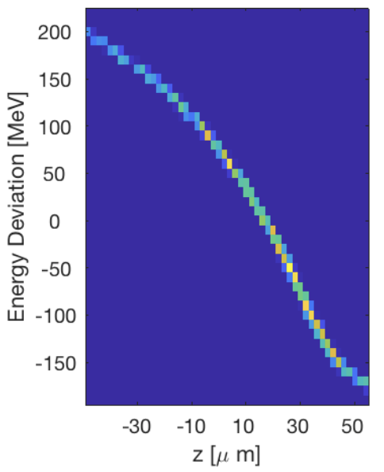
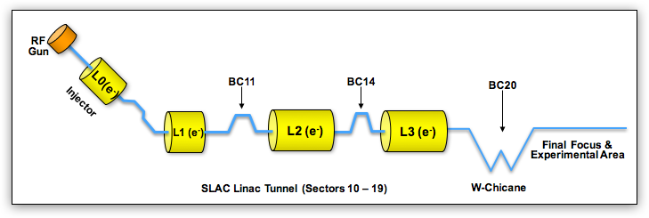

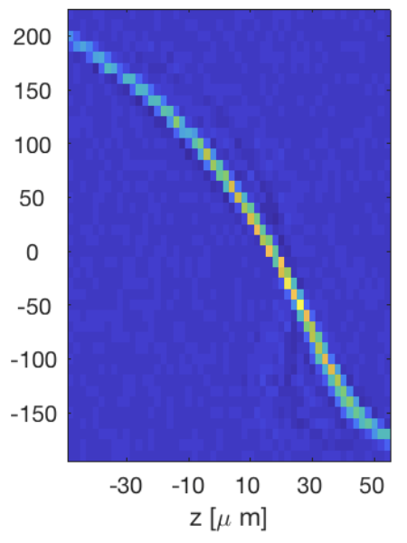

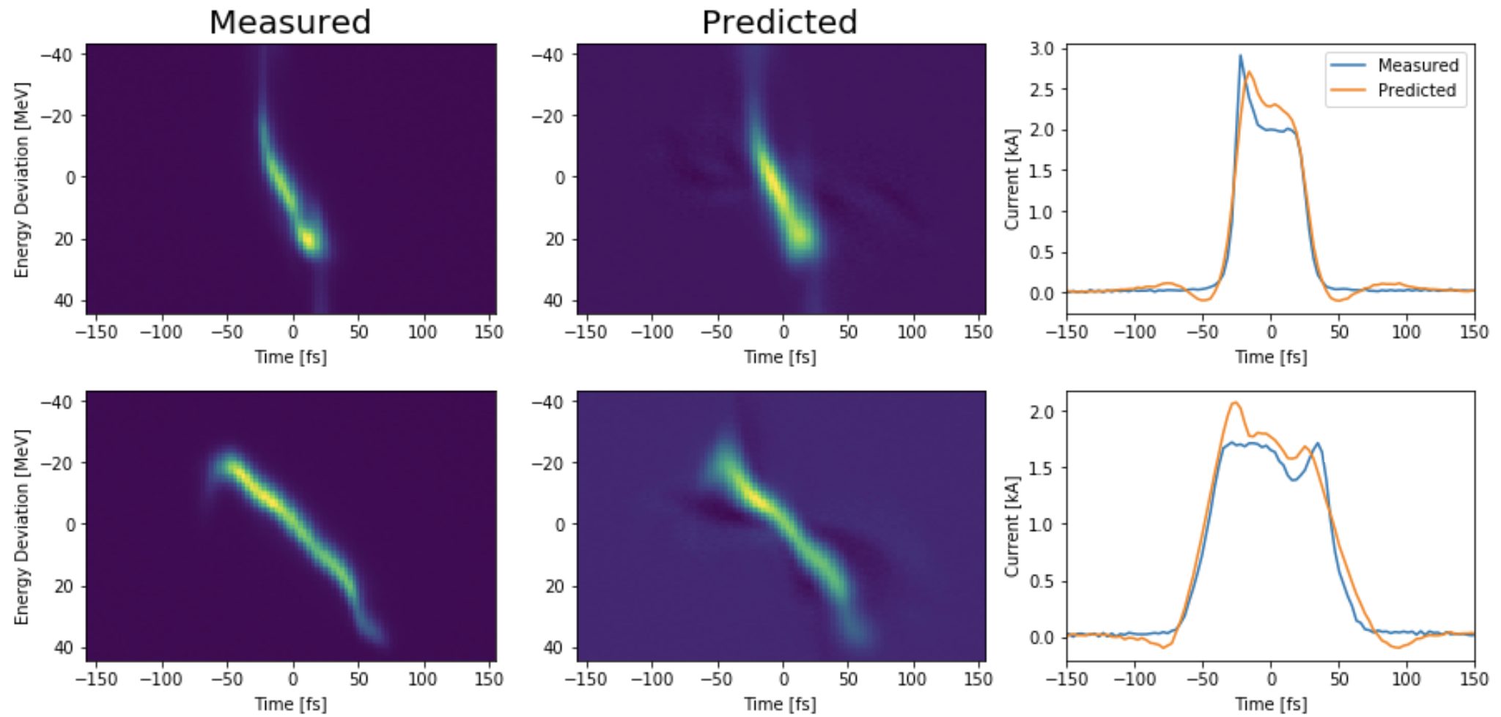
Virtual Diagnostics for High Brightness Beams
Slide credit: C. Emma
ML-diagnostic provides information about beam that is otherwise unavailable
FACET-II
Simulations
True
LPS from TCAV
2 nC
TCAV
LPS
prediction
From ML diagnostic
135 MeV
240 A
335 MeV
4.5 GeV
L1 volt.
L1 phase
L2 volt.
L1 phase
L3 volt.
L3 phase
10 GeV
400 A
3.5 kA
10-200 kA
Non-destructive measurements of e-beam and linac parameters
LCLS data
ML based virtual diagnostic
Shot-by-shot information about LPS important to understanding experiments.
“Virtual diagnostic” is a ML-based computational mapping that predicts the LPS from non-destructive measurements.
Simulation studies and proof-of-concept experiments have demonstrated initial capabilities.
Data taken at LCLS used to build experience and focus effort

Slide 12
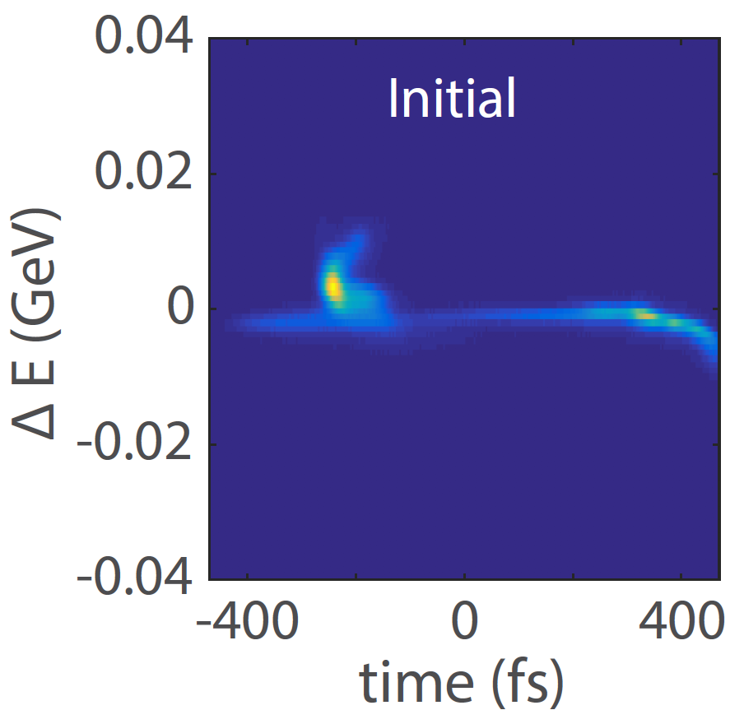
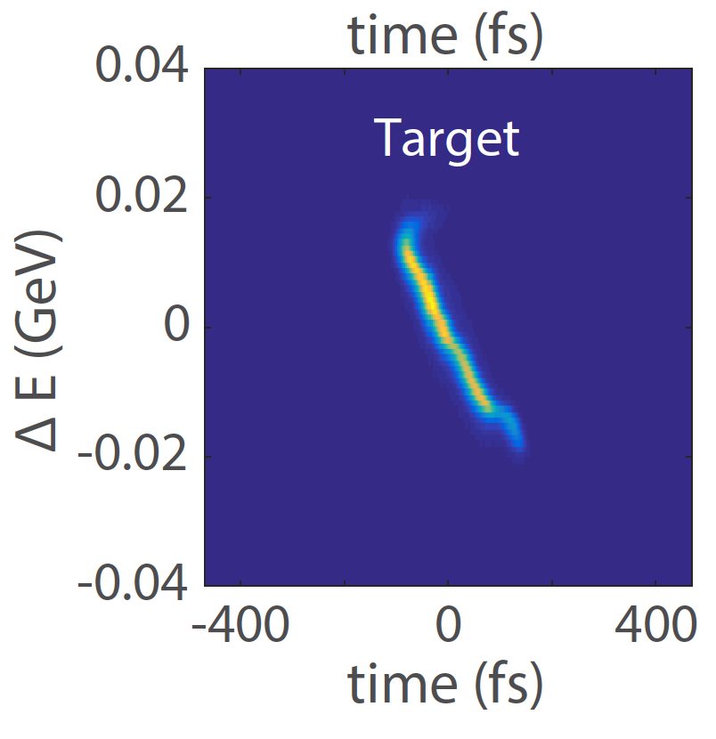
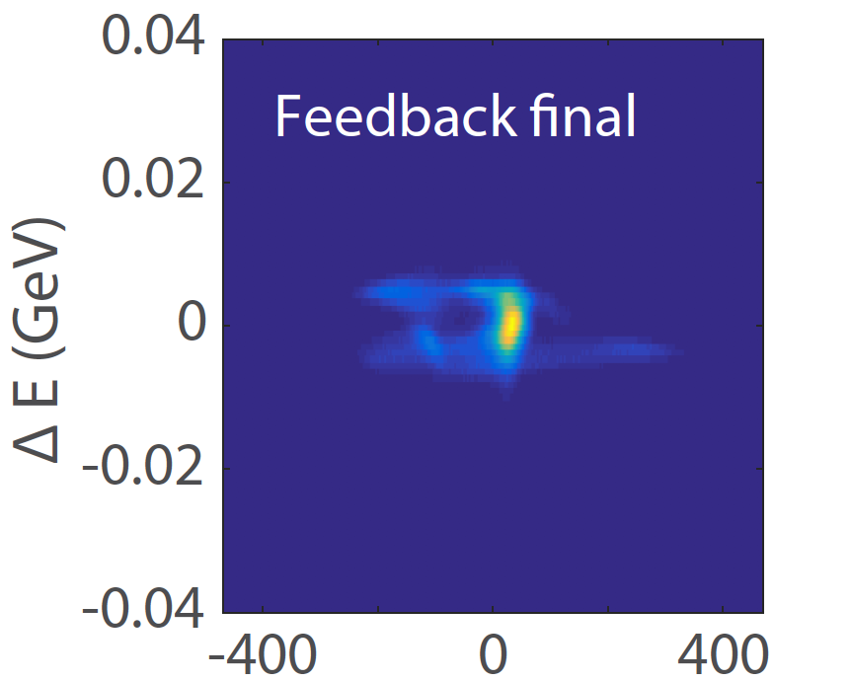
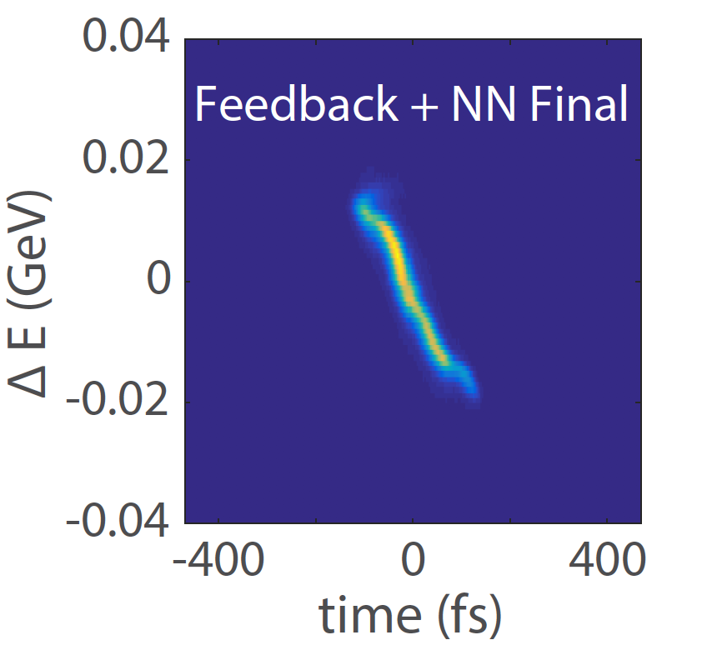
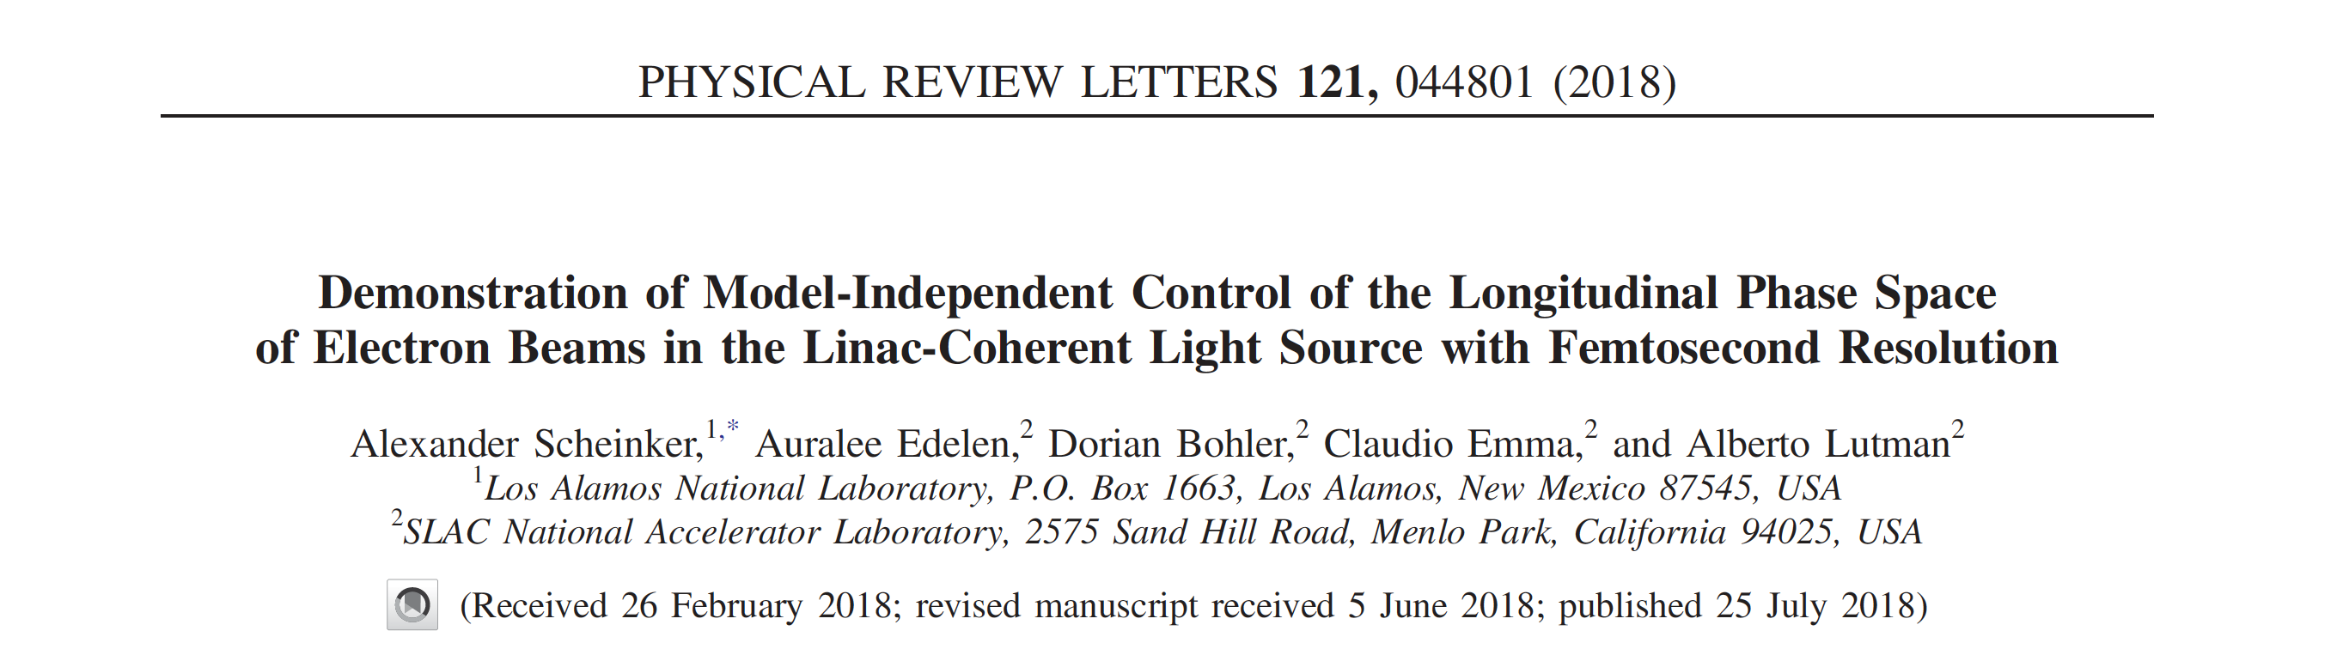
Algorithmic Beam Tuning - If you can predict it you can control it
Slide credit: C. Emma
ML-diagnostic can be used to predict machine settings required to optimize beam delivery
Flow diagram for the ML-diagnostic + feedback
1. Target LPS
2. ML-diagnostic
Actual LPS
3. Guess machine
settings
⟲
135 MeV
Feedback
(calculate difference)
240 A
335 MeV
4.5 GeV
10 GeV
400 A
3.5 kA
10-200 kA
LCLS data
Goal is to decrease tuning time and improve/tailor beam parameters for different experiments - Emittance, Longitudinal Phase Space, Energy…
ML-diagnostic and a feedback algorithm are used to automatically change machine parameters to obtain a desired target phase space
By making an initial guess using the ML-diagnostic, the feedback is able to achieve the desired phase space
Initial
Target
Feedback no ML
Feedback + ML

Slide 13
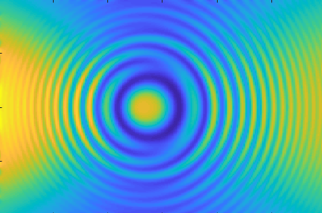
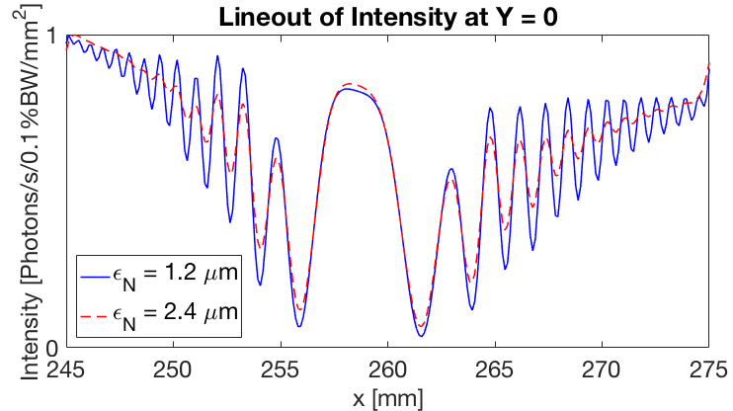
An Edge Radiation Diagnostic for beam measurements
Slide credit: B. O’Shea
Dipole Magnet
Dipole Magnet
e- trajectory
Quantify emittance and energy spread in a non-destructive manner
Edge Radiation based diagnostics naturally integrates into present linac designs
Diagnostic segments accelerator for better global tuning
Integrates into Gaussian Process, optimizer and other methods
Expect to expand work to positron damping ring
A single shot, non-intercepting diagnostic ideal for efficient computer control of accelerators
135 MeV
240 A
335 MeV
4.5 GeV
10 GeV
400 A
3.5 kA
10-200 kA

Slide 14
Summary
FACET-II will start beam commissioning in Fall 2019, and the experimental user program in 2020.
Upgrades from FACET-I will provide orders of magnitude improvements to beam emittance and peak current.
These unprecedented beam intensities create unique challenges for diagnostics of the beam in a challenging environment.
We are planning a FACET-II Science Workshop for Oct 2019:
    For more details contact Mark Hogan, hogan@slac.stanford.edu

Slide 16
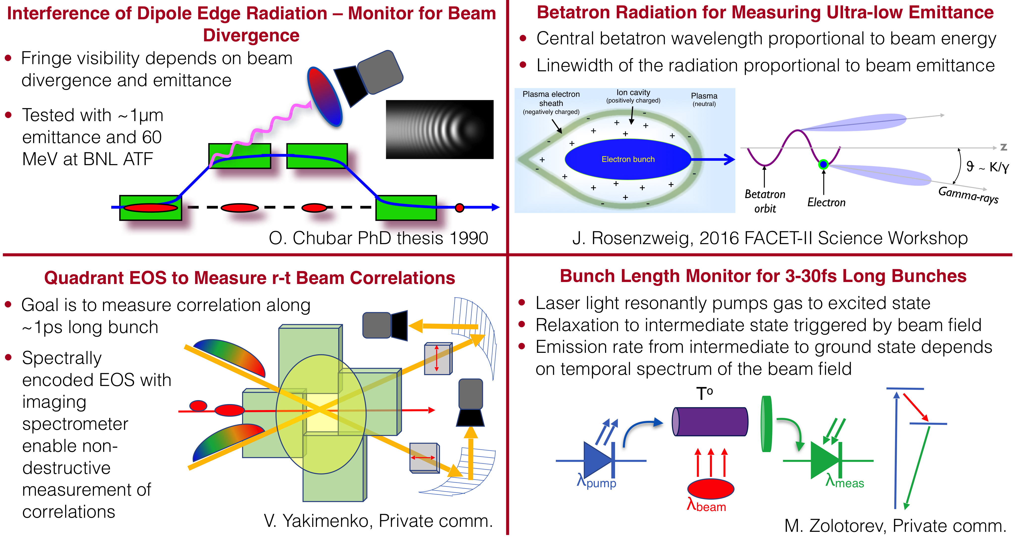
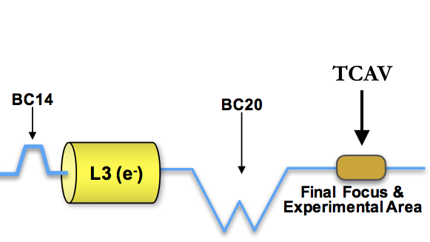
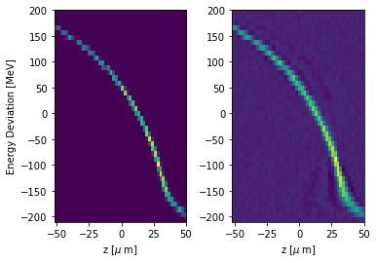
ML-based phase space reconstruction
Output LPS
ML prediction
E-beam from linac
Goal for ML-based virtual diagnostic is to provide shot-to-shot non-destructive measurements of LPS.
Can be used for machine tuning and interpretation of experimental data

