Slide 1
Recombination of Protons Accelerated by a High Intensity High Contrast Laser
Sheroy Tata^{1,2}, Angana Mondal², Soubhik Sarkar², Jagarnnath Jha², Yash Ved², Amit Lad², James Colgan³, John Pasley⁴, M. Krishnamurthy²
¹Weizmann Institute of Science
²Tata Institute of Fundamental Research
³Los Alamos National Laboratory
⁴York Plasma Institute
LPAW-2019
Phys. Rev. Lett. 121, 134801

Slide 2
Ion acceleration by TNSA
Ionized Atoms
Laser
Hot electrons
X-rays and optical emission from plasma
Electric Field
Ions then assumed to drift through space
$E_{s} ∝ \sqrt{\frac{k T_{h} n_{e}}{ε_{0}}}$
$$≥{100}^{′}s of GV/m$$

Slide 3
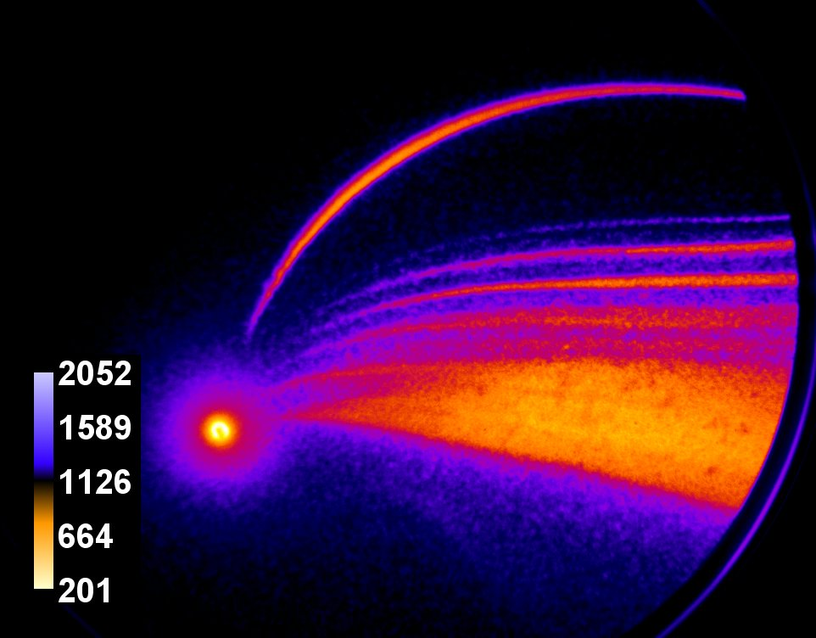
If we add detectors to measure the ions
Gated TPS + TOF
Hot electrons
Ions accelerated
Ions accelerated
We have seen neutral atoms so how are they formed?
A very strong signal at the central spot

Slide 4
Front surface neutral atom measurements
Use TOF to measure the relative flux of particles
How do we quantify how much becomes neutral?
60 % !
> 200 times higher than expected
Why is neutralization so large?
$$Neutralization(E) = \frac{H^{0}(E)}{H^{+}\left(E\right)+H^{0}(E)}$$

Slide 5
Survival of neutral atoms
HYADES – Hydrodynamic calculations
J Pasley
Can neutral atoms survive?
No
Neutral atoms at most 0.2%
X-rays and optical emission from plasma

Slide 6
Methods of neutral atom formation
Direct acceleration of neutral atoms?
No
Plasma temperature is significantly high
and
Particles accelerated in an electric field
H⁺
Some process
H⁰
So an accelerated ion needs to convert into a neutral atom

Slide 7
Neutral atoms in the past
Charge reduction methods of accelerated ions
H⁺ + N₂  H⁰
V
Charge transfer by other free molecules in a dense gas
H⁺ + M → H⁰
Has been conventionally used to produce neutral atoms
Charge transfer

Slide 8
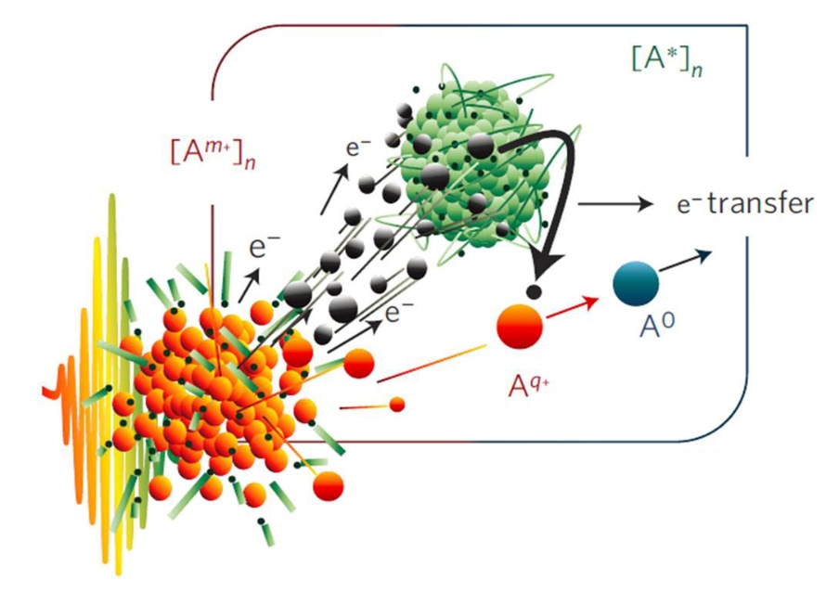
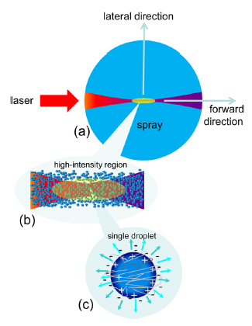
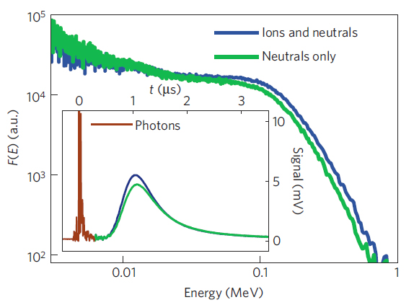
Efficient neutralization processes in laser plasma
Charge transfer
S Ter-Avetisvan et. al.
Appl. Phys. Lett. 99, 051501 (2011)
Rev. Sci. Instrm. 83, 02A710(2012)
R. Rajeev et. al. Nat. Phys. 9 185–190 (2013)
In a dense cluster jet due to surrounding clusters

Slide 9
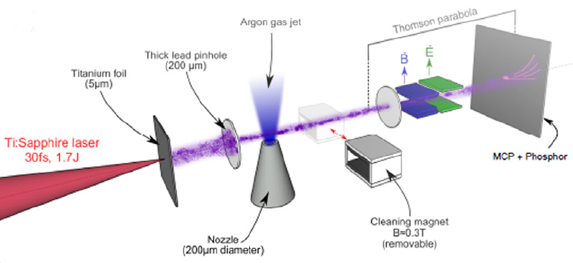
Efficient neutralization processes in laser plasma
Using a dense cluster jet
Charge transfer
F. Mollica et. al. Plasma Phys. Contr. Fusion. 58 034016 (2016)

Slide 10
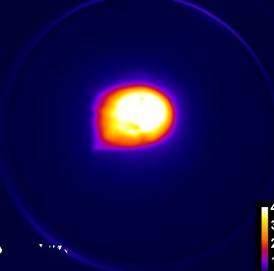
Charge transfer by background gas
Charge transfer does not seem to be a dominating process
Expected neutralization by just charge transfer in background gas
Pressure – 4.5 10⁻⁵ mbar
$$l_{f}$$
Can this happen to us?
$$\frac{dN}{dz} =− N σ n_{0}$$
H⁺ + N₂ → H⁰
Does not fit the form

Slide 11
Neutral atom formation
Up to now strong, neutral atom signals have been explained by charge transfer by target particles in vicinity of interaction
Our conditions do not present such a scenario
What now?

Slide 12
Charge reduction methods of accelerated ions
V
Low cross section
Low electron temperature
H⁺ + N₂  H⁰
A^{(q-1)+}
e
Electron ion recombination in a free electron gas
A^{q+}
M
A^{(q-1)+}
Works in a dense plasma for very slow ions where plasma has cooled sufficiently
High cross section

Slide 13
Electron ion recombination in pre-plasma
Neutralization should be at most 0.2 %
Not as high as seen in experiments

Slide 14
Neutral atom formation requires
… a low electron temperature
Can forceful reduction of temperature work?

Slide 15
Electron ion recombination in pre-plasma
A very long electron density
Neutralization through pre-plasma
Does not explain 50 % neutralization
1 % neutralization
Just traced out the dependence of rate with energy
Forceful reduction of temperature does not give the experimentally measured profiles
Is there more?

Slide 16
A possibility to change the form of neutralization
Co-propagation of ions and electrons
f(v)
V_{H+}
It provides one more thing
V_{e}
It provides
Lower energy ions co-propagate for longer time
Inherent depandence on the rate with energy is included
v
Lower energy ions co-propagate for longer time
Increases the effective number of reactions as the energy decreases
Reduced velocity in the proton frame can contribute to electron ion recombination
So if we make a model

Slide 17
Co-propagating model
Extrapolate density and temperature with time
Assume a guess for starting temperature for co-propagating electrons
For ion of energy E_{i} use relevant extrapolation of density at time t_{i}
Change starting temperature and density to fit the experimental form
Neutralization model output
Scale starting guess temperature also with time varying profile
Repeat same for different ion energy
Move through the density profile
Calculate reactions in density range

Slide 18
Co-propagating model
Measurements of electron density < 10¹⁸ cm⁻³ become difficult, Extrapolations need to be used
Hyades extrapolated density profiles at 1 ps
Starting temperature and density for calculation controls neutralization

Slide 19
Co-propagation of electrons and ions
Fits significantly well
but, deviates for low energy
Why?
Phys. Rev. Lett. 121, 134801

Slide 20
Only 1-D co-propagation considered
Transverse temperature of plasma expansion is not included
Could lead to re-ionization and decrease effective neutralization
T_{T}
T_{l}
An estimate on transverse temperature
What about other conditions for neutralization

Slide 21
Recombination under different conditions
Co-propagation explains neutralization
A higher effective temperature!
Where do these electrons come from?

Slide 22
Implications to ion acceleration
Electrons pull ions
Accelerated ions allow the release of electrons
Recombination in the co-propagating distribution
So how to know the distance of neutralization?

Slide 23
Probing the distance of neutralization
Using a magnet
Movable magnet on stage to move in and out perpendicular to TPS path
3 - 5 mm
So what do we see
3.4 cm
S
TPS/Gated TPS/TOF
Z Far
N
~>1.8KG
64 cm
72 cm
TP aperture
~10 gauss

Slide 24
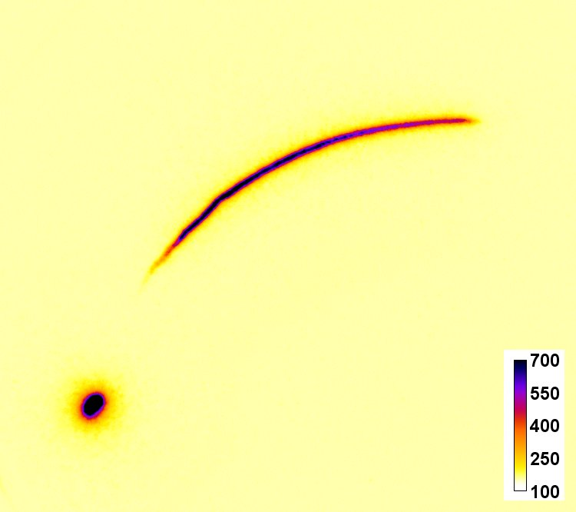
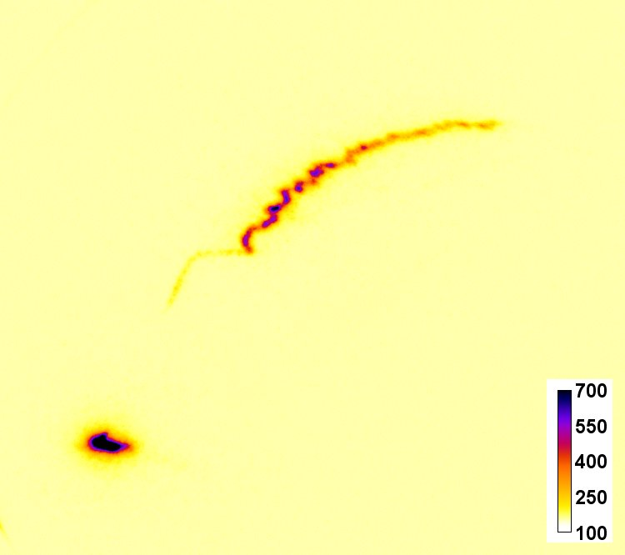
Plasma expansion in a transverse external field
Gated proton and neutral signals in an external B field
Magnet distance = 100 mm
B ~ 10 G (peak)
Magnet distance = 17 mm
B ~ 500 G (peak)
B external ion deflection direction
The neutral signal shifts in the direction as if ions were deflected in the magnetic field
RSI 88, 051708 (2017)

Slide 25
Shift in the virtual source by an external field
To TPS
34 mm
3 mm
Virtual shift in source
10 mm
Y
X
Z
Explains the shift in the position of neutral hydrogen in the TPS

Slide 26
Changing flux of atoms and neutral atoms in presence of external magnetic field
Scale Length of neutral atom formation ~ 10’s of mm
Proton Flux
Neutral Flux
Lp = 9.1 +- 2 mm
LN = 4.7 +- 1 mm
A difference in scales of increasing flux
If neutralization should have occurred before magnet – magnetic field does not change neutral flux

Slide 27
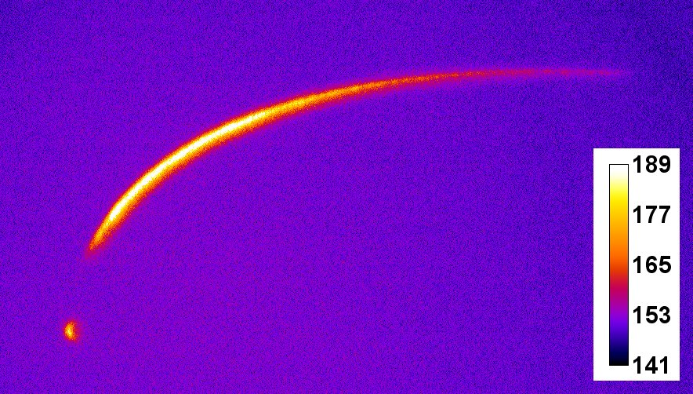
Neutral atoms from the rear of the target
2.5 % H⁺
Gated TPS of 2 µm thick Cu foil
Lower than background, other re-ionization processes by cold electrons

Slide 28
Summary
Large neutral atom generation from the front of the target
Charge transfer can not explain neutralization
Electron ion recombination in dense plasma is not possible because of high temperature
Co-propagation model proposed to explain neutralization
Model verified experimentally deflection of the neutral spot
Neutral atoms also from the rear of thin foils are also seen

