Slide 1
Laser-driven proton beam profiles in ultra-high fields
Laser Plasma Accelerator Workshop
5-10 May, MedILS Split
L. Obst-Huebl^{1,2}, C. Bernert^{1,2}, F.-E. Brack^{1,2}, J. Branco^{1,2}, M. Bussmann¹, G. Cochran³, T. E. Cowan^{1,2}, C. B. Curry⁴, L. Gaus^{1,2}, F. Fiuza⁴, M. Garten^{1,2}, M. Gauthier⁴, S. H. Glenzer⁴, S. Göde⁵, A. Huebl^{1,2}, A. Irman¹, J. B. Kim⁴, T. Kluge¹, S. Kraft¹, F. Kroll¹, M. J. MacDonald⁴, J. Metzkes-Ng¹, R. Mishra⁴, R. Pausch^{1,2}, P. Poole³, I. Prencipe¹, M. Rehwald^{1,2}, C. Rödel⁷, C. Ruyer⁴, H.-P. Schlenvoigt¹, P. Sommer^{1,2}, C. Schoenwalder⁴, W. Schumaker⁴, T. Ziegler^{1,2}, U. Schramm^{1,2}, D. W. Schumacher⁶, and K. Zeil¹
1) Helmholtz-Zentrum Dresden-Rossendorf, Dresden, Germany , 2) Technische Universität Dresden, Germany, 3) Lawrence Livermore National Laboratory, Livermore, USA , 4) SLAC National Accelerator Laboratory, Menlo Park, USA , 5) European XFEL, Schenefeld, Germany, 6) The Ohio State University, Columbus, USA 7) Friedrich-Schiller-Universität Jena, Germany

Slide 2
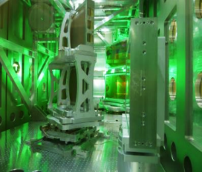
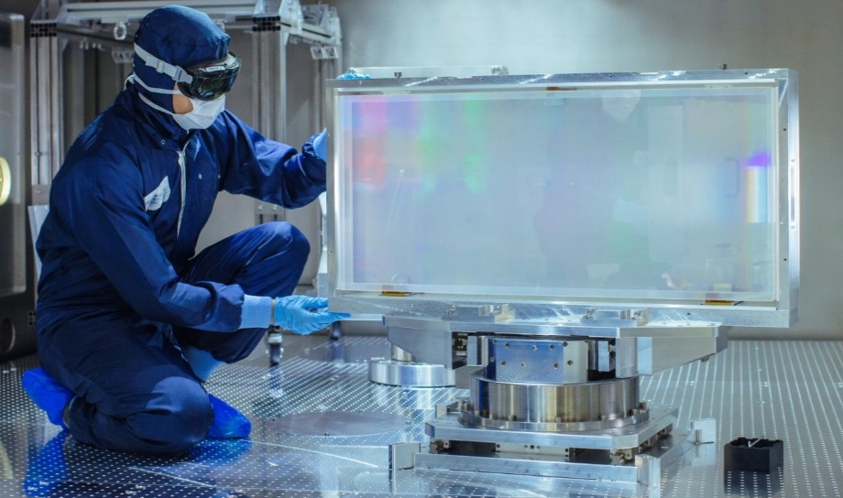
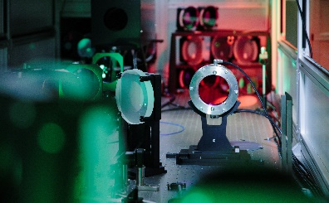
PW laser development at HZDR
Penelope diode pumped 150J / 150fs laser
in setup phase
→ applicable laser-proton accelerators
Draco Ti:Sapphire laser dual-beam:
150TW (6 J in 30 fs before final compression)
PW (45 J / 30 fs)
→ laser-electron and -proton acceleration
U. Schramm et al.: Journ. of Physics: Conf. Series (2017)

Slide 3
PW laser development at HZDR
Penelope diode pumped 150J / 150fs laser
in setup phase
→ applicable laser-proton accelerators
Draco Ti:Sapphire laser dual-beam:
150TW (6 J in 30 fs before final compression)
PW (45 J / 30 fs)
→ laser-electron and -proton acceleration
U. Schramm et al.: Journ. of Physics: Conf. Series (2017)

Slide 4
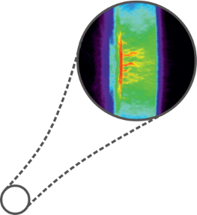
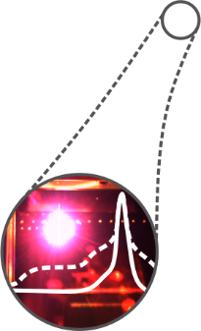
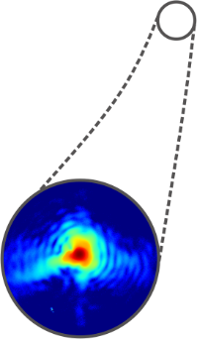
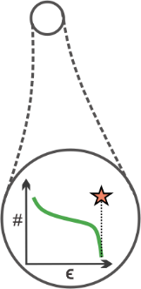
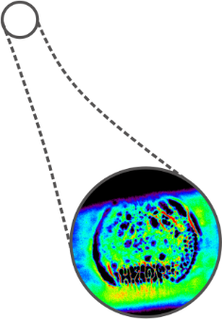
Laser-driven proton sources for applications
Poster Florian Kroll
expanded target: Weibel-like instability
small/transparent target: laser imprint
S. Göde et al.: Phys. Rev. Lett. (2017), L. Obst-Huebl et al.: Nature Comm. (2018)

Slide 5
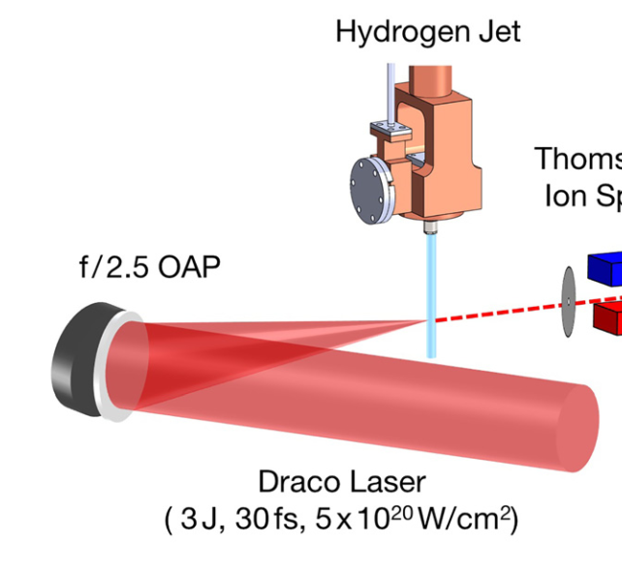
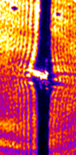
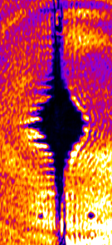
Cryogenic hydrogen jet target
debris-free
pure proton beams
optical probing
transverse probing
pre-expanded
Optical probe
Talk Karl Zeil
+5ps
+10 ps
+20 ps
+35 ps
plasma density of 30 n_{c} → model case for PIC
study acceleration from near critical density target, e.g. enhanced TNSA schemes
Poster Axel Huebl
Talk Martin Rehwald
L. Obst et al.: Sci. Rep. (2017), T. Ziegler et al.: Plasma Phys. Contr. F. (2018)

Slide 6
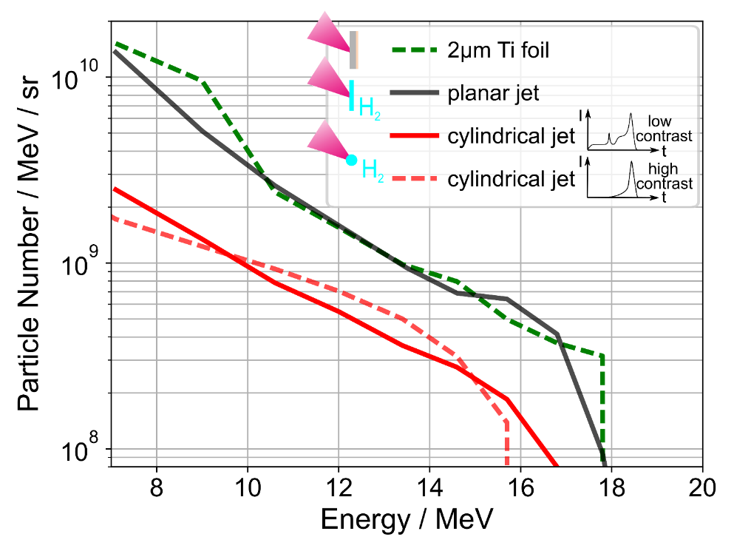
Cryogenic hydrogen jet target
debris-free
pure proton beams
optical probing
Optical probe
Draco 150 TW
comparable proton energies and numbers as from foils
Talk Martin Rehwald
L. Obst et al.: Sci. Rep. (2017), T. Ziegler et al.: Plasma Phys. Contr. F. (2018)

Slide 7
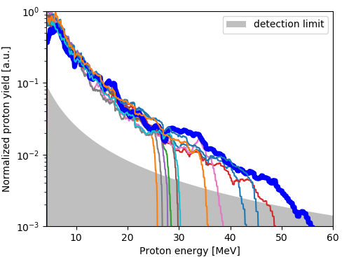
Cryogenic hydrogen jet target
debris-free
pure proton beams
optical probing
Draco PW
Optical probe
comparable proton energies and numbers as from foils
Talk Martin Rehwald
L. Obst et al.: Sci. Rep. (2017), T. Ziegler et al.: Plasma Phys. Contr. F. (2018)

Slide 8
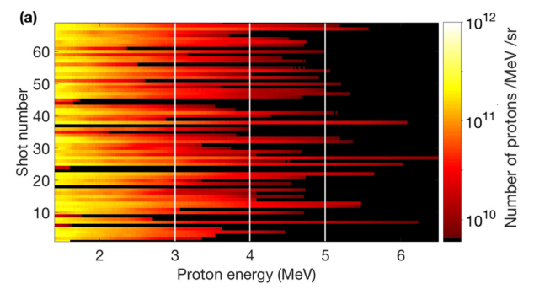
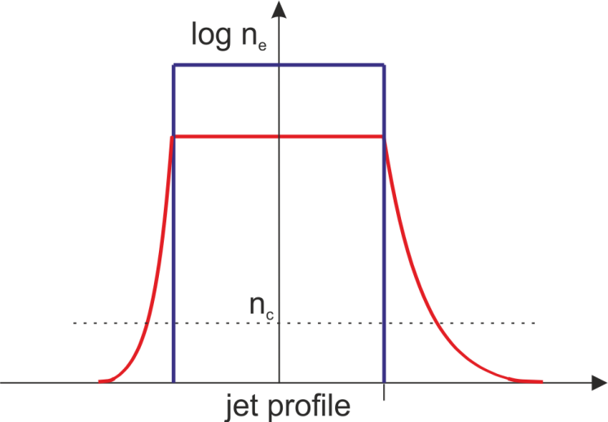
Low contrast – poor proton beam quality
TNSA not optimized
low proton energies
Draco 150 TW
Laser focus
1 Hz operation demonstrated
Laser
~ µm scale
length
M. Gauthier et al: Appl. Phys. Lett. (2017)

Slide 9
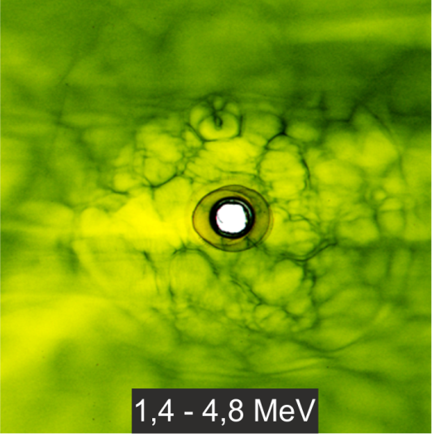
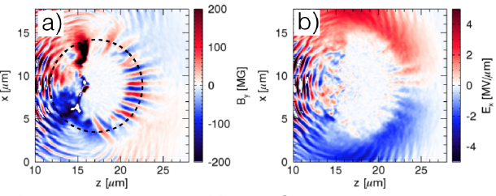
Low contrast – streaming instability
G. Scott et al.: NJP (2017), J. Metzkes et. al: NJP (2014), M. King et al.: HPLSE (2019)
Bubble-like modulations of proton beam profile
Weibel-like instability in rear surface plasma
~ 4 cm
3D PIC simulation with OSIRIS
B-field
E-field
~ 4 cm
TNSA protons are deflected in rear-side field structure
Laser
~ µm scale
length
S. Göde et al.: Phys. Rev. Lett. (2017)

Slide 10
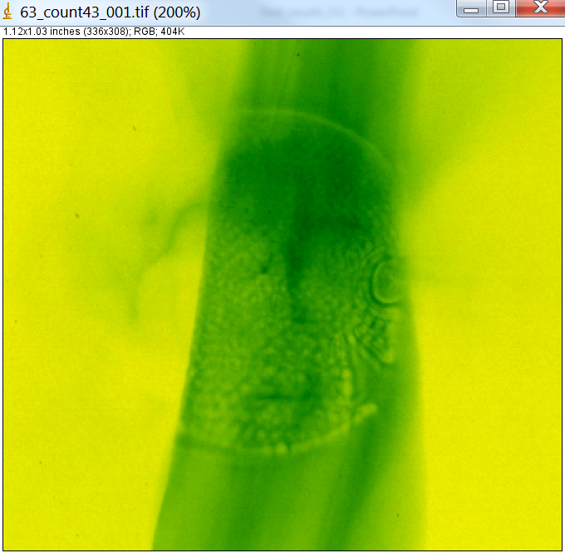
Improved contrast – laser imprints
Bubble-like modulations of proton beam profile
imprint of laser near field features
~ 4 cm
laser near field
jet-axis
~ 4 cm
intrinsic contrast
plasma mirror enhanced contrast

Slide 11
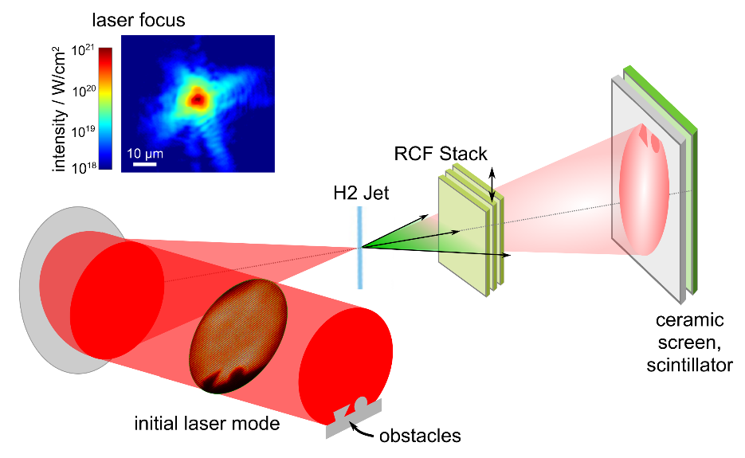
All-optical beam structuring
no temporal overlap between transmitted laser pulse and proton bunch
laser focus
target
intensity / W/cm²
RCF stack
features not visible in laser focus
H₂ jet
transmitted light
diagnostic
residual gas = memory?
initial laser mode
obstacles
L. Obst-Huebl et al.: Nature Comm. (2018)

Slide 12
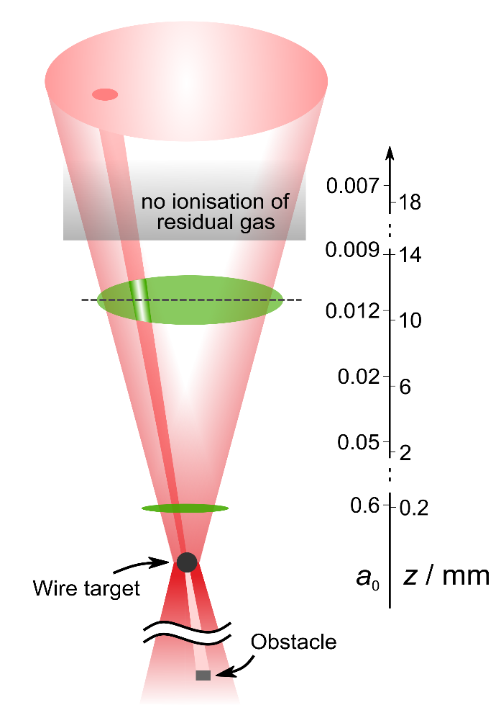
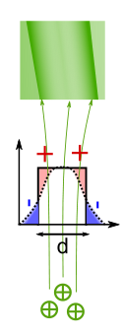
All-optical beam structuring
test experiment with metal wire at different target chamber pressures
low density plasma cylinders behind laser pulse
quasi-static deflecting fields of MV/m
fields probed by TNSA protons
L. Obst-Huebl et al.: Nature Comm. (2018)

Slide 13
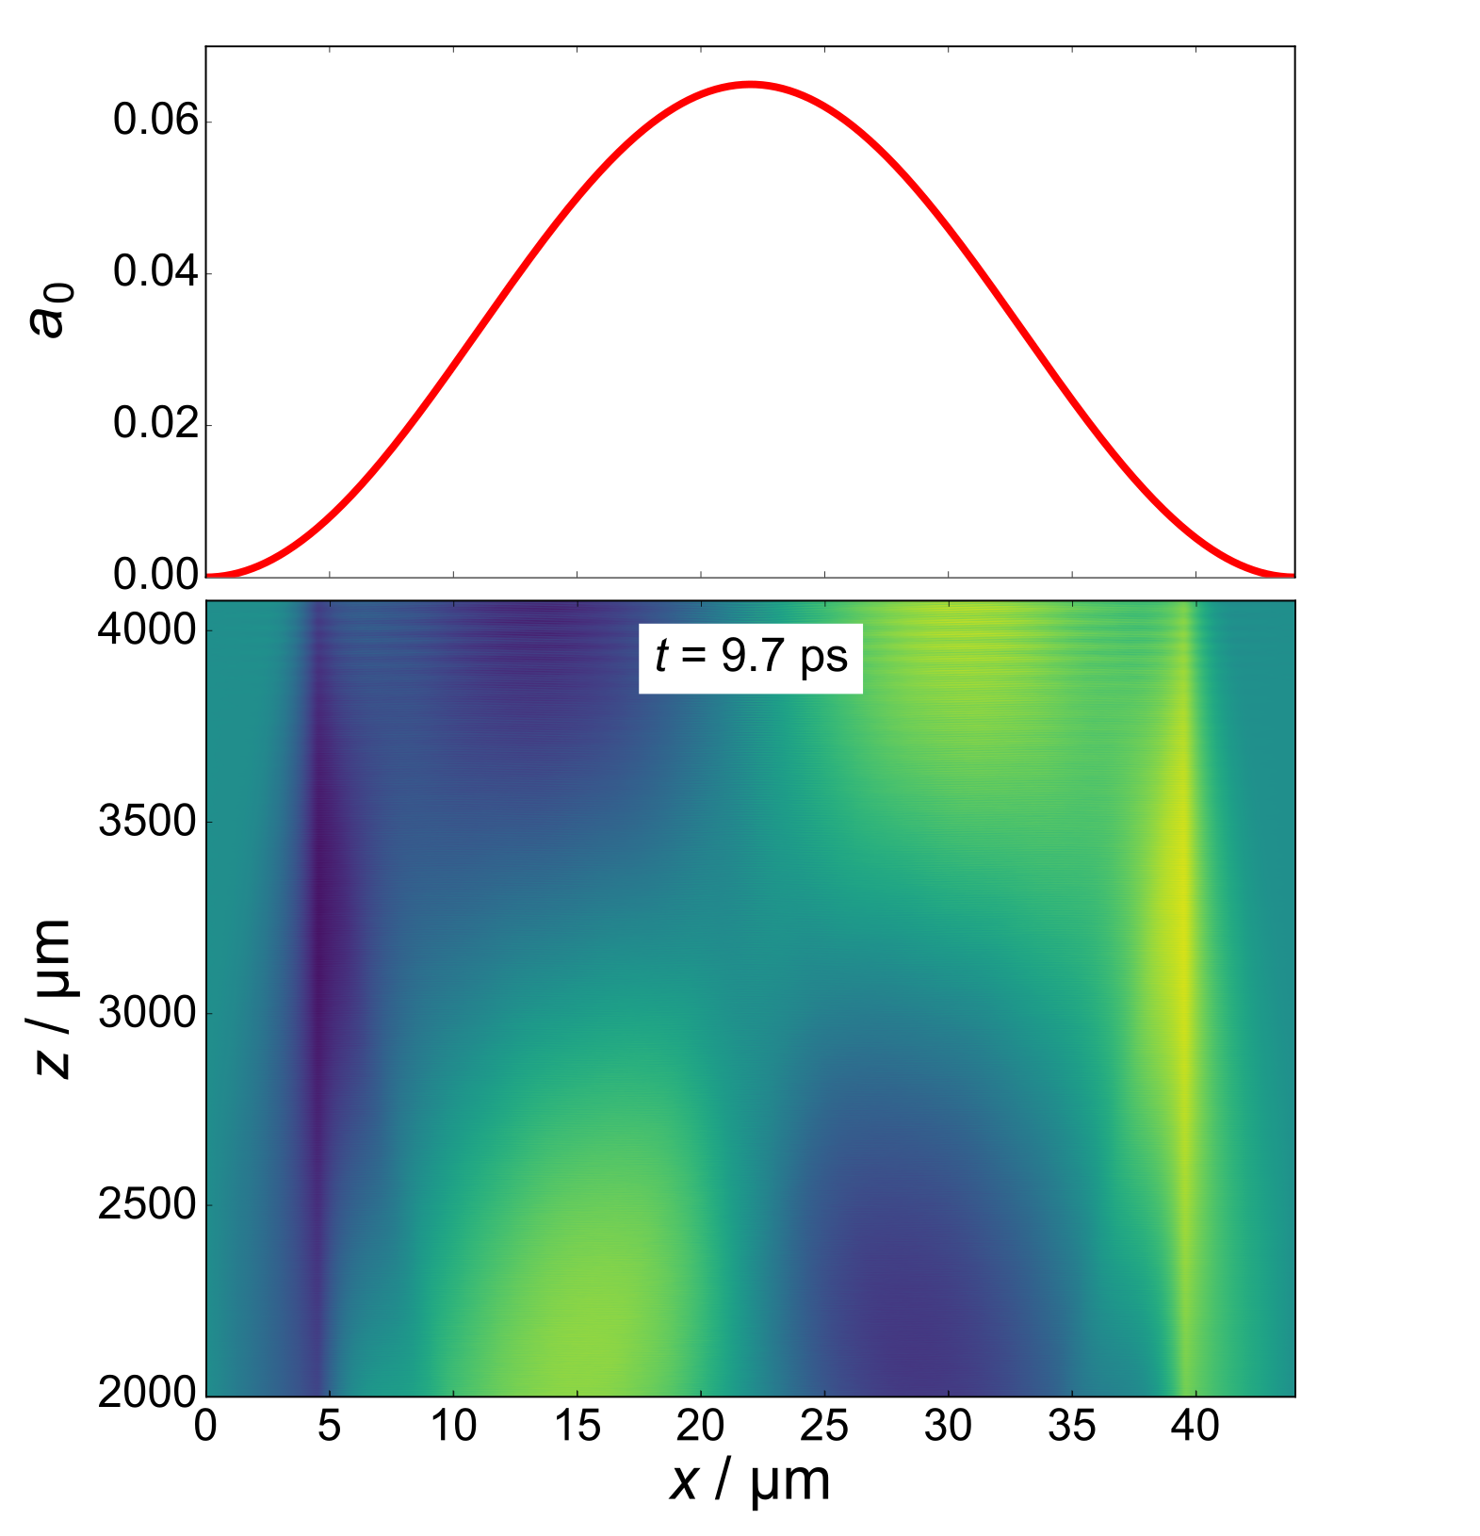
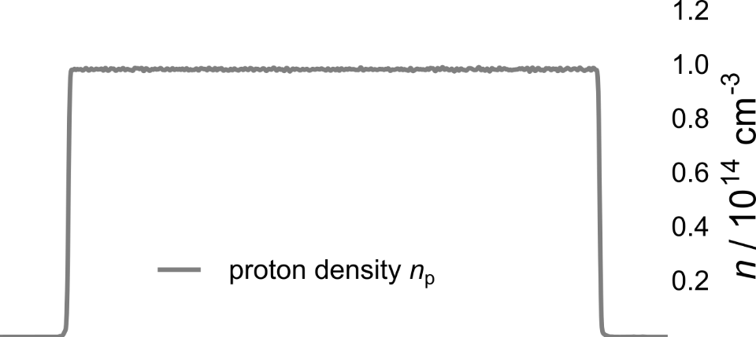
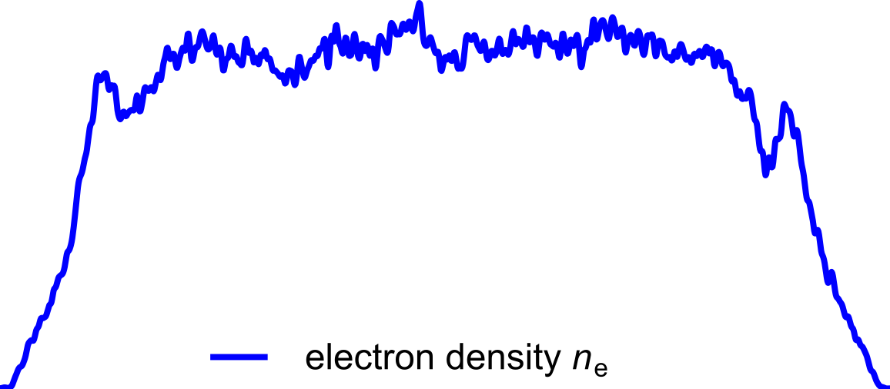
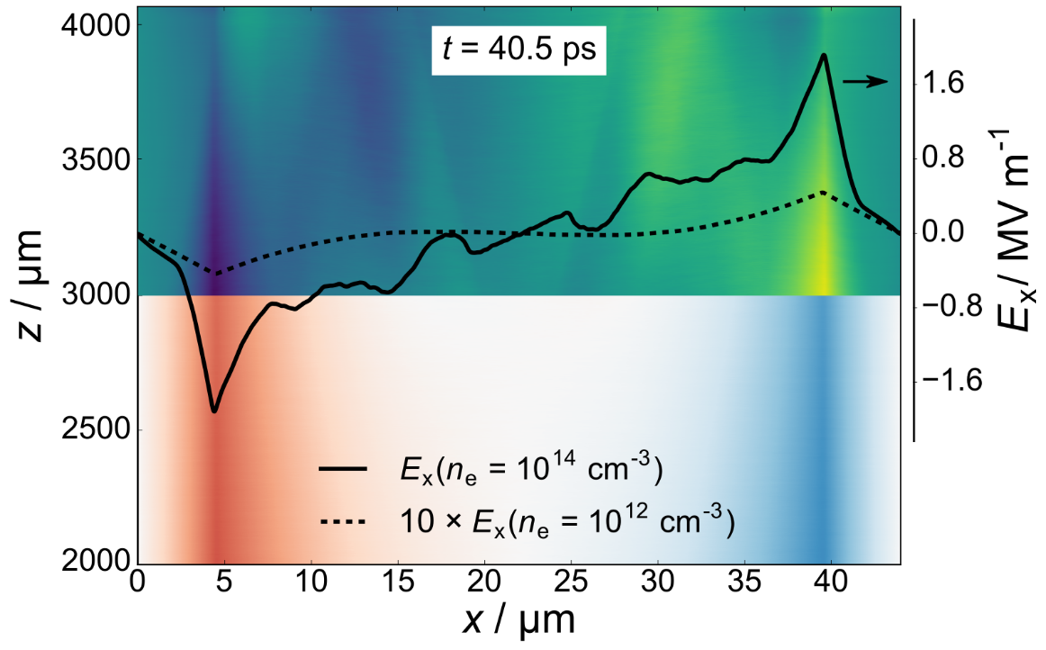
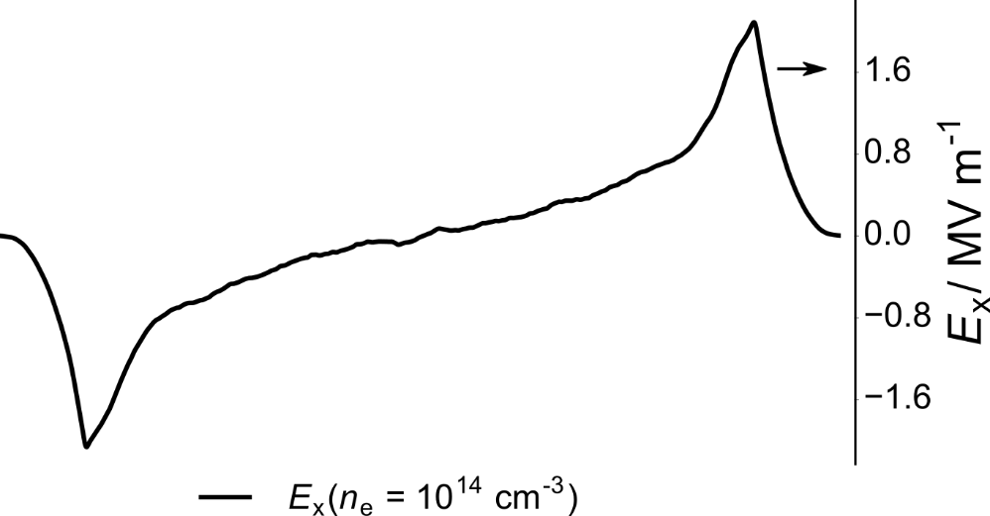
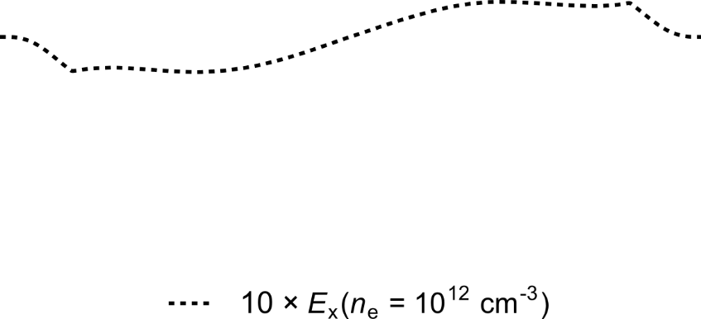
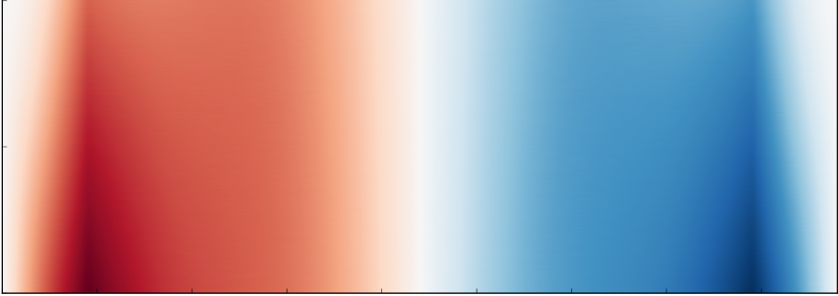
All-optical beam structuring
PIC simulation of underdense plasma region
laser
n_{e} = 10¹⁴ cm⁻³
n_{e} = 10¹⁴ cm⁻³
n_{e} = 10¹² cm⁻³
n_{e} = 10¹² cm⁻³
L. Obst-Huebl et al.: Nature Comm. (2018)

Slide 14
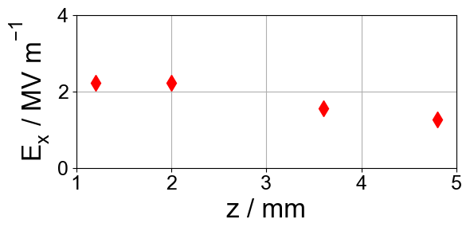
All-optical beam structuring
PIC simulation of underdense plasma region
n_{e} = 10¹⁴ cm⁻³
laser
n_{e} = 10¹⁴ cm⁻³
n_{e} = 10¹⁴ cm⁻³
field strength nearly constant over mm
n_{e} = 10¹² cm⁻³
n_{e} = 10¹² cm⁻³
L. Obst-Huebl et al.: Nature Comm. (2018)

Slide 15
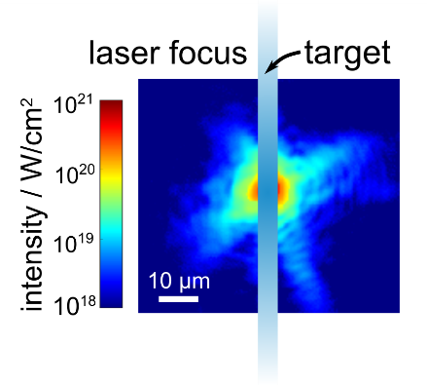
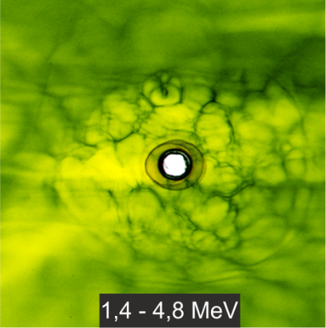
Intermediate conclusions
high amount of transmitted light (small targets) + sufficient residual gas → all-optical proton beam structuring
potential superposition with modulations arising at the target

Slide 16
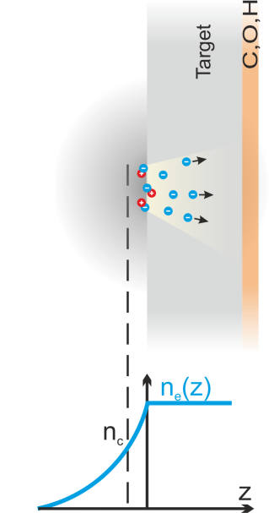
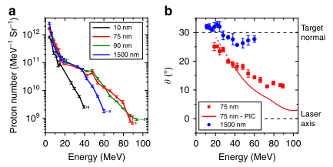
Thin targets turning transparent
increasingly volumetric target interaction → potentially higher accelerating fields
Higginson Nature Comm. 2018
P. Poole, L. Obst et al.: New Journ. Phys. (2018)

Slide 17
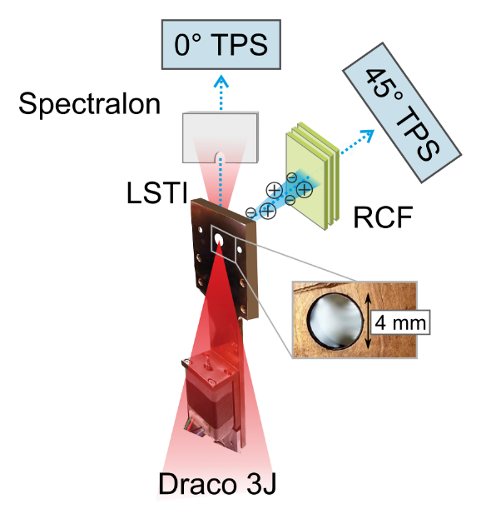
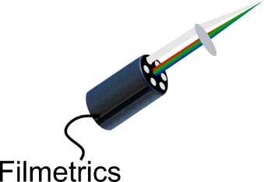
Thin targets turning transparent
elaborate target thickness scan with liquid crystal films targets
Draco PW: up to 60 MeV
Talk Tim Ziegler
ion emission along target normal:
P. Poole, L. Obst et al.: New Journ. Phys. (2018)

Slide 18
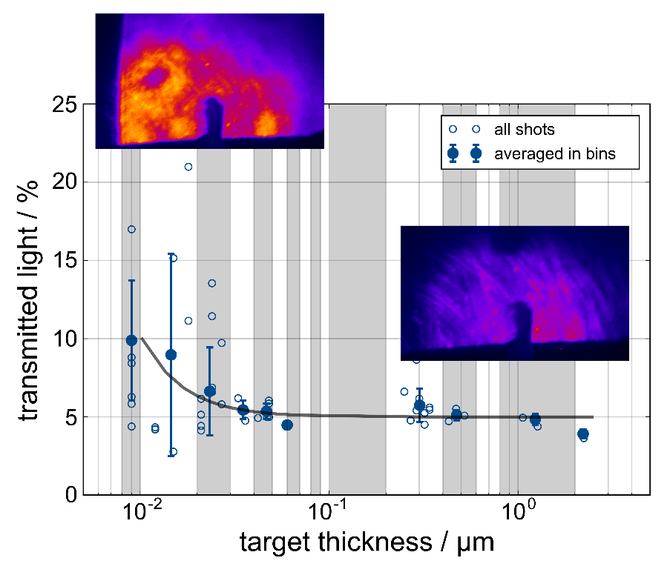
Thin targets turning transparent
transparency increase for the thinnest targets used
P. Poole, L. Obst et al.: New Journ. Phys. (2018)

Slide 19
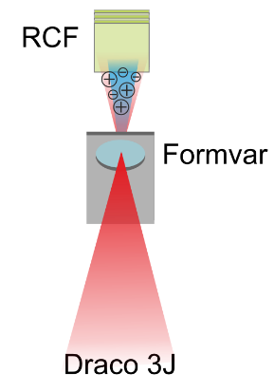
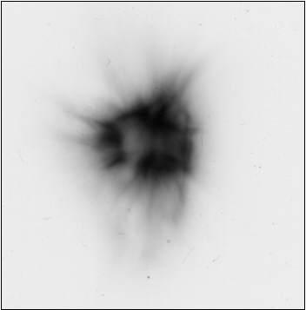
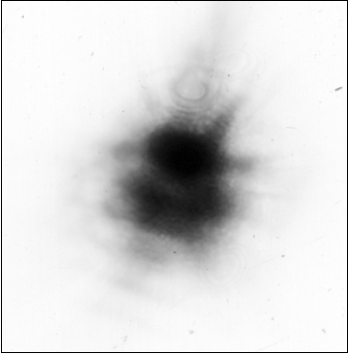
Thin targets turning transparent
< 20 nm formvar foils under 0° laser incidence
first signs of laser imprinting visible
transmitted light mode
3E-5 mbar
1E-3 mbar
proton beam on RCF

Slide 20
Thank you for your attention!

