Slide 1
Using laser plasma accelerator for simultaneous X-ray absorption and 2-photon Light Induced Fluorescence imaging of a car engine spray
Diego Guénot, Edouard Berrocal, Kristoffer Svendsen, Jonas Björklund Svensson, Martin Hansson, Isabel Gallardo Gonzalez, Henrik Ekerfelt, Anders Persson, Olle Lundh.

Slide 2
Outline
Spray imaging (what does the title mean?)
Experiment
Setup
Betatron radiation
2p-LIF
Results and comparison with synchrotron
Conclusion/outlook

Slide 3
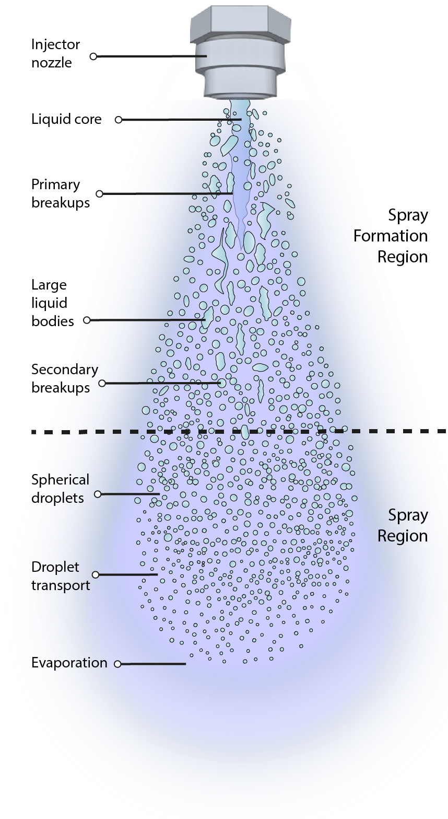

Spray imaging
Liquid core
What is a spray?
Systems of droplets immersed in a gaseous
continuous phase.
Widely used in industry: medicine, painting,
cooling, car engines…
Collaboration with Dr. Berrocal
from div. Combustion physics (Lund).
Aims at providing the best images of
sprays to understand their dynamic
Primary breakup
Spray formation region
Large liquid bodies
Secondary breakup
Spherical
droplets
Spray region
http://www.spray-imaging.com

Slide 4
Optical techniques
Sprays are highly scattering difficult to image:
Ballistic imaging
Structured Illumination
Light sheet scattering
2 photon Light Induced Fluorescence (2p-LIF)
M. Linne Progress in Energy and Combustion Science 39, 5 (2013)

Slide 5
2 photons Light Induced fluorescence (2p-LIF)
Idea: 1) Adding a fluorescent dye in the Spray
2) Exciting the dye with a 2 photon process
Single-photon fluorescence
Two-photon fluorescence
Results: remove the scattering before the excitation!
E. Berrocal et al. continuum, 2, 3 (2019).

Slide 6
2 photons Light Induced fluorescence
Allows for semi-quantitative measurement

Slide 7
X-ray imaging techniques
Low scattering, tunable absorption:
Phase contrast imaging:
Resolution (few µm)
High speed camera
x Interpretation
Y. Wang et al. Nature Physics, 4 (2008).
M. Linne. Exp Fluids, 52, 1201-1218 (2012).

Slide 8
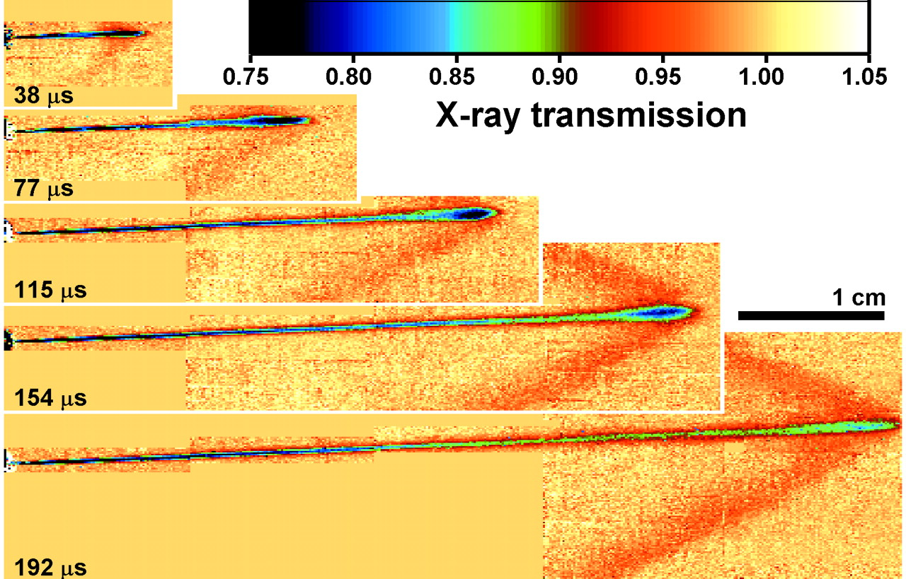
X-ray imaging techniques
Low scattering, tunable absorption:
Radiography (< 10keV):
Interpretation: Liquid mass.
x Resolution (50/100µm): Contrast agent.
LWFA: Simultaneous X-rays and femtosecond laser!
A. G. Macphee et al Science, 295, 5558 (2002).

Slide 9
Experimental setup
Vacuum
Air
Lanex screen
CCD camera + 550nm filter
Laser (800mJ, 38fs)
Al + Kapton
window
Electrons
Fluorescence
Gas jet
99% He +1% N₂
Betatron
radiation
X-ray camera
Magnets
Spray
(water + KI + fluorescine)
Light sheet
(10mJ, 50µm x 2cm)

Slide 10
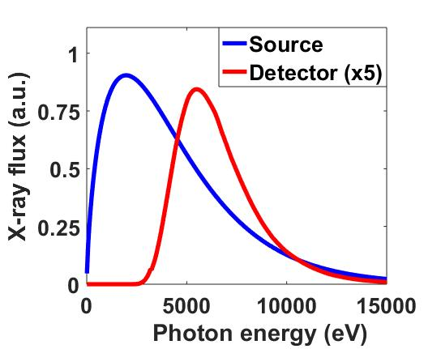
Betatron radiation
At the source:
E_{max} = 2keV, <5.10⁸ photons, >20mrad
Beam transport (80cm):
Al (3µm) + Kapton (50µm) + Be (250µm) + air (12cm)
E_{max} = 5.5keV, <5.10⁷ photons
S. Corde et al. Rev. Mod. Phys. 85, 0034–6861 (2013).

Slide 11
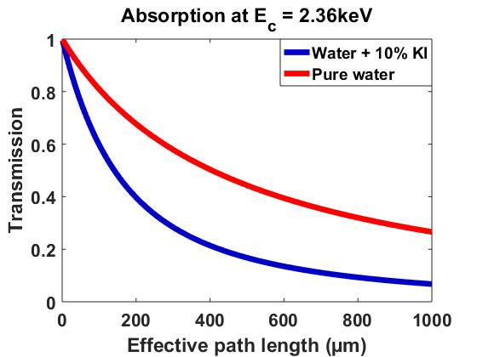
X-ray absorption
100µm of water transmit 80% of the light.
Adding 10% Potassium Iodide (KI) the
transmission drops to 60%.
Changes the viscosity by 5% ☹.

Slide 12
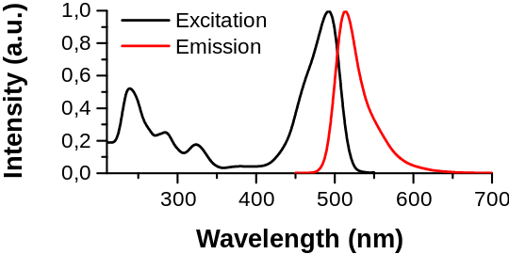
2 photons Light Induced fluorescence
Add 0.1% of fluorecein in the water.
Emit fluorescence around 550nm.
Observation with a long range objective
(8µm/pixel).
Quenched by KI ☹.
Excitation 1p
Emission
https://commons.wikimedia.org/wiki/File:Fluorescein_spectra.svg

Slide 13
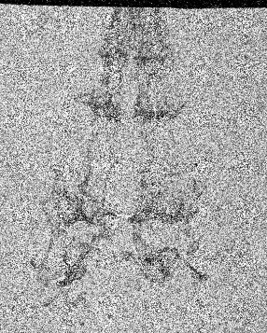
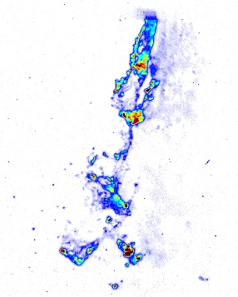
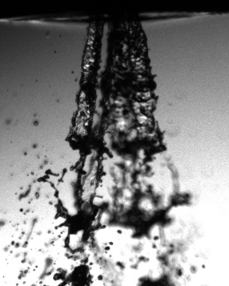
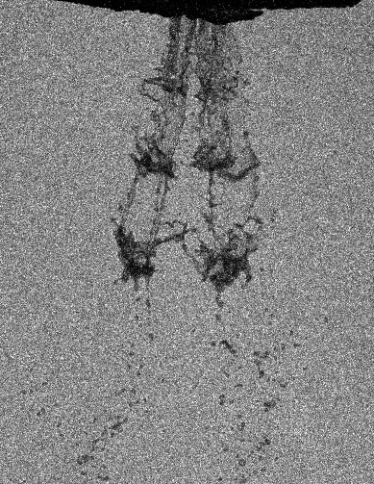
Results: simultaneous imaging
X-ray
Light sheet 2p-LIF
Shadowgraphy
X-ray (KI)
2 mm
60µm sensitivity in absorption
2x better than with synchrotron
8mm
6.4mm
Simultaneous
The absorption is too weak to distinguish clearly the structures Need to use KI and averaging.

Slide 14
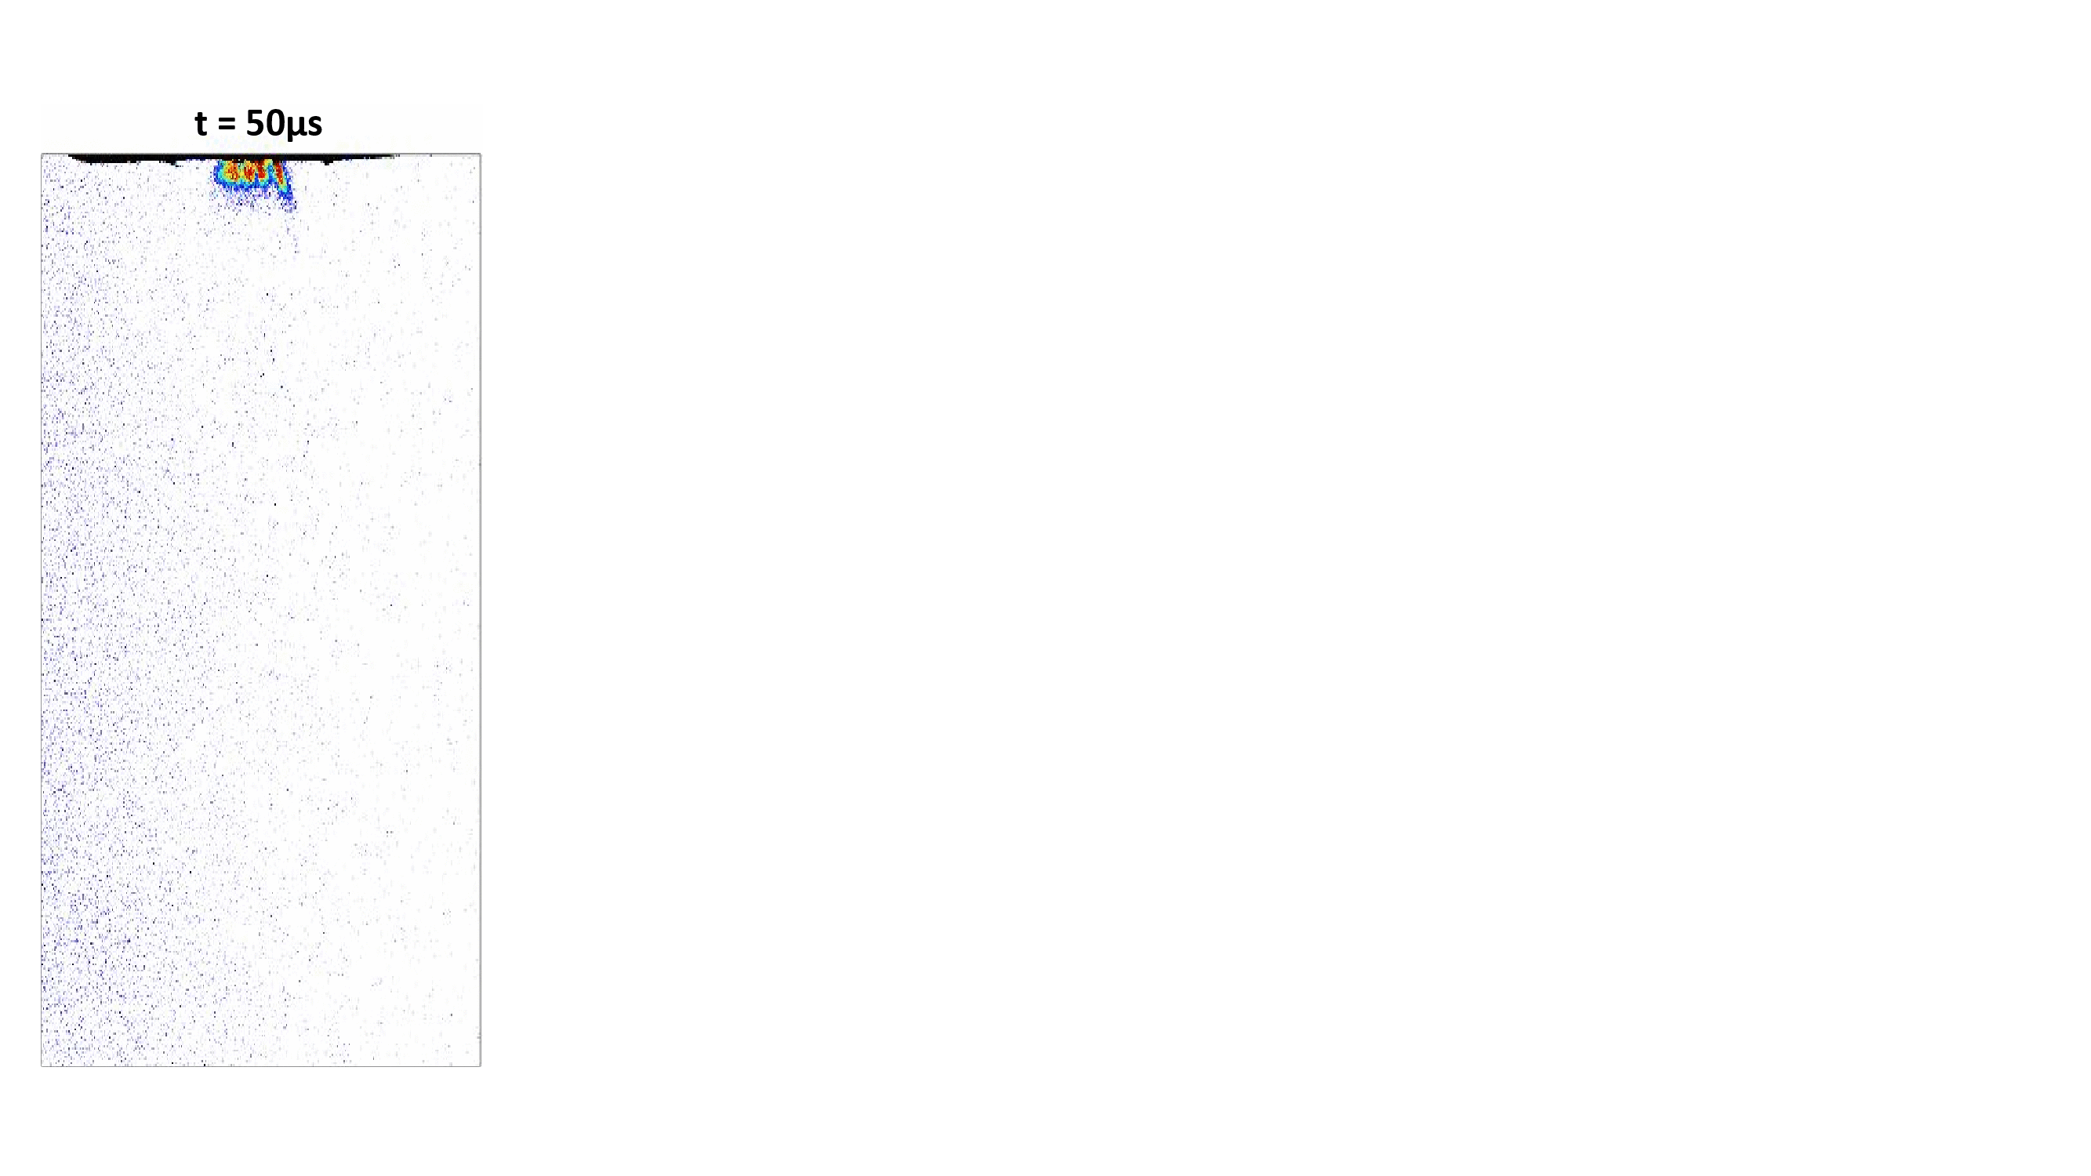

Liquid mass dynamic
Average of 50 images
18 times (steps of 50µs and then 100µs)
18mm
Equivalent Path Length [µm]
10
100
200
300
400
8.7mm

Slide 15
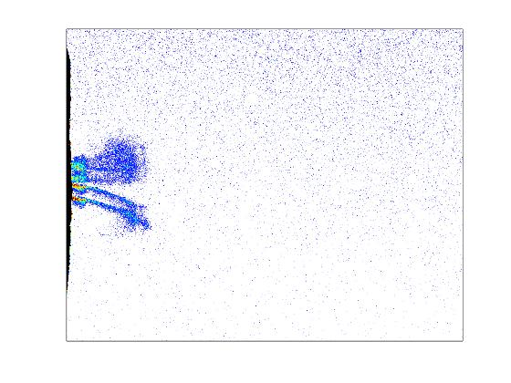
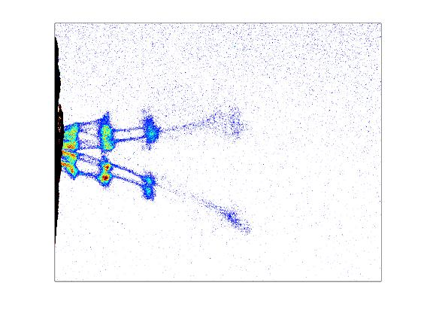
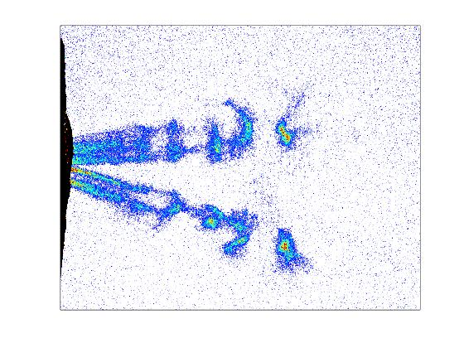
Liquid mass dynamic
t = 150µs
t = 350µs
t = 750µs
Emission of a «sac».
Three large breakup structure.
Steady state: after 500µs.
Equivalent Path Length [µm]
10
100
200
300
400

Slide 16
Comparison with synchrotron?
Argonne synchrotron (white beam operation):
5.10¹⁰ph (10W), 5µm source size
High rep rate ( video @ 120kHz)
x 5-100keV
x Sensitivity of 50µm with 10% KI
Why so high photon energies?
Designed for phase contrast imaging
Too much absorption in windows
https://www.aps.anl.gov/Sector-7/7-BM
https://www.aps.anl.gov/Imaging
Halls B. R. Halls et al. Optics express, 25, 2 (2017).

Slide 17
Conclusion and outlook
Conclusion:
Demonstration of the possibility of simultaneous radiography and 2p-LIF imaging of sprays
Improved sensibility compared to synchrotron based measurement
Improvement
x4 Enhanced flux (talk from Vidmantas Tomkus)
Beam transport: reduce distance, thinner Kapton, Al, and Be window.
Future experiments:
High pressure sprays (500bars for GDI or biodiesel)
Swirl sprays, flashball sprays…
Temperature and velocity measurement
D. Guénot et al. Proc. of the 29th European Conf. on Liquid Spray Atomization and Spray Systems (2019).

Slide 18





Thank you for your attention!

Slide 19
Annex

Slide 20
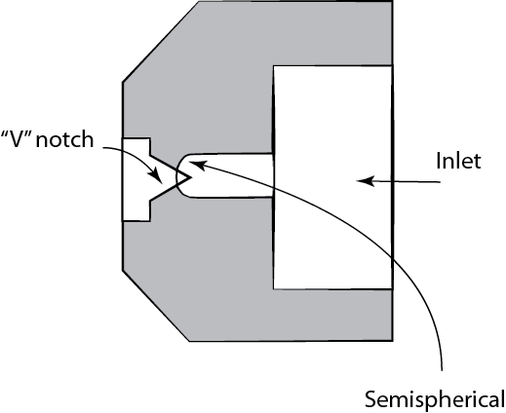
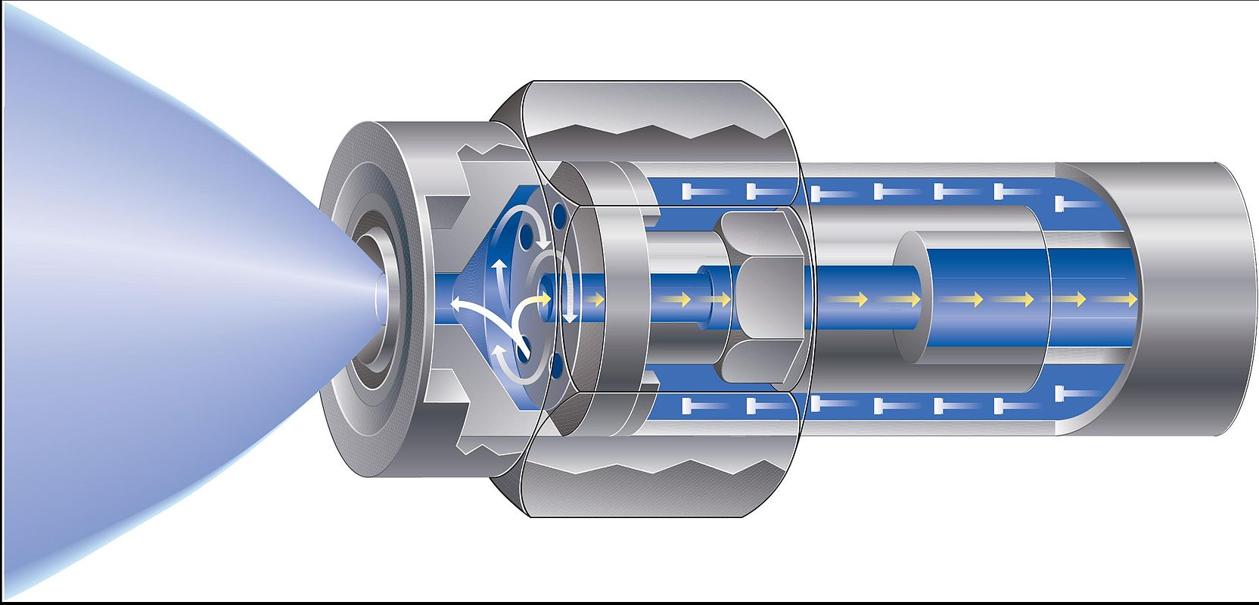
Spray shapes
Shaped-orifice nozzle:
Swirl nozzle (indirect injection):
https://en.wikipedia.org/wiki/Spray_nozzle

Slide 21
Engine combustion network
https://ecn.sandia.gov/
The ECN is an international collaboration among experimental and computational researchers in engine combustion, with partners listed below. Our objectives are to:
1. Establish an internet library of well-documented experiments that are appropriate for model validation and the advancement of scientific understanding of combustion at conditions specific to engines.
2. Provide a framework for collaborative comparisons of measured and modeled results.
3. Identify priorities for further experimental and computational research.
Over 50 collaborators (Universities, Bosch, GM, Caterpillar…)

Slide 22
 | LWFA | Synchrotron (APS; 7-BM) (Monochromatic) | Synchrotron (APS; 7-BM) (White beam)
Flux/shot | 10⁸ph | 4.10¹¹ph/s ≈ 3.10⁶ph @ 8keV (±1%) | 10W (max around 10) ≈ 5.10¹⁰ph
Energy | 1 to 10keV | 5-15keV | 5-100keV
Source size | 2-3µm | 5*6µm | 80*200µm
Beam divergence | 20mrad | ≈0.1mrad | ≈0.1mrad
Repetition rate | 0.1 Hz (max 1kHz) | 120kHz | 120kHz
Field of view | 22mm (camera) | 4mm | 4mm

Slide 23
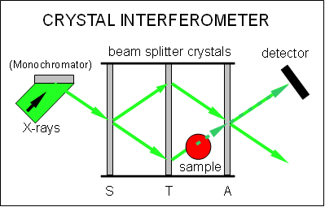
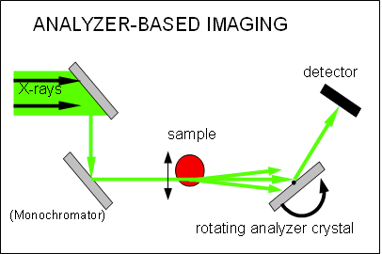
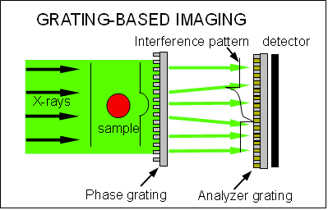
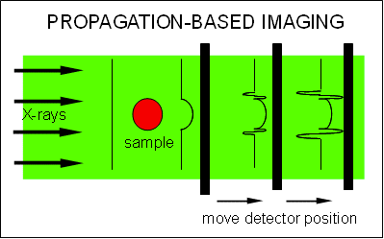
Phase Contrast
Setups
Move detector position to disentangle absorption and phase change information
No optics → easy setup, polychromatic source
With assumptions, single-distance measurement
https://en.wikipedia.org/wiki/Phase-contrast_X-ray_imaging
Wilkins, S et al.,Nature. 384 (6607): 335–338 (1996).

Slide 24
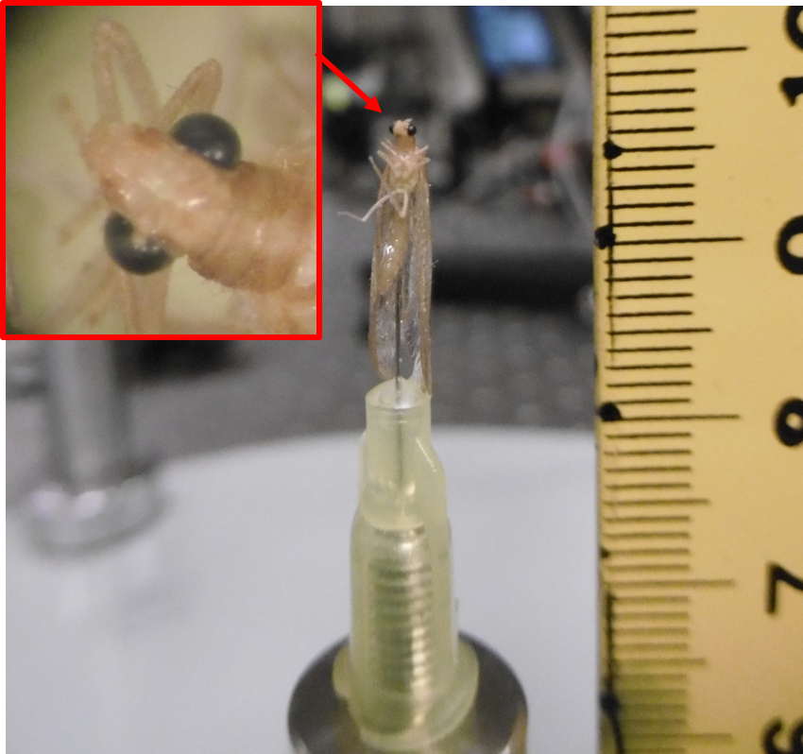
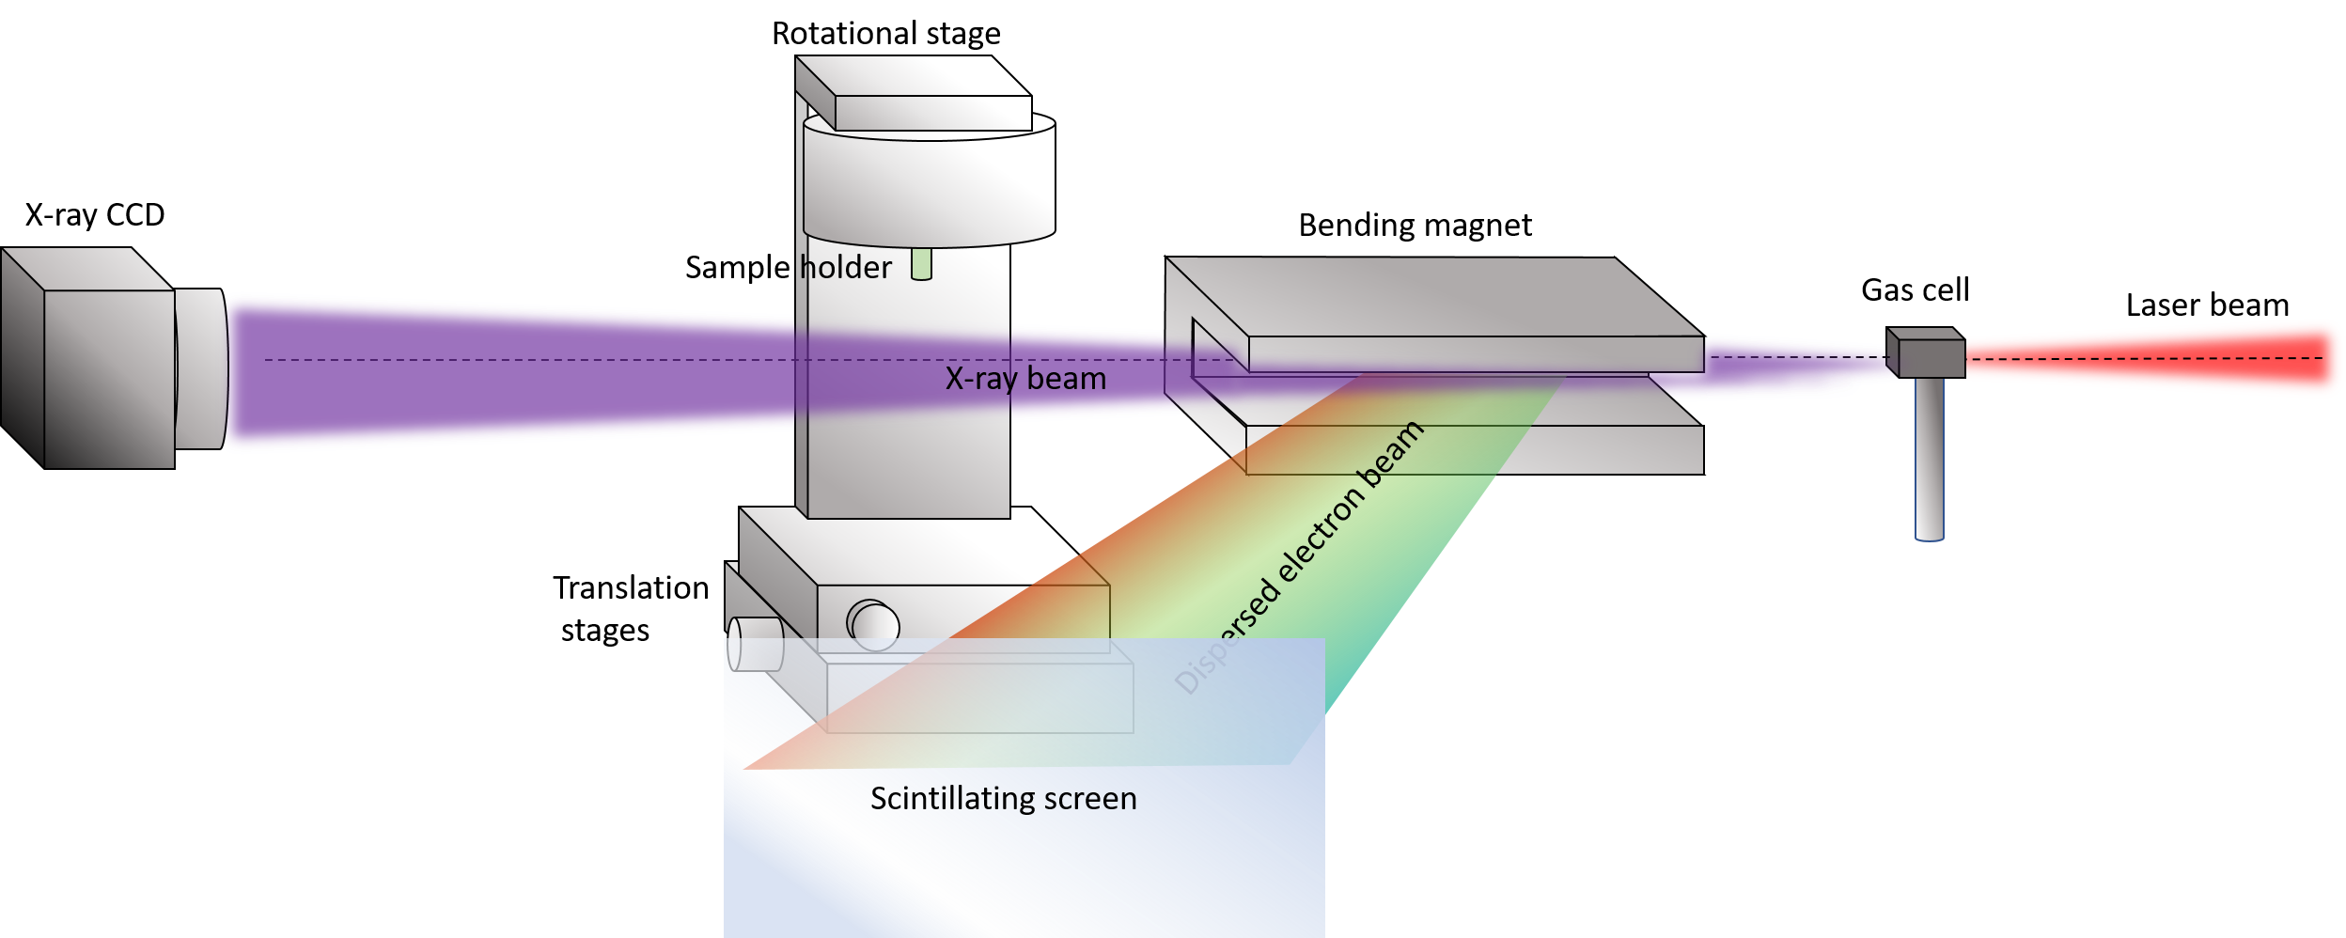


Setup
$$r_{2}=180 or 280 cm$$
$$r_{1}=30 cm$$
5 images/angle over
180 degrees in 1 degree increments
→ 900 images

