Slide 1
Tunable relativistic single-cycle infrared pulses generated from tailored plasma density structures
Chih-Hao Pai
Tsinghua University
Laser Plasma Accelerator Workshop
May 5—11, 2019
Split, Croatia
Notes:
I am Pai, from Tsinghua U
Glad to have the opportunity to talk about our works, …
我們最近系列利用等離子體作用
產生…….的工作

Slide 2
Collaboration
Jie Zhang, Xiaonan Ning, Yunxiao He, Yipeng Wu, Qianqian Su, Shuang Liu, Yue Ma, Zhi Cheng, Jianfei Hua and Wei Lu
Zan Nie, Chaojie Zhang, Warren Mori and Chan Joshi
Hsu-Hsin Chu and Jypyng Wang
Notes:
This work is a combined efforts of Thisnghua U, UCLA and National Central University in Taiwan.

Slide 3
Outline
Motivation: ultrashort mid-IR pulses
Simulation: Generation of relativistic, single-cycle, tunable, IR pulses from density-tailored plasma structure
Experimental demonstration using 800-nm drive laser
Summary
Notes:
First I will briefly introduce the motivation of the generation of ultrashort infrared pulse.
Second will be principle for photon
And then our new proposal to …
Then show the experiments results that demonstrate of generation of tunable, relativistic, single-cycle by simulation and experiment.
Last will be the conclusion.

Slide 4
Ultrashort infrared pulses
From near-infrared (NIR) to mid-infrared infrared
(0.8-1) μm (2-20) μm
Pump-probe experiments
Mode-selective chemistry
Attosecond science
Dave Caffey, et al. Proc. SPIE 7953, 79531K(2011)
Notes:
The ultrashort infrared radiation has a widespread applications, such as pump-probe experiments in the molecular fingerprint region and generation of attosecond x-ray pulses via high-harmonic generation
Here, we focus on the mid-infrared radiation in the spectral range of 3-14μm. From this picture, the mid-infrared radiation in this spectral range has a widespread applications. Here, what we care about is the strong field applications, for example, …
The mir source based on our scheme can fill this gap.
连续输出或低峰值功率的中红外光在环境监控、气体分子识别、医疗诊断、相干断层成像、军事等领域已经有着广泛的应用。
超强中红外非线性光学
有机原子分子超快化学
阿秒硬X射线高次谐波产生应用

Slide 5
Current ultrashort IR sources
MIR sources | Energy | Pulse duration | Peak power | Wavelength range
CO₂ laser¹ | 45 J | 3 ps | 15 TW | ~10 μm
OPCPA² | 31 mJ | 70 fs | 300 GW | 3.1~3.6 μm
DFG³ | 1.5 μJ | 11 fs | 136 MW | 1.8-4.4 μm
Two-color filamentation⁴ | 1.5 μJ | 13 fs | 115 MW | 2.5~5.5 μm
Mid-infrared fiber laser⁵ | 150 nJ | ~100 fs | ~1.5 MW | 1.4~13.3 μm
MIR-FEL⁶ | Macro: 6-8 mJ Micro: 2-2.7 μJ | Macro: 2 μs Micro: 2 ps | ~1 MW | 5~16 μm
No existing relativistically intense, single-cycle pulses in long-wavelength (5-14 μm)!
[1] D. Haberberger, et al. Opt. Express, 18, 17865(2010)
[2] Yuxi Fu, et al. Appl. Phys. Lett. 112, 241105(2018)
[3] Peter Krogen, et al. Nat. Photonics 11, 222(2017)
[4] Takao Fuji, et al. Opt. Lett. 32, 3330(2007)
[5] I. Pupeza, et al. Nat. Photonics 9, 721(2015)
[6] Kyohei Yoshida, et al. Energy Procedia 9, 483(2011)
Notes:
Current ultra-short mid and longwave IR sources are most based on CO2、
We can find, for a specific technology, the intense IR pulse can be generated or the pulse duration can achieve single cycle or the wavelength can be tunable. However, (Difference-frequency generation, DFG)
CO2 can gen large energy but pulse duration is ps long
No existing sources can generate relativistically intense, single-cycle pulses for wavelength longer than 5um.
缺乏像钛宝石这样的超宽增益带宽、高损伤阈值的增益介质，很难直接获得超短超强的中红外脉冲。
OPCPA:由于要兼顾近红外波段的泵浦光，很难找到合适的非线性晶体，使得输出中红外波长达到5 um以上
Lack of broadband gain medium in this wavelength range

Slide 6
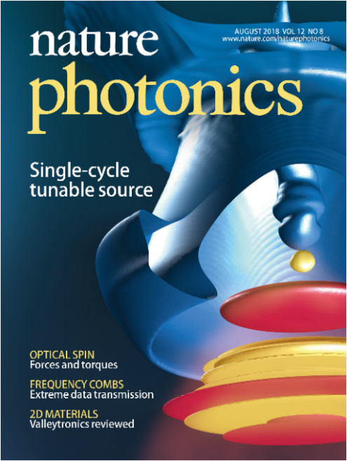
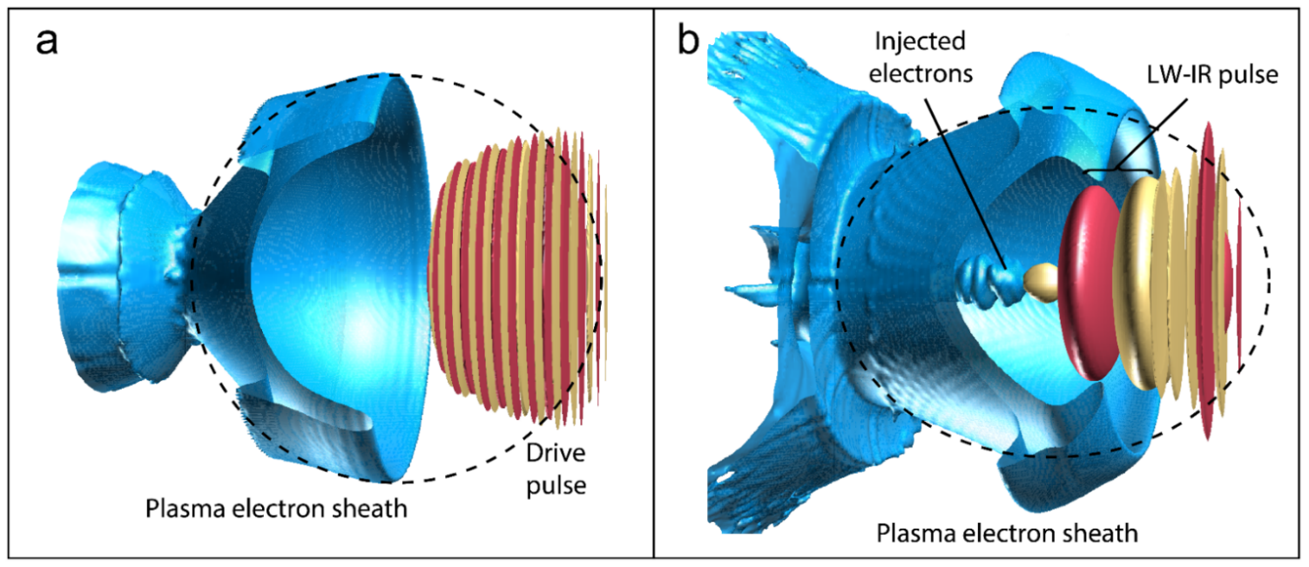
Laser-plasma interaction
Laser
Plasma
Particle
Photon
Decelerator
(IR generator)
Particle
Accelerator
(LWFA)
Wakefield
Z. Nie, et al. Nature Photonics 12, 489-494 (2018)
Notes:
In LWFA, The high gradient can accelerate electrons.
So the laser pulse give its energy to electron beam.
For photons in the laser pulse, since the photon number in this process is conservative the loss of energy means the decrease of laser frequency, So this is how the LW-IR pulse is generated.

Slide 7
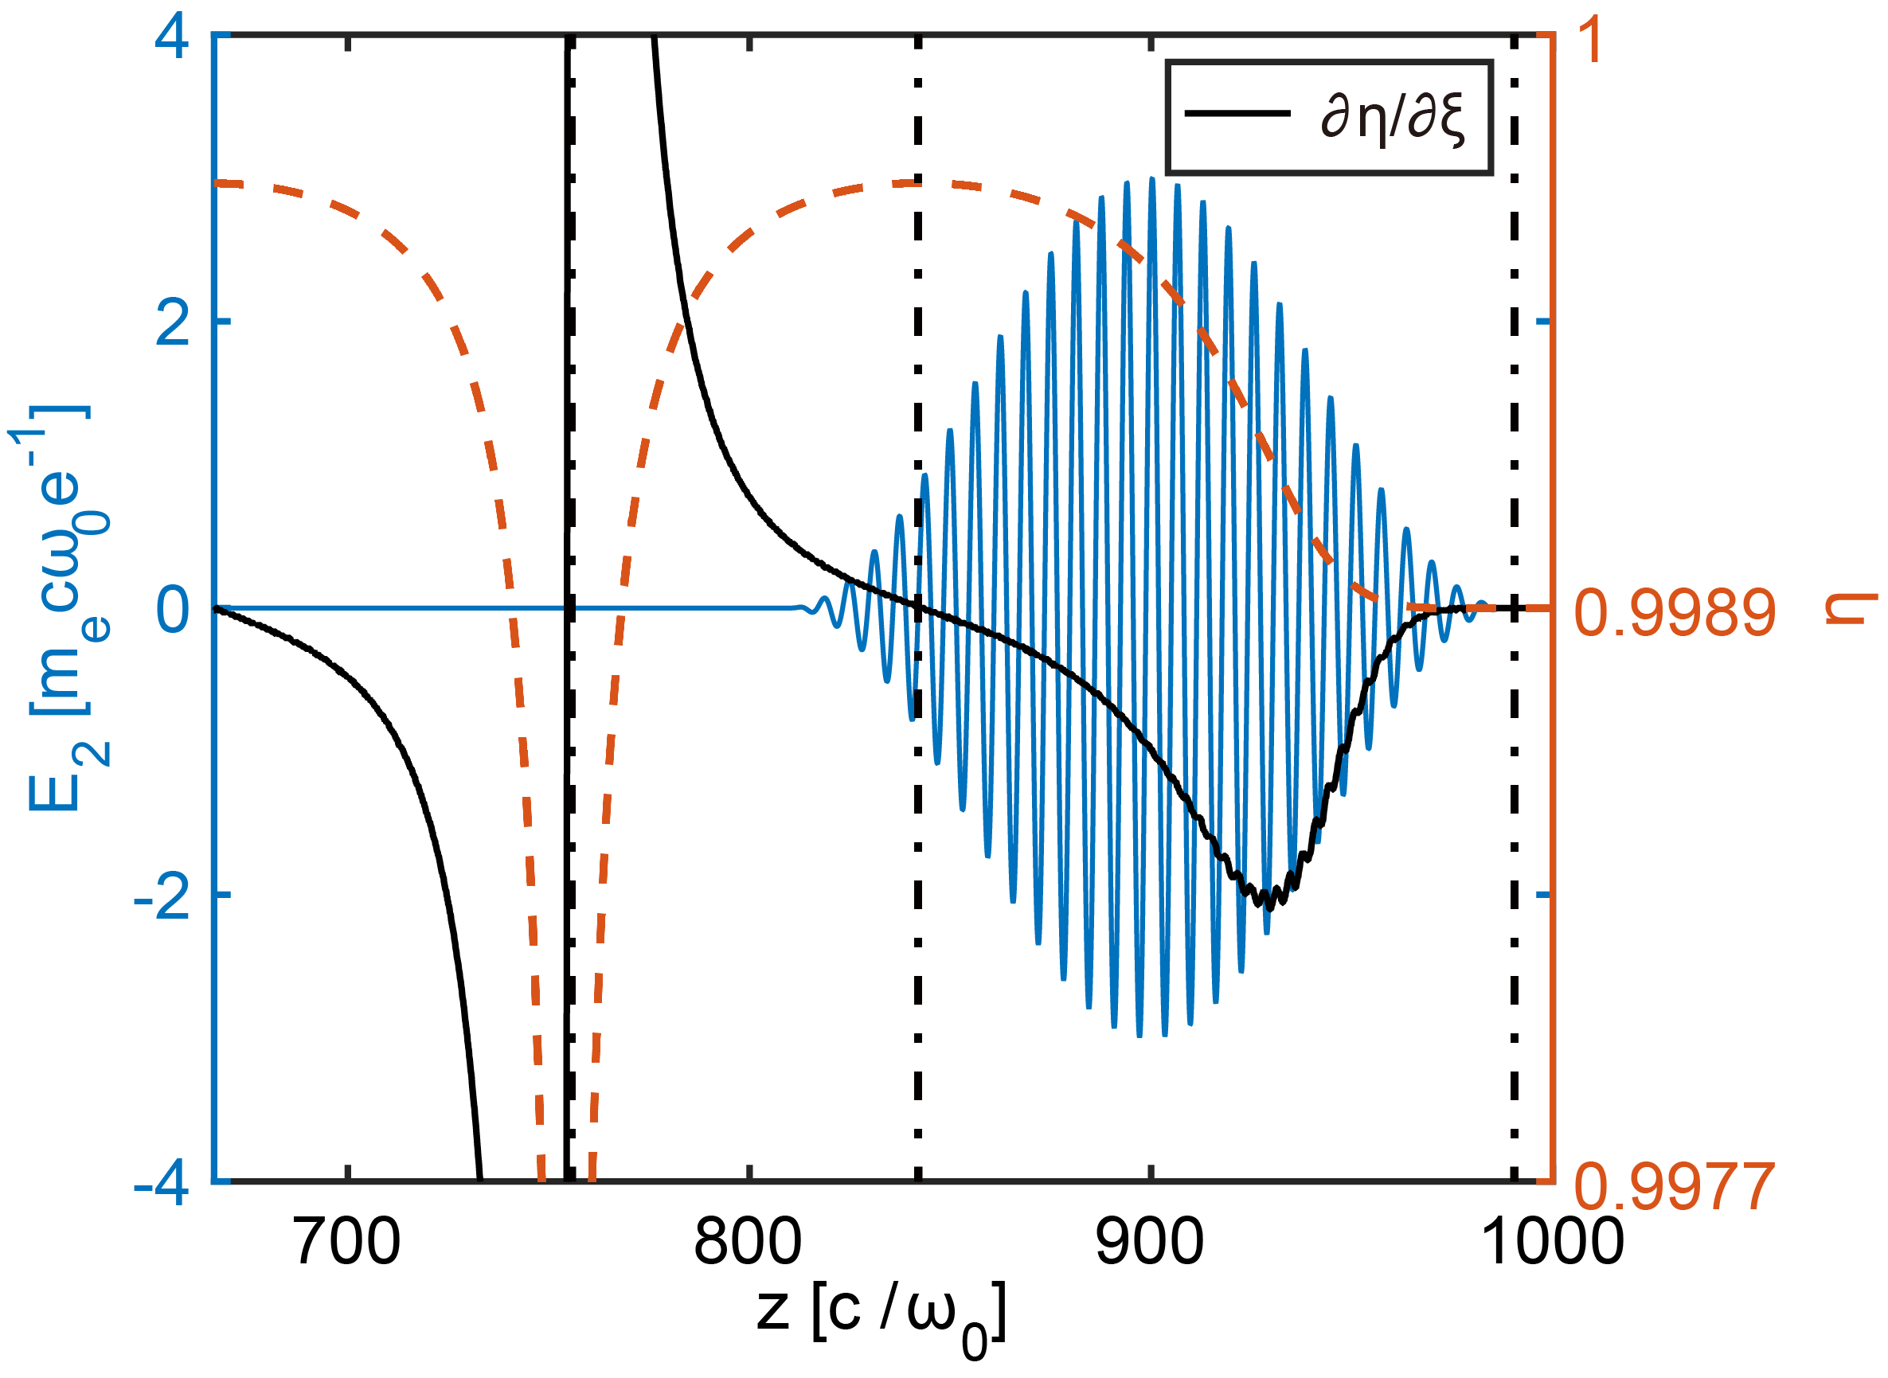
Photon deceleration
Theory and simulations:
S. C. Wilks, et al. Phys. Rev. Lett. 62, 2600 (1989)
P. Sprangle, et al. Phys. Rev. Lett. 64, 2011 (1990)
W. B. Mori, IEEE J. Quantum Electron. 33, 1942 (1997)
F. S. Tsung, et al, PNAS 99, 29-32 (2002)
Gordon, D. F. et al. Phys. Rev. Lett. 90, 215001 (2003)
Experiments:
J. Faure, et al. Phys. Rev. Lett. 95, 205003 (2005)
J. Schreiber, et al. Phys. Rev. Lett. 105, 235003 (2010)
C.-H. Pai, et al. Phys. Rev. A 82, 63804 (2010)
Blueshift
Redshift
Notes:
The laser frequency downshifting in plasma is called photon deceleration. This phenomenon has been studied both in theory and experiments.
The nature of this phenomenon is SPM. We know that refractive index gradient will lead to the variation of laser frequency. And from 1D nonlinear theory, we can get the profile of the refractive index shown with the red dashed line. So, the pulse in the front of the wake will be redshifted since the refractive index gradient is negative, and the pulse in the rear part of the wake will be blueshifted since the gradient is positive.
To generate the IR pulse, we need to make sure the laser pulse is located in the front of the wake.

Slide 8
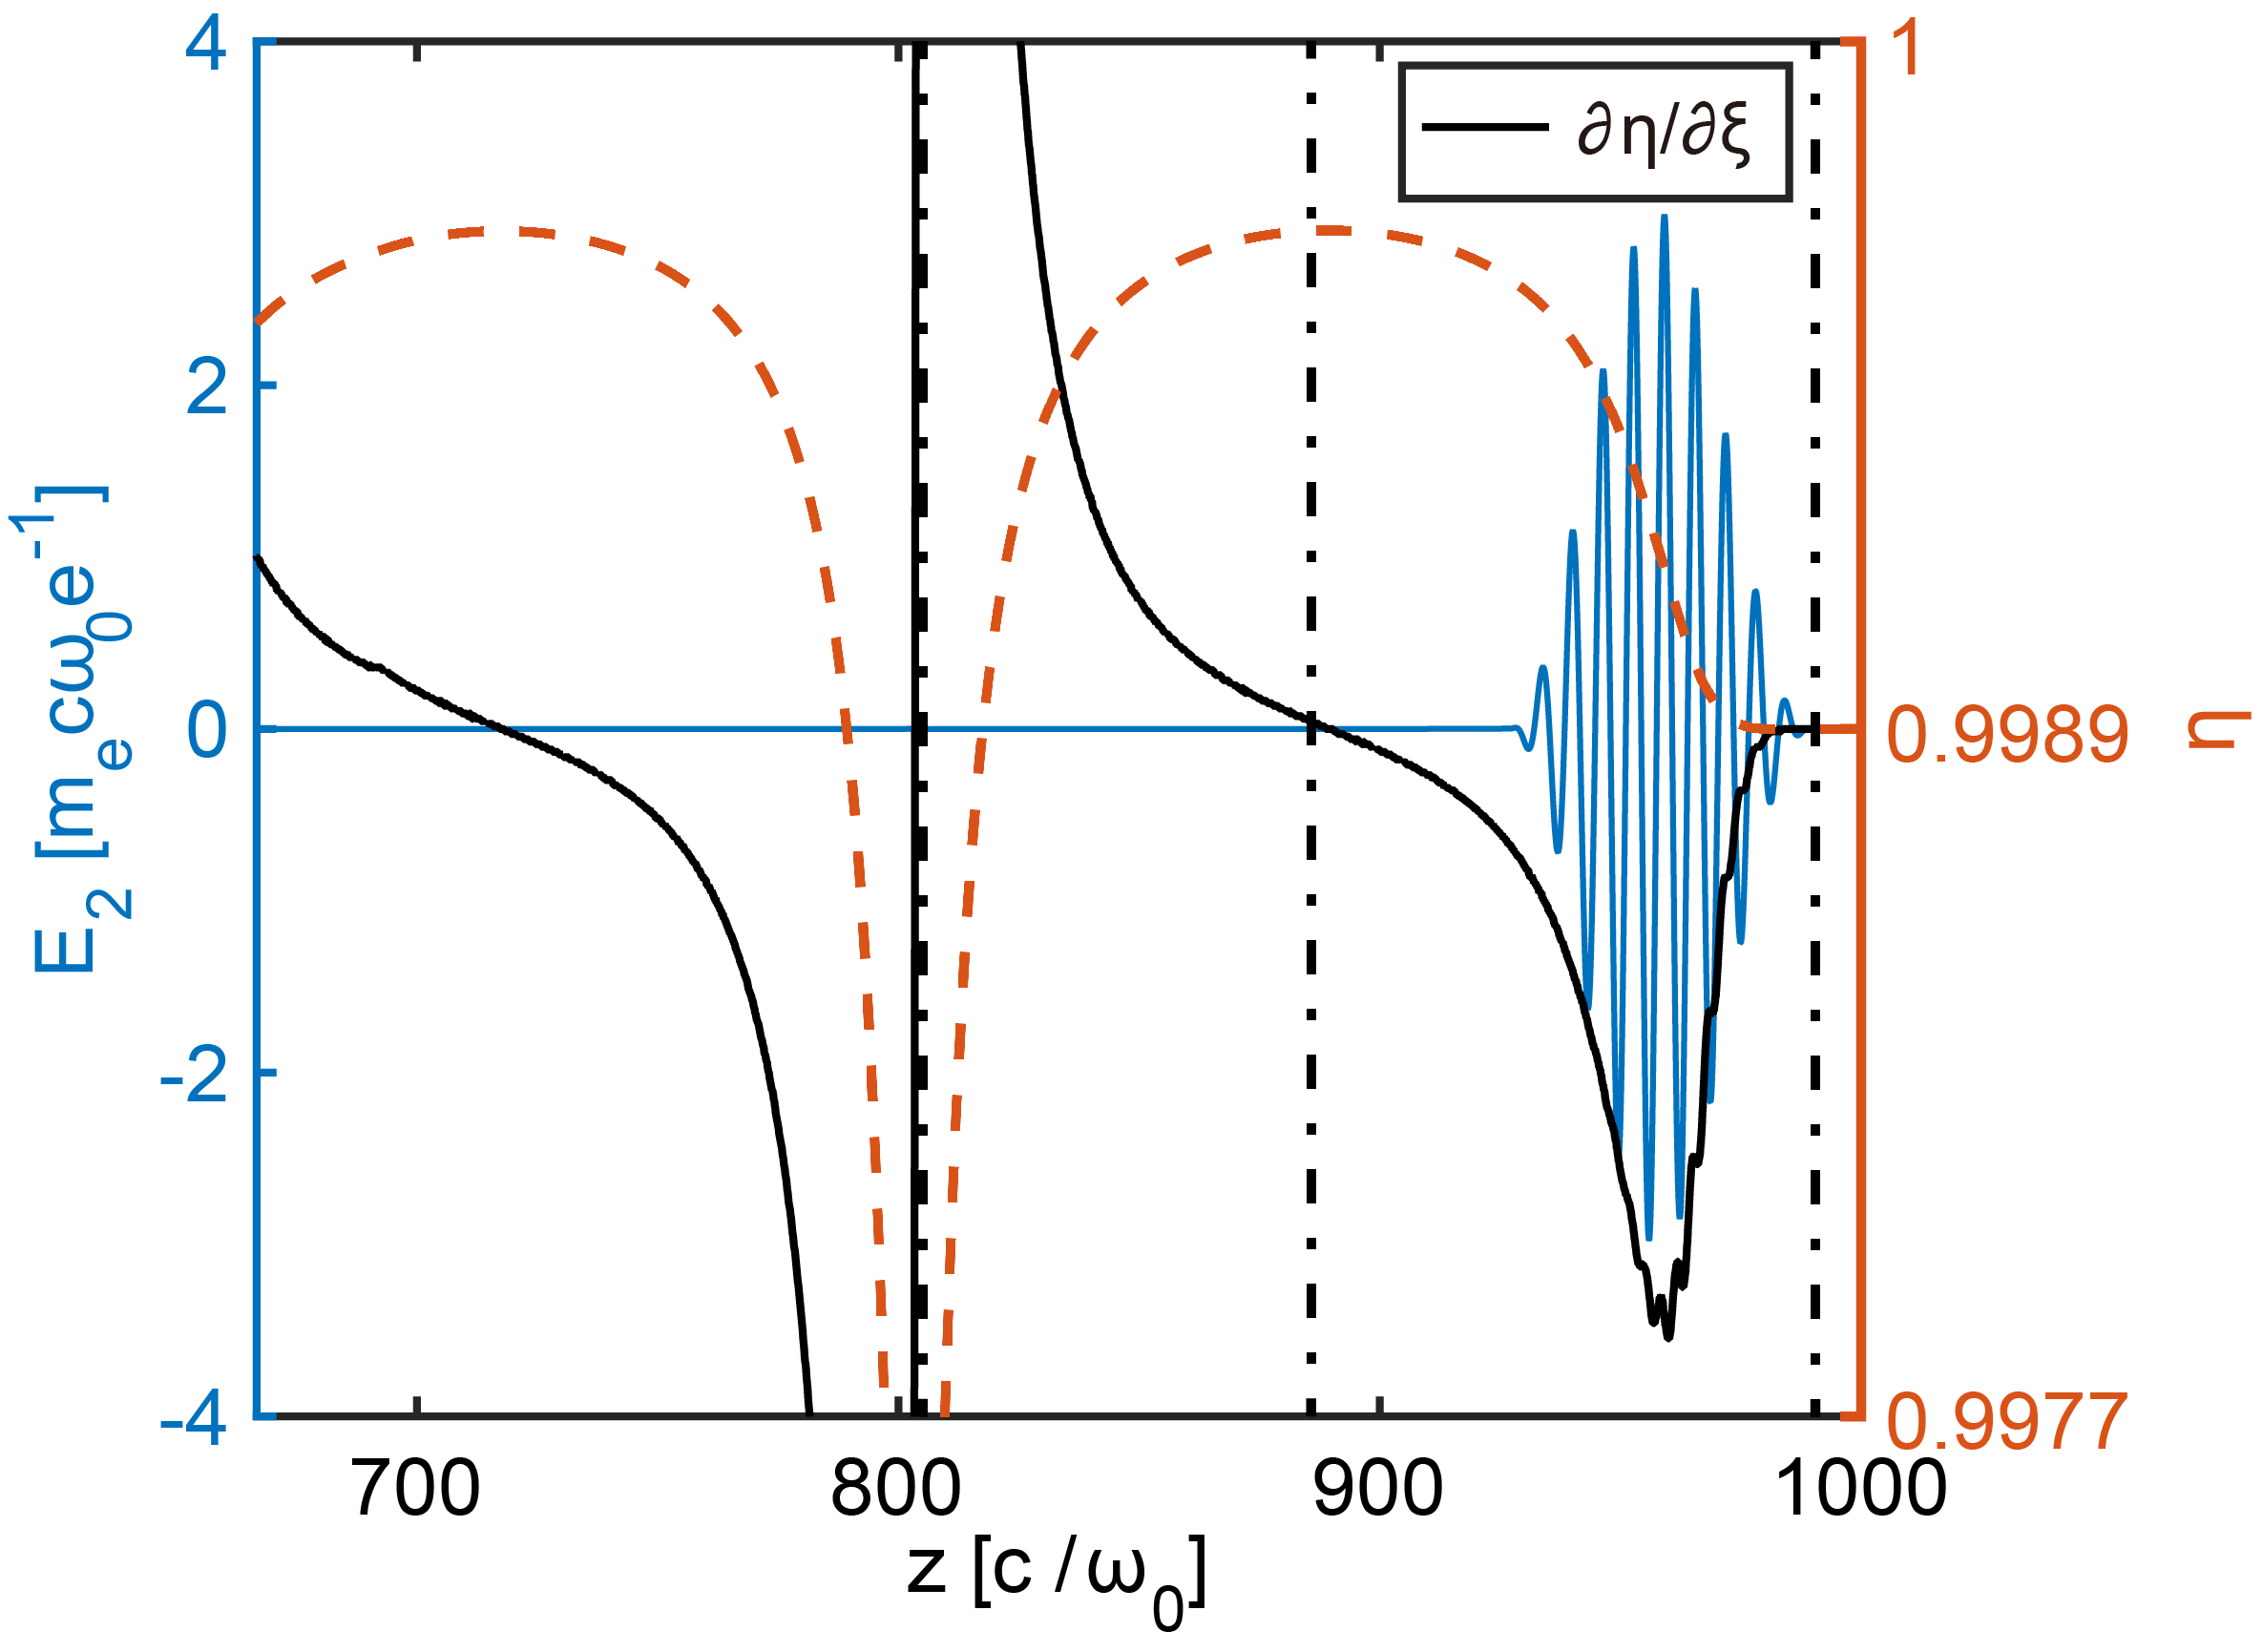
Photon deceleration
Optimal pulse duration for IR pulse generation
Blueshift
Redshift
Notes:
Then arise a question how to increase conversion efficiency?
We hope the pulse is totally frequency downshifted, however it is practically impossible.
So we should find the best solution, which is shown in this picture.
The peak of the laser pulse rides on the peak of the refractive index gradient. Based on this idea, we can get the optimal pulse duration .
For the case of plasma density and normalized vector potential, the pulse duration equals to 10fs.
However, it is hard to get such intense and short laser pulse.

Slide 9
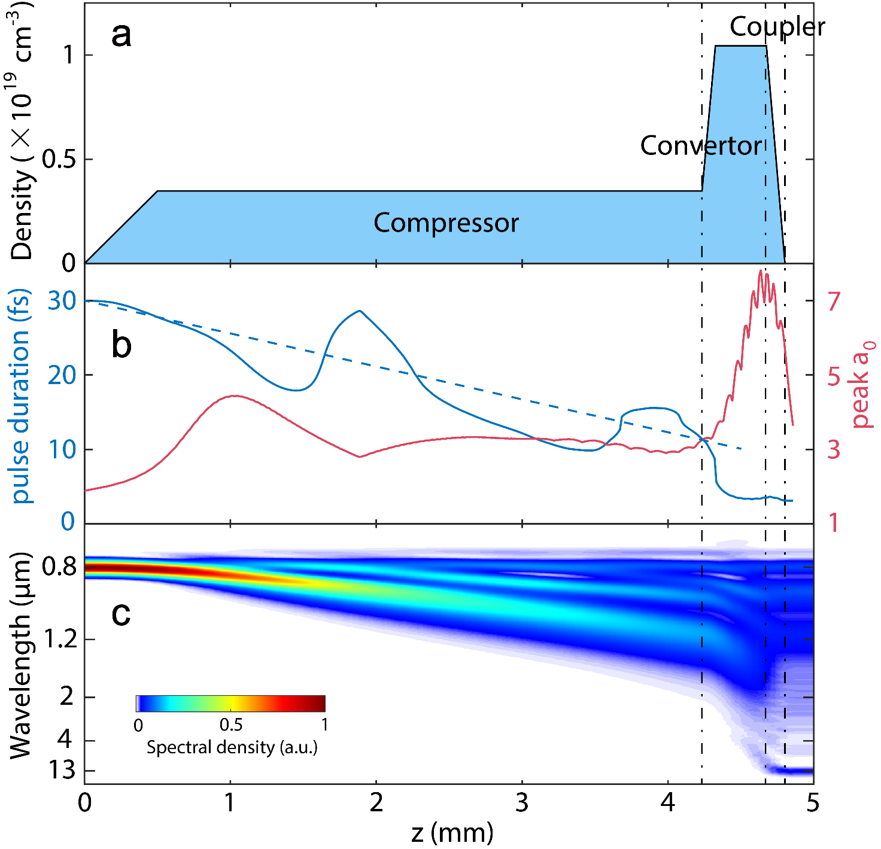
Photon deceleration in density-tailored plasma
Osiris 3D simulation:
Energy | 1.2 J
Pulse duration (FWHM) | 30 fs
Spot size $w_{0}$ | 16 μm
Initial $a_{0}$ | 2.16
Notes:
So a special density-tailored plasma structure is proposed to generate relativistic single-cycle tunable infrared pulses with high conversion efficiency.
It can be divided into 3 sections: compressor; converter and coupler.
Here I will give a 3D PIC simulation case to illustrate the whole physical process involved based on achievable laser parameters.
It can be divided into 3 sections: the first part is low density laser pulse compressor; the second is high density converter for frequency downconversion, and the final coupler module is used to transfer the pulse to outside with small attenuation and without any significant distortion due to GVD effects.

Slide 10
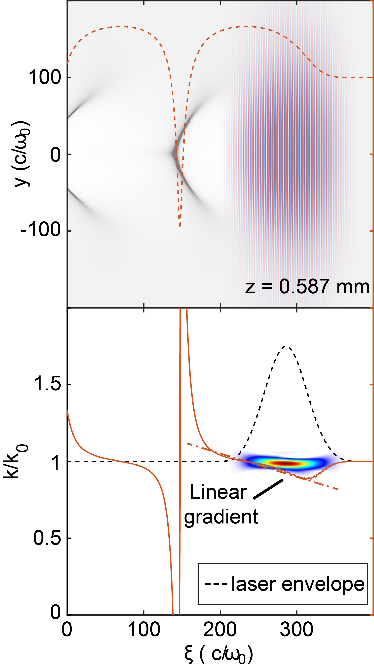
Photon deceleration in density-tailored plasma
Notes:
In the long low-density compressor module, the spectrum of the pulse is only modestly broadened.
This top figure show the information of the transverse electric field of laser, the wake and the refractive index,
while the bottom figure show the Wigner spectrum of the transverse electric field of the evolved laser pulse, the gradient
At the beginning of compressor, the initial pulse occupies mostly the first half of the wake, so the whole laser pulse undergoes gentle frequency downshifting and develops a nearly linear chirp.

Slide 11
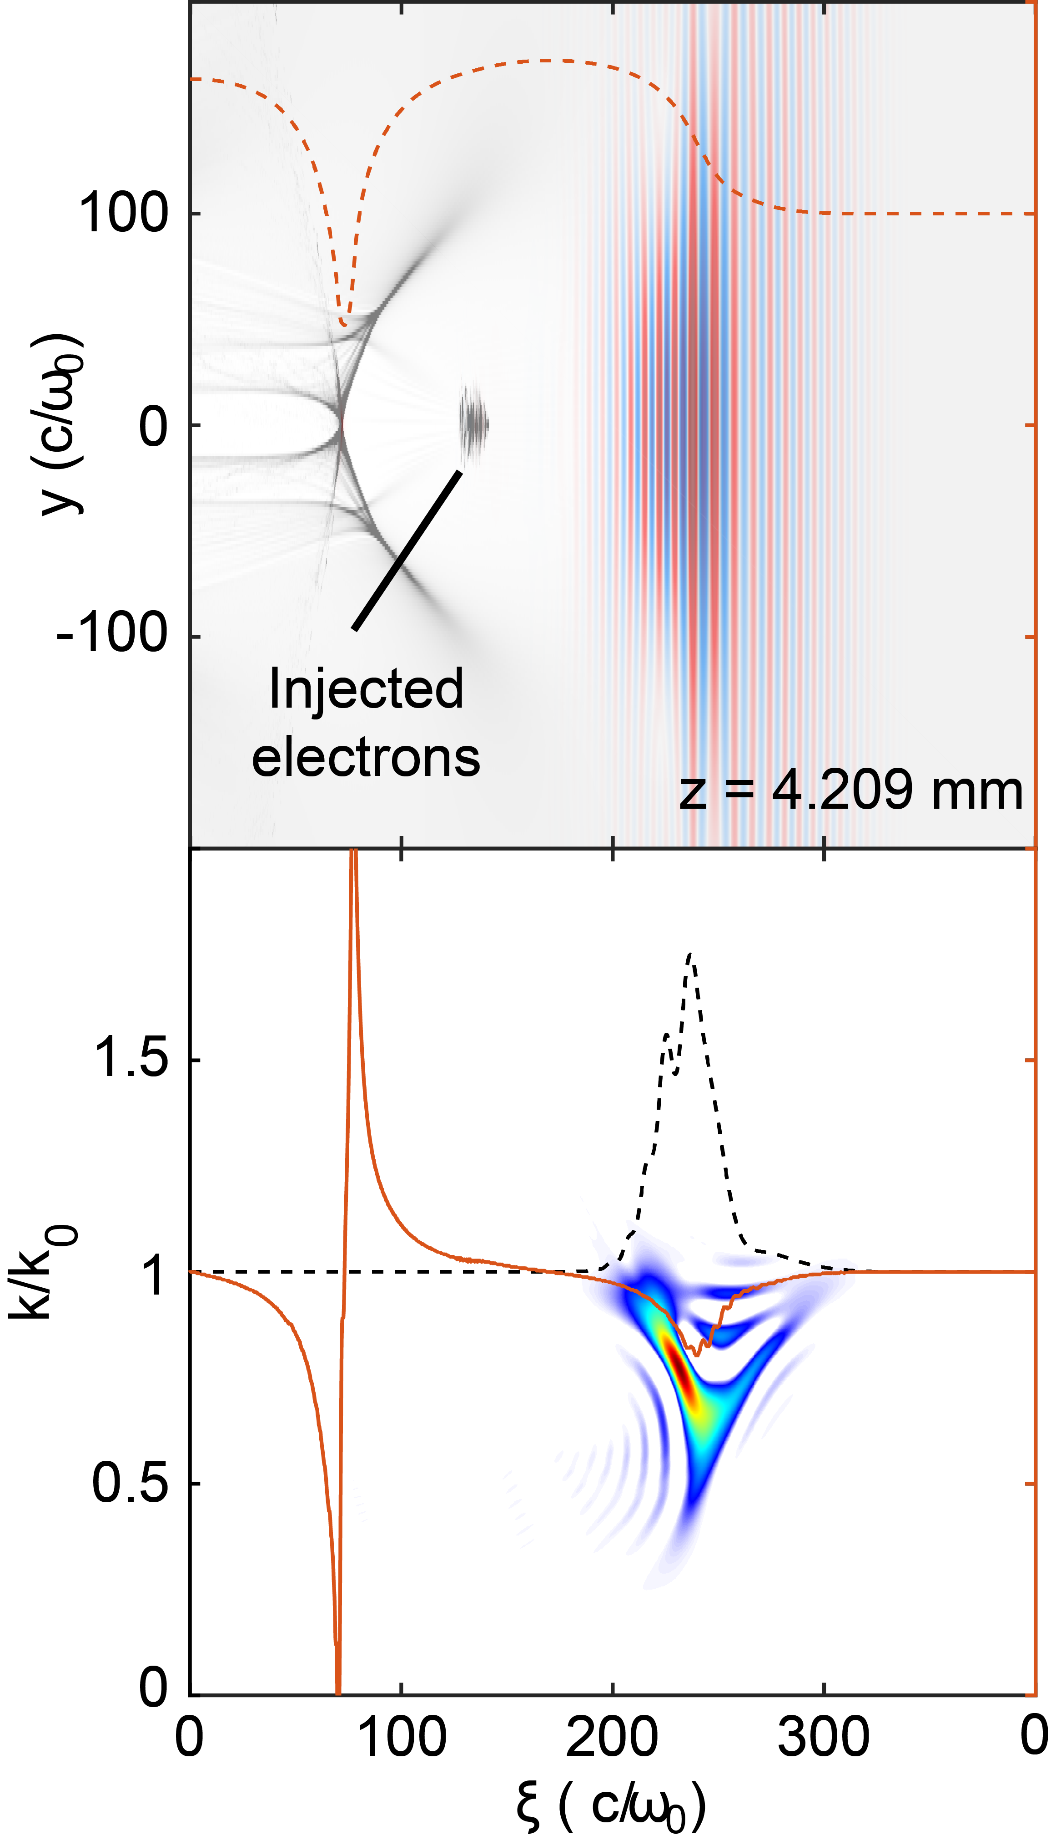
Photon deceleration in density-tailored plasma
Notes:
However, during the self-compression, the nearly linear refractive index gradient gradually becomes nonlinear and leads to a higher-order chirp, which will produce the variation of pulse duration.
Overall, the negative GVD of the plasma results in self-compression of the laser pulse from 30 to11fs, and the peak of the laser pulse is located where the refractive index gradient is the largest.

Slide 12
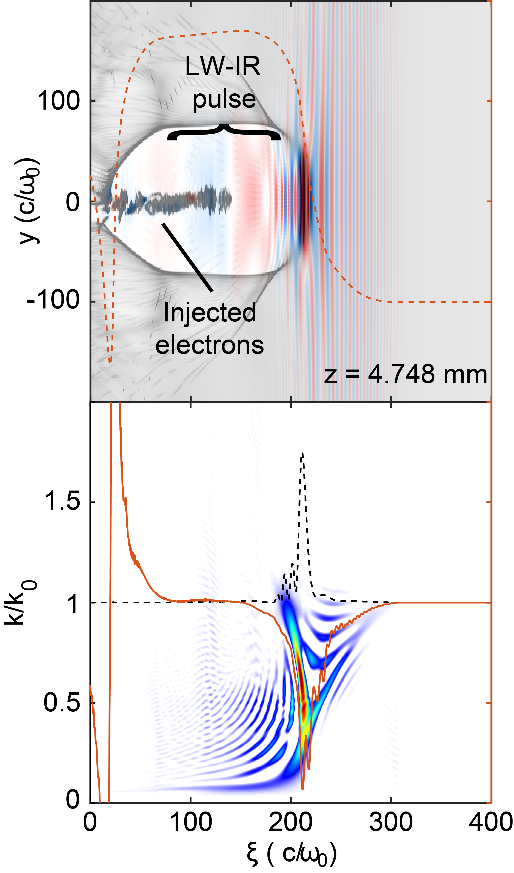
Photon deceleration in density-tailored plasma
Notes:
In the convertor, the plasma density is three times as high as that in the compressor. The converter length is only 450 μ m including a 100 μm up-ramp. The increase of plasma density leads to self-focusing and further self-compression of the drive pulse.
Together with frequency downshifting of the photons, it leads to a rapid increase of normalized vector potential.
At the end of the converter, the LW-IR pulse is generated and capsulated in the wake.
From the Wigner distribution, the LW-IR pulse almost has no chirp. So it is nearly a transform limited pulse.

Slide 13
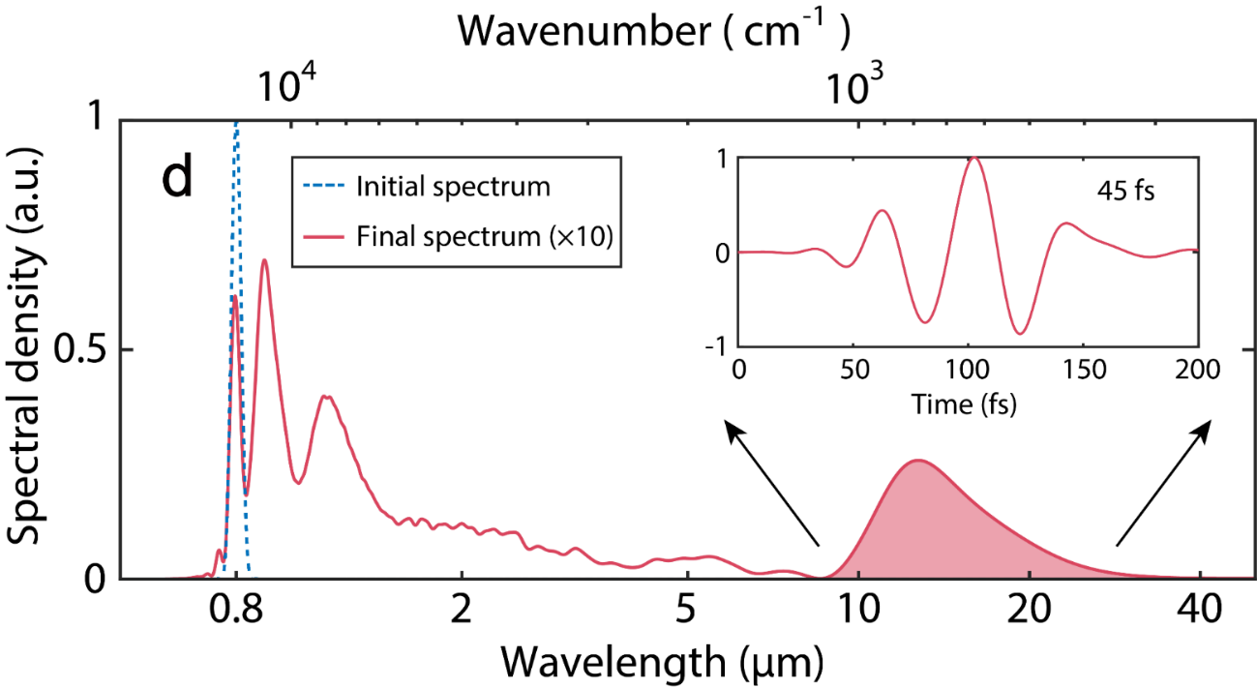
IR spectrum and pulse duration
Central wavelength | 12 μm
Pulse duration (FWHM) | 45 fs
LWIR Energy (8-30μm) | 20 mJ
LWIR Energy efficiency (8-30μm) | 1.7%
Quantum limit (0.8μm to 12μm) | 6.7%
Photon efficiency (8-30μm) | ~25.5%
Peak power | 0.44 TW
Peak a₀ | 7
Electric field | 1.87 TV/m
Notes:
Here are the initial and final spectrum. For IR part, the central wavelength is 12micron,and pulse duration is 45fs, corresponding to near single-cycle.
The photon efficiency , that means every four photons have one photon converted to the long-wavelength range.

Slide 14
Beam quality of the IR pulse
Original electric field
Filtered E-field in 6-20μm （Central wavelength of 9.6μm ）
Beam pattern close to TEM₀₀
Notes:
To quantify the beam quality of IR pulse, we have filter out the electric field of IR from the original electric field.
it has a near ideal TEM₀₀ mode after exiting the plasma structure

Slide 15
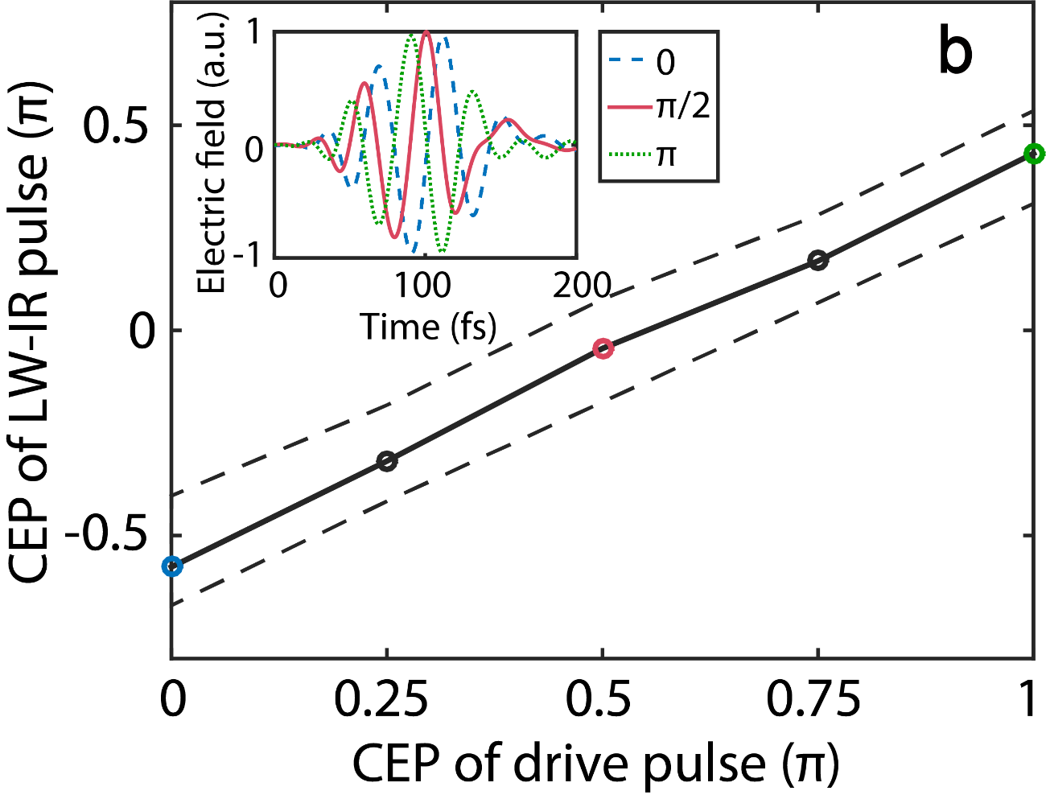
Carrier-envelope phase locking
The evolution of the CEP:
The product of plasma density-length
+3.3×10¹⁹cm⁻³μm
-3.3×10¹⁹cm⁻³μm
Notes:
At the same time, we find that the CEP of the IR pulse is locked to the CEP of the initial drive pulse.
CEP is due to the difference between the phase velocity and group velocity.
Once the plasma density profile is fixed, the variation of the CEP caused by propagation is fixed.
So there is a linear relationship between the CEP of the generated infrared pulse and that of the initial drive pulse
This is a very useful property for attosecond science.

Slide 16
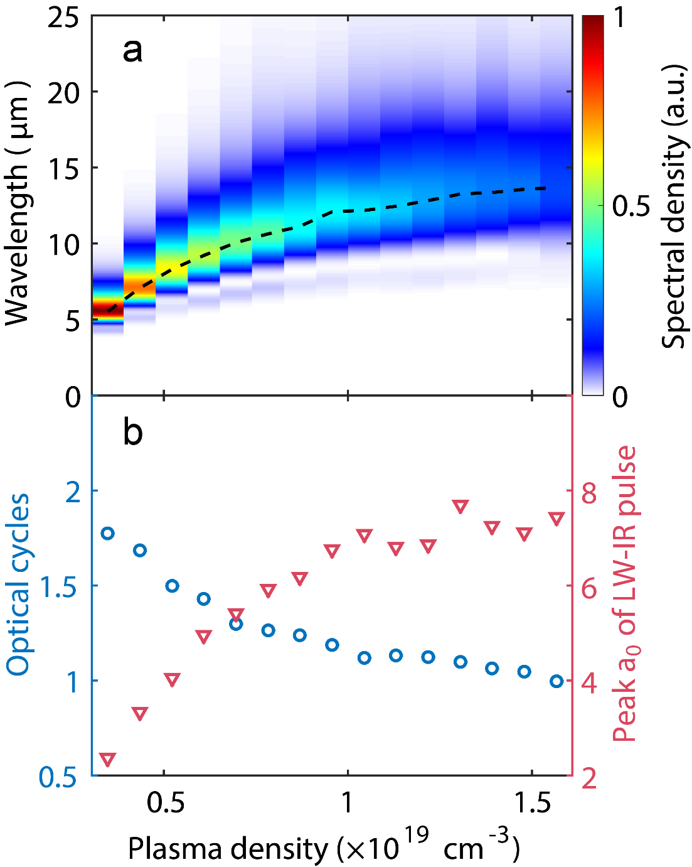
Wavelength tunability
Wavelength tunability from 5-14μm
Near-single-cycle
Relative intense
Notes:
For the tunability of wavelength, we made a parameter scanning of the density in the converter section. The output wavelength can be tuned from 5-14μm.and the pulse duration is near-single-cycle and the normalized vector potential is large than unit.

Slide 17
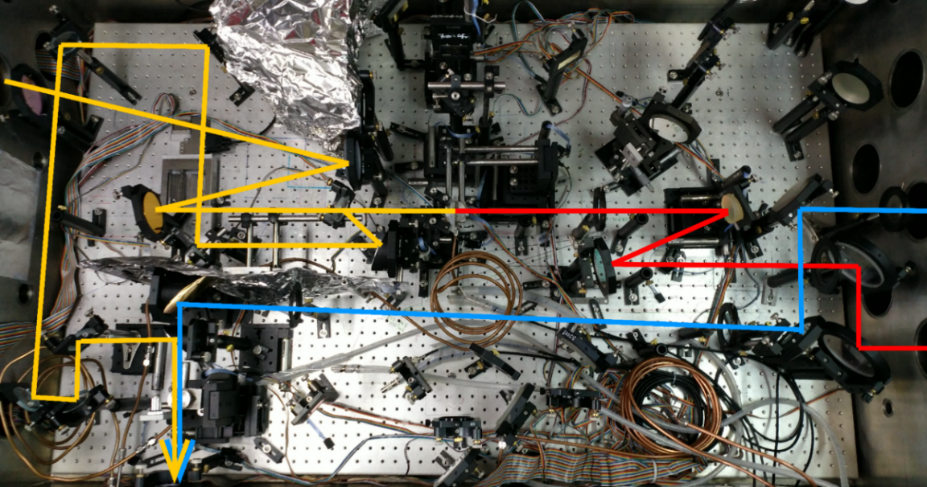
Demonstration of ultra-intense single-cycle IR generation
T.-S. Hung et al., Appl Phys B, 117, 1189 (2014)
100 TW laser platform at National Central University, Taiwan
Notes:
The experiment were done on

Slide 18
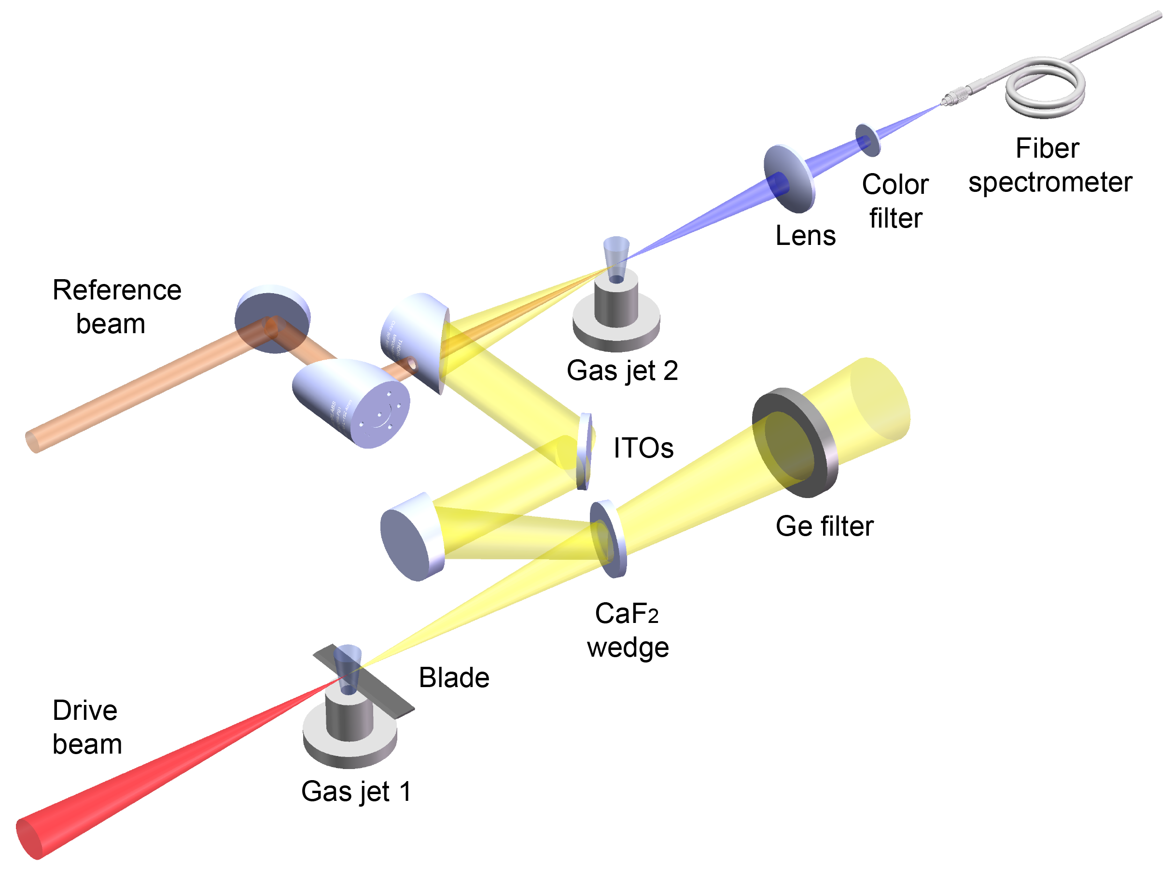
Experimental setup (schematic)
IR pulse measurement
(XFROG)
Reference beam
IR pulse transport
IR pulse generation
Notes:
IR pulse is generated in laser-plasma interaction and the plasma structure is produced by scanning the position of blade.
and a part of the pulse is reflected for measurement.
another synchronized 810 nm reference pulse with known temporal amplitude and phase is used for XFROG measurement.

Slide 19
Optimization of plasma structures— blade scanning
FWDFG
FWSFG
423.0 nm
405.0 nm
389.5 nm
Notes:
Here are three measured XFROG traces for three different plasma density profiles when scanning the blade position.
The XFROG traces simultaneously show the spectra of four-wave sum-frequency generation (FWSFG) and difference-frequency generation (FWDFG) as a function of delay.
Since both processes use the same input optical fields, these traces are symmetrical around 405nm, half of the drive laser wavelength.
The FWSFG signal is weaker than the FWDFG signal because the former process is less efficient than the latter due to phase mismatch and beam mode mismatch.
Moreover, the transmission of optics below 360 nm decreases significantly, which also results in a weak FWSFG signal.
So we use the FWDFG signal for XFROG retrieval^{17–19} to get both the amplitude and phase information of IR pulse.

Slide 20
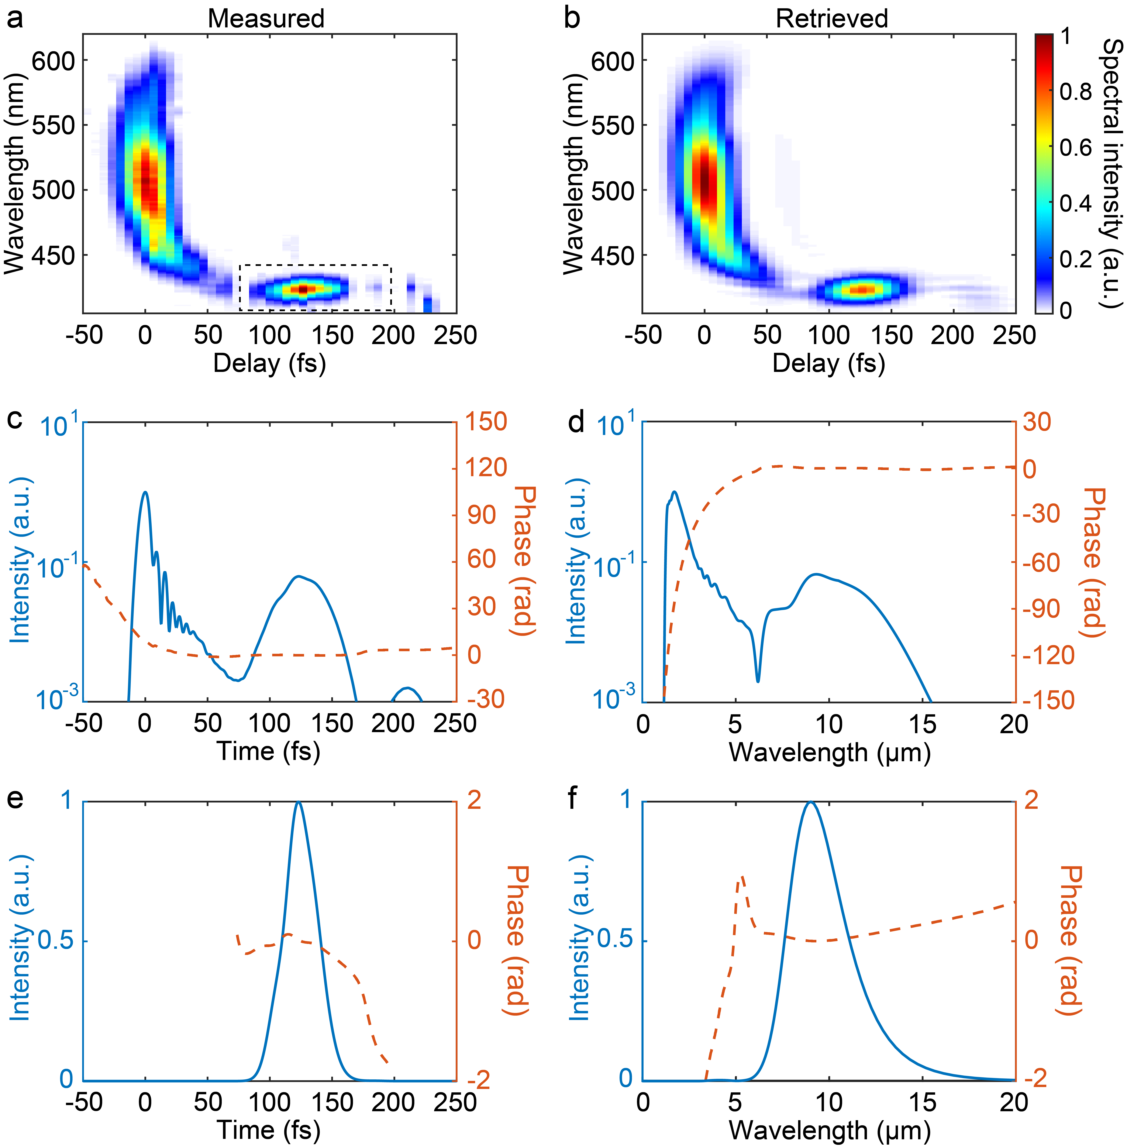
Retrieved IR pulse
error 0.9%
XFROG trace:
IR pulse:
32fs
9.4μm
LWIR pulse:
Notes:
These are XFROG traces for infrared pulse measurement.
The left row is for temporal domain and the right row is for spectrum domain.
The bottom line are the enlargement of long wavelength signal.

Slide 21
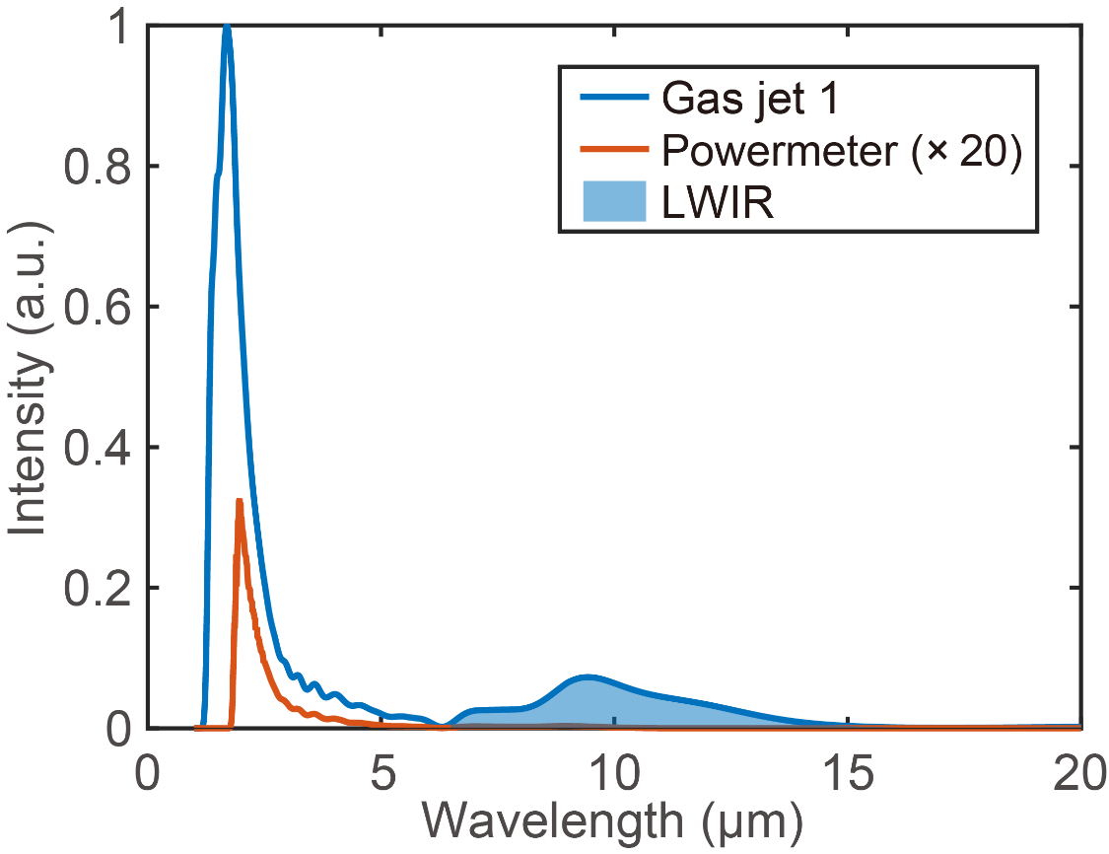
IR spectrum and energy
Central wavelength | 9.4 μm
Pulse duration (FWHM) | 33 fs
LWIR energy (6-20μm) | (3.41±1.08) mJ
LWIR efficiency (6-20μm) | (0.84±0.27)%
Peak power | (103±33) GW
Peak a₀ | 1.53±0.25
Electric field | (0.52±0.08) TV/m
Overall energy (1.2-20μm) | > (15.0±4.8) mJ
Overall efficiency (1.2-20μm) | > (3.7±1.2)%
Measured IR energy:
132.5±42.0 μJ
Notes:
According to the systematical calibration of energy, we find the peak power of IR is 100GW and the normalized vector potential of 1.5, reaching to relativistical intensity.

Slide 22
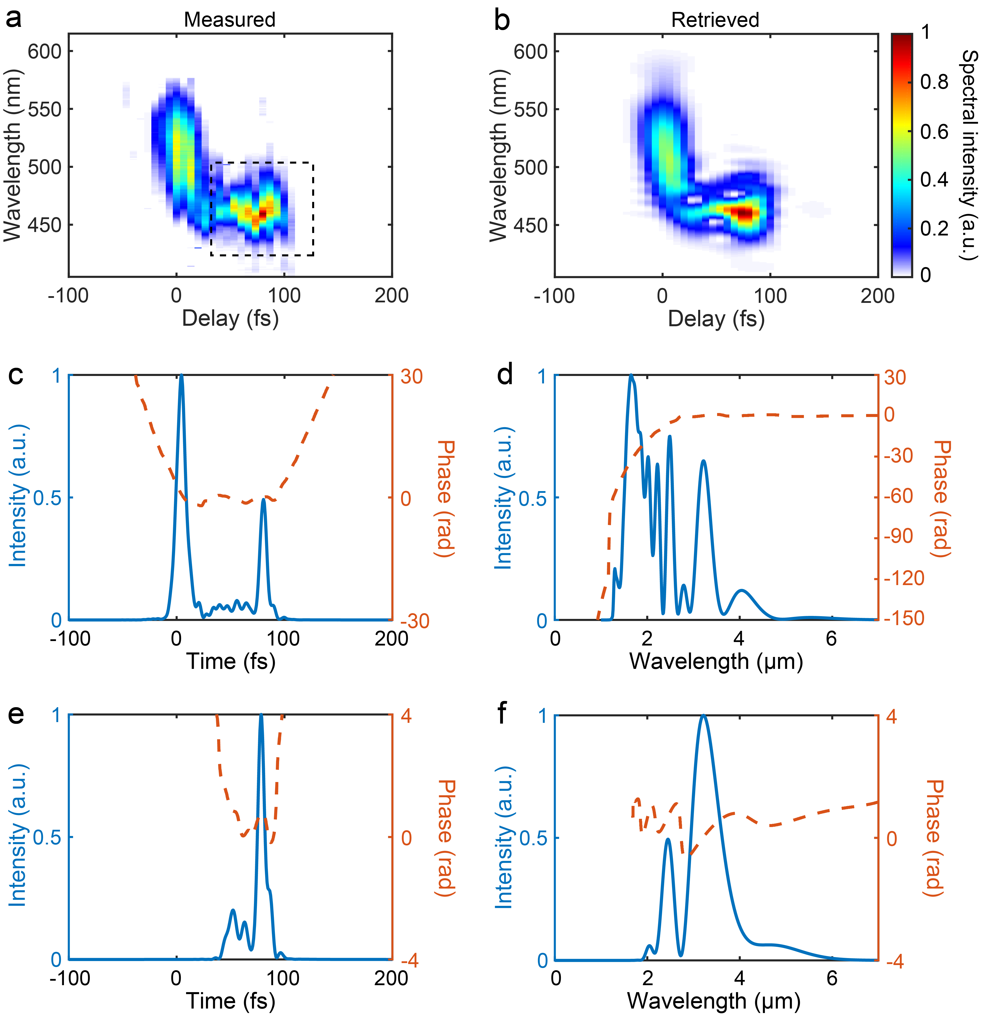
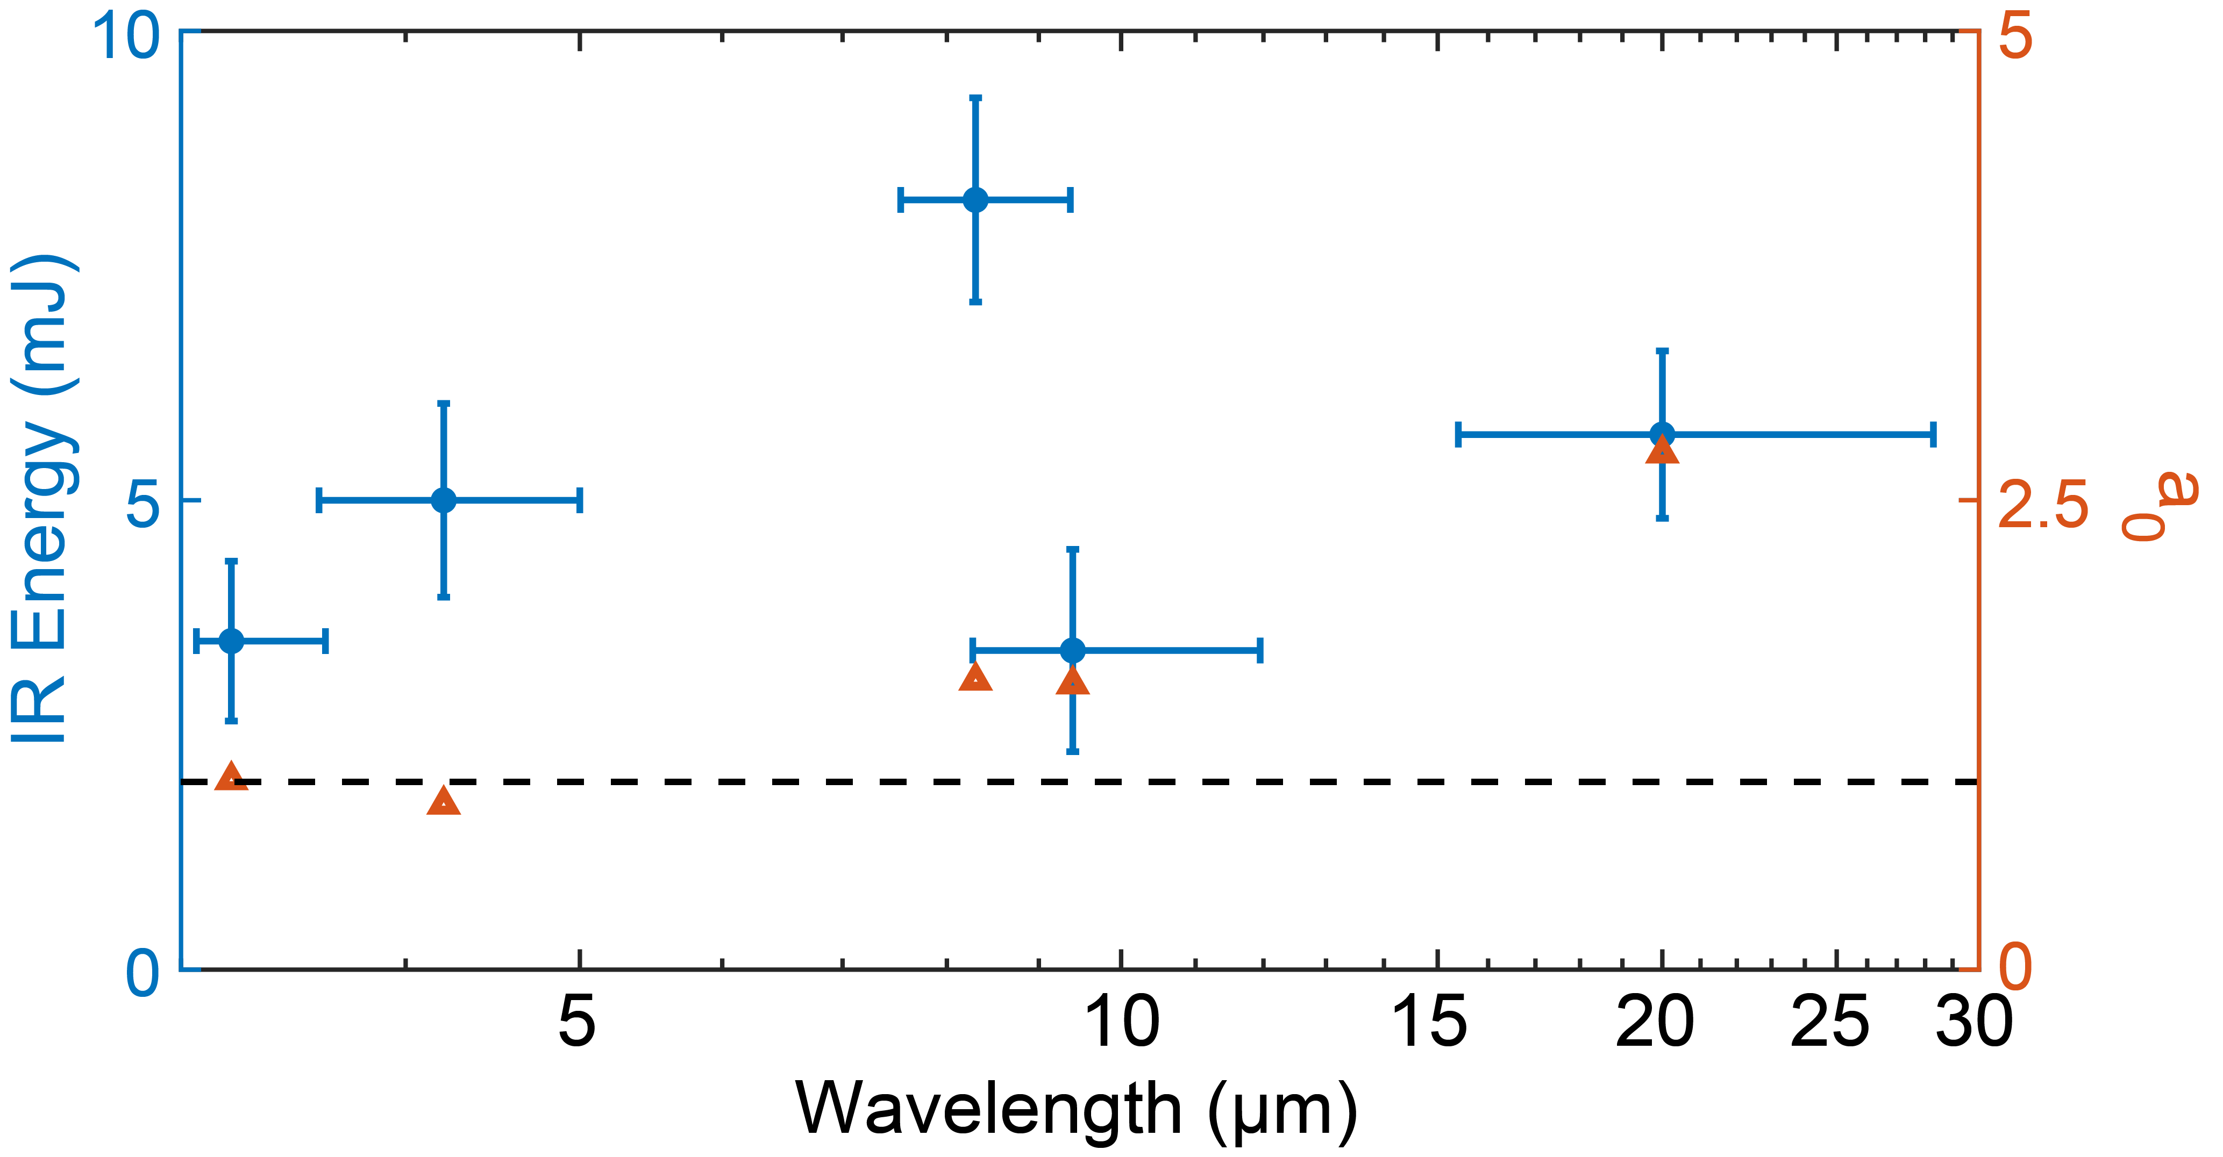
Wavelength tunability
Driver energy (mJ) | 385
Central wavelength (μm) | 3.2
IR pulse duration (fs) | 9.0
IR energy (mJ) | 3.5 (2.7~7μm)
IR a₀ | 1.01
Driver energy (mJ) | 385 | 490 | 721 | 576 | 853
Central wavelength (μm) | 3.2 | 4.2 | 8.3 | 9.4 | 20.0
IR pulse duration (fs) | 9.0 | 29.0 | 61.6 | 32.0 | 77.4
IR energy (mJ) | 3.5 (2.7~7μm) | 5.0 (3~9μm) | 8.2 (5.3~16μm) | 3.4 (6~20μm) | 5.7 (13~40μm)
IR a₀ | 1.01 | 0.88 | 1.54 | 1.53 | 2.75
3.2μm
9fs
Notes:
The central wavelength of IR pulse can be turned from 3um to 20um when scanning the laser power. For all these five cases, the generated IR pulses has near single cycle pulse duration and relativistical intense.

Slide 23
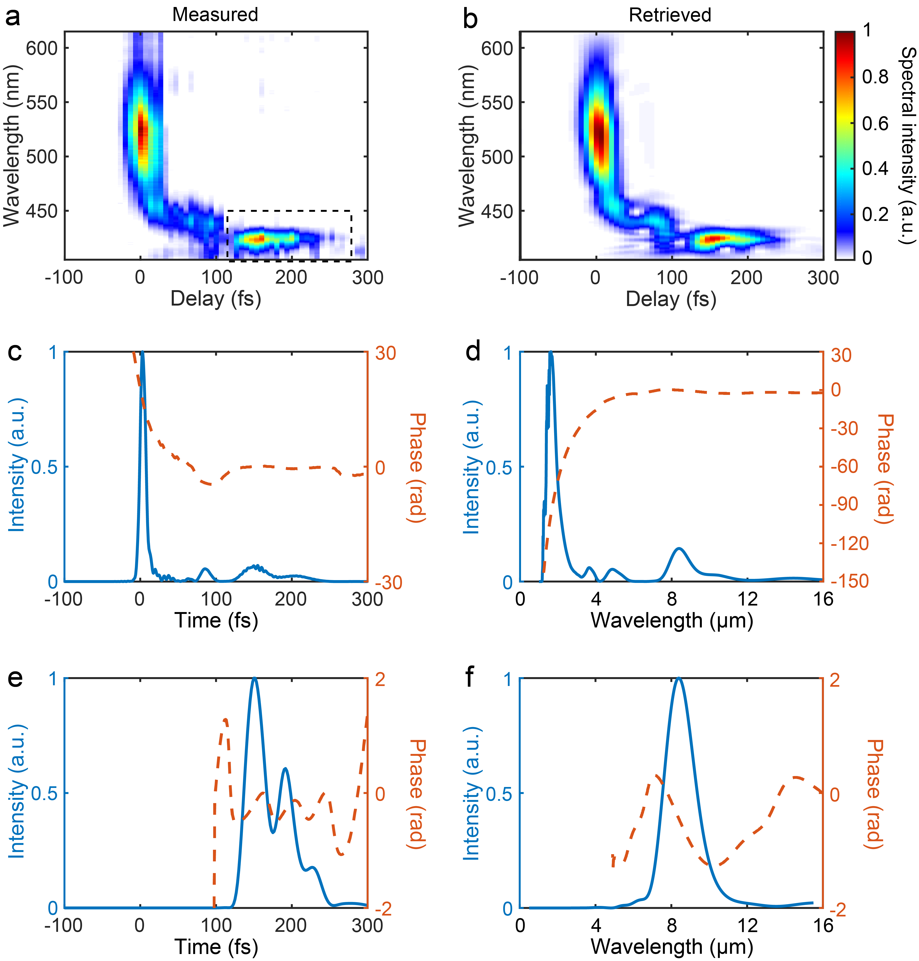
Wavelength tunability
Driver energy (mJ) | 385 | 490 | 721 | 576 | 853
Central wavelength (μm) | 3.2 | 4.2 | 8.3 | 9.4 | 20.0
IR pulse duration (fs) | 9.0 | 29.0 | 61.6 | 32.0 | 77.4
IR energy (mJ) | 3.5 (2.7~7μm) | 5.0 (3~9μm) | 8.2 (5.3~16μm) | 3.4 (6~20μm) | 5.7 (13~40μm)
IR a₀ | 1.01 | 0.88 | 1.54 | 1.53 | 2.75
721
8.3
61.6
8.2 (5.3~16μm)
1.54
61.6fs
8.3μm

Slide 24
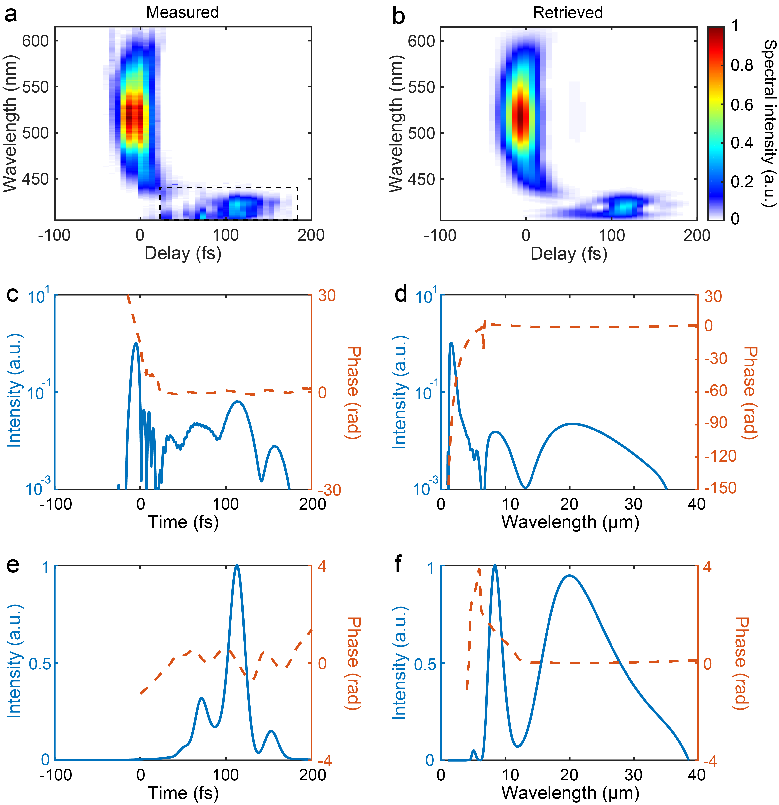
Wavelength tunability
Driver energy (mJ) | 385 | 490 | 721 | 576 | 853
Central wavelength (μm) | 3.2 | 4.2 | 8.3 | 9.4 | 20.0
IR pulse duration (fs) | 9.0 | 29.0 | 61.6 | 32.0 | 77.4
IR energy (mJ) | 3.5 (2.7~7μm) | 5.0 (3~9μm) | 8.2 (5.3~16μm) | 3.4 (6~20μm) | 5.7 (13~40μm)
IR a₀ | 1.01 | 0.88 | 1.54 | 1.53 | 2.75
853
20.0
77.4
5.7 (13~40μm)
2.75
77.4fs
20μm

Slide 25
Summary
A novel scheme of generating relativistic single-cycle long-wavelength IR pulses by density-tailored plasma structures has been proposed.
We demonstrate relativistic, single-cycle IR pulses tunable in the spectral range of 3-19 μm can be generated from a tailored plasma structure using an 810 nm drive laser.
This new IR sources based on nonlinear plasma wakes opens up a new area of relativistic plasma physics and brings new opportunities for strong-field physics and impulse IR spectroscopy.
Thank you for your attention!

