Slide 1
Optimal beam loading in a nanocoulomb-class laser wakefield acceleration
Jurjen P. Couperus Cabadağ
Institute of Radiation Physics, Helmholtz-Zentrum Dresden - Rossendorf, Germany
LPAW, May 2019, Split, Croatia

Slide 2
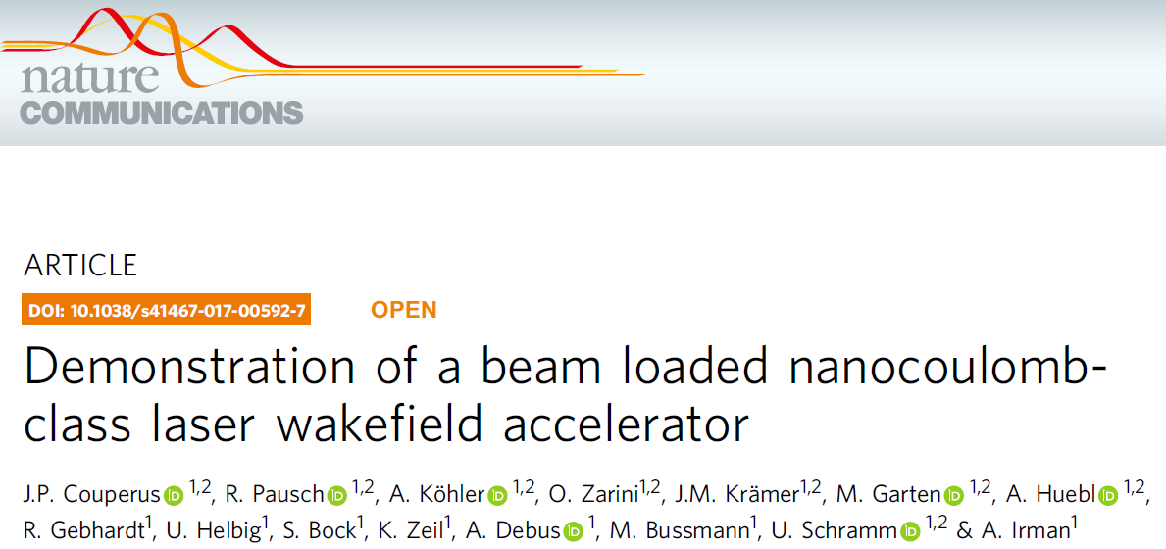
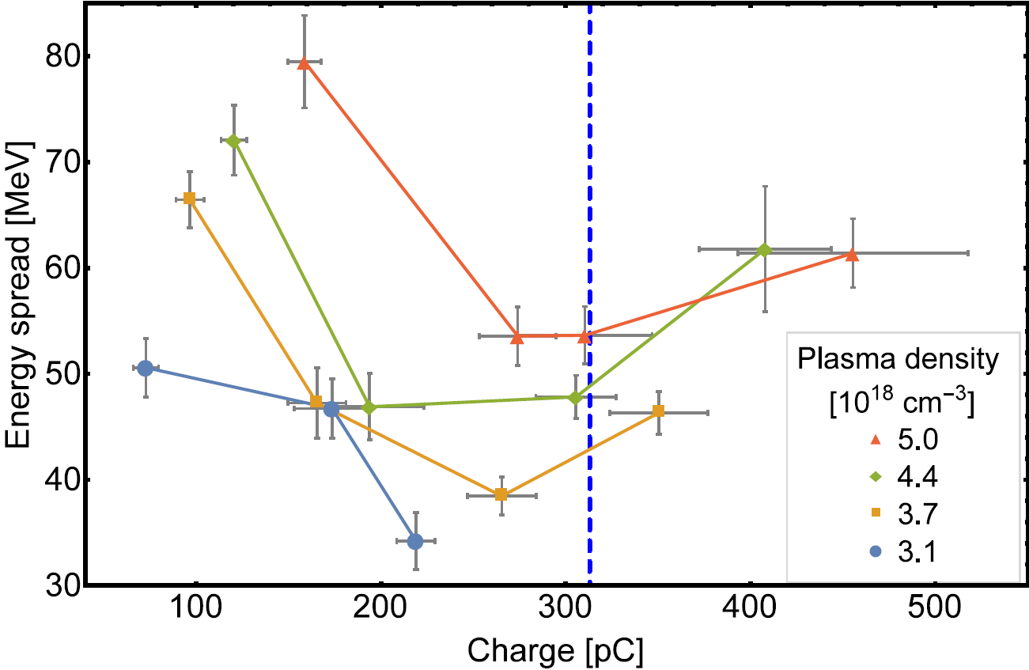
Reduce energy spread by beam loading
Beam loading
Injection of quasi mono-energetic bunches up to 0.5 nC charge (within FWHM)
Increasing charge
→ energy decrease
→ energy spread decrease

Slide 3
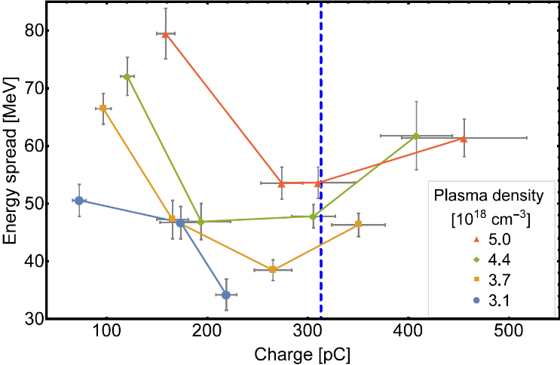
Controlled beam loading
Tailoring of Self-truncated ionization injection
Minimization of energy spread
Reduction of normalized divergence
Small energy spread by beam loading limits betatron phase mixing
Bunch measurements using optical transition radiation
Peak currents of >10 kA
A hybrid laser- to beam-driven plasma accelerator (L|PWFA)
Toward high-brightness PWFA beams in a laserlab
First proof-of-principle results from the hybrid collaboration

Slide 4
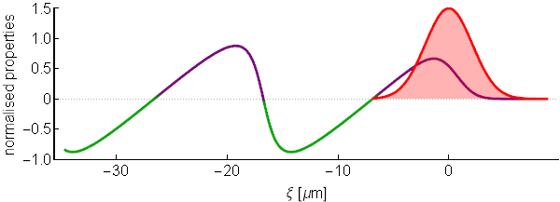
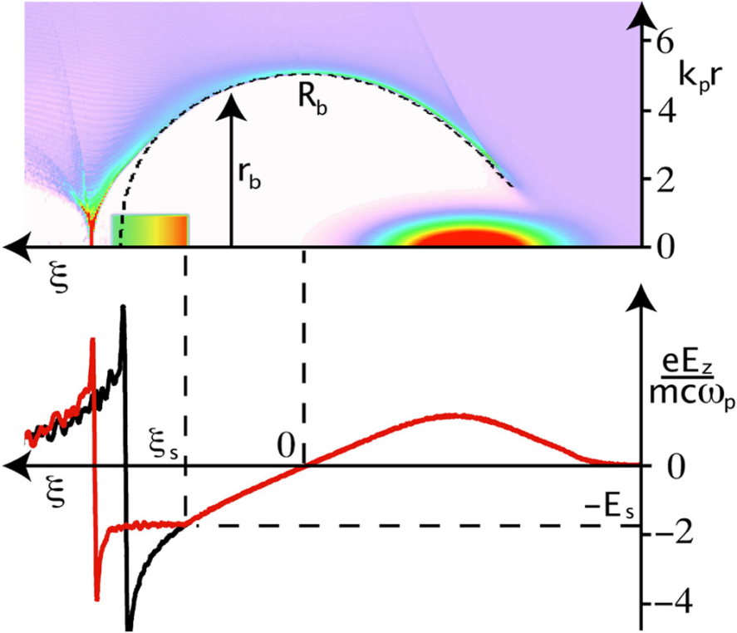
High charge induces beam loading
Self-fields of bunch reshape the accelerating wakefield
one can use this for accelerating field flattening:
→ Injection of an optimum bunch shape with a specific charge Q_{s}
Charge scaling at the optimum loading condition for non-linear bubble regime:
Laser driven
acc. field
+
Requires ~0.3 nC of injected charge at 65 TW laser power
e⁻ beam self field
=
Tzoufras et al.,
PRL 101, 145002 (2008)
Beam loading
Optimum beam loading
Accelerating gradient constant along the bunch
No extra addition of energy spread
Rechatin et al., PRL 103, (2009)
Guillaume et al., PRSTAB 18 (2015)
Vafaei-Najafabadi et al., PRL, 112, (2014)
S. van der Meer, CLIC note No. 3 (1985)
Katsouleas et al., Part. Acc. 22 (1987)

Slide 5
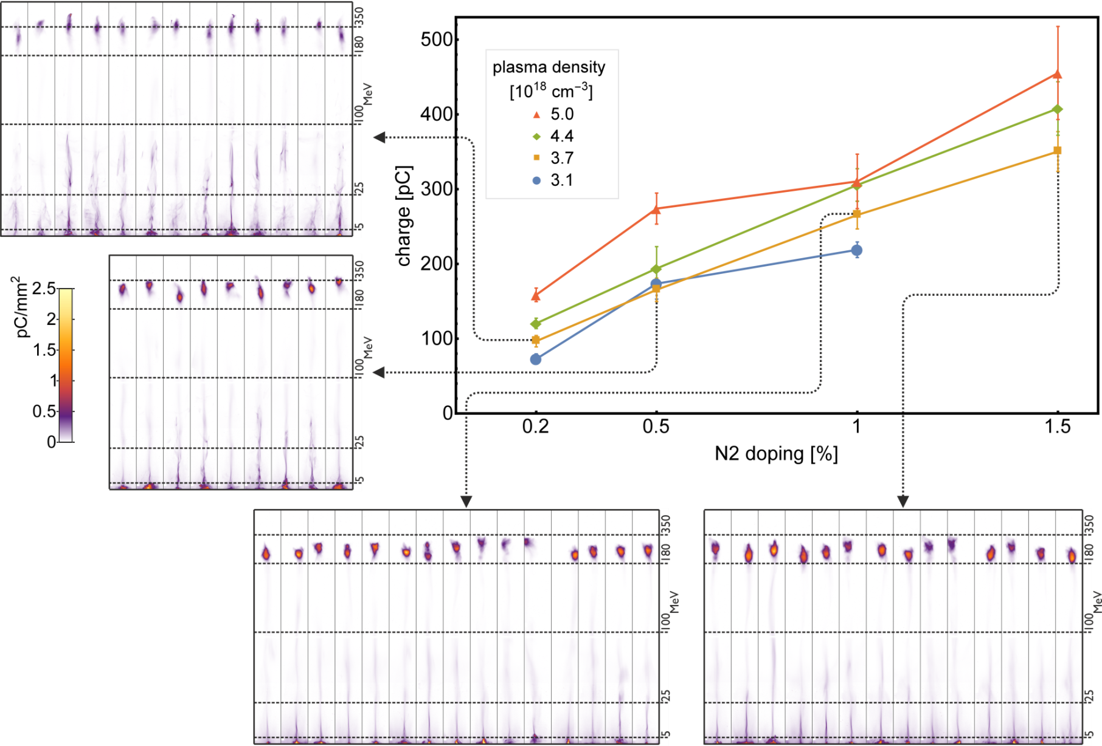
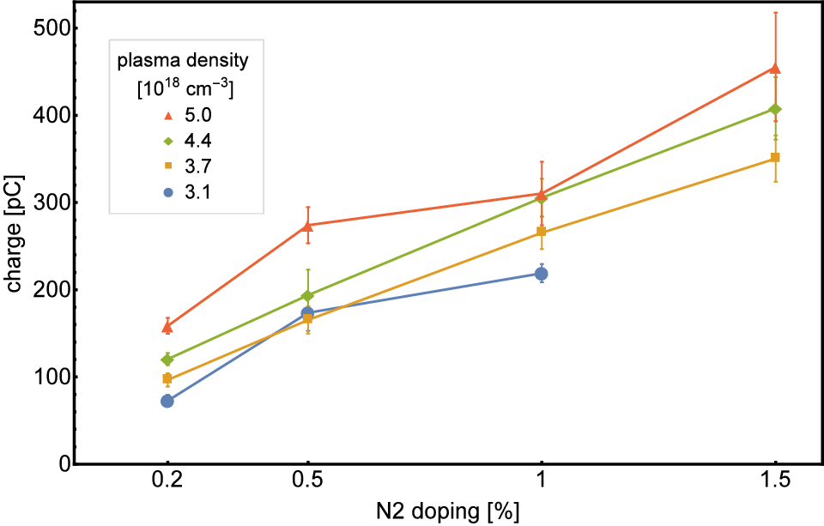
Controlled injection of high charge
Controlled injection using self-truncated ionization injection (STII)¹ of large loads the wakefield
Injected charge can be tuned by concentration of high-z dopant gas
(0.1 up to 0.5 nC
in FWHM)
Systematic study: each data point is acquired by averaging up to 20 shots
Charge is increased by increasing nitrogen doping
Keep laser parameters constant
→ Injection volume phase-space constant
A. Irman, J.P. Couperus et al., Plasma Phys. Control. Fusion 60, 044015 (2018)
¹Zeng et al. Phys. Plasmas 21, 030701 (2014), Mirzaie et al. Sci. Rep. 5, 14659 (2015), Pak et al., PRL 104, 025003 (2010)

Slide 6
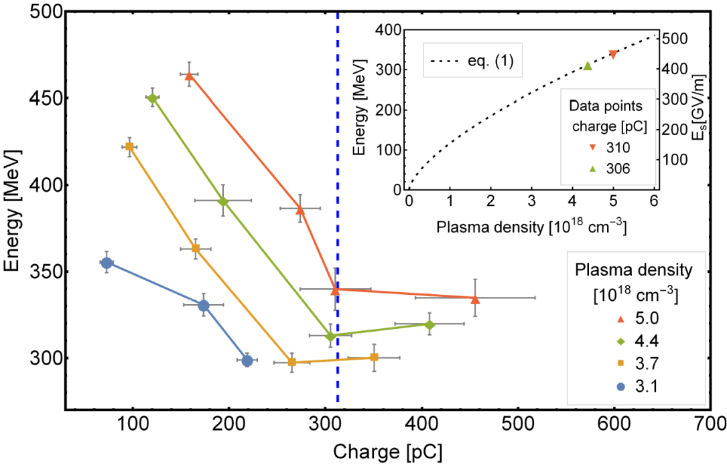
Optimal beam loading: minimizing energy spread
Controlled injection using self-truncated ionization injection (STII) of a large charge (0.1 up to 0.5 nC in FWHM) loads the wakefield.
Stable and reliable operation
Allows for systematic studies
Maximum electron energy
FWHM energy spread
0.2%
Theoretical prediction Tzoufras et al.
0.5%
1%
1.5%
Optimal beam loading: At increased charge a minimum of energy spread occurs.
Here the acceleration process no longer increases energy spread.
The remaining energy spread originates from the injection process.
To minimise energy spread at high peak current in a
plasma accelerator, the charge has to be increased for optimal beam loading
J.P. Couperus et al. Nat. Commun. 8, 487 (2017)

Slide 7
Controlled beam loading
Tailoring of Self-truncated ionization injection
Minimization of energy spread
Reduction of normalized divergence
Small energy spread by beam loading limits betatron phase mixing
Bunch measurements using optical transition radiation
Peak currents of >10 kA
A hybrid laser- to beam-driven plasma accelerator (L|PWFA)
Toward high-brightness PWFA beams in a laserlab
First proof-of-principle results from the hybrid collaboration

Slide 8
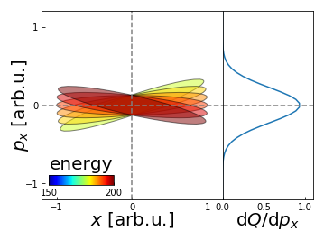
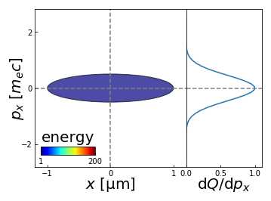
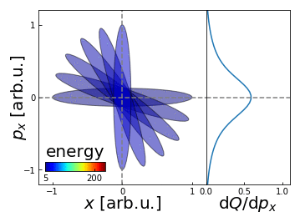
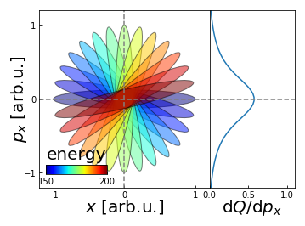
Beam decoherence affecting normalized beam divergence
A. Köhler et al., arXiv:1905.02240 (2019)
Small energy spread
→Small divergence
Bunch electrons with different energies orbit with a different frequency
betatron phase mixing
beam decoherence
$$ω_{β}=\frac{ω_{p}}{\sqrt{2γ(t)}}$$
Large energy spread
→ Large divergence

Slide 9
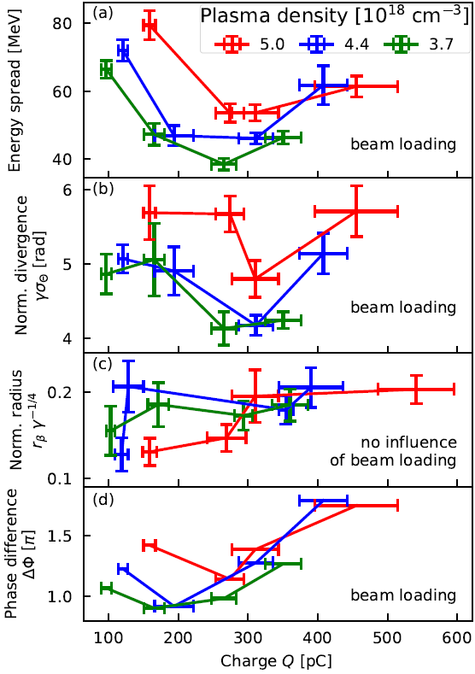
Betatron phase-mixing; minimizing norm. divergence
A. Köhler et al., arXiv:1905.02240 (2019)
Injection of high charge leads to beam loading and a minimum energy spread
Minimum of normalize divergence
Source size stays constant (extracted from betatron x-ray spectroscopy)
Lowering energy spread limits betatron phase mixing, thus leading to a reduced beam divergence.

Slide 10
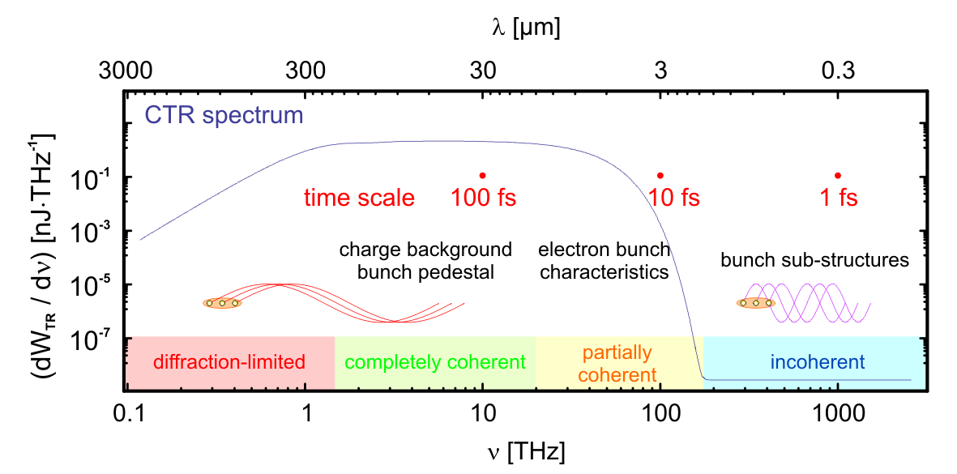
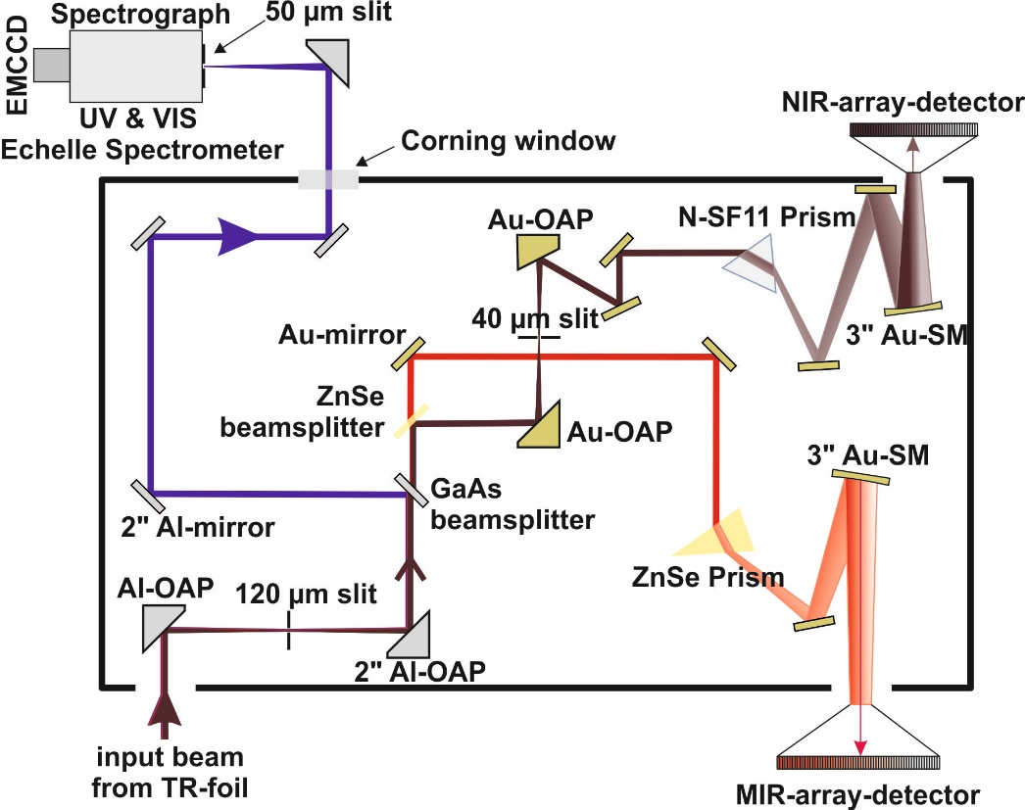
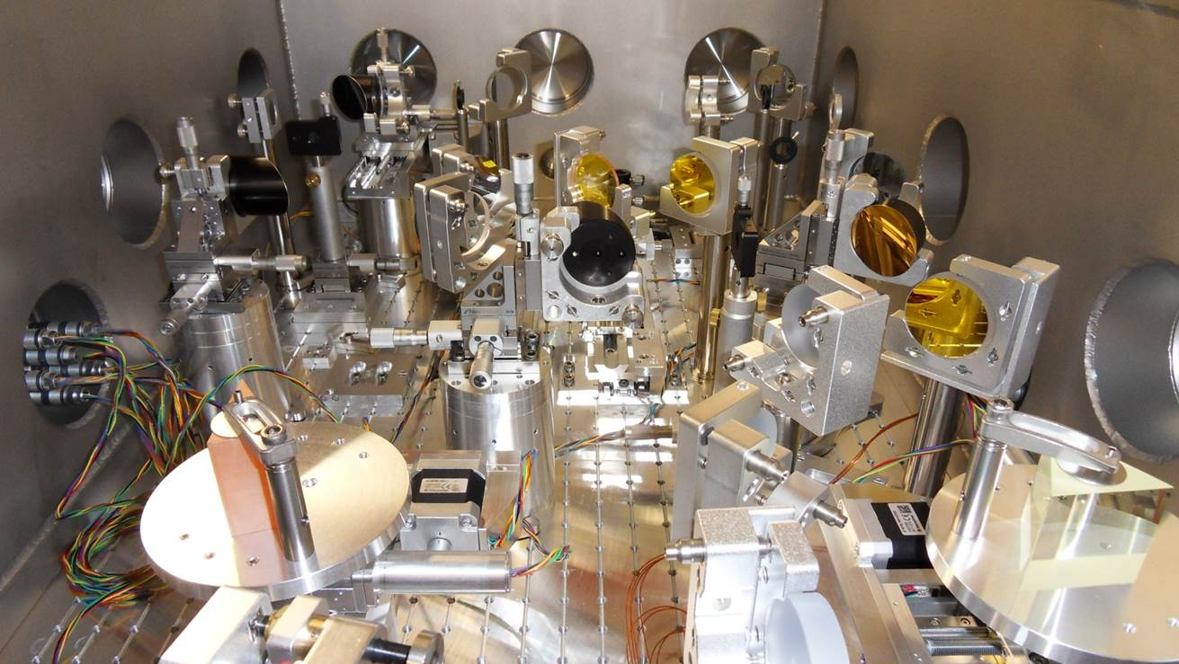
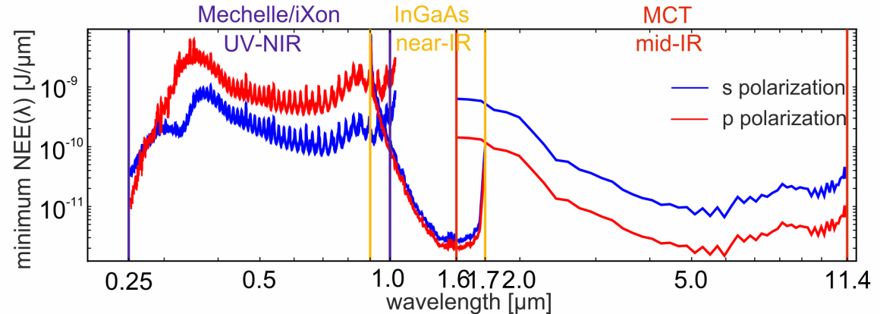
CTR spectrometer technique to measure bunch durations
O. Zarini, A. Debus et al., in preparation
Large charge + short bunch duration → high current
CTR input
250-900 nm
1600-12000 nm
Sim: 200 MeV, 20pC,
10 fs bunch length, 20 µm dia
900-1600 nm
Detection threshold curve
single-shot capability
5.5 octaves frequency range
absolutely and relatively calibrated
detection limit ~ 50 fJ
time resolution ~ 0.4 fs
Was presented in more detail last Monday by Alexander Debus
O. Lundh et al., Nat. Phys. 7, 219–222 (2011), S.L. Bajlekov et al., PRSTAB 16, 040701 (2013), T. Maxwell et al., PRL. 111, 184801 (2013)
M. Heigoldt et al., PRSTAB 18 121302 (2015), B. Schmidt et al., arXiv:1803.00608 (2018), O. Zarini et al., IEEE AAC (2018)

Slide 11
Injection: Pulse duration
CTR spectrometer technique to measure bunch durations
O. Zarini, A. Debus et al., in preparation
Self Truncated Ionization injection
Q_peak = 250 pC
dE = 40 MeV (15%)
Wave-breaking
Q_peak = 50 pC
dE = 10 MeV (5%)
Was presented in more detail last Monday by Alexander Debus
O. Lundh et al., Nat. Phys. 7, 219–222 (2011), S.L. Bajlekov et al., PRSTAB 16, 040701 (2013), T. Maxwell et al., PRL. 111, 184801 (2013)
M. Heigoldt et al., PRSTAB 18 121302 (2015), B. Schmidt et al., arXiv:1803.00608 (2018), O. Zarini et al., IEEE AAC (2018)

Slide 12
Controlled beam loading
Tailoring of Self-truncated ionization injection
Minimization of energy spread
Reduction of normalized divergence
Small energy spread by beam loading limits betatron phase mixing
Bunch measurements using optical transition radiation
Peak currents of >10 kA
A hybrid laser- to beam-driven plasma accelerator (L|PWFA)
Toward high-brightness PWFA beams in a laserlab
First proof-of-principle results from the hybrid collaboration

Slide 13
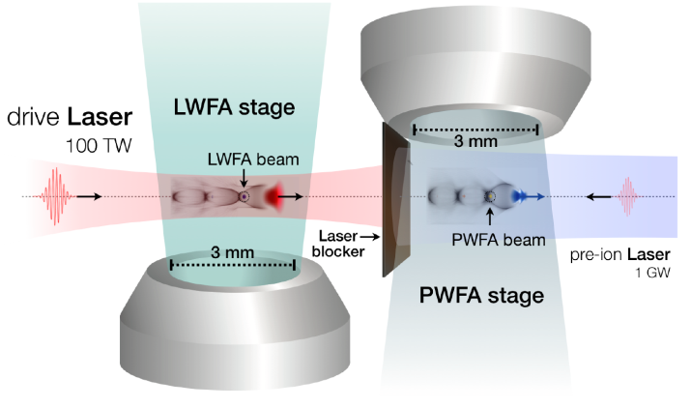
A hybrid scheme:
Using a LWFA driver to accelerate a PWFA witness (L|PWFA)
LWFA stage:
Serves as PWFA driver
PWFA stage:
High current required (>few kA)
Dephasing-free acceleration
Can serve as an energy and quality booster
Hidding, B. et al., Phys. Rev. Lett. 104, 195002 (2010)
Couperus, J. P. et al., Nat. Commun. 8, 487 (2017)
Zarini, O. et al., (in preparation)
Irman, A. et al.,PPCF 60, 044015 (2018)
Martinez de la Ossa, A. et al.,
Phil. Trans. R. Soc. A. (accepted) (2019)
A. Irman et al.
A. Martinez de la Ossa et al.
S. Karsch et al.
S. Corde
et al.
B. Hidding
et al.

Slide 14
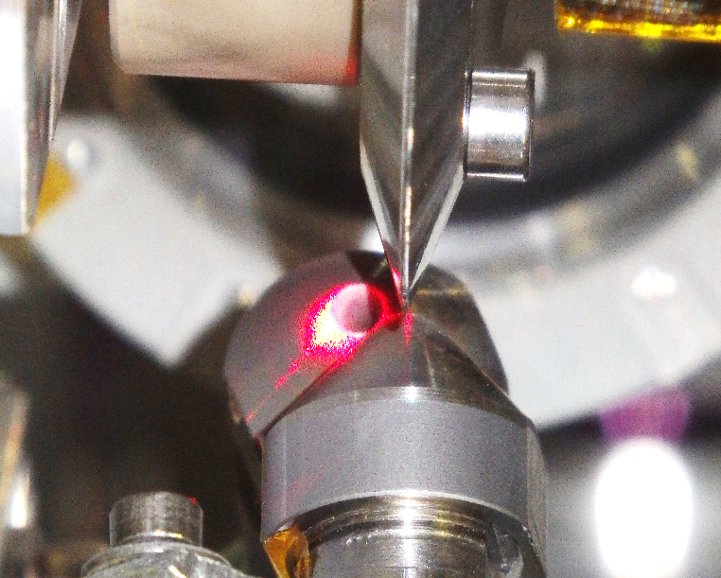
A hybrid scheme:
Using a LWFA driver to accelerate a PWFA witness (L|PWFA)
Blocker
foil
LWFA driver
laser
Pre-ionizer
LWFA
stage
PWFA
stage
6 mm
~10 kA electron driver from LWFA
→ A laser-laboratory scale beam driven accelerator
Proof-of-principle experiment: Not optimized injection scheme
Next steps:
Controlled injection injection of high-quality witness beams
Energy booster

Slide 15
Proof-of-principle demonstration
Driver
reference
Clear driver ←→ gas/plasma interaction
Loss of charge
Reduction of spectral brightness
Ionization trace & weak wakefield visible
Self-ionizing
Stronger driver ←→ plasma interaction
Increased energy spread
Further reduction of spectral brightness
Strong wakefield visible
Clear acceleration of witness beam (~70 GV/m)
Pre-ionized

Slide 16
Proof-of-principle demonstration
Driver
reference
 | LWFA reference | PWFA Self-ionization | PWFA pre-ionised
Q_{FWHM} [pC]
ΔE [MeV]
E_{mean} [MeV]
S_{Δ} [pC/%]
Self-ionizing
Pre-ionized
Clear acceleration of witness beam (~70 GV/m)

Slide 17
Conclusion
Operation of a nano-coulomb class laser plasma accelerator
A tailored STII scheme:
→ very robust, good shot-to-shot stability
→ control of the injected charge (up to 0.5 nC in FWHM)
Optimization of beam loading
Minimizing energy spread
Verifying predicted optimal loading condition by Tzoufras et al.
Minimization of normalized beam divergence
Small energy spread limits betatron phase mixing
Pulse length measurements using optical transition radiation
Peak currents >10 kA
Few-fs probing of wakefields
Laser- and beam-driven
Proof-of principle demonstration of witness bunch energy gain in a hybrid laser- to beam-driven wakefield accelerator (L|PWFA)

Slide 18
HZDR, team electrons:
Arie Irman
Ulrich Schramm
Alexander Köhler
Omid Zarini
Vincent Chang
Thomas Kurz
Susanne Schöbel
Many thanks to:
Thank you for your attention!
Hybrid collaboration:
Alberto Martinez de la Ossa
Sebastian Corde
Stefan Karsch
Bernard Hidding
Thomas Heinemann
Olena Kononenko
Hao Ding
Andreas Döpp
Max Gilljohann
Gaurav Raj
Johannes Götzfried
Moritz Förster
HZDR, theory team:
Richard Pausch
Alexander Debus
Michael Bussmann
Marco Garten
Axel Huebl
Klaus Steiniger
René Widera
University of Texas
at Austin
Michael Downer
Raphael Zgadzaj
Maxwell LaBerge
Andrea Hannasch
Brant Bowers
HZDR:
Thomas Cowan
Karl Zeil
Stefan Bock
Uwe Helbig
René Gebhardt
Thomas Püschel
Simon Grams
Christoph Eisenmann
And many others…

