Slide 1
Beam quality optimization in a beam loaded nanocoulomb-class laser wakefield accelerator
Jurjen P. Couperus Cabadağ¹
A. Köhler^{1,2}, O. Zarini^{1,2}, R. Pausch^{1,2}, A. Debus¹, Y.Y. Chang¹, T. Kurz^{1,2}, S. Schöbel^{1,2}, M. Bussmann¹, U. Schramm^{1,2} & A. Irman¹
¹Institute of Radiation Physics, Helmholtz-Zentrum Dresden - Rossendorf, Germany
² Technische Universität Dresden, Germany
LPAW, May 2019, Split, Croatia

Slide 2
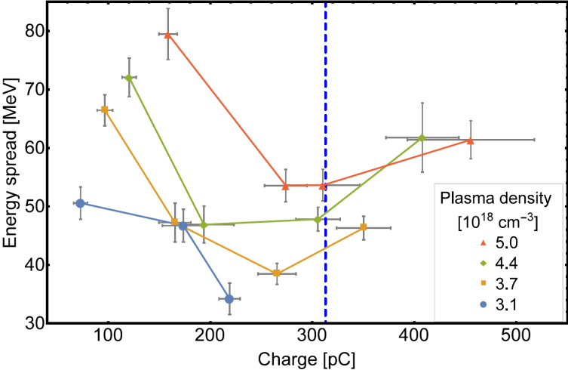
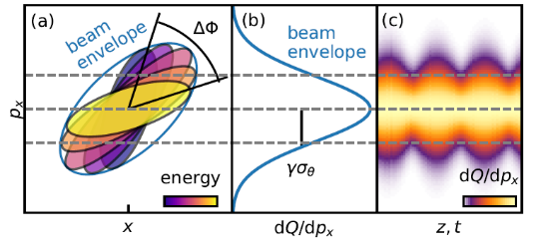
In this talk
Energy spread
Using beam loading to minimize energy spread
Increasing charge:
→ energy decrease
→ energy spread minimization
J.P. Couperus et al. Nat. Commun. 8, 487 (2017)
Normalized divergence
Peak current
small energy spread limits betatron phase-mixing
Single-shot diagnostic of >10 kA peak current bunches
A. Köhler et al., arXiv:1905.02240 (2019)
O. Zarini, A. Debus et al., in preparation

Slide 3
In this talk
Energy spread
Using beam loading to minimize energy spread
Increasing charge:
→ energy decrease
→ energy spread minimization
See talk Friday
J.P. Couperus et al. Nat. Commun. 8, 487 (2017)
Normalized divergence
Peak current
small energy spread limits betatron phase-mixing
Single-shot diagnostic of >10 kA peak current bunches
A. Köhler et al., arXiv:1905.02240 (2019)
O. Zarini, A. Debus et al., in preparation

Slide 4
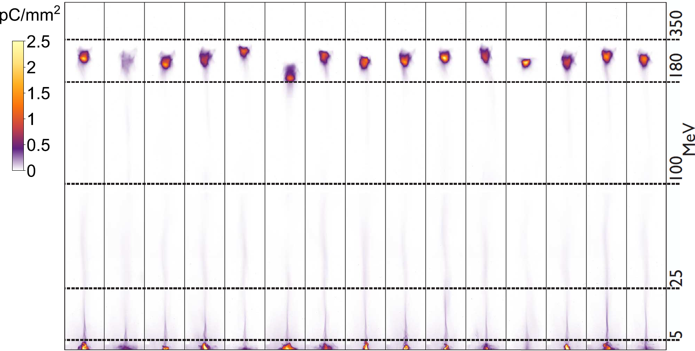
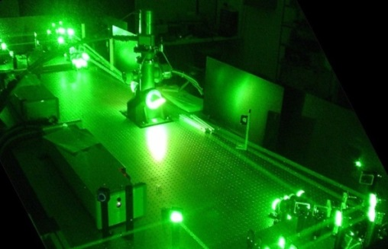
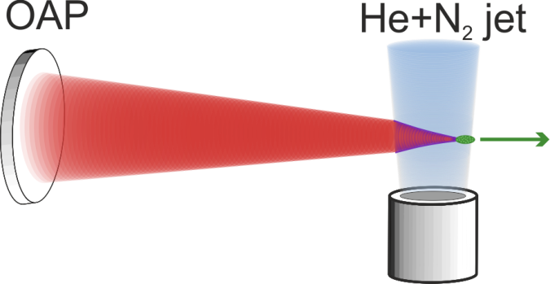
Stable operation with high charge
consecutive shots
Ti:Sa Laser DRACO
λ₀ = 800 nm
up to 4 J on target
27 fs pulse width (FWHM)
Strehl-ratio > 0.9
20 μm FWHM
Parameters | Mean ± Shot-to-shot jitter
Mean peak energy | 250 MeV ± 22.5 MeV
Charge in fwhm | 220 pC ± 40 pC
Abs. energy width | 36 MeV ± 11 MeV
Divergence | 7 mrad ± 1 mrad
2.5 J, 30 fs, plasma density 3.1x10¹⁸ cm⁻³ , mixed He + 1% N₂ , 3 mm gas jet
A. Irman, J.P. Couperus et al., Plasma Phys. Control. Fusion 60, 044015 (2018)

Slide 5
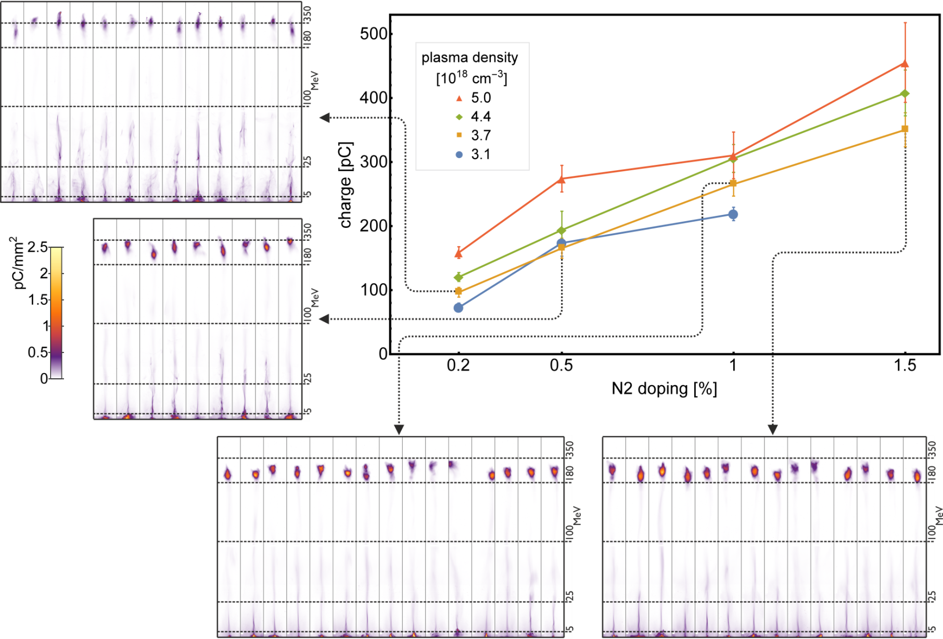
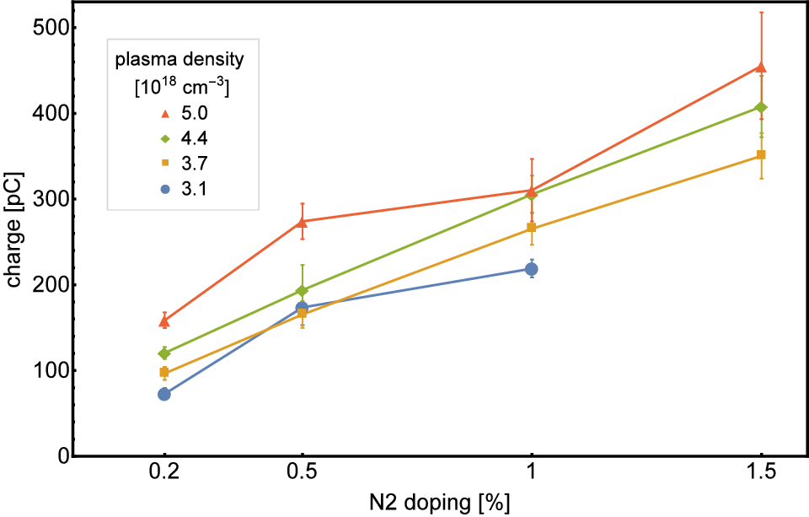
Controlled injection of high charge
Controlled injection using self-truncated ionization injection (STII)¹ of large loads the wakefield
Injected charge can be tuned by concentration of high-z dopant gas
(0.1 up to 0.5 nC
in FWHM)
Systematic study: each data point is acquired by averaging up to 20 shots
Charge is increased by increasing nitrogen doping
Keep laser parameters constant
→ Injection volume phase-space constant
A. Irman, J.P. Couperus et al., Plasma Phys. Control. Fusion 60, 044015 (2018)
¹Zeng et al. Phys. Plasmas 21, 030701 (2014), Mirzaie et al. Sci. Rep. 5, 14659 (2015), Pak et al., PRL 104, 025003 (2010)

Slide 6
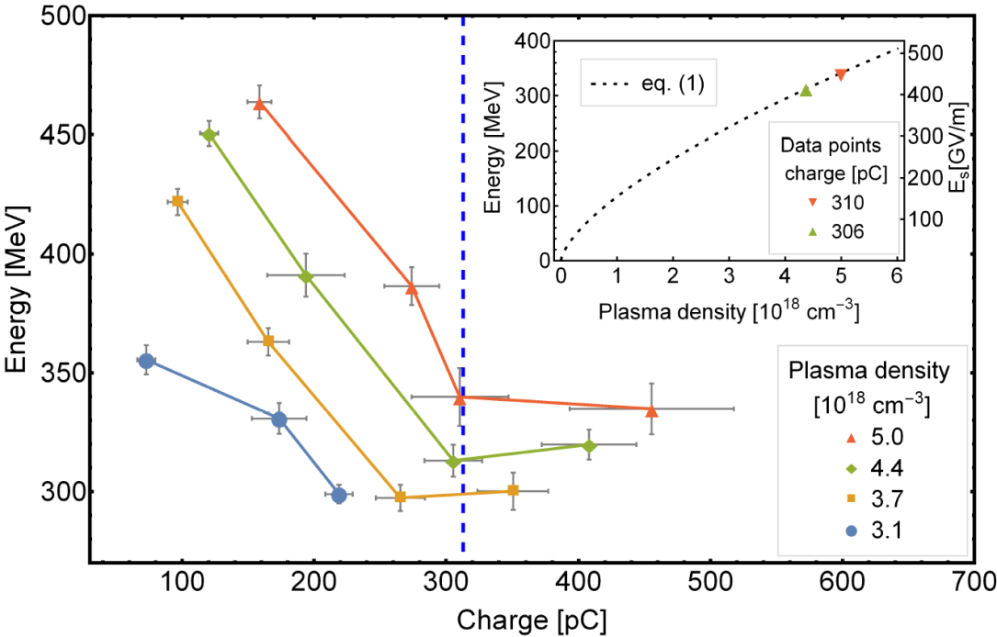
Optimal beam loading: minimizing energy spread
Controlled injection using self-truncated ionization injection (STII) of a large charge (0.1 up to 0.5 nC in FWHM) loads the wakefield.
Stable and reliable operation
Allows for systematic studies, e.g. beam loading, L|PWFA
Maximum electron energy
FWHM energy spread
0.2%
Theoretical prediction Tzoufras et al.
0.5%
1%
1.5%
J.P. Couperus et al. Nat. Commun. 8, 487 (2017)

Slide 7
Measuring the peak current
CTR spectrometer technique to measure bunch durations
O. Zarini, A. Debus et al., in preparation
Large charge + short bunch duration → high current
Coherent Transition Radiation (CTR) spectrometer for
bunch length measurements
time resolution ~ 0.4 fs
single-shot capability
5.5 octaves frequency range
absolutely and relatively calibrated
detection limit ~ 50 fJ
Self Truncated Ionization injection
Q_peak = 250 pC
dE = 40 MeV (15%)
Was presented in more detail last Monday by Alexander Debus
O. Lundh et al., Nat. Phys. 7, 219–222 (2011), S.L. Bajlekov et al., PRSTAB 16, 040701 (2013), T. Maxwell et al., PRL. 111, 184801 (2013)
M. Heigoldt et al., PRSTAB 18 121302 (2015), B. Schmidt et al., arXiv:1803.00608 (2018), O. Zarini et al., IEEE AAC (2018)

Slide 8
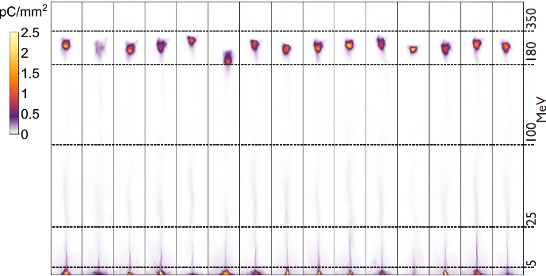
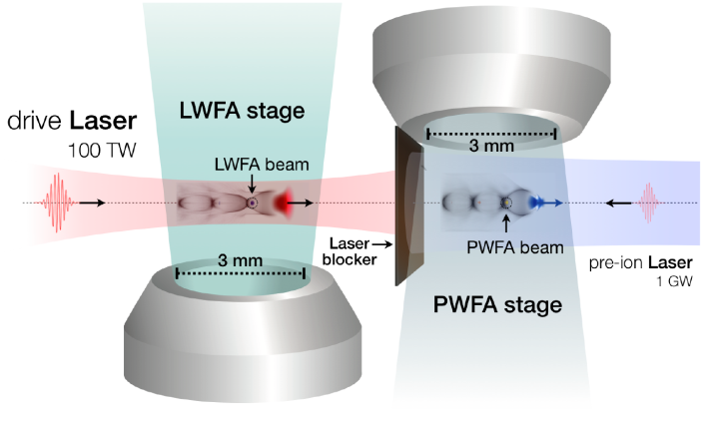
Conclusion
Operation of a nano-coulomb class laser plasma accelerator
A tailored STII scheme:
→ very robust, good shot-to-shot stability
→ control of the injected charge
(0.1 – 0.5 nC in FWHM)
Pulse length measurements using optical transition radiation
Peak currents >10 kA
Outlook
Thank you for your attention!
Experimental results: Next talk by T. Kurz
Front-to-end simulation: R. Pausch WG4
A hybrid laser- to beam-driven plasma accelerator
LWFA stage:
Serves as PWFA driver
high current required (>few kA)
PWFA stage:
dephasing-free acceleration
serves as an energy and quality booster

