Slide 1
Upgrading the Cosmic Ray Facility for Tests Regarding the Phase-II Upgrade of the ATLAS Muon Spectrometer
Florian Egli, 14.12.2022
Joint Particle Physics Group Seminar

Slide 2
Upgrading the Cosmic Ray Facility for Tests Regarding the Phase-II Upgrade of the ATLAS Muon Spectrometer
Florian Egli, 14.12.2022
Joint Particle Physics Group Seminar

Slide 3
High-Luminosity LHC
[7] https://hilumilhc.web.cern.ch/article/ls3-schedule-change

Slide 4
ATLAS Muon Spectrometer
[1] The ATLAS Collaboration, The ATLAS Experiment at the CERN Large Hadron Collider (2008)

Slide 5
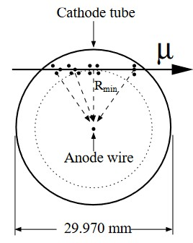
Monitored Drift Tubes
0 V
+3080 V
From [1]
[1] The ATLAS Collaboration, The ATLAS Experiment at the CERN Large Hadron Collider (2008)

Slide 6
Where Can We Test the Upgrade?

Slide 7
Cosmic Ray Facility

Slide 8
Cosmic Ray Facility
Why is it not used for Phase-II tests yet?
Outdated readout electronics (pre Phase-I)
Outdated infrastructure
➔ Incompatible Phase-II (and even Phase-I)
➔ First step: Upgrade the CRF to the Phase-I standard of the Muon Spectrometer

Slide 9
Upgrading the Cosmic Ray Facility for Tests Regarding the Phase-II Upgrade of the ATLAS Muon Spectrometer
Florian Egli, 14.12.2022
Joint Particle Physics Group Seminar

Slide 10
Upgrade the Electronics Install New Scintillators

Slide 11
Upgrade the Electronics Install New Scintillators

Slide 12
The CRF Electronics
Windows PC
Configuration
CAN-BUS
MDT-DCS
Jtag
CSM-Card
25MHz
Mezzanine Cards
(x 18)
Linux PC
GOLA/FILAR
Optical Fiber
Readout

Slide 13
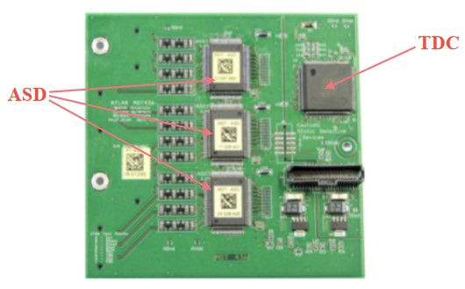
Mezzanine
Readout of the MDTs
[5] The ATLAS Collaboration, Technical Design Report for the Phase-II Upgrade of the ATLAS Muon Spectrometer(2017)

Slide 14
The CRF Electronics
Windows PC
Configuration
CAN-BUS
MDT-DCS
Jtag
CSM-Card
25MHz
Mezzanine Cards
(x 18)
Linux PC
GOLA/FILAR
Optical Fiber
Readout

Slide 15
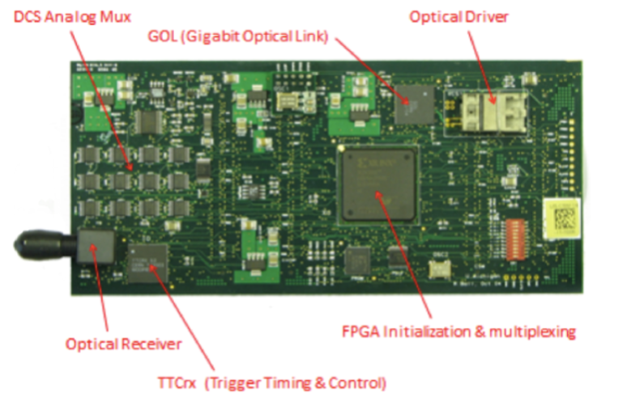
CSM
Chamber Service Module
DCS Analog Mux
Optical Driver
GOL (Gigabit Optical Link)
Optical Receiver
FPGA Initialization & multiplexing
TTCrx (Trigger Timing & Control)
[5] The ATLAS Collaboration, Technical Design Report for the Phase-II Upgrade of the ATLAS Muon Spectrometer(2017)

Slide 16
The CRF Electronics
Windows PC
Configuration
CAN-BUS
MDT-DCS
Jtag
CSM-Card
25MHz
Mezzanine Cards
(x 18)
Linux PC
GOLA/FILAR
Optical Fiber
Readout

Slide 17
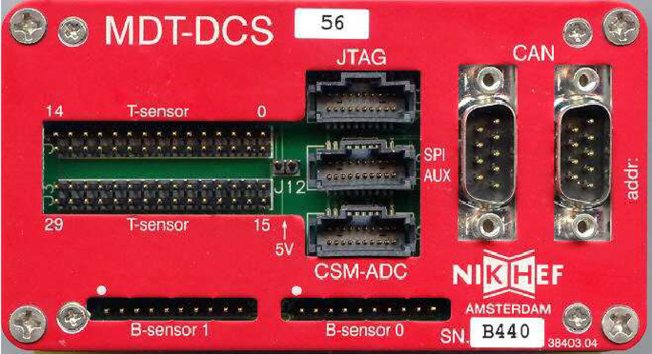
MDT-DCS
DCS: Detector Control System
[3] Y. Arai et al., ATLAS Muon Drift Tube Electronics (2008)

Slide 18
The CRF Electronics
Windows PC
Configuration
CAN-BUS
MDT-DCS
Jtag
CSM-Card
25MHz
Mezzanine Cards
(x 18)
Linux PC
GOLA/FILAR
Optical Fiber
Readout

Slide 19
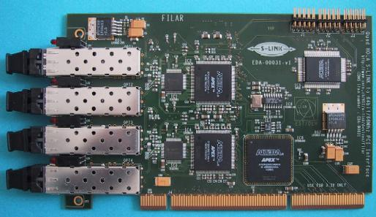
FILAR
Four Input Links for Atlas Readout
Interface between PC and Optical Link
[6] https://hsi.web.cern.ch/s-link/devices/filar/welcome.html

Slide 20
FELIX
Front-End LInk eXchange
Trigger and Data Acquisition (TDAQ) system
Installed in ATLAS during Phase-I Upgrade
Scalable, detector agnostic and easily upgradable
Compatible to Phase-II Electronics

Slide 21
FELIX
[4] FELIX User Manual (Version: 4.2.4)

Slide 22
Upgrade of the CRF Electronics
Windows PC
Configuration
CAN-BUS
MDT-DCS
Jtag
CSM-Card
25MHz
Mezzanine Cards
(x 18)
50 MHz
Linux PC
GOLA/FILAR
Optical Fiber
FELIX
Readout

Slide 23
The CRF Electronics (Phase-I)
Configuration
CAN-BUS
MDT-DCS
Jtag
Linux PC
CSM-Card
50MHz
Mezzanine Cards
(x 18)
FELIX
Optical Fiber
Readout

Slide 24
Validation and Verification of the CRF Upgrade
So far installed in a small test setup
How do I validate that I setup the system correctly?
Step 1: Does it produce data? ✓
Step 2: Does the data make sense?

Slide 25
Step 2.1: Untangle the Data

Slide 26
FELIX Dataformat
[4] FELIX User Manual (Version: 4.2.4)

Slide 27
CSM Dataformat
[4] Y. Arai, AMT-3 User‘s Manual (2003)

Slide 28
Does the Data make sense?
Look at time between trigger and threshold crossing of MDT Signal
Signal Individual MDTs
[4] Y. Arai, AMT-3 User‘s Manual (2003)

Slide 29
Step 2.2: What should the data look like?

Slide 30
Garfield++
Garfield++ is a program designed to simulate electron drift and gas amplification
I translated an old Garfield script to the new Garfield++ standard
[1] The ATLAS Collaboration, The ATLAS Experiment at the CERN Large Hadron Collider (2008)

Slide 31
MDT Drifttime Spectra
Gas Mixture: Ar:CO2 (93:7)
Muons with fixed energy (90 GeV)
Sample $R_{min}$ from uniform distribution
Plot time difference between muon crossing and signal of MDT into histogram
[1] The ATLAS Collaboration, The ATLAS Experiment at the CERN Large Hadron Collider (2008)

Slide 32
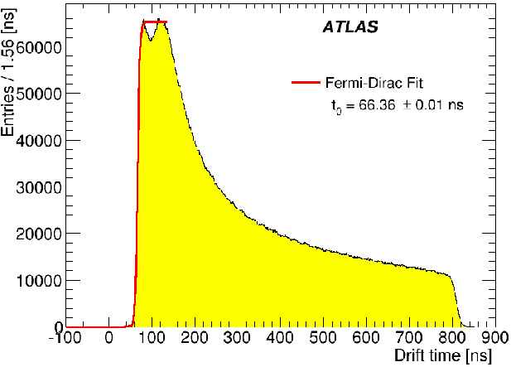
MDT Drifttime Spectra
[2] The ATLAS Collaboration, Resolution of the ATLAS muon spectrometer monitored drift tubes in LHC Run 2 (2019)

Slide 33
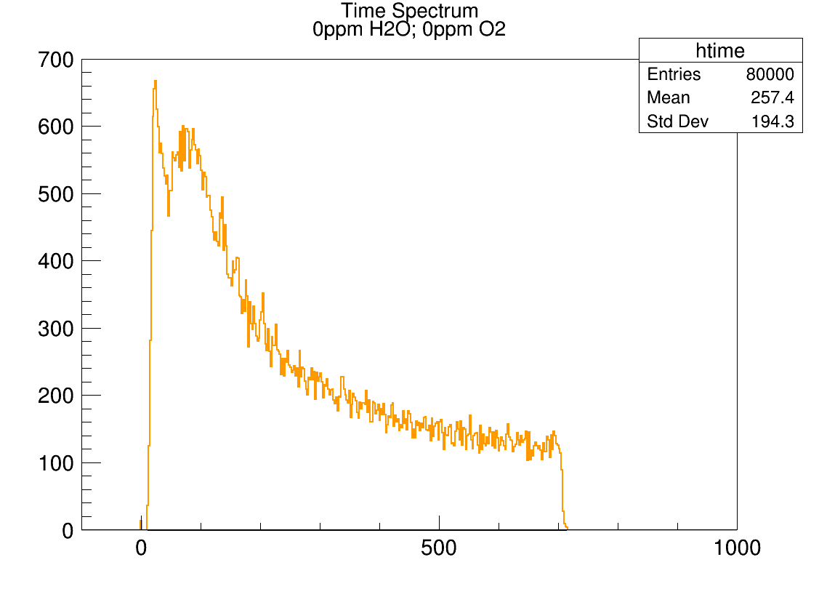
What does the data actually look like?

Slide 34
Outlook: Finish the setup of the FELIX system
Optimize configuration parameters of Mezzanines
Compare to Data from old setup
Merge FELIX Datastream with existing Datastream
Expand from Test Setup to a whole MDT-Chamber

Slide 35
Upgrade of Electronics Install New Scintillators

Slide 36
Cosmic Ray Facility

Slide 37
Install New Scintillators
All scintillators now are perpendicular to MDTs
Install new scintillators in parallel MDTs
➔ This will allow the implementation of a path-based trigger

Slide 38
Path-Based Trigger

Slide 39
Summary
Goal: Use CRF as testing site for tests of the Phase-II Upgrade
Problem: Readout Electronics and Infrastructure in the CRF are outdated
Current Project: Upgrade the CRF to Phase-I standard
Next Project: Install new Scintillators and Test Path-Based Trigger on the CRF

Slide 40
Backup

Slide 41
Gas Contents

Slide 42
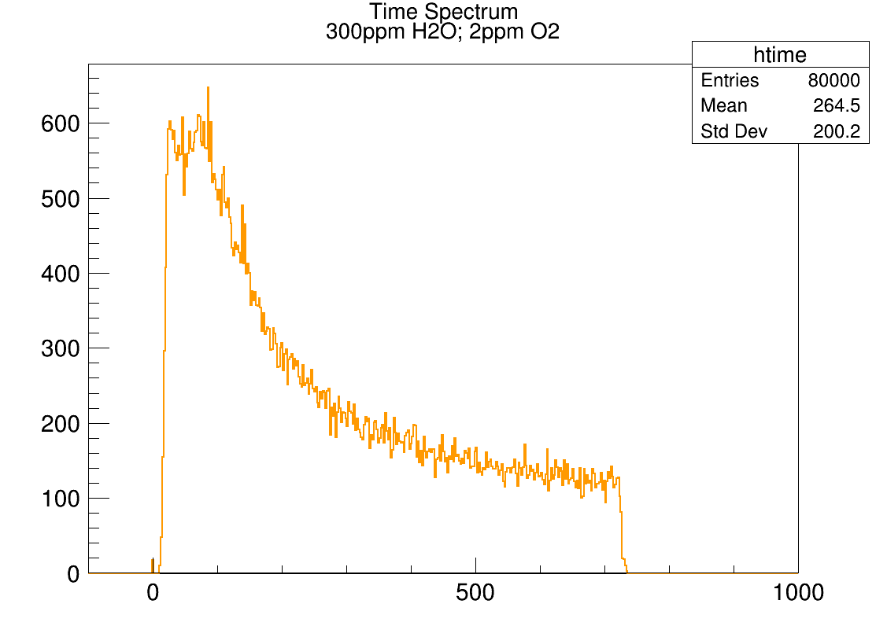
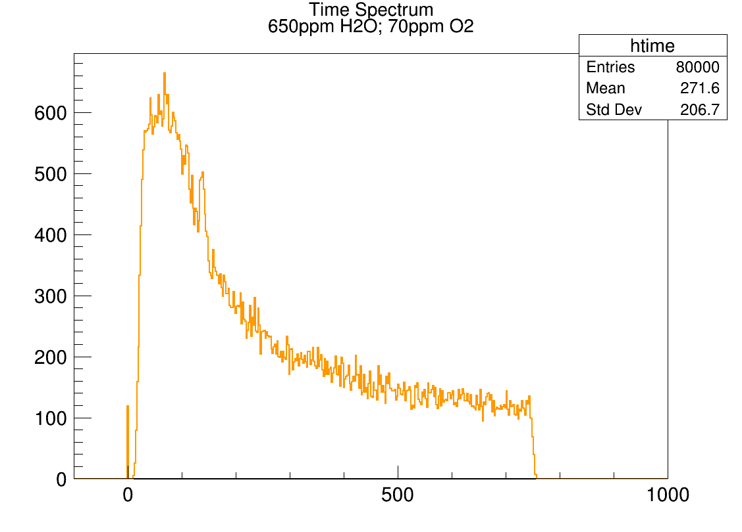
Gas Contents
Simulations with Water and Oxygen admixture in the Gas:

