Slide 1
The PAHN-PaN* Consortium
*Particle, Astroparticle, Hadron & Nuclear Physics Accelerate(s) the NFDI
A proposal for the NFDI
Thomas Schörner-Sadenius (DESY)
Karlsruhe, 30 September 2019

Slide 2
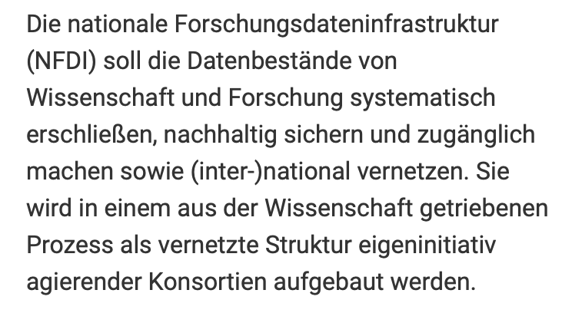
The NFDI
... And what happened so far, and budget
March 2019 Submission of extended abstract
4 Jul 2019 Submission of letter of intent
22 binding and 23 (3) non-binding letters submitted
30 Aug 2019 DFG governance workshop
15 Oct 2019 Deadline for proposal submission
5/6 Dec 2019: Evaluation
1 Oct 2020: Start of funding
Budget: Max grant sum 5 MEUR, including 22% overheads, corresponding to ~52 FTE / year.

Slide 3
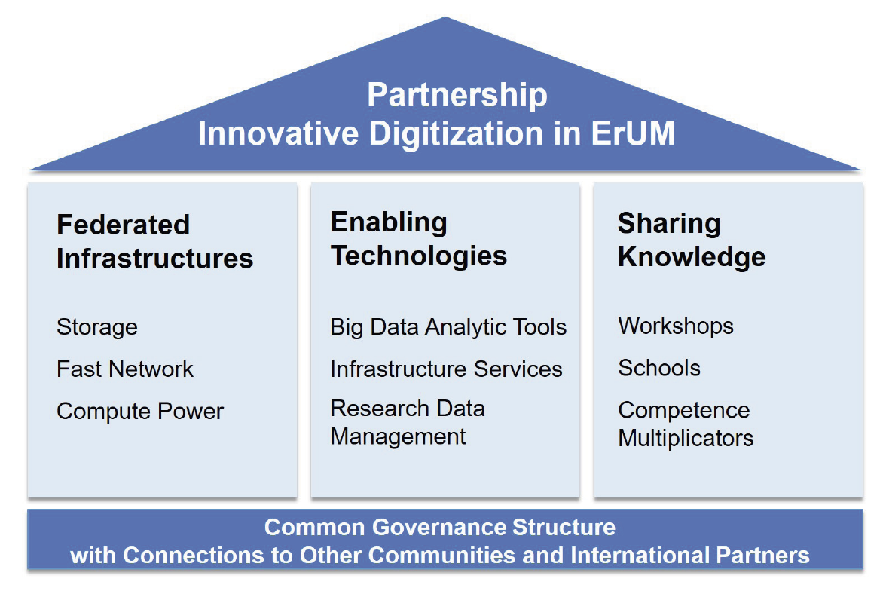
The NFDI
... and discrimination against ErUM-Data
Difficult, unfortunately.
One clear distinction:
NFDI focuses on the curation of scientific data across all disciplines.
Emphasis in NFDI is on the development and provision of data management infrastructures and services within and beyond the consortium.
However, significant overlap especially in the „Enabling Techologies“ part of the ErUM Partnership for Innovative Digitization.

Slide 4
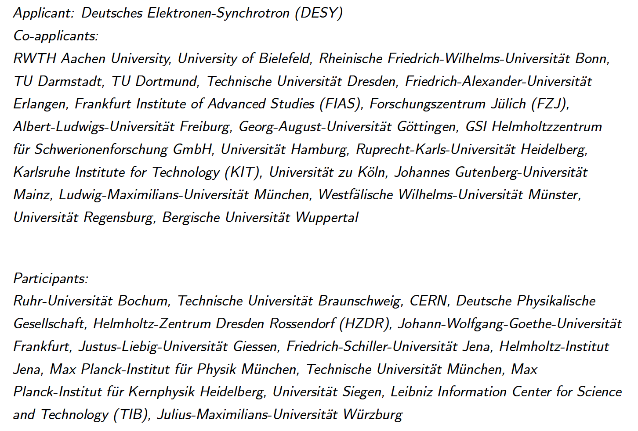
The PAHN-PaN Consortium

Slide 5
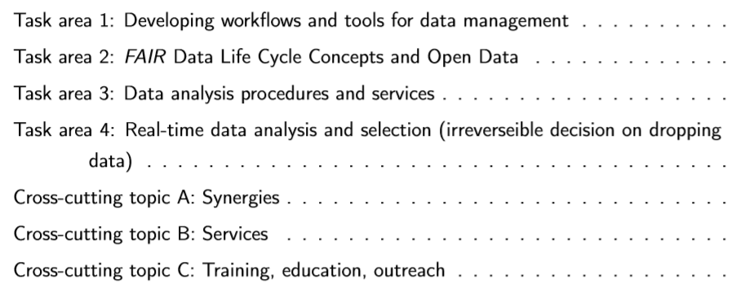
Task Areas
TA1 addresses developments and their technical integration for the PAHN-PaN consortium and the embedding of solutions in the international context. The required services and infrastructure will be developed towards industry standard to allow shared usage with other scientific disciplines, cost effective operations and maintainability.
And cross-cutting topics
The goal of TA2 is to develop and apply a concept of research data management for the entire field of PAHN research. Concept must meet broad requirements to be applicable to other fields of research. A demonstrator should generalize and combine the different developments in the various research areas of the consortium. In addition, the complete life cycle and each individual step of the handling of research data must be equally integrated.
The projects of TA3 maximise the scientific value of data by providing high-level services and tools for analysis. Procedures for interactive analysis and inference on large data sets are provided as well as numerical methods and hardware-specific optimisations. Based on these developments, automated machine learning services greatly simplify the training and deployment of deep learning. Finally, generic studies of systematic uncertainties, stability and visualisations of machine learning improve the usefulness of these new algorithms.
TA4 deals centrally with the question of how the necessary data reduction can be achieved in real-time with a minimum loss of physically relevant information. Also using prototyping and demonstrator setups for hardware-software-code design, special intelligent algorithms and methods for data quality assurance will be developed. The focus of these developments is on exemplary problem solutions that can be applied in the entire community.

Slide 6
Task Areas
And cross-cutting topics
One aim of the NFDI is to create synergies between different fields of science, and with task area ”Cross-cutting topic A: Synergies” we will contribute to this effort by following up concrete and existing joint projects or ideas with other consortia, and by explicitly looking for new ideas to be exploited in the future.
Already now there are some services operated for and within the PAHN-PaN consortium. Sizable effort that is spent in this task areas is targeted at identifying, improving and delivering existing services, or developments towards new ones. The cross-cutting topic activity „Services“ identifies the needs for services in the consortium and beyond in order to foster the development of generic services that address broad spectrum of needs, ideally from multiple communities.
In the task area ”Cross-cutting topic C: Training, education, outreach”, a focus is placed on teaching young students and early- career researches in PAHN-PaN-relevant topics, mentor and advise them, and disseminate concepts, tools and results to the general public. Teaching material is provided for university education, and courses and hands-on masterclass are provided for high-schools in order to inspire them and to get them involved.

Slide 7
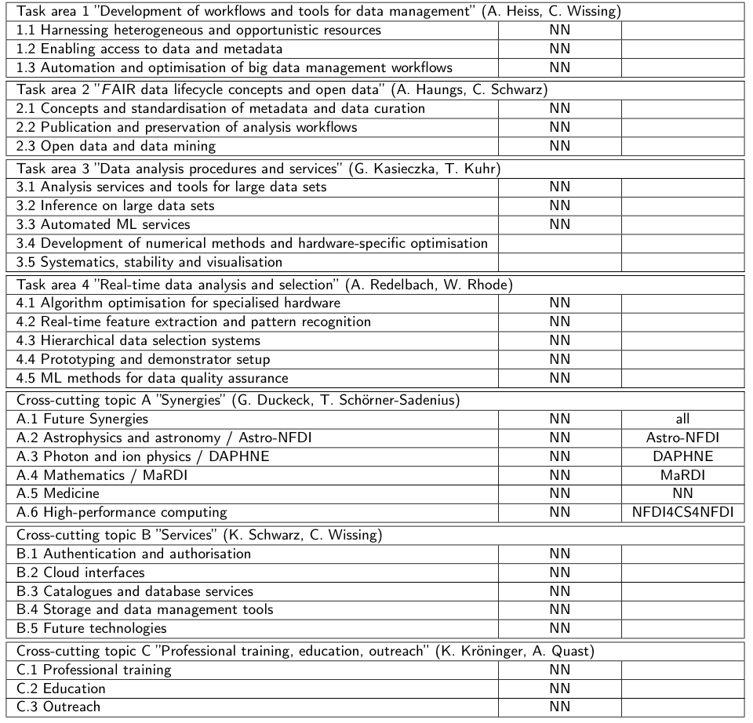
Task Areas
And cross-cutting topics

Slide 8
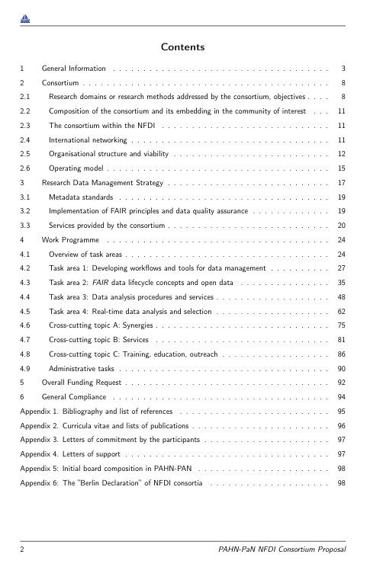
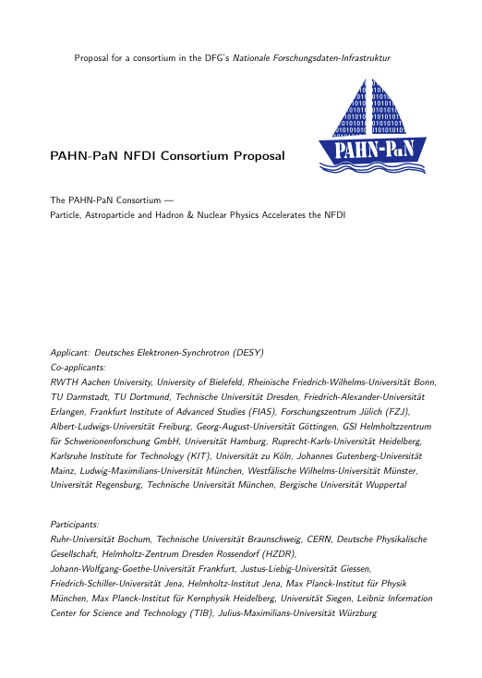
The Proposal
Status
> 100 pages and filling quickly
Especially introductory text parts still missing
Numbers being consolidated
2,5 weeks to go ...

Slide 9
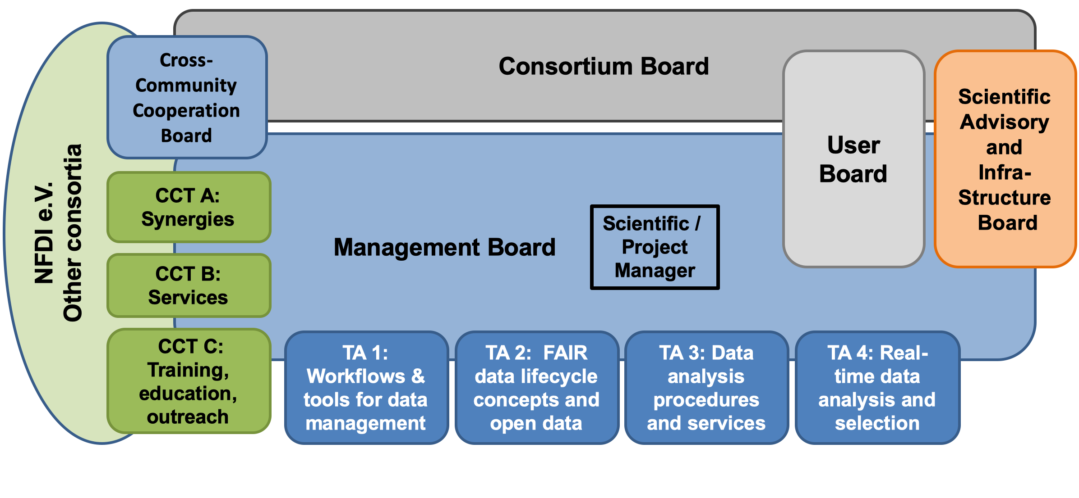
Governance and Organisation
Of the PAHN-PaN consortium

Slide 10
A Word on Synergies
With other NFDI consortia
NFDI Directorate / e.V.
AstroNFDI
DAPHNE
...
HPC
PAHN-PaN
...
...
FAIR-Mat
...
MARDI
NFDI4Phys

Slide 11
Thank you
Thomas Schörner-Sadenius
DESY FM / CMS
E-Mail: thomas.schoerner@desy.de
Phone: +49 40 8998 3429

Slide 12
Backup

