Slide 1
FAIR, Belle II, (Theorie)
Computingstrategie in der HL-LHC-Ära
Thorsten Kollegger, Thomas Kuhr and input from many colleagues
May 6, 2020

Slide 2

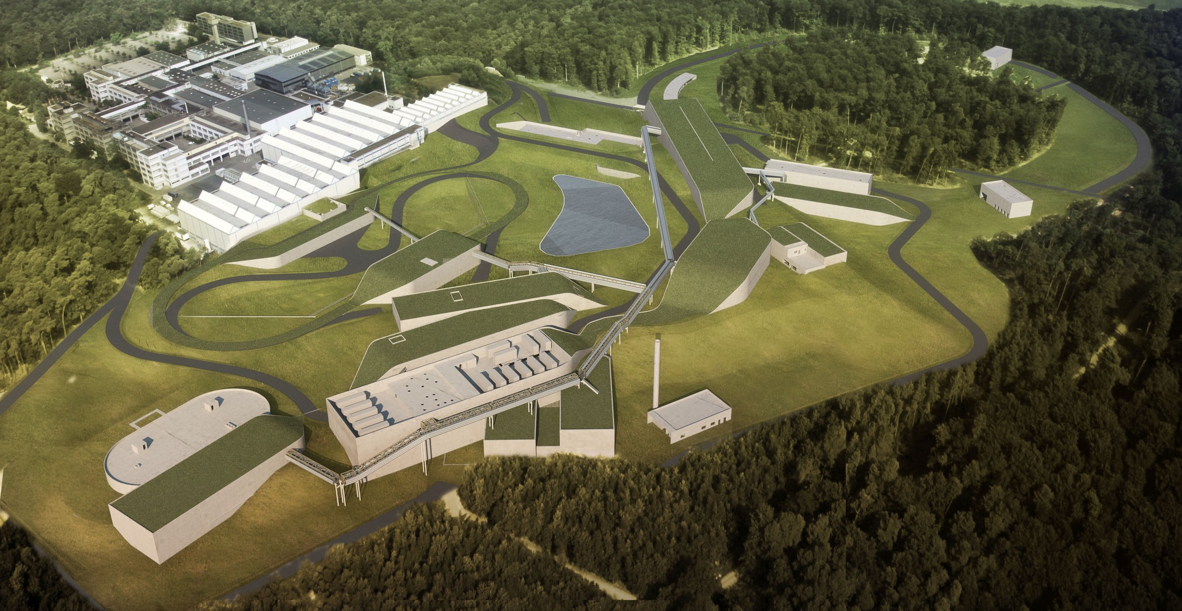
FAIR:Facility for Antiproton and Ion Research
ESFRI Landmark
Top priority for European Nuclear Physics Community
Driver for Innovation in Science and Technology
2

Slide 3
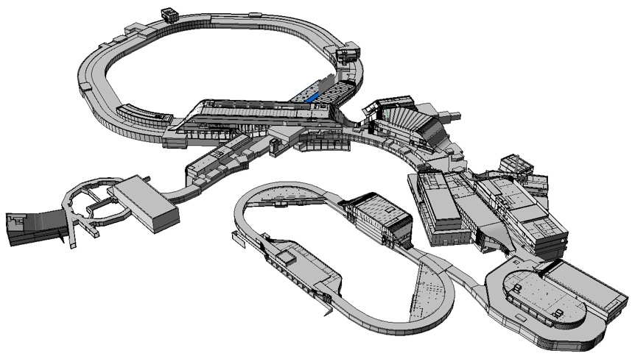
FAIR – Civil Construction
Synchrotrons: 1.1 km
HESR: 0.6 km
With beamlines: 3.2 km
Existing SIS 18
Total area > 200 000 m²
Area buildings ~ 98 000 m²
Usable area ~ 135 000 m²
Volume of buildings ~ 1 049 000 m³
Substructure:~ 1500 pillars, up to 65 m deep

Slide 4
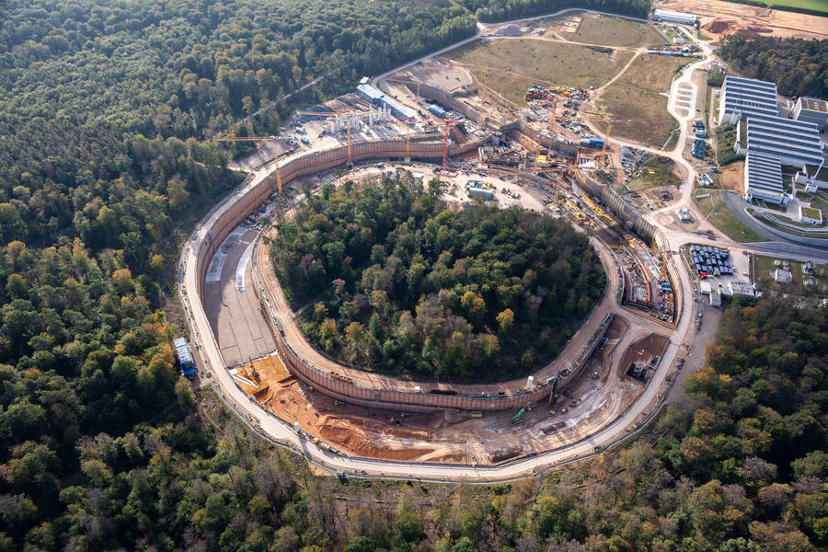
FAIR – Civil Construction
FAIR Construction Site: October 2019
GSI Green Cube
Computing
Contract for Area South Shell Construction awarded in April 2020
First tunnel segments constructed
Tunnel Excavation nearly completed
Video from March 2020: https://youtu.be/U6WuXJ5lj6E

Slide 5
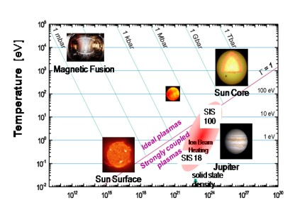
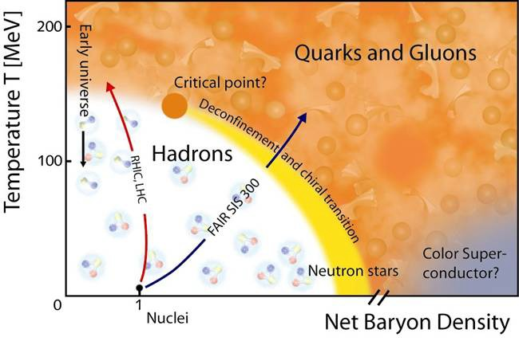
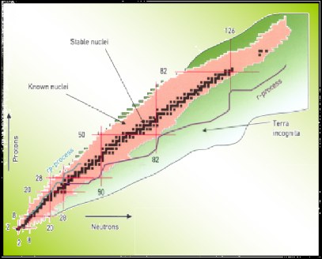

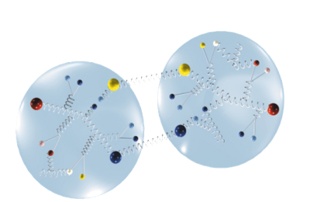
The FAIR science: four pillars
atomic physics, biophysics, plasma physics, material research, other applications
APPA
nuclear- and quark-matter
CBM
nuclear structure and nuclear astrophysics
NuSTAR
hadron structure and dynamics
PANDA
18

Slide 6
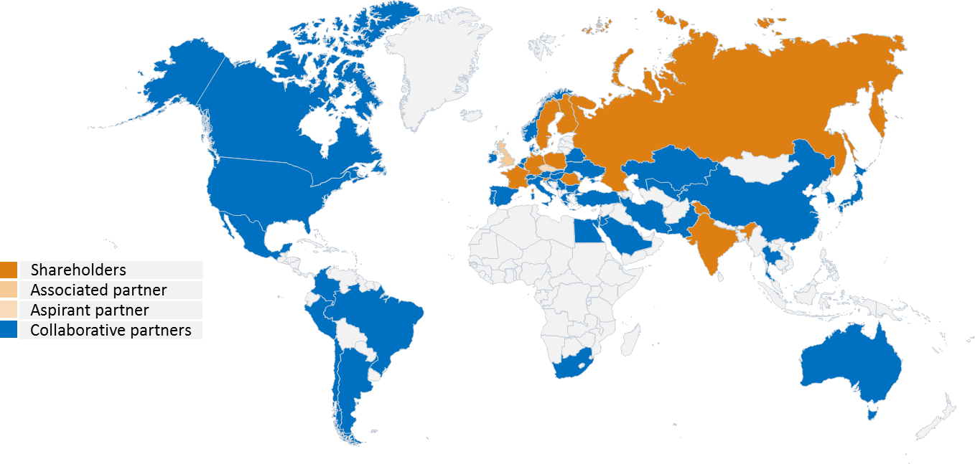
FAIR: International Cooperation
9 international FAIR Shareholders
1 Associated Partner (United Kingdom)
1 Aspirant Partner Czech Republic (Since 2018)
Participation of 3.000 scientists from all continents
6

Slide 7
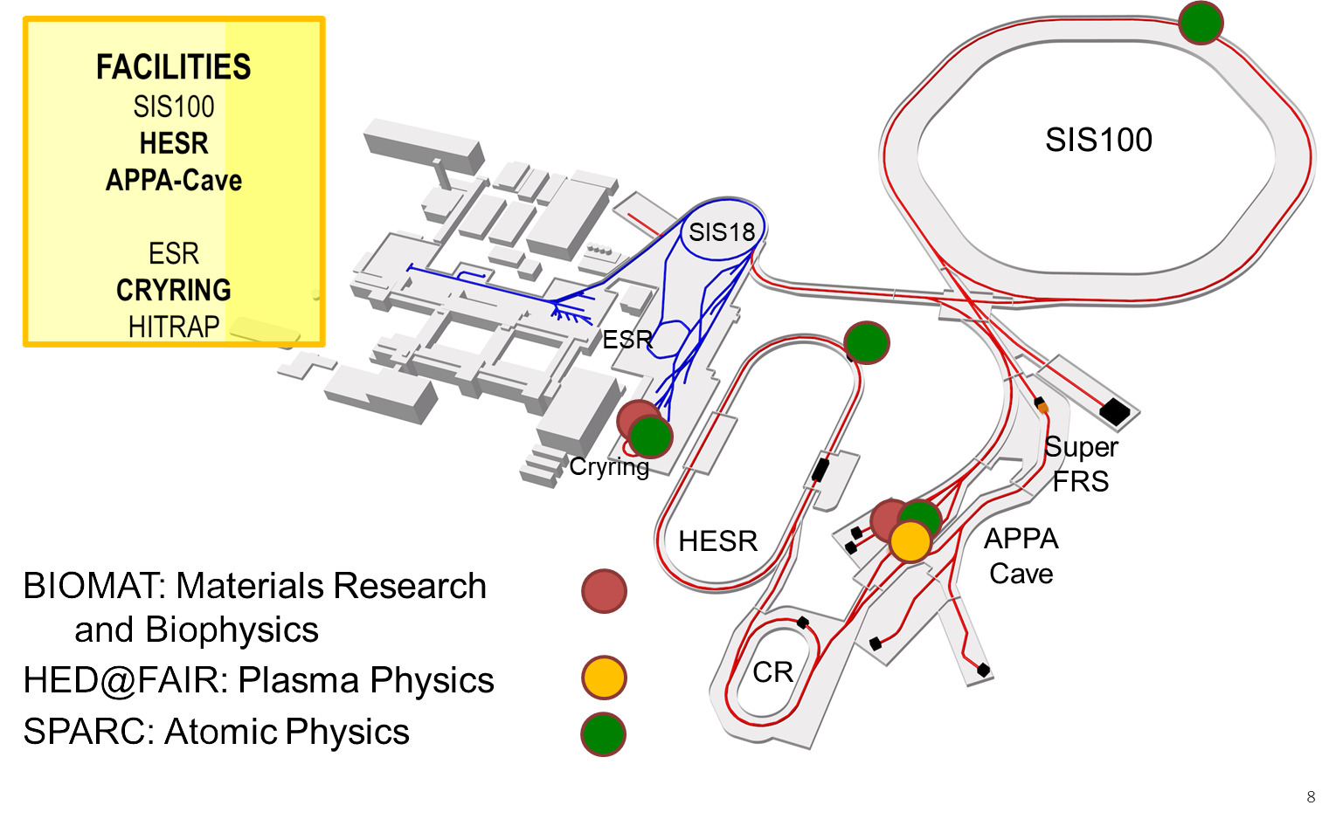
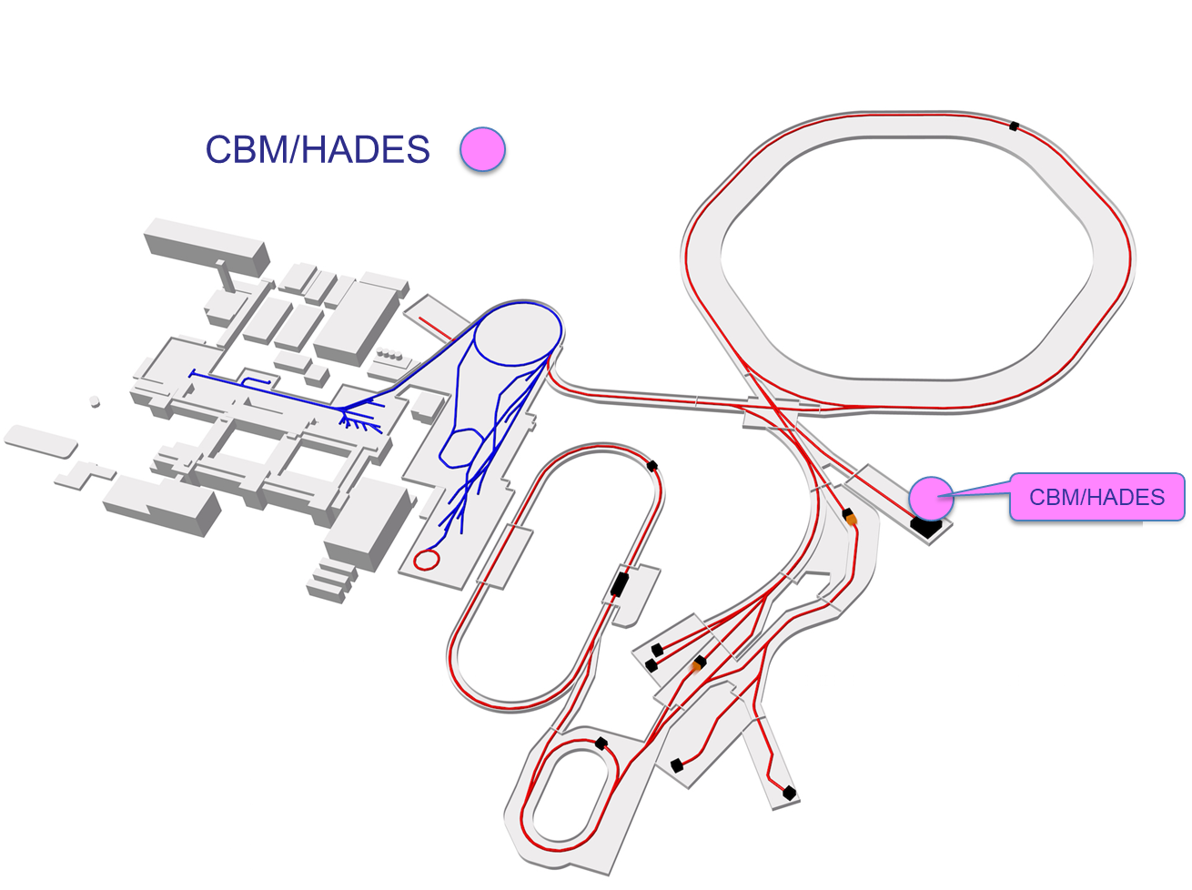
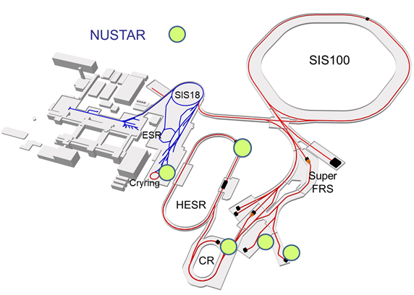
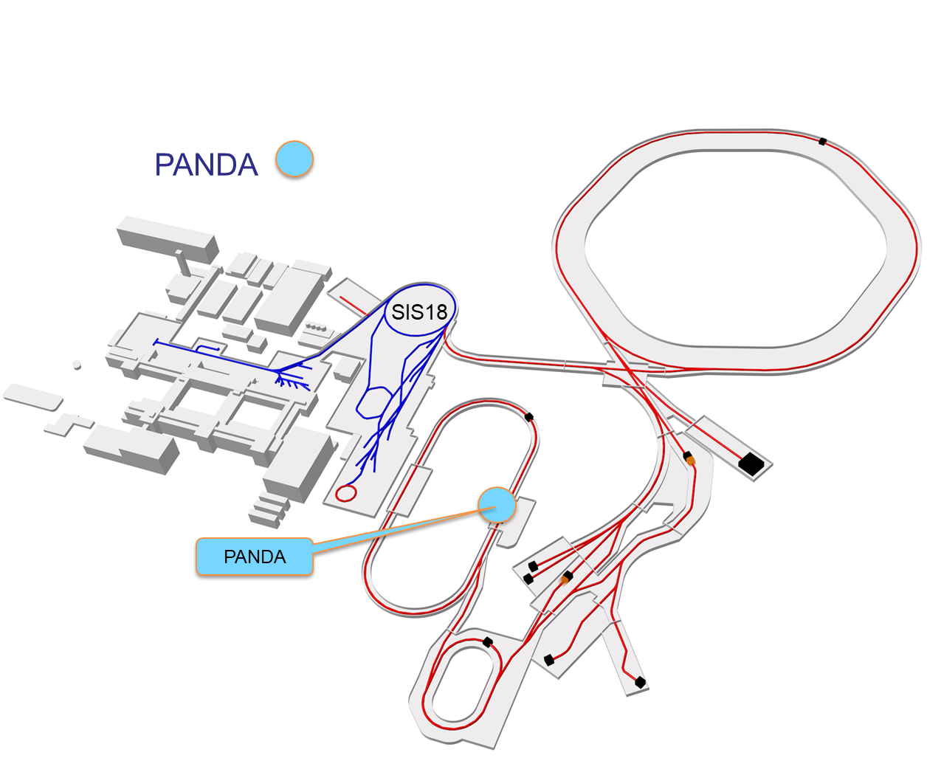
Schedule for FAIR Science
Working towards the completion of FAIR by 2025/26
Major thrust is on construction of FAIR accelerators and experiments.
At the same time staged approach to FAIR science C
and progressive commissioning of accelerators ^{B}
M
and detectors:
FAIR phase 0 : start in 2018/2019
FAIR day 1 configurations/ phase 1 experiments with FAIR accelerators progressively approaching design parameters à 2025/26 …
Full FAIR operation 2026+...
A
P P A
N
U S T A R
P
A N D A
7

Slide 8

Computing Requirements
Assumptions for resource requirements:
Day-1 and MSV detector setups, nominal accelerator performance, multi-year integrated values (data lifetime)

Slide 9
FAIR Computing Requirements
Day-1
 |  | Permanent Storage/year | Additional Disk Storage | Raw Data/year | Raw Data #years | Raw Data Total
Pillar | Experiment
APPA | Plasma | 5 | 2 | 5 | 1 | 5
APPA | Atomic | 2.000 | 0 | 2.000 | 2 | 4.000
APPA | BioMat | 100 | 0 | 0 | 0 | 0
CBM | CBM | 18.000 | 11.000 | 18.000 | 2 | 36.000
CBM | HADES | 500 | 0 | 700 | 5 | 3.500
NUSTAR | NUSTAR | 5.000 | 500 | 5.000 | 2 | 10.000
PANDA | PANDA | 12.000 | 100 | 2.000 | 2 | 4.000
Sum (TB) |  | 37.605 | 11.602 | 27.705 |  | 57.505
 |  | Simulation/year | Simulation #years | Simulation Total | Derived | #years | Derived Total | Disk Total
Pillar | Experiment
APPA | Plasma | 2.000 | 1 | 2.000 | 1 | 1 | 1 | 2.008
APPA | Atomic |  |  | 0 | 1.000 | 4 | 4.000 | 8.000
APPA | BioMat | 0 | 0 | 0 | 100 | 2 | 200 | 200
CBM | CBM | 9.000 | 4 | 36.000 | 4.000 | 5 | 20.000 | 103.000
CBM | HADES | 0 | 0 | 0 | 0 | 0 | 0 | 3.500
NUSTAR | NUSTAR | 500 | 2 | 1.000 | 1.250 | 2 | 2.500 | 14.000
PANDA | PANDA | 3.500 | 2 | 7.000 | 6.500 | 4 | 26.000 | 37.100
Sum (TB) |  | 15.000 |  | 46.000 | 12.851 |  | 52.701 | 167.808
~168 PB total disk required
~38 PB on tape per year
Single replica

Slide 10
FAIR Computing Requirements
Day-1
 |  | Planned Computing Resource Requirements (in HEPSPEC06)
Compute Class |  | 1.a | 1.b | 1.c | 1.d | 2.a | 2.b
Pillar | Experiment
APPA | Plasma | 0 | 0 | 0 | 0 | 220.000 | 0
APPA | Atomic | 0 | 0 | 0 | 0 | 22.000 | 0
APPA | BioMat | 0 | 0 | 0 | 0 | 2.200 | 0
CBM | CBM | 2.200 | 0 | 0 | 0 | 1.000.000 | 980.000
CBM | HADES | 0 | 0 | 0 | 0 | 176.000 | 22.000
NUSTAR | NUSTAR | 12.000 | 0 | 0 | 0 | 120.000 | 0
PANDA | PANDA | 0 | 0 | 0 | 0 | 1.500.000 | 1.100.000
Sum (HEPSPEC06) |  | 14.200 | 0 | 0 | 0 | 3.040.200 | 2.102.000
No significant installations at experiment locations foreseen
“Offline resources”
Year-averaged resource request
“Online resources”
Guaranteed resources during operation

Slide 11
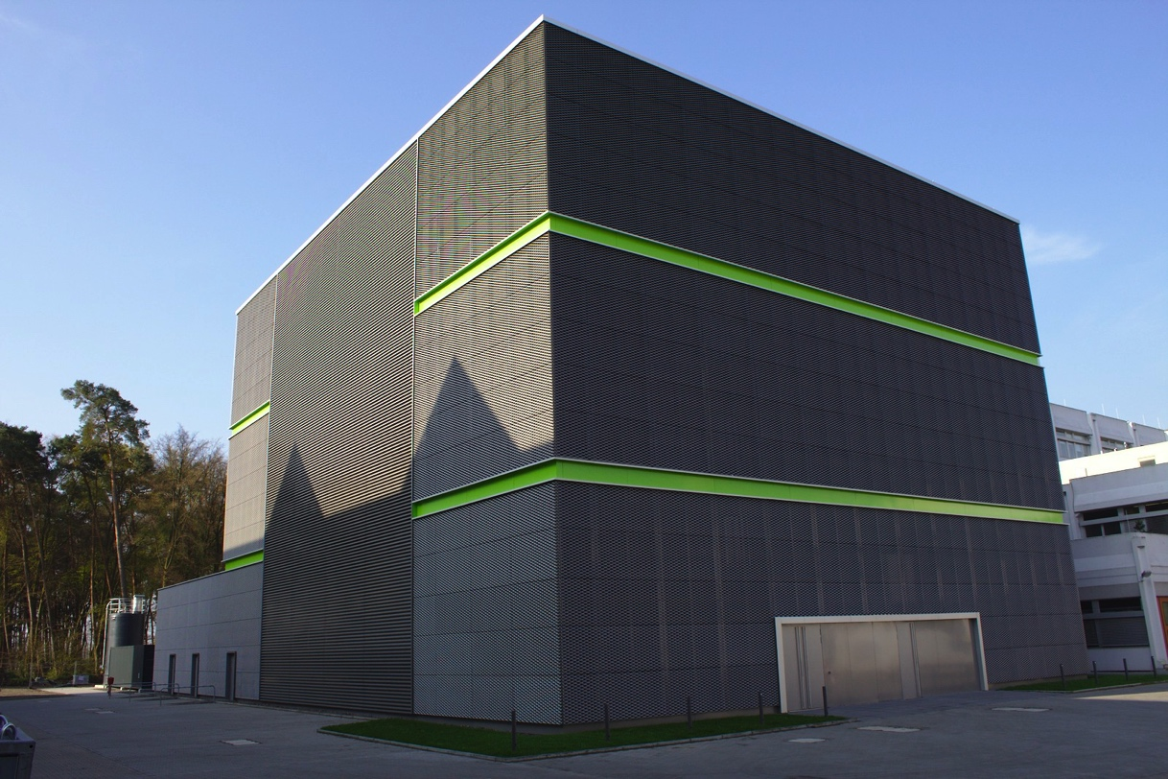
FAIR Computing
GSI/FAIR Green Cube Common data center for
FAIR Tier 0
FAIR Experiment Online Clusters (HLT’s)
GSI Computing
Significant resource contribution from partner countries
Replica of (raw) data
Compute resources and associated storage for efficient use

Slide 12
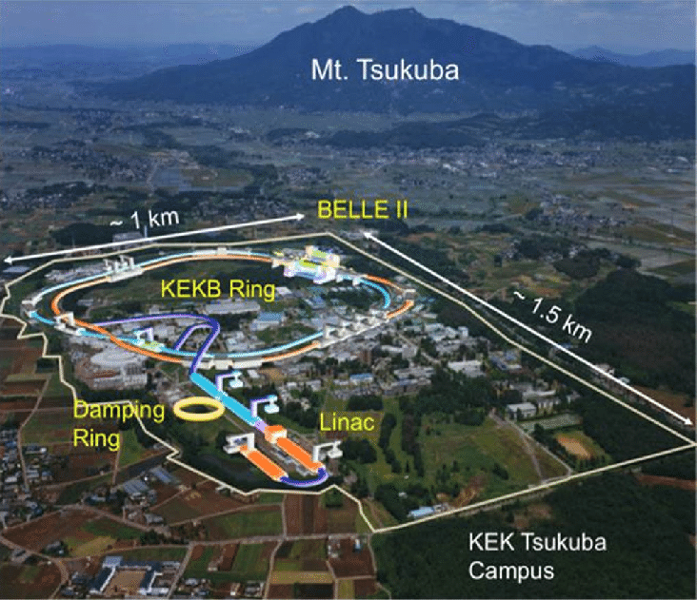
Belle II

Slide 13
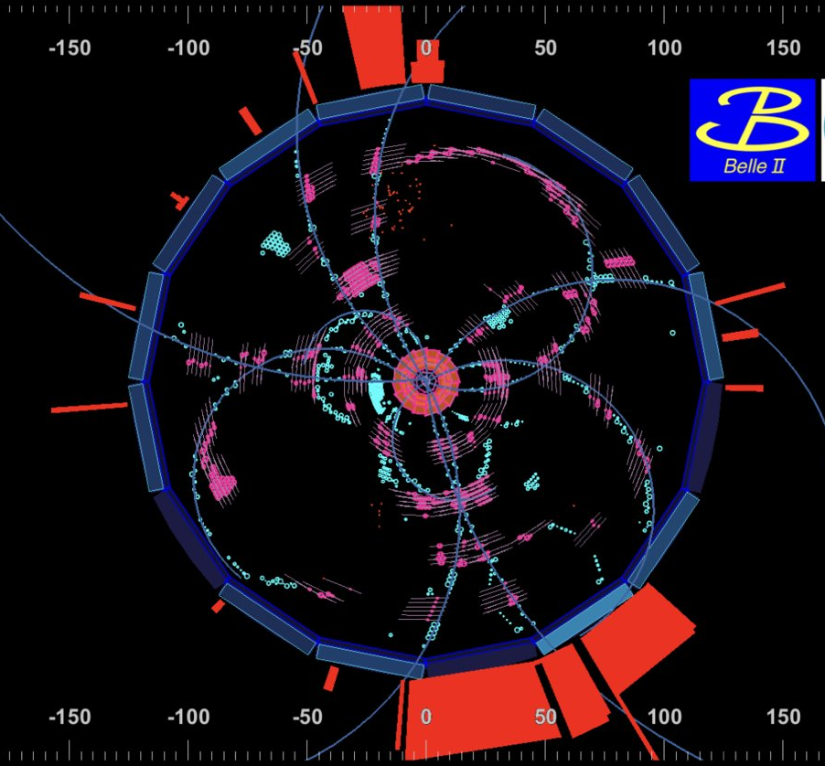
Belle II Experiment
Suche nach neuer Physik durch Präzisionsmessungen von Zerfällen von B-Mesonen, Charm-Hadronen, tau-Leptonen; Studium von (exotischen) hadronischen Zuständen; …
Ziel: 50 mal mehr Daten als Belle bis 2029
e⁺e– @ √s ≈ 10.6 GeV
Start des Physik-Runs 2019
O(10) Spuren pro Event, Rohdaten; 100-200 kB pro Event, Analyse (mdst): ~10 kB pro Event
HLT-Output-Rate bis ~10 kHz → O(GB/s)

Slide 14
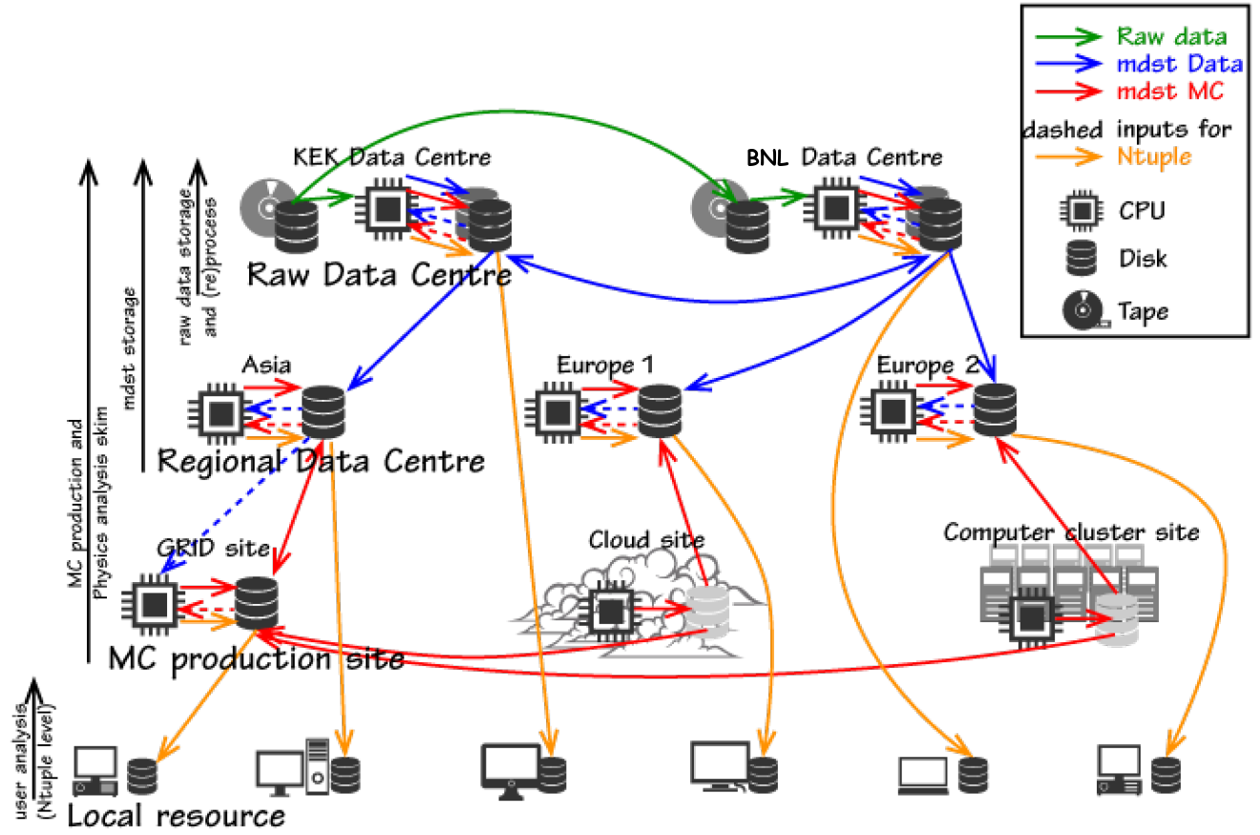
Belle II Computing
Computing-Modell ähnlich wie LHC-Experimente, Mitglied von WLCG
Analyse in Python
Integration der Experimentsoftware in Jupyter

Slide 15
Belle II Ressourcen
Private Abschätzung
Deutscher Anteil: ~15%
Storage (PB)

Slide 17
(Theoretical Particle Physics)
Disclaimer: not a full picture…

Slide 18
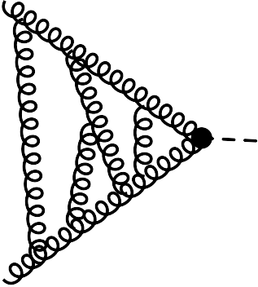
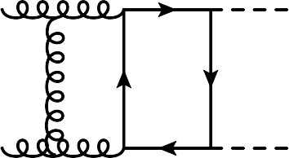
Computing in theoretical particle physics
Typical workflow/tasks:
- generation of amplitudes,
- processing of amplitudes (integral families, asymptotic expansions etc.)
- reduction to so-called master integrals
- analytic computation of master integrals
- numerical computation of master integrals
- real radiation/phase space integration
- ...
Many different applications with
different demands on
computer hardware.
application (examples) | RAM | #cores (CPU) | #cores (GPU) | storage | parallelization | comments
Redution to master integrals | O(1TB) | O(20) | - | O(100GB) to O(2TB) | yes | Fast local disks necessary, e.g. NVME
Numerical evaluation of loop integrals | O(256GB) | O(10) | 2-4 per node O(10-100) nodes | O(10GB) | yes
Real radiation | O(10GB) | O(50.000)-O(100.000) | - | O(1-2TB) | yes
Slide from Matthias Steinhauser, KIT
Notes:
18

Slide 19
Theoretical Particle Physics
Computing Needs
up to ~100.000 cores for certain calculations
Typically done at HPC centers
Slide from Matthias Steinhauser, KIT
Challenge: Data Storage and Management
Datasets approaching size of several PB Long term storage strategy? Data Management and availability at analysis sites?

Slide 20
A Summary
FAIR
Becoming operational in the HL-LHC timeframe
FAIR Tier-0 in Germany at GSI
Tight integration of Online Computing and Tier-0
Resources: ~3M HS06 + online, 170PB disk, 38PB tape/year (single replica)
Belle II
Resources at HL-LHC timeframe: ~3-4M HS06, ~300PB disk
German membership ~20%, strong German computing contribution
(Theoretical Particle Physics)
HPC for computation; main challenge data storage and management
Common
Leading German role in software development

