Slide 1
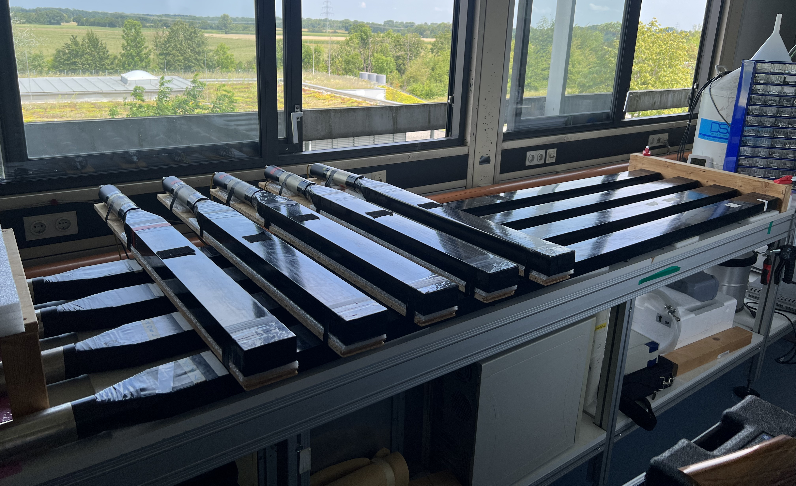
Muon Detection with Scintillators

Slide 2
Muon Detection with Scintillators
We need 20 well working scintillators
look for leaks, absorption length
Determine efficiency along length

Slide 3
Signal Absorption of Scintillators
1
2
3
distance
4

Slide 4
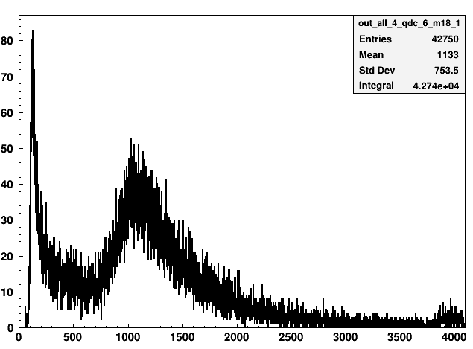
Signal Absorption of Scintillators

Slide 5
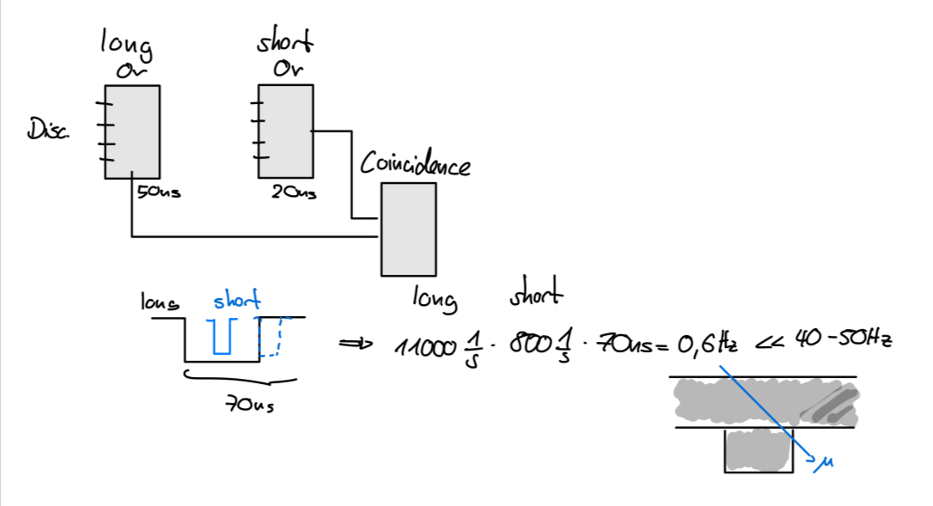
Signal Absorption of Scintillators
by chance?:

Slide 6
Signal Absorption of Scintillators
by chance?:
No!

Slide 7
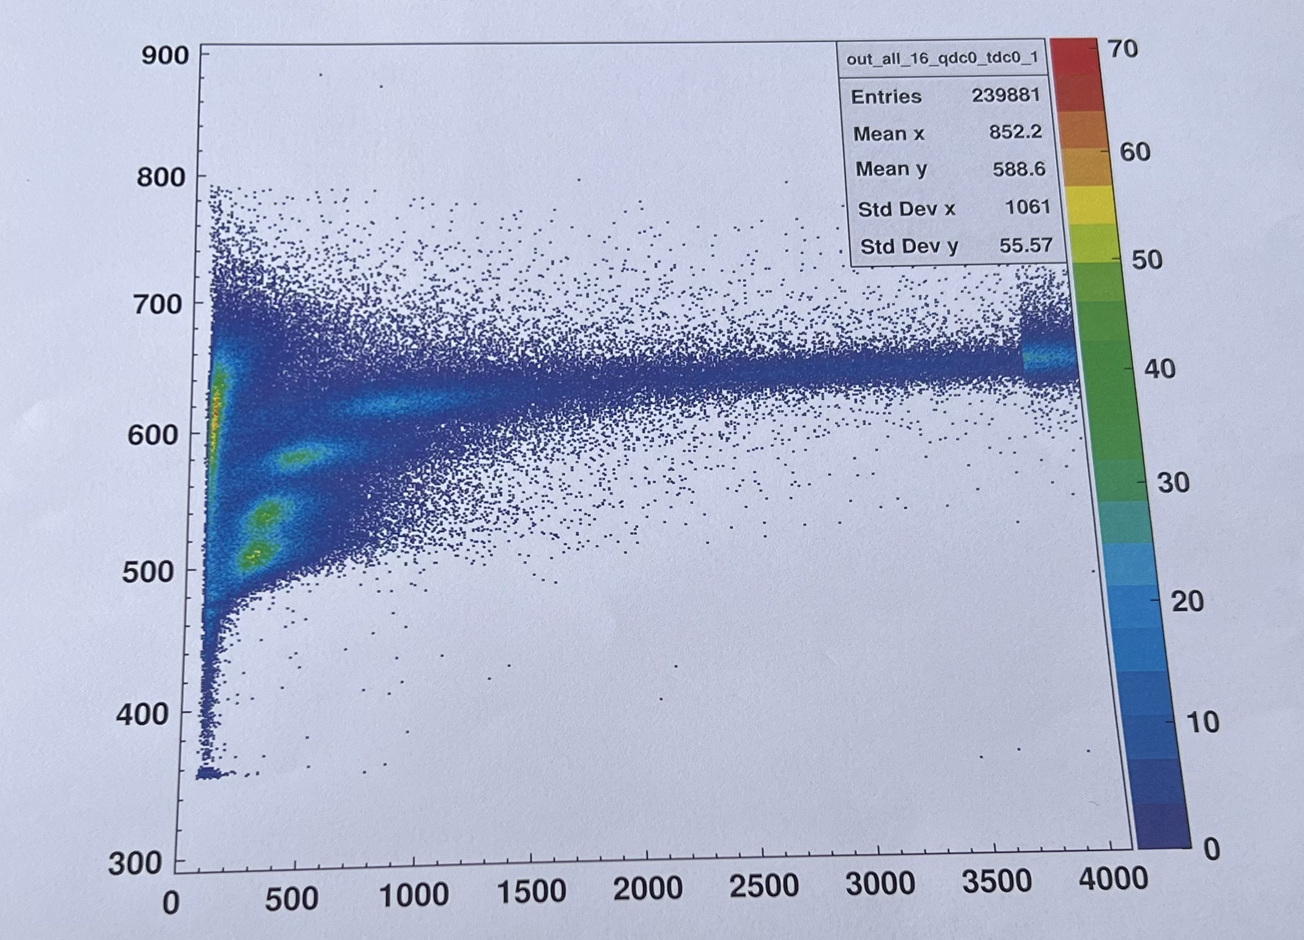
Signal Absorption of Scintillators
time
charge

Slide 8
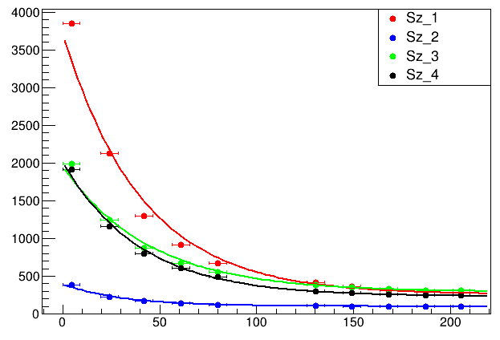
Signal Absorption of Scintillators
1
2
3
distance
4

Slide 9
Signal Absorption of Scintillators
Amplification
Loss of signal
1
2
3
distance
4
Leak?

Slide 10
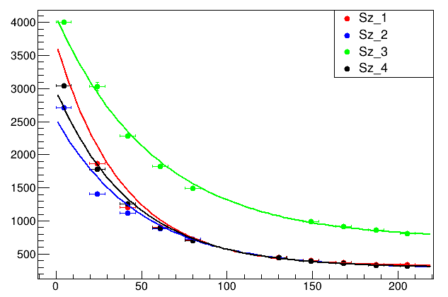
Signal Absorption of new Scintillators

Slide 11
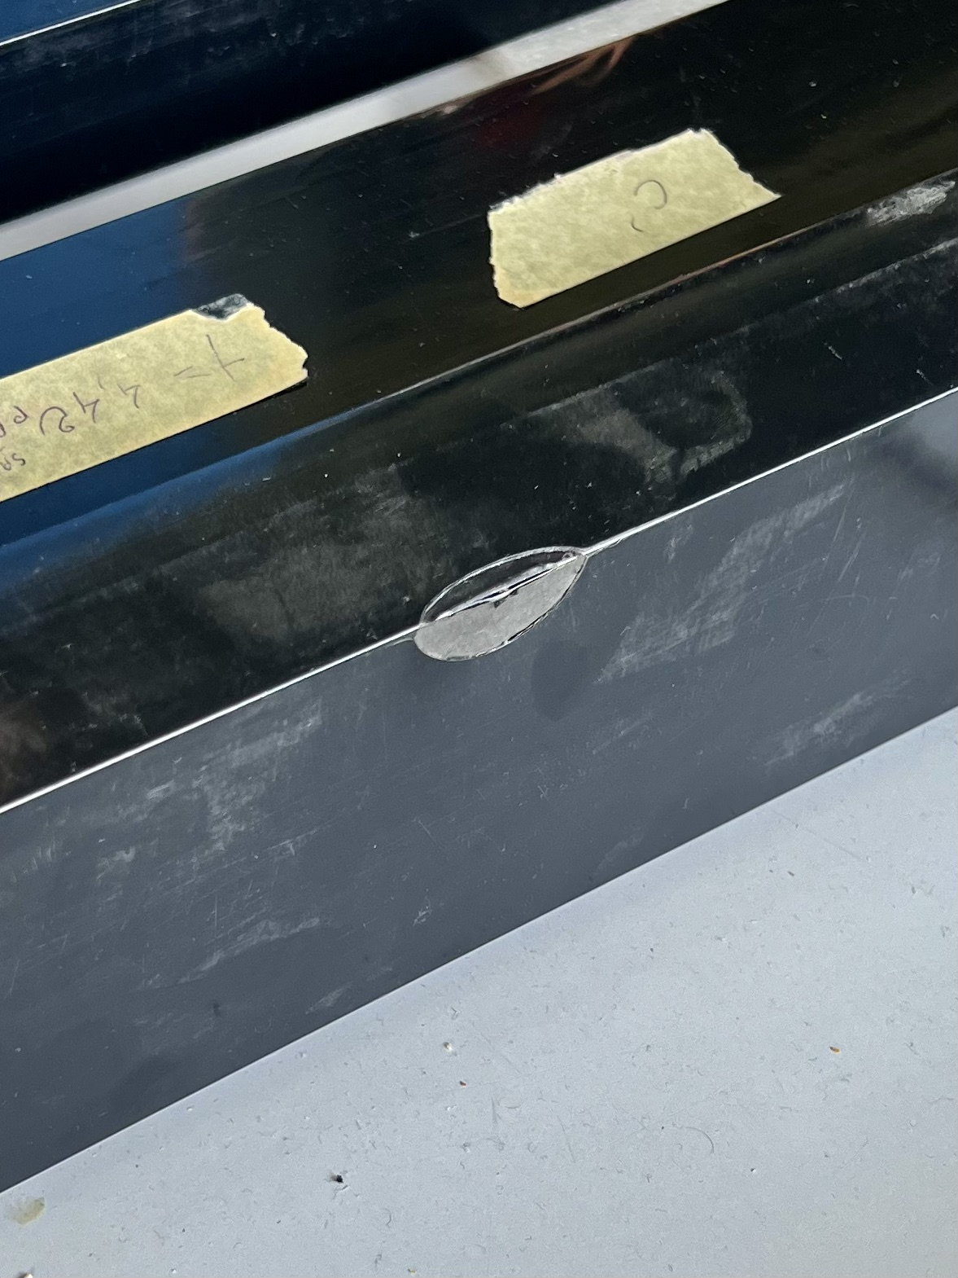
Leak at Scintillator
Leak
to much signal for
photomulsiplier
nothing detected

Slide 12
Leak at Scintillator
to high
small leak

Slide 13
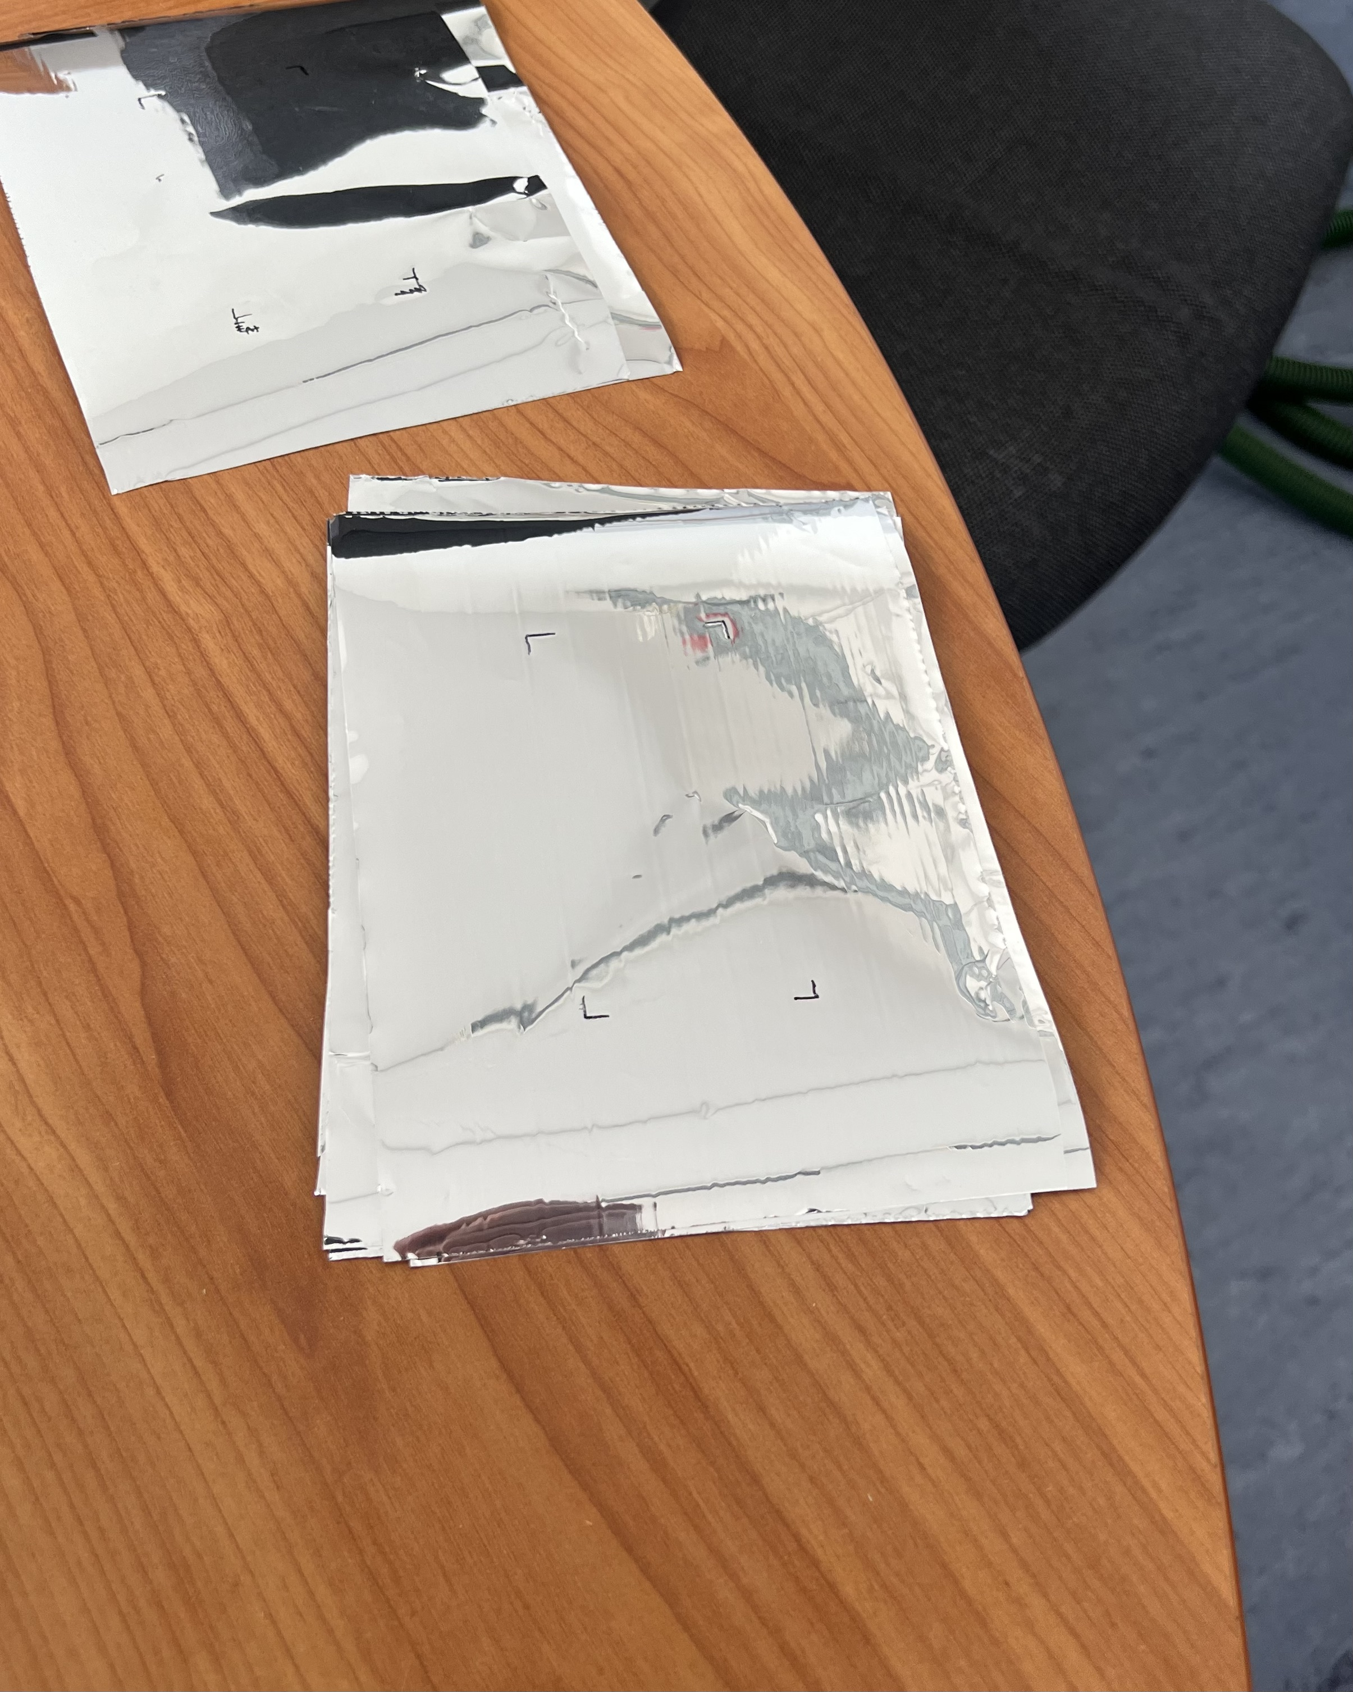
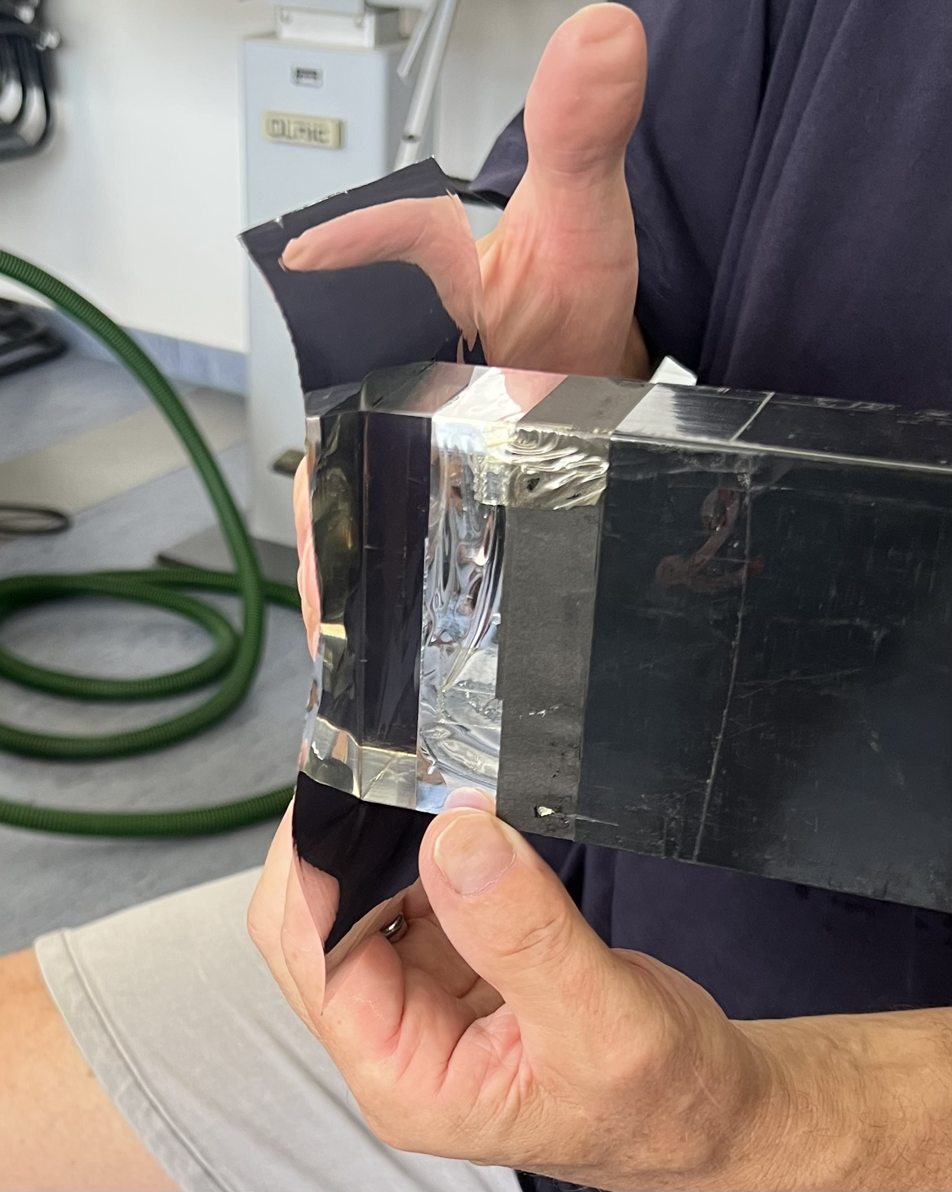
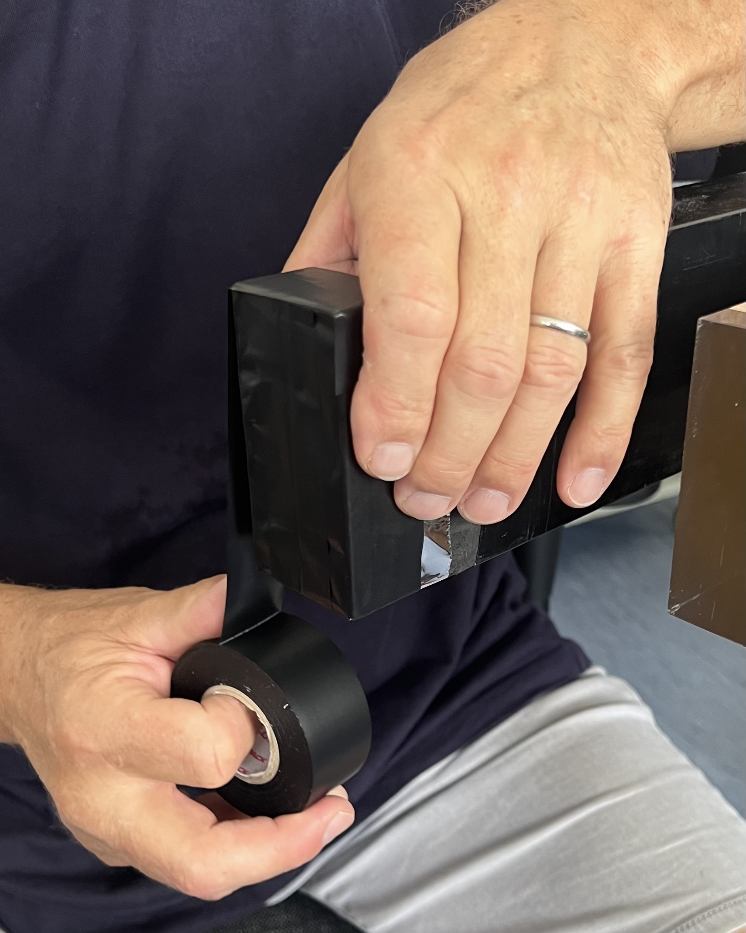
Assembling the Scintillators

Slide 14
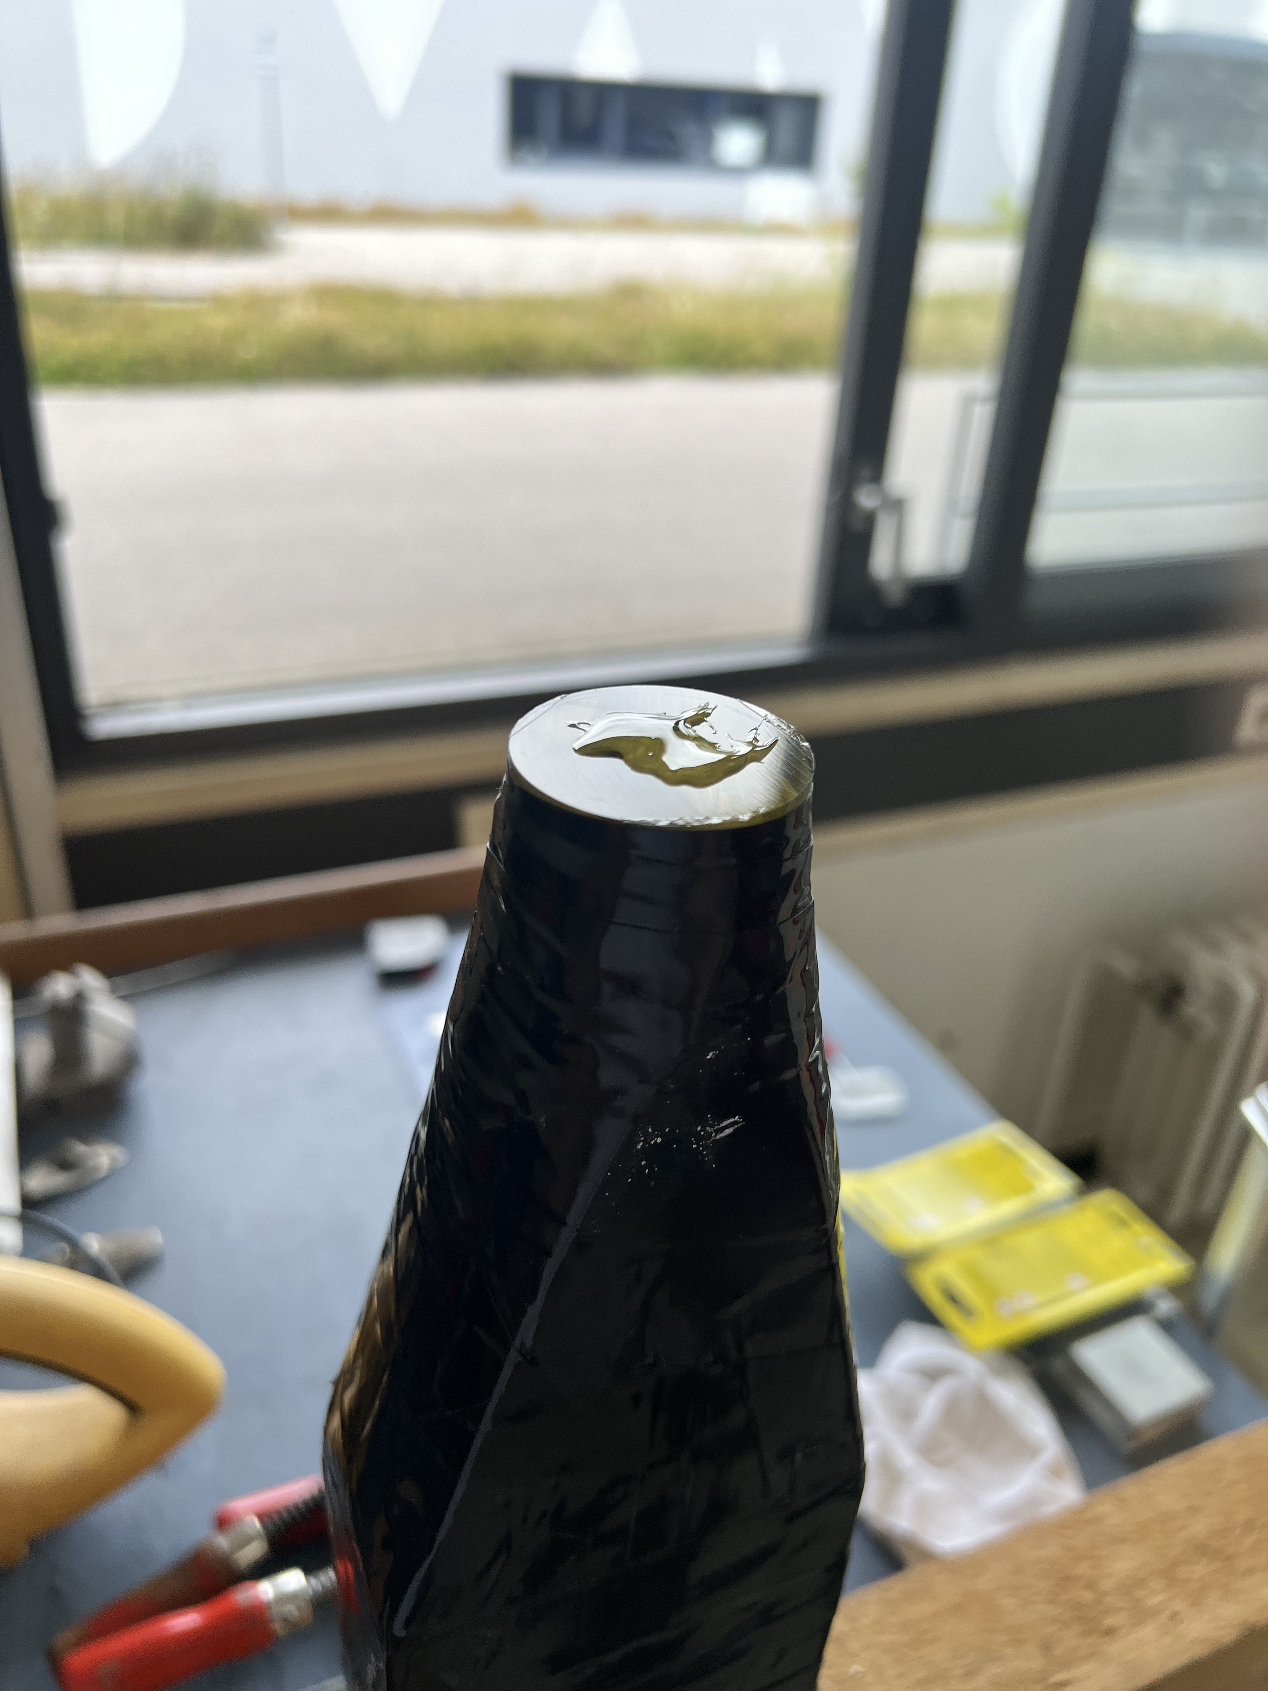
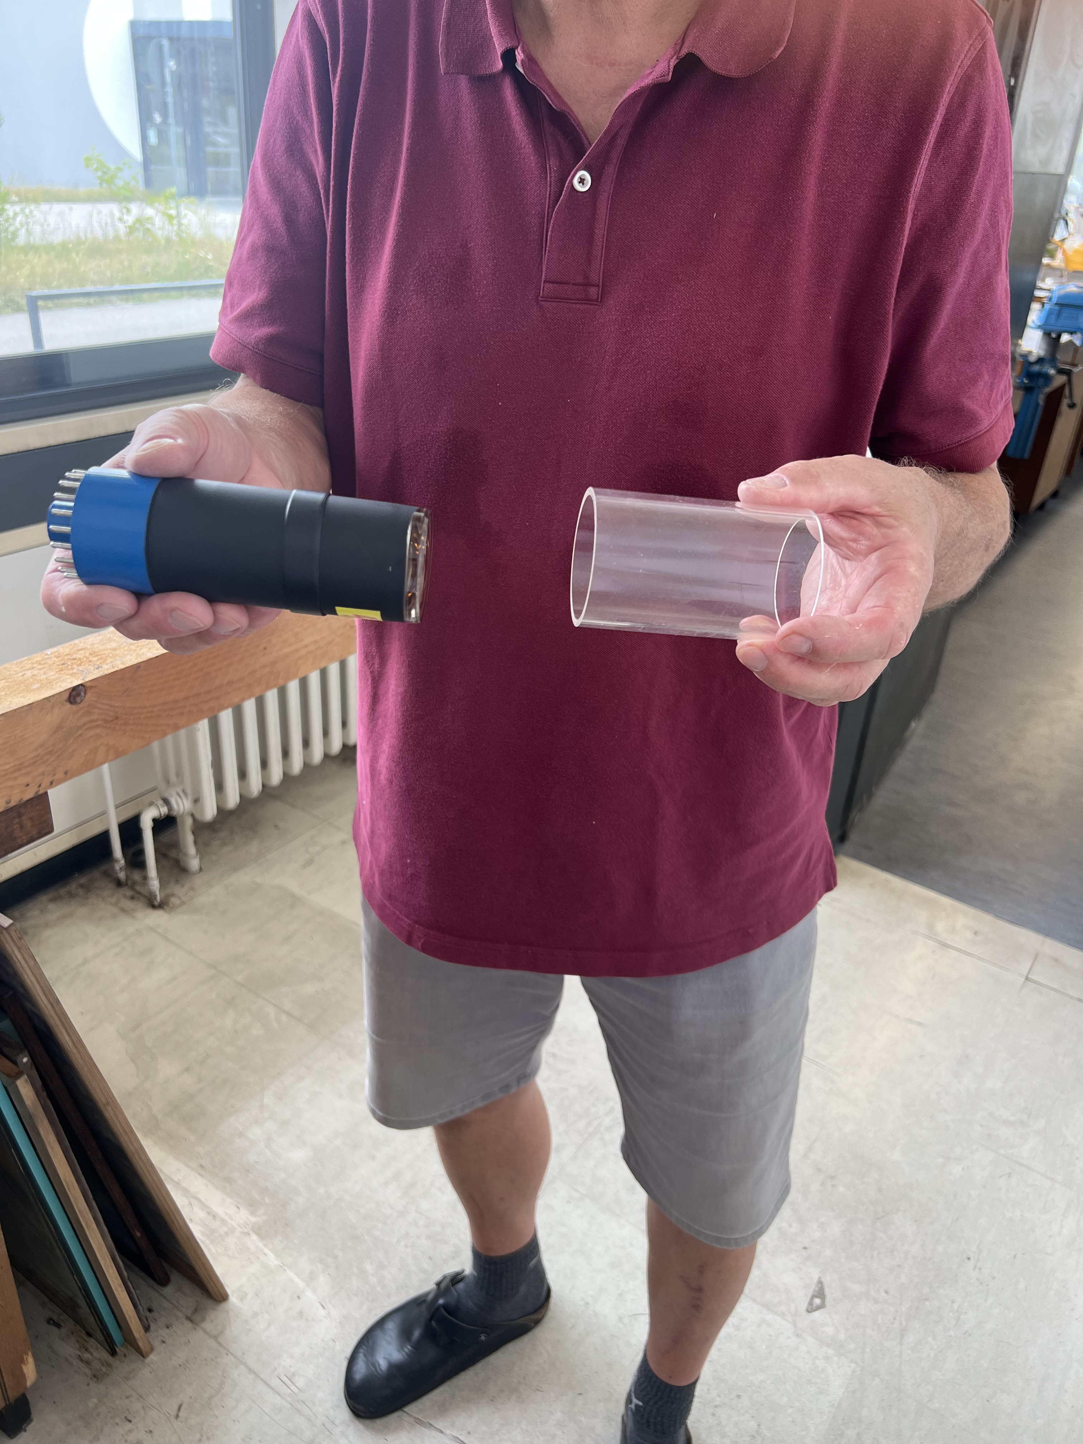
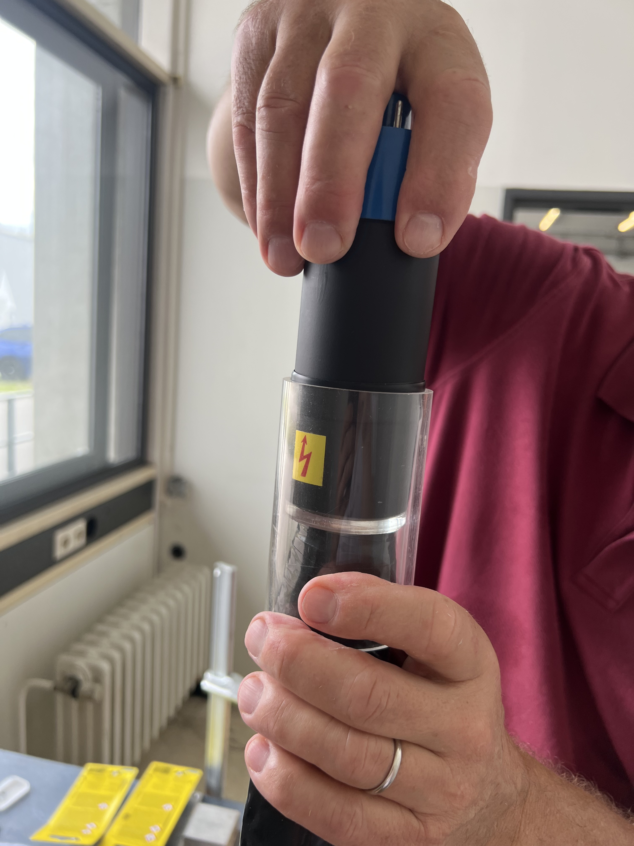
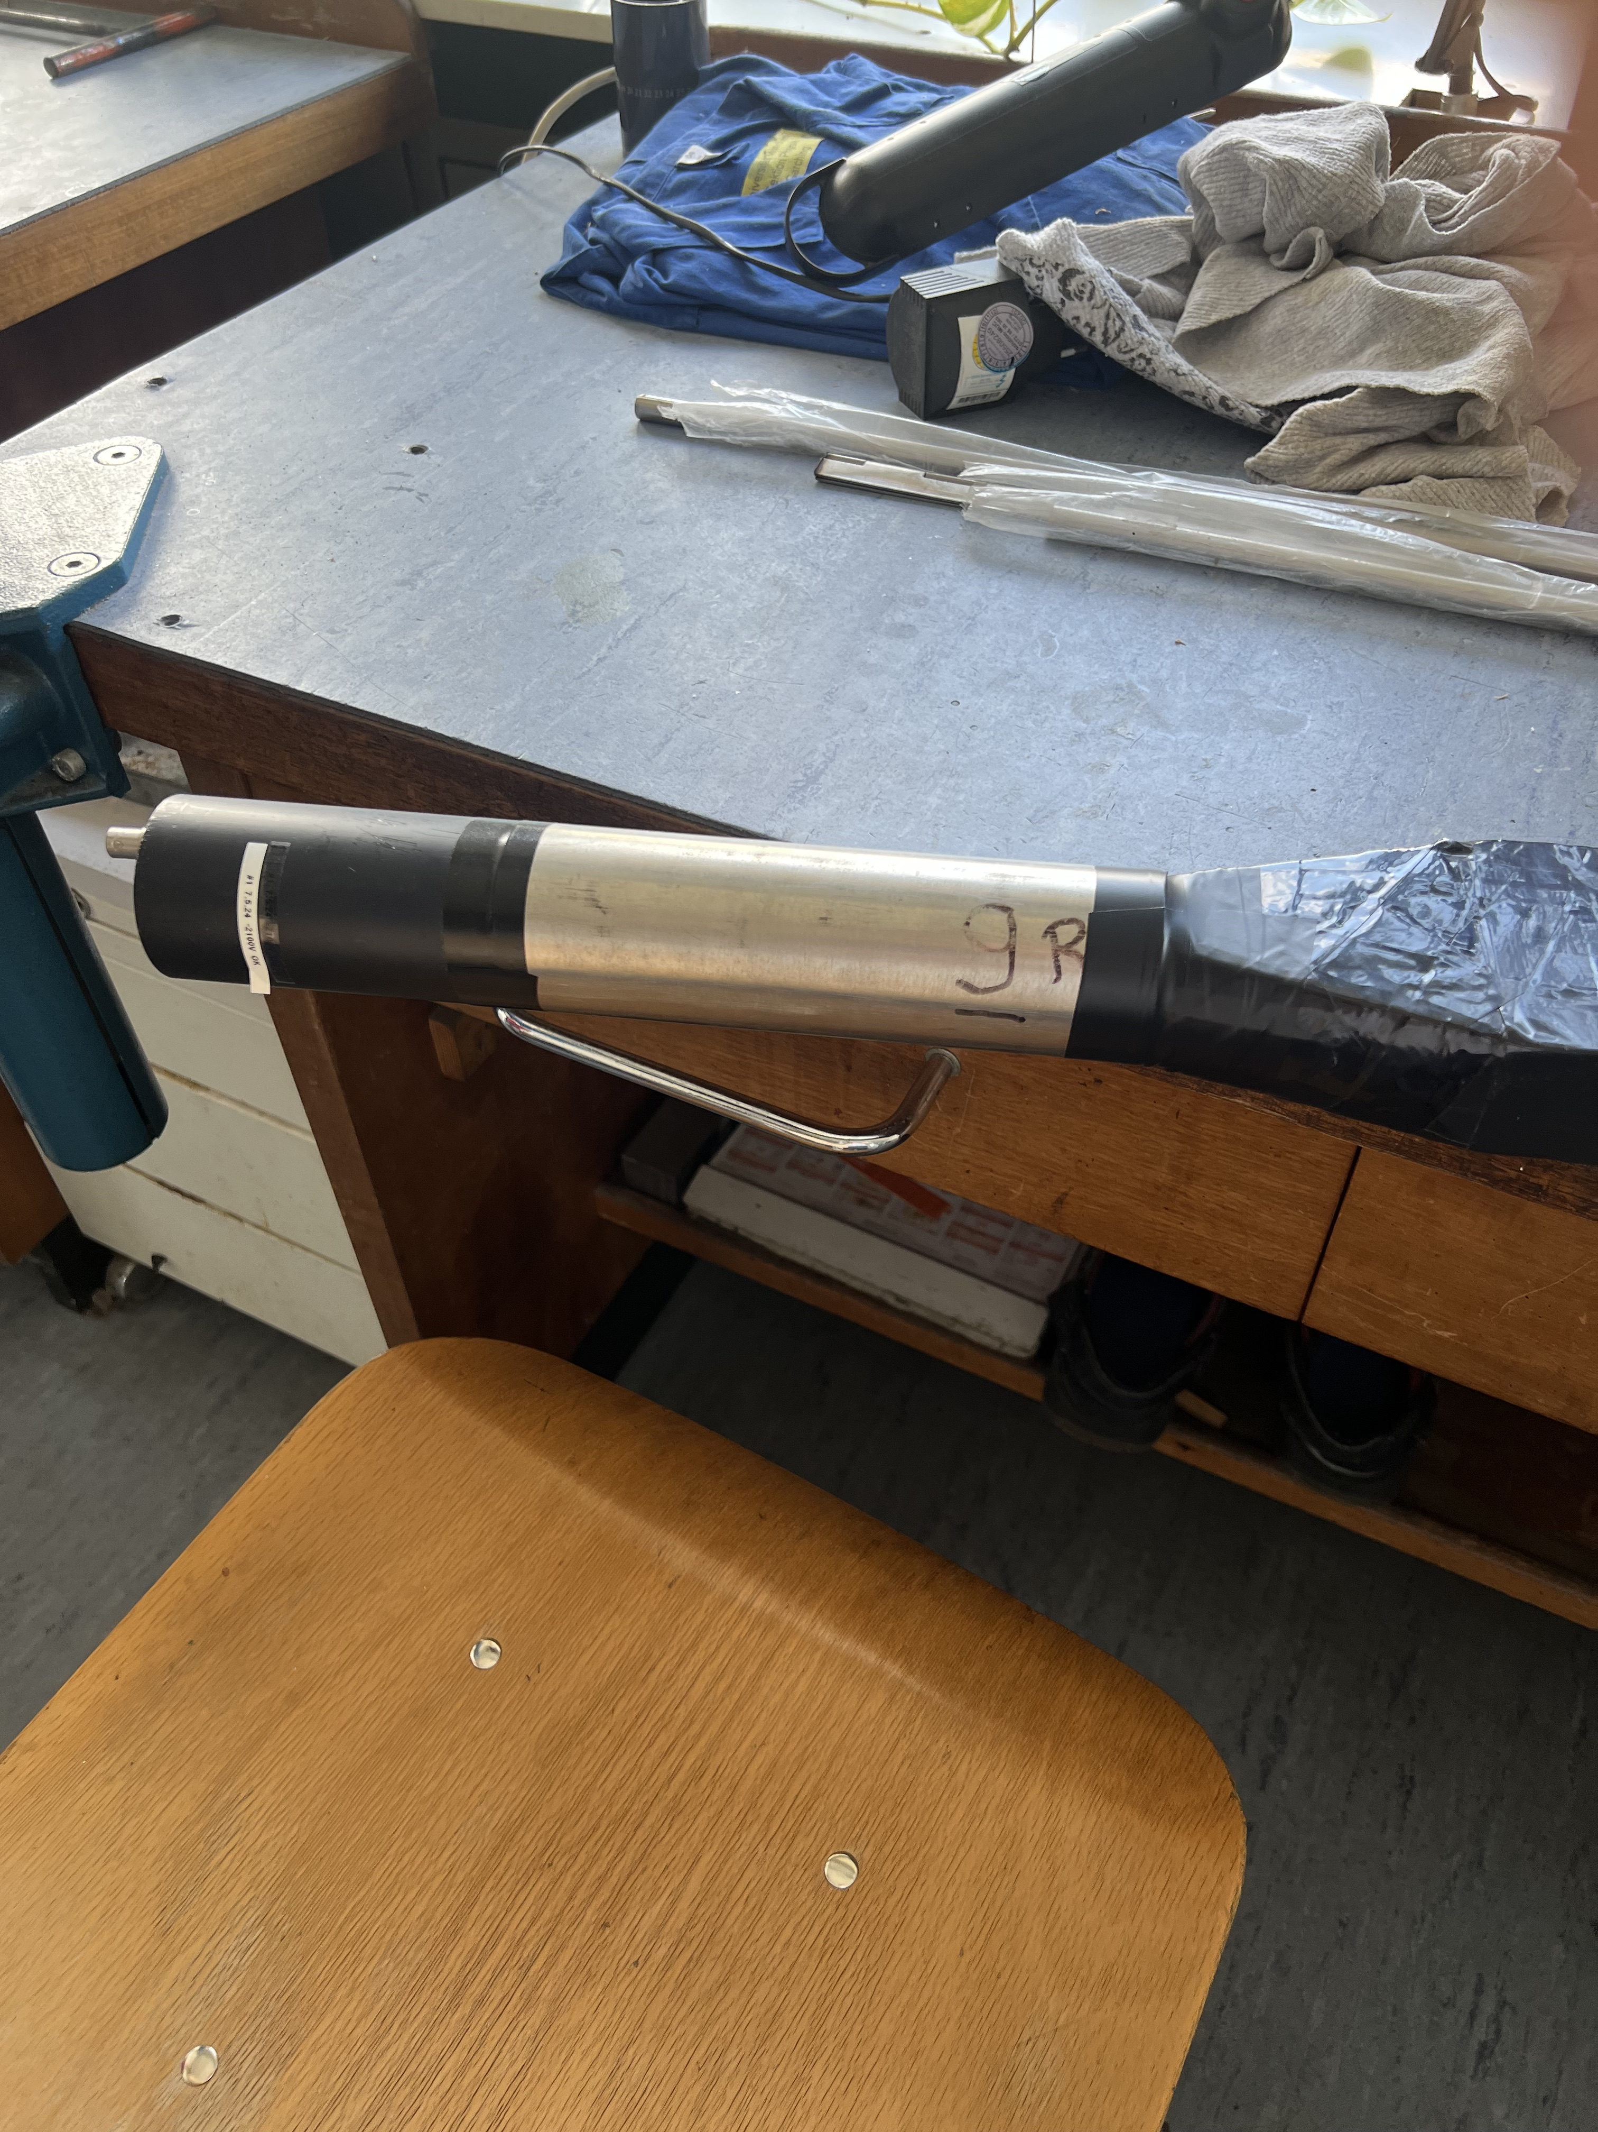
Assembling the Scintillators

