Slide 1
Adaptive optics integration at PHELIX
Udo Eisenbarth
THRILL Workshop 16.01.2025

Slide 2
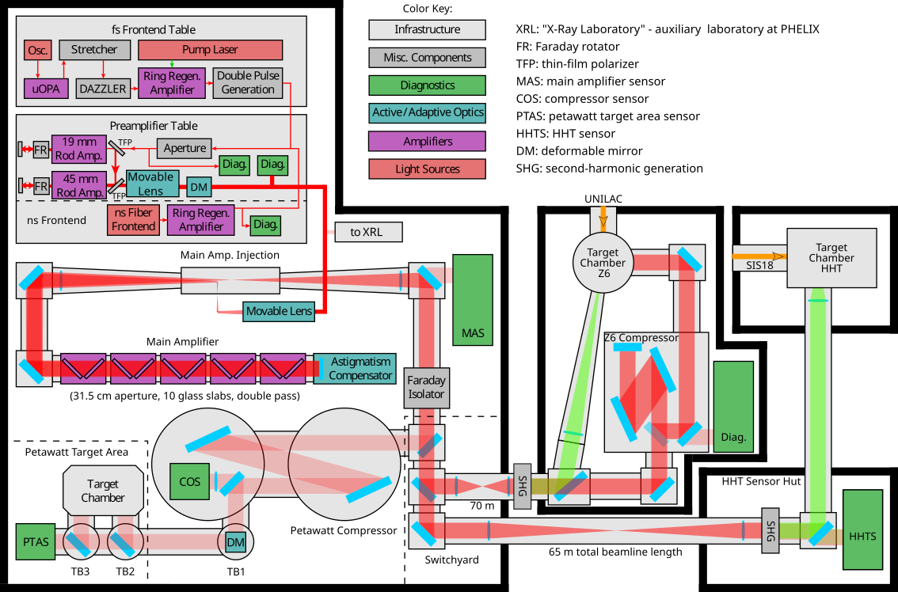
Phelix in a nutshell
High energy / intensity laser system
1053 nm (Nd:glass)
short pulse: 400 fs, 180 J
long pulse: 10 ns, 1kJ
1 full energy shot / 90 min
3 target chambers
unique combination of high energy laser with heavy ion accelerator

Slide 3
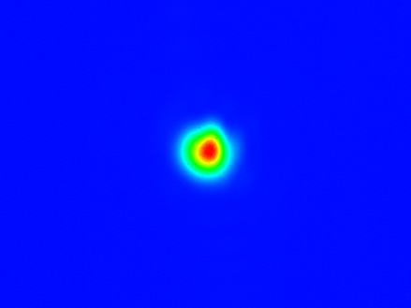
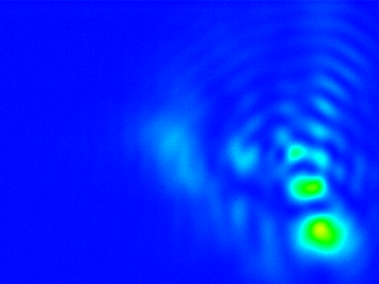
Wavefront Aberrations
...Beamlines, Amplifiers...
shot #1
shot #2
shot #3
cool down
wavefront PtV
on-shot
0
static
time

Slide 4
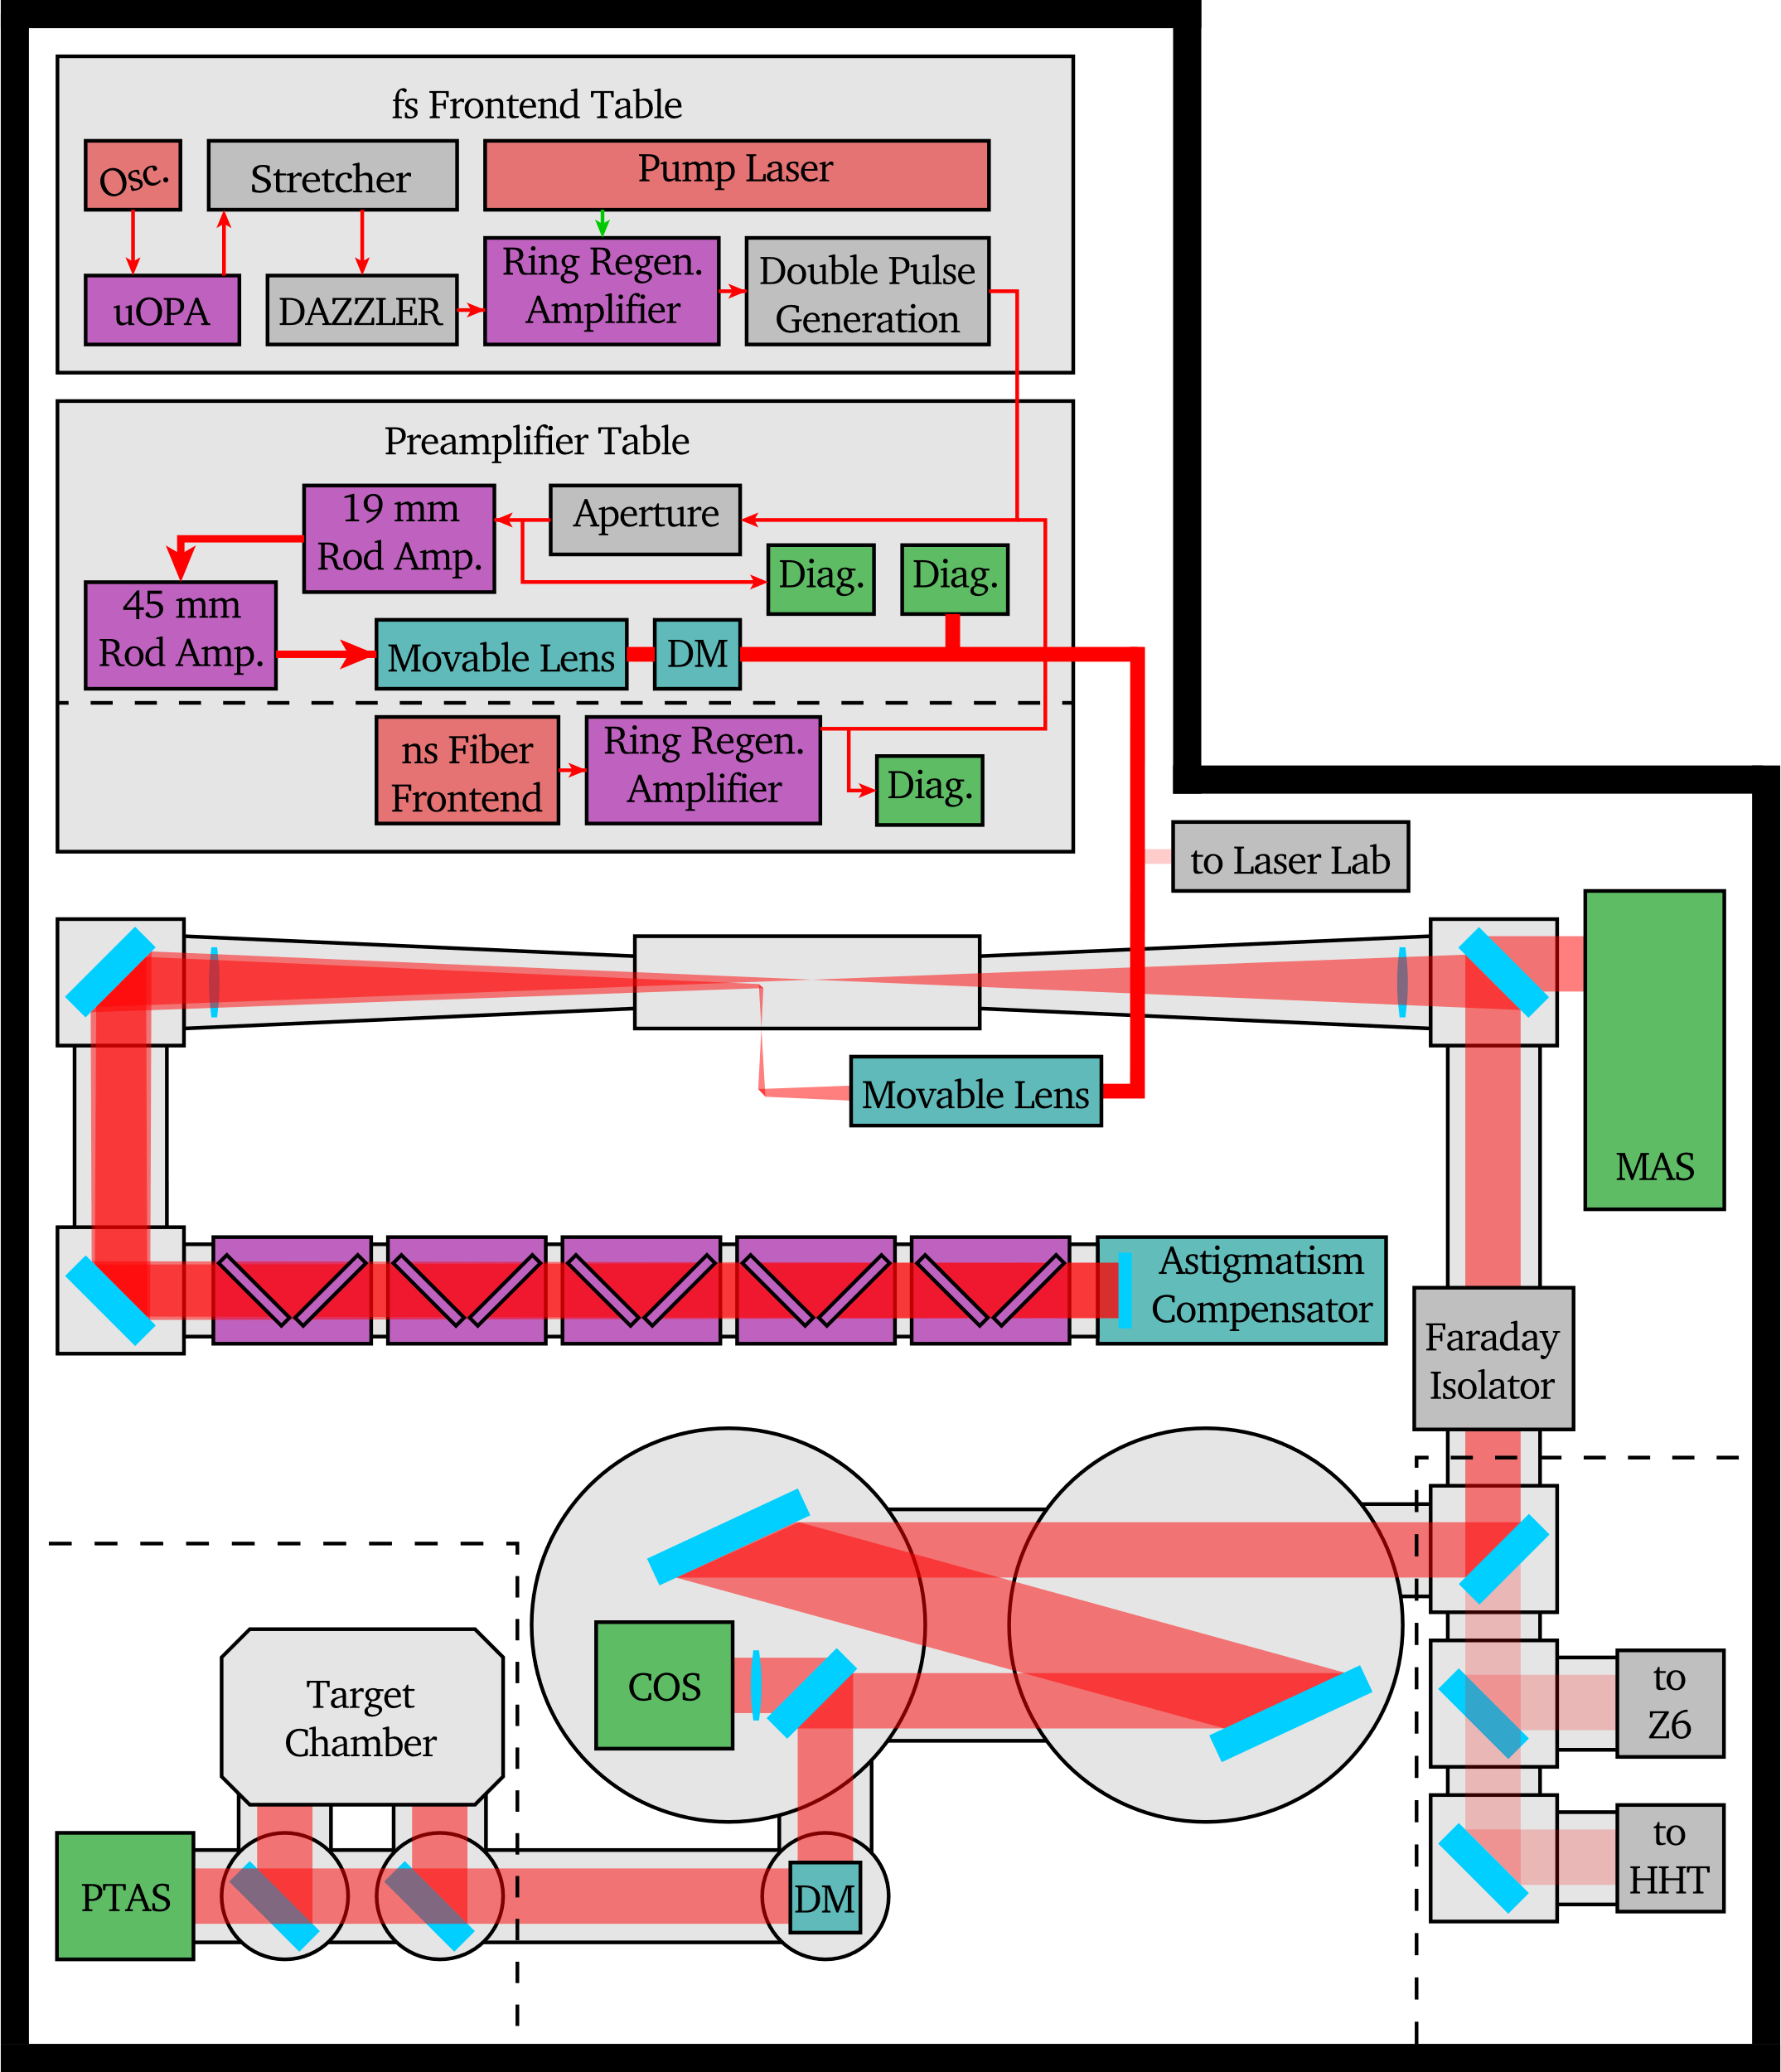
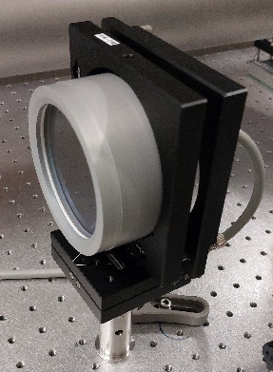
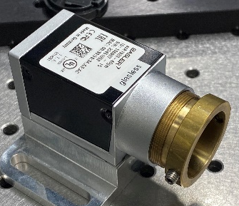
Static Aberrations
Measured at MainAmp output sensor (MAS).
Compensated by deformable mirror at pre-amplifier.
Pre-compensation of MainAmp aberrations.
Measurement / Regulation software: Own development within control system.
Static compensation performed once every morning.
No further compensation over the day (so far).

Slide 5
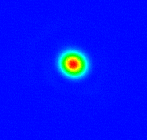
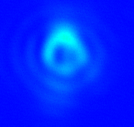
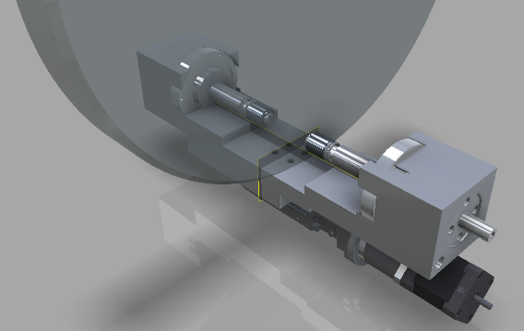
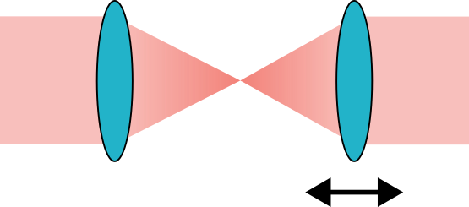
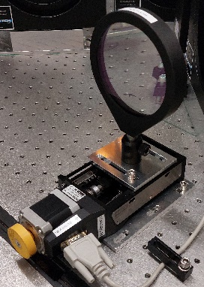
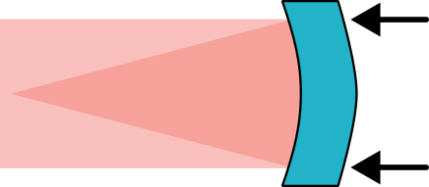
On-Shot Aberrations
Main on-shot aberrations are defocus and astigmatism.
before shot
on-shot
Defocus compensation
Astigmatism compensation
motorized lens
bendable mirror

Slide 6
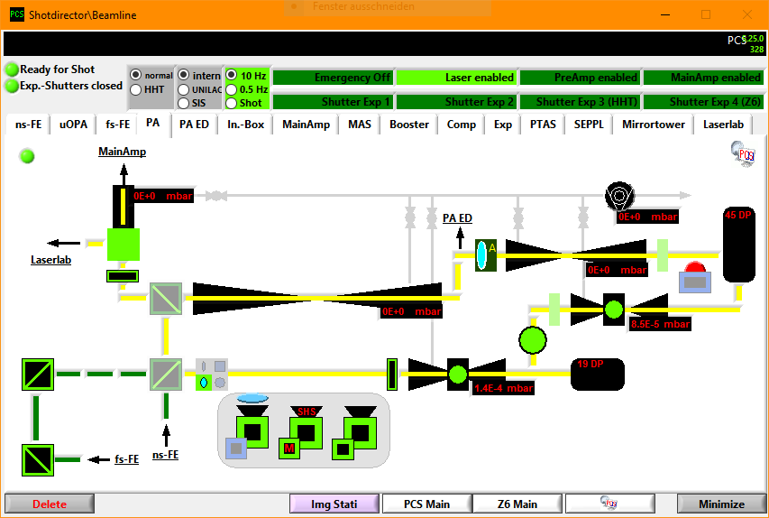
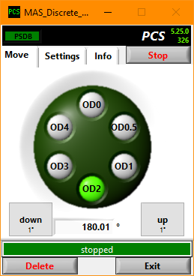
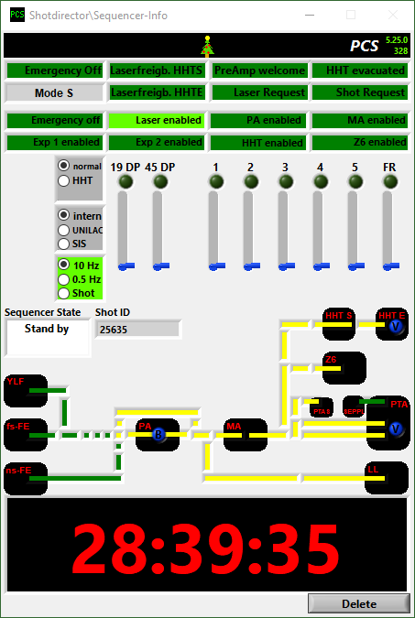
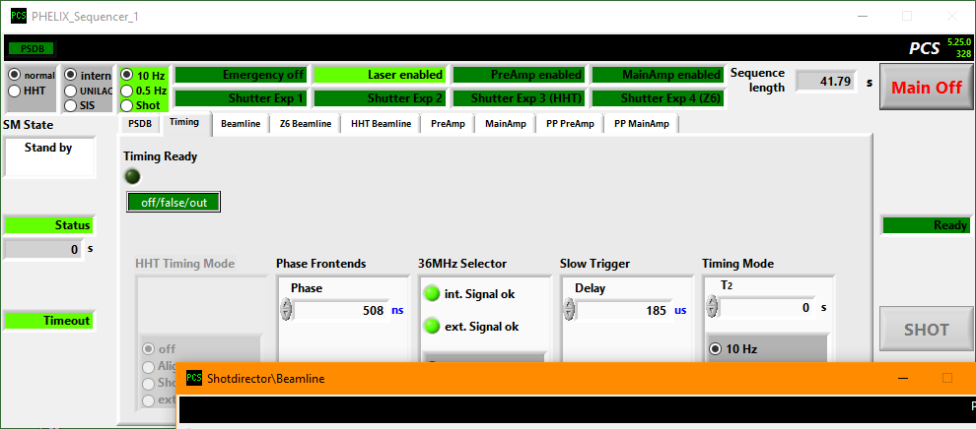
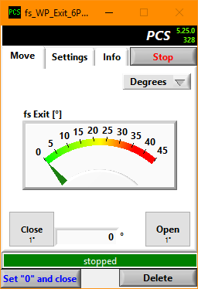
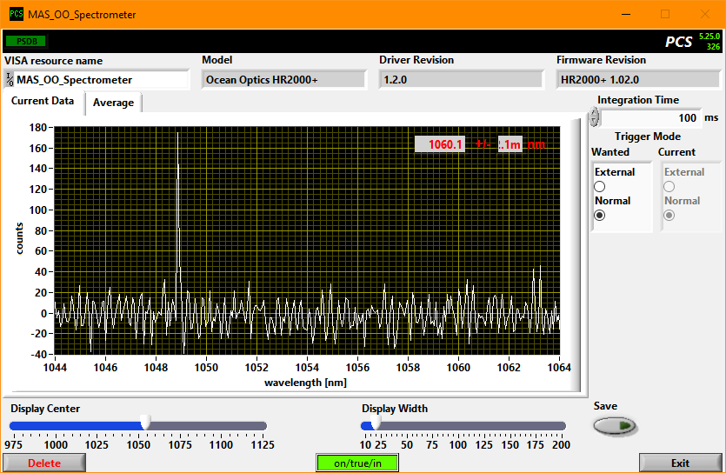
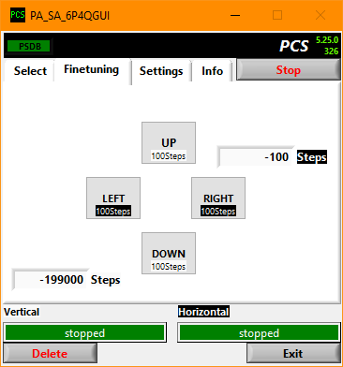
PHELIX Control System (PCS)
In-house development based on LabVIEW
> 15000 process variables
> 30 PCs in a network cluster
> 100 device classes
  cameras
  energy meters
  motion controllers
  pulsed power
  database
  …
> 350 device instances

Slide 7
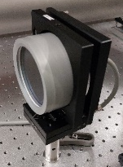
Wavefront Control Integration I
Static wavefront correction
Beam quality manager
Deformable mirror 1
MainAmp WF sensor
Actor | Sensor
Def. mirror 1 | MainAmp WF sensor
Def. mirror 2 | Target Chamber WF sensor
Deformable mirror 2
Target Chamber WF sensor
network
network
Actors and sensors are connected through a routing table.
Communication over control (ethernet) network.
Prepared for controlling not only deformable mirrors but also adaptive groups.
Adaptive Group

Slide 8
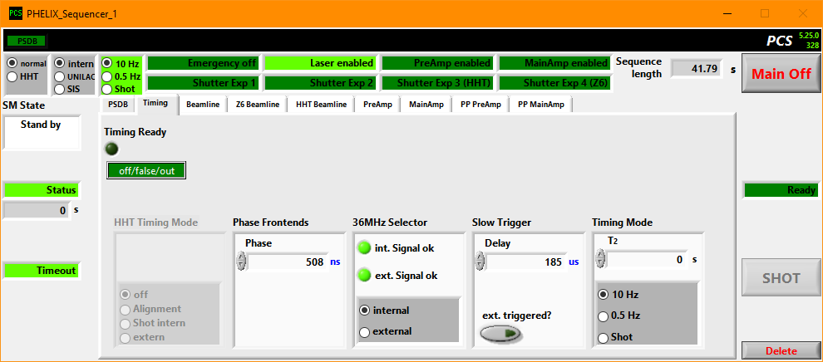

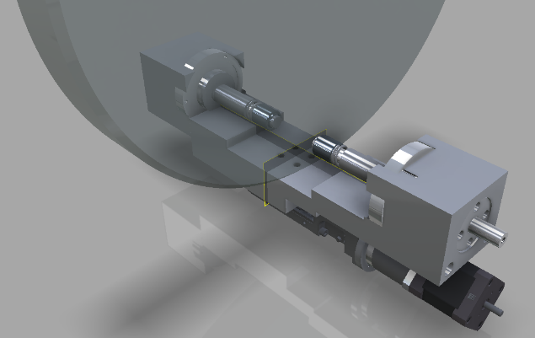
Wavefront Control IntegrAtion II
Pre-compensation of on-shot aberrations
Motorized lenses and bendable mirror have an alignment and 1 (or more) predefined shot positions.
During shot configuration:
  PCS sequencer selects the appropriate shot positions depending on desired setup (e.g. # of amplifier heads to be fired).
Beginning of shot sequence:
  Energy meters are zeroed
  # of averages for wavefront sensors set to 1
  . . .
End of shot sequence:
  Write mesaurement and config data to shot database (PSDB).
  Go back to alignment positions
  # of average back to original value
PCS sequencer

Slide 9
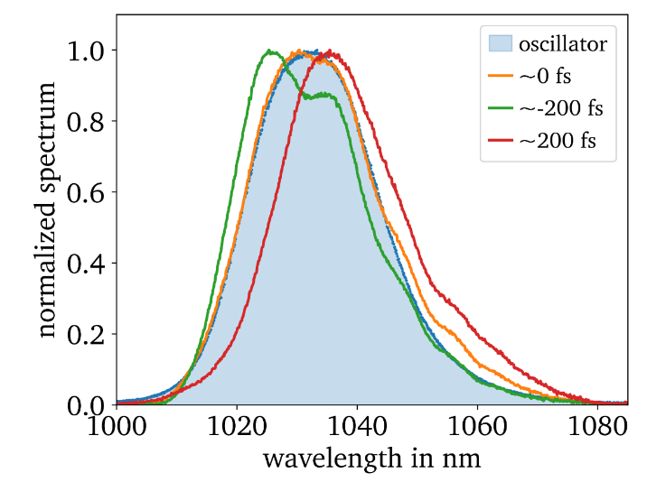
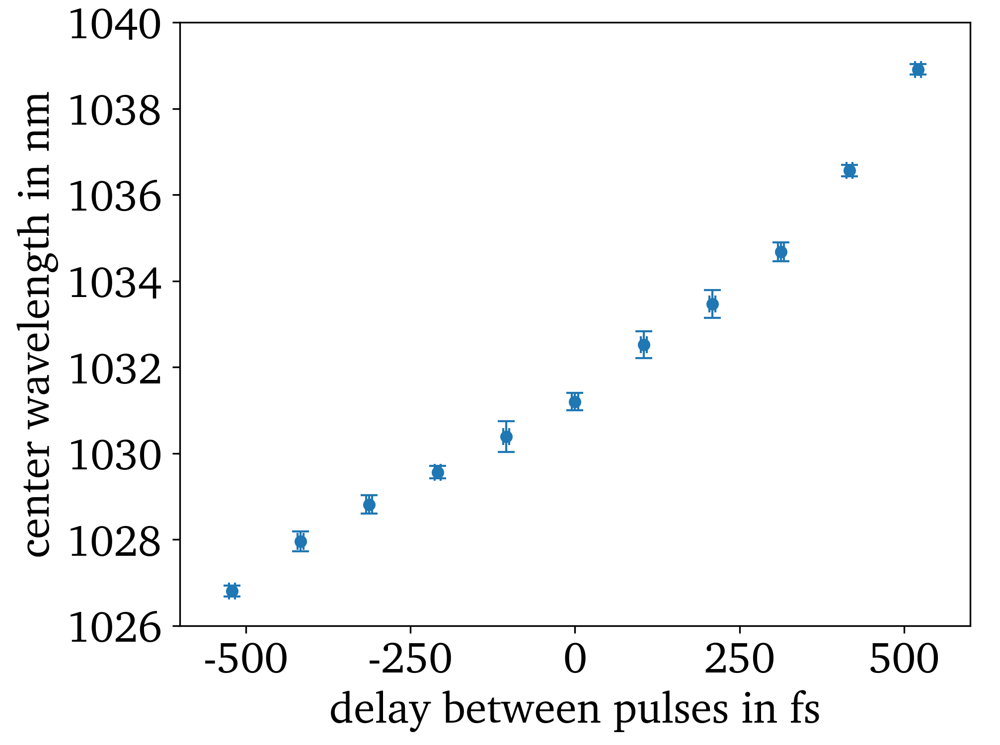


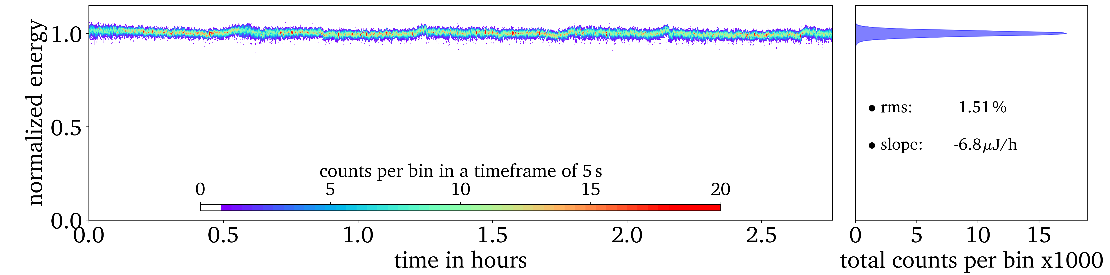
FURTHER Controls LOOPS: Temporal stabilization
Spectral shift
Spectral shift over delay
Different paths of pump and signal of ps-OPA:
temporal drift → gain fluctuation
Chirped signal + temporal drift: spectral shift
Use spectral shift to stabilize temporal drift
Energy Stability

Slide 10
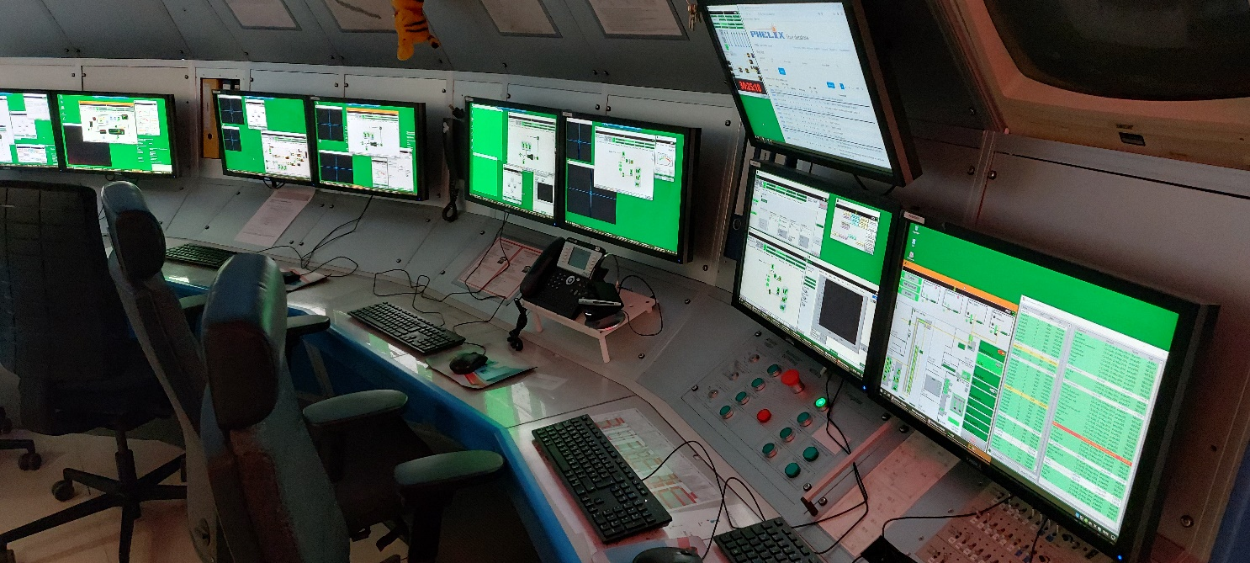
Future Automations
Currently: two persons / beamtime shift
Goal: One person operation
Automatic setup of laser system depending on desired output beam parameters
  number and gain of amplifiers
  input energy (delivered by frontends)
  diagnostic filter and cam settings
Much more and improved automatic fault detection

Slide 11
Udo Eisenbarth
GSI Helmholtz centre for heavy ion research
69291 Darmstadt
GERMANY

