Slide 1
Machine Learning applications at ISIS Neutron and Muon Source
Kathryn Baker (k.baker@stfc.ac.uk)
on behalf of ISIS Controls and Scientific Machine Learning Group at STFC
2nd LPA Special Workshop on Intelligent Systems
Department of Physics, University of Oxford
14 January 2025

Slide 2
Overview
Introduction to ISIS
Anomaly Detection
Intelligent Control
Surrogate Modelling
ML Operations (MLOps)
Summary
Questions

Slide 3
Introduction
What is ISIS and how do we make neutrons?

Slide 4
Oxford
Abingdon
Didcot
A34
ISIS
Harwell Campus
Notes:
ISIS is a neutron spallation source based on the Rutherford Appleton Laboratory, part of the Hrawell Campus just south of Oxford. On the same site we have the Diamond Light Source as well as the central laser facility who you may be more familiar with, but ISIS is here as you can see in the red box

Slide 5

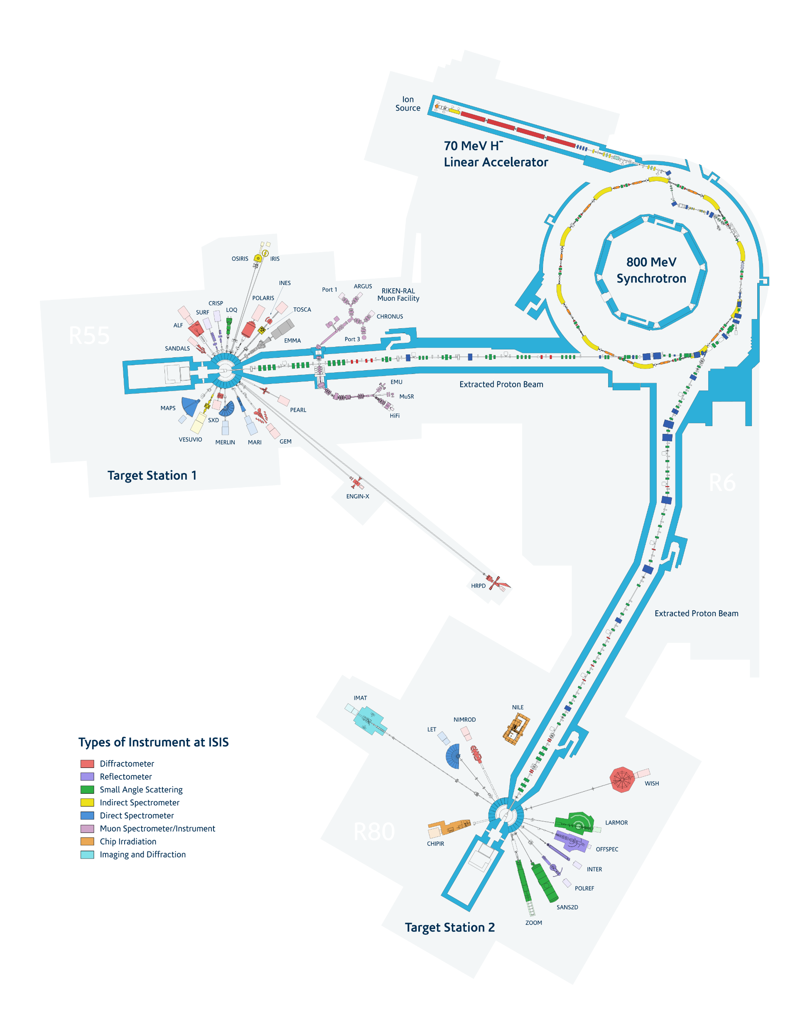
H- Ion source
RFQ & DTL
Rapid Cycling
Synchrotron
Target Stations
Notes:
So I’ve told you that we are a spallation neutron source but how do we make these neutrons? The accelerator part of ISIS consists of a linear accelerator that takes H- ions up to approximately 70MeV. At this energy, the H- ions are stripped of their electrons to produce positive hydrogen ions are protons which are accelerated to 800MeV and bunched together into pulses over 10,000 turns in the synchrotron that you can see here in yellow. Once the 10k turns have completed, the proton bunches are kicked out of the ring, four of them being sent down the extract proton beam line towards target station one and one being sent to target station 2. At these targets, the proton bunches collide with a neutron dense tungsten target, where the impact from the high energy protons essentially kicks the neutrons out in a shower where they go down our beamlines to be used in different experiments for examply reflectometers and diffractometers as we as for imaging

Slide 6
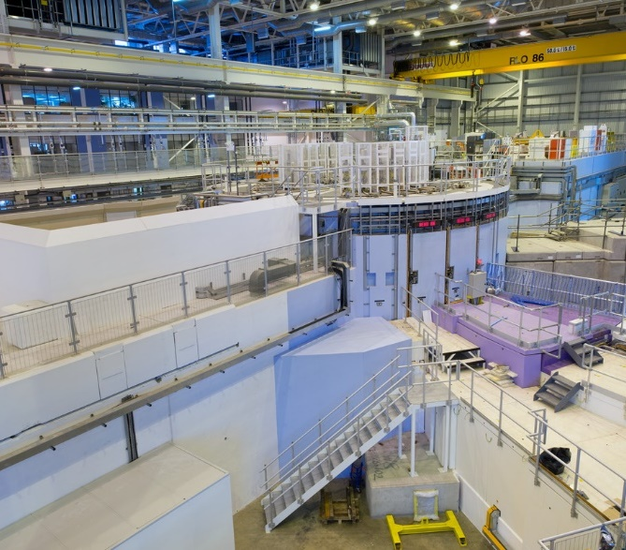
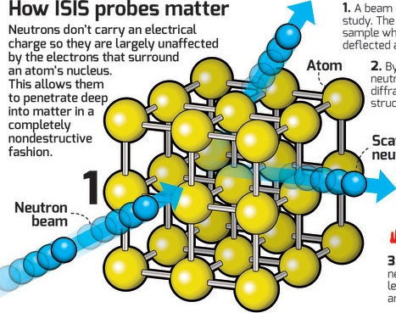
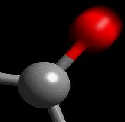
Why do we do it?
Study materials using neutrons to discover:
Where the atoms are
And what they do
For more information:
A Practical Guide to the ISIS Neutron and Muon Source (PDF)
Notes:
So why do we do this? Essentially ISIS is a big neutron microscope, the interaction of the neutrons with the samples that users bring us allows us to determine where the atoms are within the sample as well as what they are doing and how the interact with neighbouring atoms. The neutrality of neutrons also lets us penetrate much further into the atoms so it interacts with the nucleus rather than the electron cloud, essentially meaning that you can study a very wide range of materials, even including very light atoms like Hydrogen and carbon that are more difficult to image using light-based techniques

Slide 7
What are the key parameters?
Provide high intensity, stable, efficient pulsed beam to a target with minimal downtime
Proton Accelerator
Laser Facility
Beam generation from a particle source
Acceleration using RF cavities and magnets
Beam guidance using bending and focusing magnets
Synchronises proton bunches in the order of milliseconds
Diagnostics include beam position, intensity and losses
Beam generation from an optical oscillator
Amplification using optical gain media
Beam guidance using adaptive optics and filters
Synchronisation at the femto or picosecond scale
Diagnostics include beam profile, pulse duration and wavelength
Notes:
What I’m trying to show with this slide is that despite the differences between the two types of facility, ultimately we share the same goal where we want to provide a high intensity, stable and efficient pulsed beam to a target. In the case of a laser facility that target might be the sample itself while for us it’s a neutron dense target, ultimately it’s the same. Although we might use different tools to produce, guide, shape and measure our beam, ultimately we all want the same thing – we want to know as much about our beam as we can so we can accurately modify change control parameters to keep things running smoothly. Again, the timescale over which we do that might vary but the solutions and techniques we apply will likely be quite similar.

Slide 8
Anomaly Detection
TS1 Methane Moderator
Notes:
With that in mind I’m going to spend some time today talking through some of the use cases we’ve identified where machine learning could be used to help improve performance of the accelerator and I hope you’ll be able to draw some parallels with examples in your area of expertise.
I will start with anomaly detection

Slide 9
Anomaly Detection - Current
Normal operations
Instability occurs
Identify the cause
Fix it
Highlighted to operator
Manual intervention
Rules-based triggers
Expert knowledge
Notes:
The normal cycle of operations is as such:
normal operations until some instability occurs
Instability is picked up by rules-based alarm triggers in control system
The alarm highlights the issue to the operator
They use their expert knowledge to identify the cause of the problem
They fix it
However, this relies on expert knowledge and also that the alarm will be picked up by these rules based triggers. Sometimes they are more insidious or are hard to capture with simple rules

Slide 10
Anomaly Detection – Now (ish)
Normal operations
Instability occurs
Identify the cause
Fix it
Highlighted to operator
Manual intervention
Machine learning
Root Cause Analysis
Notes:
What we’re currently working towards is to have system where instabilities can be detected and highlighted to the operator more accurately using machine learning. Anomaly detection will identify the problem and highlight it to the user. Then, based on an automated analysis of associated channels, it can help to find the cause of the problem to tell the operator where to look to fix it.

Slide 11
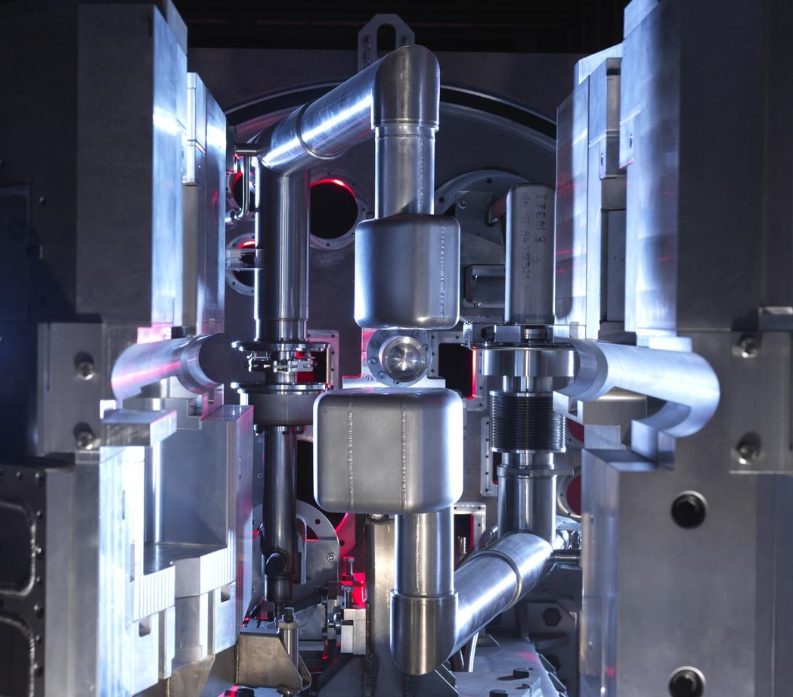
Anomaly Detection – ISIS Example
Neutrons must be slowed (“moderated”) to perform scattering experiments
Very stable moderator temperature required
Target station 1 uses a liquid methane moderator
Interaction with neutrons causes ‘gunk’ build up
Causes pressure and temperature fluctuations
Notes:
One of the cases where we’re applying this at ISIS is in our Target Station 1 Methane Moderators.
The neutrons that come directly from the target have a really wide range of energies but specific experiments require neutrons at much lower energies, so we use moderators to slow the neutrons down. One of these in TS1 is a liquid methane moderator, which requires a very stable temperature to get the correct energy range for the neutrons. However, the interaction with the liquid methane over time can cause methane molecules to link together and form gunk or sometimes gas bubbles as well which can cause temperature fluctuations in the moderator, which we don’t want! SO what we would like to be able to do is identify when spikes and fluctuations like these are occurring

Slide 12
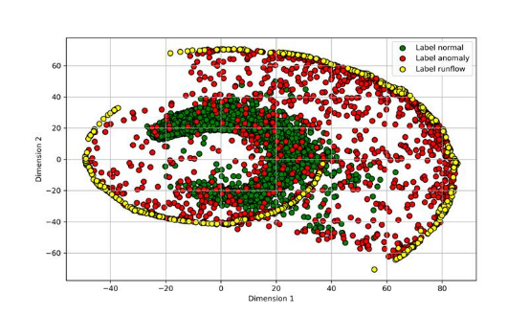
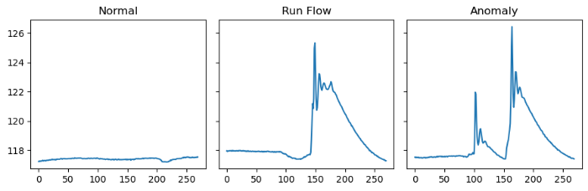
Anomaly Detection – The Solution
Train neural networks on what normal behavior looks like for all channels in system
Deploy onto control system for monitoring
Highlight times when channels deviate from normal
Use channel distance from ‘normal’ to perform root cause analysis
Operators interpret RCA to manually find problem and rectify
Notes:
However we have the case where there are much more examples of normal behaviour than abnormal behaviour. In this case what we’ve done is identify channels that are relevant to the component within the control system. We train a variety of neural networks on what normal looks like and then use those networks or a lower dimensional representation to estimate the ‘distance’ to normal behaviour, triggering an alert if the channel’s behaviour is very different. Then you can use each of these channels and their respective distances to normal to determine which was the most likely cause of the problem.

Slide 13
Anomaly Prediction – Future
Normal operations
Instability occurs
Identify the cause
Fix it
Highlighted to operator
Intelligent control
Machine learning
Root Cause Analysis
Notes:
In the even more distant future, what you actually want is anomaly prediction. This will allow us to predict that the failure will happen ahead of time and we can take action to prevent the anomaly from ever occurring so we never deviate from normal operations.

Slide 14
Key Points
We always want stable systems
When something is unstable you want to know about it
We also want to know what’s causing the instability
If possible, we want to fix it automatically
ISIS Example – TS1 moderator
  Lots more examples of normal
  Train on normal and highlight periods outside of this
  Use analysis of difference from ‘normal’ to perform Root Cause Analysis

Slide 15
Intelligent Control
Bayesian Optimization – Low Energy Beam Transport
Notes:
As I work in the controls group, the other thing we have been looking into is the use of intelligent control and Bayesian optimization to improve the speed and ease at which operators can tune the machine.

Slide 16

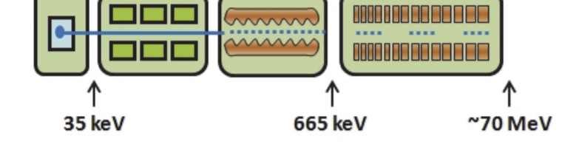
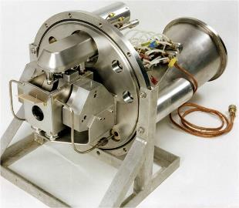
ISIS Operations
Notes:
ISIS runs in approximately 12 week cycles, between which we have maintenance periods where the machine is switched off. Between each cycle and at a maintenance day throughout the cycle we replace the ion source. However there is a lot of variation in these sources and what we often find is that things aren’t behaving in the exact same way as we left them so the operators and machine physicists have to tune the machine to get it to it’s best performance after each shut down and ion source replacement.

Slide 17
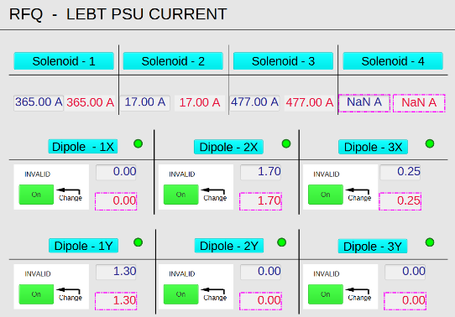
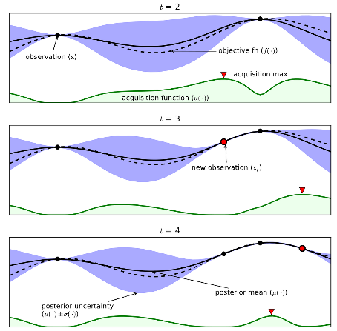
Automated Tuning of the Accelerator
Accelerator is never exactly the same cycle to cycle or ion source to ion source
Has to be tuned at each start up – currently done by hand – slow!
Bayesian Optimization can be used to efficiently search complex spaces
Source: https://towardsdatascience.com/shallow-understanding-on-bayesian-optimization-324b6c1f7083?gi=7f8b0ee93c28
Notes:
Currently this is all done by hand using control screens but we are experimenting with using Bayesian optimization to do some of this tuning automatically. For this to work, we need to accurately define the optimization problem we’re trying to solve. This not only includes determining what we want to optimize but also define environment we’re working in and how we can change parameters in this system. It requires a very in-depth knowledge about the system you’re working with.

Slide 18
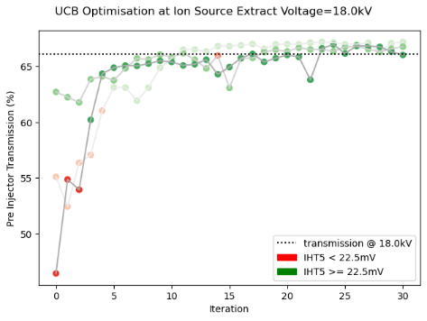
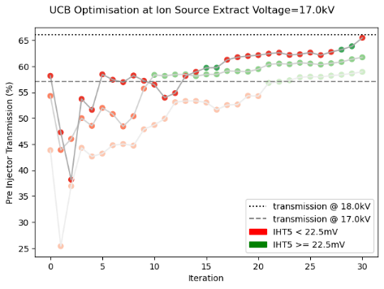
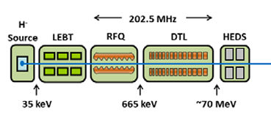


Bayesian Optimization at ISIS – Low Energy Beam Transport (LEBT)
Define optimization problem
Define environment and control parameters
Write code to interface with machine via EPICS
Simulating different cycle conditions e.g. degrading ion source
Pre-injector efficiency
Current at end of Linac (IHT5)
Notes:
Once we have this defined, Badger and Xopt (which I think Ryan already presented yesterday) can be used to get access to a range of optimization algorithms really quickly and easily. One of the areas we’ve been testing these methods is in our Low Energy Beam Transport (LEBT) which immediately follows the ion source. Here we want to optimize the transmission efficiency of the LEBT but on the condition that we don’t decrease the current at the end of the linac too much. Therefore we have one objective and one constraint. We’ve been testing these methods running simple optimisations in different operating conditions that simulate the different conditions during cycle, for example here we have a much worse performing ion source which we tend to see at the end of a cycle.

Slide 19
Automated Tuning - Future
Set up GUI for operators to use in control room
Testing of more complex algorithms and configurations offline with surrogate models
Define more optimization problems across the linear accelerator
Investigate continuous control / stabilization algorithms
Notes:
Using Xopt has made it really easy for us to get this working out of the box and we’ve had very positive results from operators about it’s use. Most of the testing we’ve done has been through scripts in machine development periods so next we want to make this available as a tool for operators. For this we’ll need a GUI. We also want to expand to different areas of the machine. So far we’ve only tested this on one-off optimisations like start ups but we’ve also had requests from operators for more continuous control which is more like stabilization tasks so this is another area we want to explore.

Slide 20
Intelligent Control – Key Points
Bayesian optimization can be used for complex, expensive tasks like tuning an accelerator
You have to define the optimization problem well
You have to know your system well
So far the most effective introduction to machine learning for operators and physicists!

Slide 21
Surrogate Modelling
Longitudinal Beam Dynamics & Medium Energy Beam Transport
Notes:
The other area we have been paying a lot of attention to is surrogate modelling so I’ll talk about a couple of examples of how we’ve applied this at ISIS.

Slide 22
Surrogate Modelling – Why?
Physics Models
Machine Diagnostics
All beam info available
Easily configurable
Available offline = safe!
Slow to run
Show ideal case
Representative of actual behaviour
Fast
Not always available
Sometimes destructive
Dictated by machine state
Notes:
I’m sure many of you already have experience using particle tracking codes for simulating beam behaviour under different conditions
You therefore already know that these codes can be really powerful in giving you as much information about the beam as possible including information that isn’t normally measurable on the machine. You also probably therefore know how slow these codes can be to run and the limitations in their scope in that they show the beam behaviour under ideal conditions.
Whereas when you’re working with the beam itself, you obviously get a full view of what the beam is actually doing but there will be some parameters that you can’t estimate. You also probably don’t get to take the measurements that you want to take because pesky users keep wanting the beam to be stable in operations!

Slide 23
Surrogate Modelling – Why?
Physics Models
Machine Diagnostics
All beam info available
Easily configurable
Available offline = safe!
Slow to run
Show ideal case
Representative of actual behaviour
Fast
Not always available
Sometimes destructive
Dictated by machine state
Surrogate models can give the best of both worlds!
Notes:
This is where surrogate modelling comes in because it can give you the best of both worlds. By building fast-executing models of particle tracking codes you can get offline estimates of unmeasurable parameters based on current or configurable conditions at any time. You can also factor in known deviations or offsets if you want to to make the results better match live observations. The best thing is that you can put these models into bad machine configurations without actually posing any risk to safety.
This creates a really powerful tool for making these beam parameter estimates available in the control room for operators to use to guide decision making. Likewise, they can be used for testing control applications offline.

Slide 24
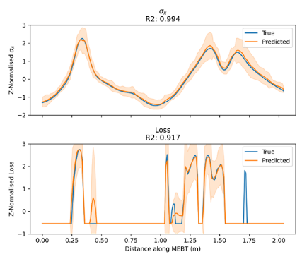
Medium Energy Beam Transport (MEBT)
Predicting the beam evolution through the MEBT for a given combination of machine settings
ASTRA (Fortran) particle tracking code takes approx. 2 days to run a sim
Predicting envelope, position, energy, loss from quad settings, cavity settings and incoming beam profile
Using densely connected layers to predict outputs
Uncertainty Quantification (UQ) via quantile regression or HyperGAN model
Deployed as model in EPICS control system
Used to test optimization behaviour offline
MEBT will go here
Inputs:
Quadrupoles x 8
Cavities x 4
Beam Position (x&y)
Beam Size (x & y)
Beam current
Outputs:
Loss profile
Beam Position (x&y)
Beam size (x&y)
Beam Energy
Bunch Length
Emittance (x&y)
Notes:
We have applied this to the Medium Energy Beam Transport at ISIS, a new component due to be installed between the RFQ and the drfit tube linac in the ISIS injector. Essnetially we predict key beam descriptors like it’s position, size, emittance and beam losses along the length of the MEBT from machine settings like the quadrupole and cavitiy field strengths and the incoming beam. We used ASTRA to generate a dataset of about 1,600 samples, each one taking on the order of days to run. We trained a relatively simple neural network using only densely connected layers to predict these outputs, using a quantile regression loss function to get uncertainty estimates for the model prediction.
Once trained, the model executes in less than a second rather than days, so the model can be used either as a virtual diagnostic in the control room to gain access to beam parameters that can’t be measured during operation, or as a ‘virtual component’ that we can leverage to develop optimization routines that can be used during commissioning of the MEBT to reduce the time it takes to go from installation to operation. Using this model we can test optimization algorithm behaviour and better construct and hone the optimization routine for more rapid deployment of the component during commissioning.

Slide 25
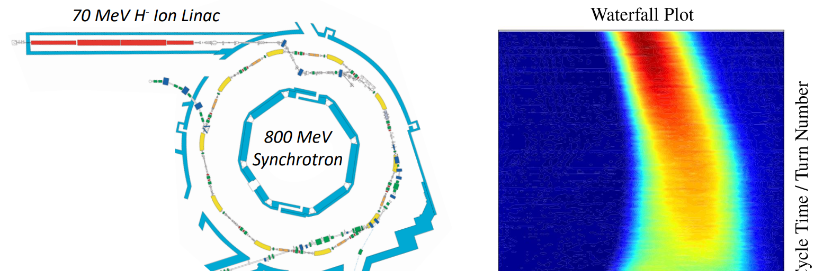
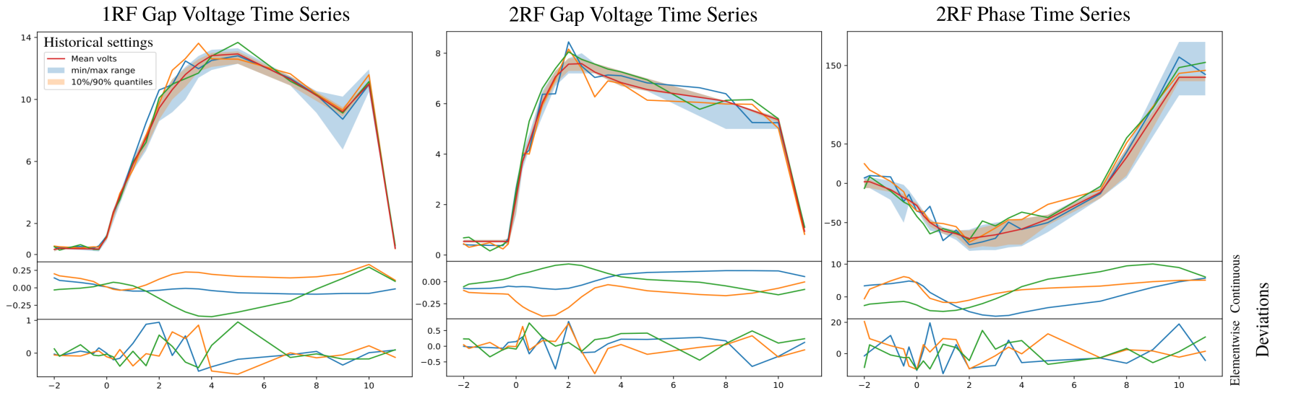
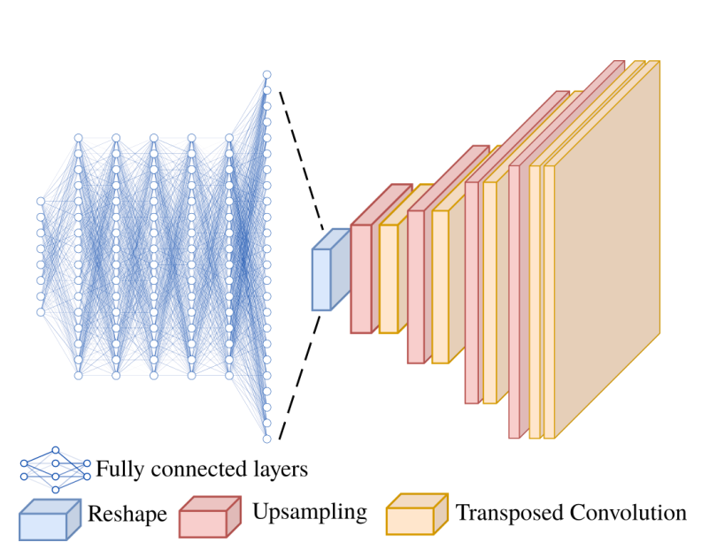
Longitudinal Beam Dynamics
Here we predict the evolution of the bunch’s longitudinal charge length – a ‘waterfall’ plot
In-house developed simulation takes approx. 5 mins to run
Inputs are machine settings (RF cavity voltage and phase)
11,000 simulations used
Developed using a combination of densely connected layers and convolutional layers
Custom loss function to focus on oscillations
Inputs
Outputs
Notes:
Likewise, we trained a surrogate model on some in-house code for modelling the longitudinal beam dynamics in the synchrotron. Here the input features are the RF cavity voltage settings and the phase
And the output ‘waterfall plot’ represents the evolution of the bunch’s longitudinal charge length over the 10,000 turns of the acceleration cycle at ISIS. This model utilized a combination of densely connected layers with convolutional layers, as well as a custom loss function during training. Again, this sped up the model from taking 5 minutes to run to less than a second, making it possible to deploy in the control room to test changes to the synchrotron RF before applying it to the machine.

Slide 26
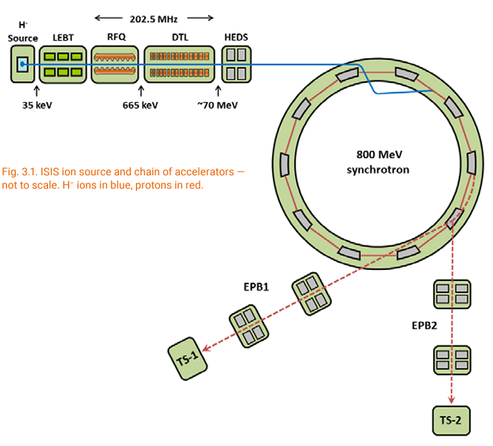
Surrogate Modelling - Future
Start to end digital twin of the accelerator
Ability to compare live against predicted
  Continual learning
  Continuous control
Physics informed neural networks
Notes:
The two cases I’ve described here are so far independent. What we would like to do in future is train a series of these models and link them together to make an end-to-end digital twin of the linear accelerator. This will allow us to know how changes to upstream control parameters will affect diagnostics downstream, useful in both the control room and also for testing and honing more complex optimisation routines in a safe environment. Comparison with live values against model predictions can also be used to update models or even to inform continuous control to improve stability of the machine.
Finally, one of the areas we’re keen to explore is physics-informed neural networks primarily to increase the speed at which these models are able to learn and to gain more accurate results from smaller datasets

Slide 27
Surrogate Modelling – Key Points
Physics simulations give comprehensive information about beam dynamics but can take a long time to run
Real diagnostic data is highly accurate but not always available
Surrogate modelling gives the best of both worlds - speed of real time diagnostics with more info and safer
ISIS Example – MEBT
  Densely connected layers with quantile regression or HyperGAN for UQ
ISIS Example – Longitudinal Beam Dynamics
  Densely connected layers with custom loss function
Surrogate modelling can support automated tuning efforts and training
Notes:
ISIS runs in approximately 12 week cycles, between which we have maintenance periods where the machine is switched off. At the beginning of the next cycle, what we often find is that things aren’t behaving in the exact same way as we left them so the operators and machine physicists have to tune the machine to get it to it’s best performance after each shut down. Currently this is all done by hand but we are experimenting with using Bayesian optimization to do some of this tuning automatically. However, that requires us to define the optimization problem appropriately, write the code to interface with the machine and test the implementation to ensure that safety constraints are not violated. We are in the process of testing these methods on the low energy beam transport at ISIS.

Slide 28
Machine Learning Operations (MLOps)
How do you use and maintain ML models?

Slide 29


MLOps
Notes:
If anyone has ever worked on a machine learning project I’m sure you’re all aware of how organised and structured everything feels at the beginning. You’ve got a great idea for a model that will help improve your facility and an idea of what type of model you want to use.
I’m sure you also know how quickly it can descend into chaos. Something didn’t quite work so you tweak a hyperparameter and get a better model and you continue down this rabbit hole until eventually you can’t remember which model was best and the notebook you’re using to compare all of your models starts to get VERY big.
Even worse is when someone comes along to help on your project and you have to try to explain your directory structure and results and share all of the training results with them.

Slide 30
MLOps – Software Development Inspiration
Collaborative development
Version control
Don’t Repeat Yourself (DRY) coding
Databases
Rapid, agile development
Out of the box solutions
Notes:
It’s funny because a lot of machine learning developers (although not all) have experience in software development and yet it’s very easy when working on ML projects to forget all of the good practice we’ve learned from our software experience. Things like writing code for collaborative development using modular code and using version control to track changes.
Databases are also used as standard for storing large information so that we can query and retrieve information quickly and easily and often the come with a front-end out of the box.
Likewise, agile software development teaches us that we should be starting with a simple solution that meets most of the needs of the client and then iterating and improving on this over time.
Quite often (at least from my experience) these concepts get forgotten in machine learning projects.

Slide 31
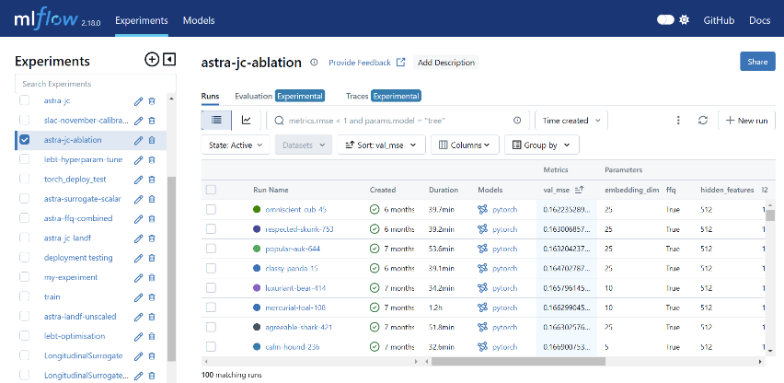
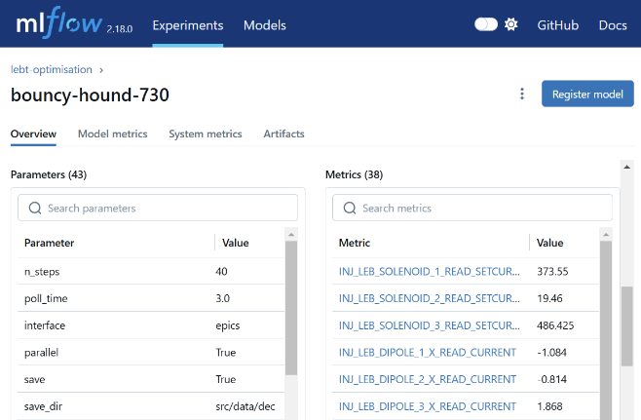
MLOps - Model Training with MLFlow
Models saved for later retrieval
Metrics saved at every epoch for convenient comparison and plotting
Training runs grouped by experiment
Hyperparameters stored for querying later
Notes:
One of the things we’ve tried to do recently is to bring some of these concepts into our machine learning development, primarily through the introduction of MLFlow, an experiment tracking tool. It allows you to:
Group training runs by experiment or project
Track hyperparameters
Follow training metrics
store models and training artifacts (plots) in a centralized database so anyone can access them later
It comes with an API for querying and comparing runs
All of this bodes well for a more collaborative approach to machine learning model development.

Slide 32
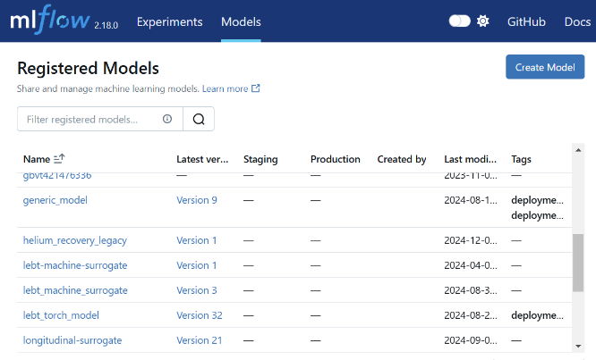
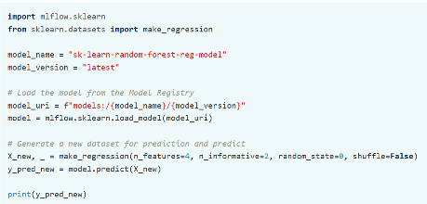
MLOps – Model Deployment with MLFlow
Notes:
MLFlow also has a model deployment component which addresses the issues around rapid prototyping and continuous deployment that has become accepted as good practice in software development.
Version controlling models in Git can be difficult due to their size so in MLFlow you can register a model and it will version control it for you. You can then doenload the registered model using the deployed model’s name and write applications on top of that. As soon as you’ve trained a better model you simply re-reister the model and the most recent one is used in production.

Slide 33

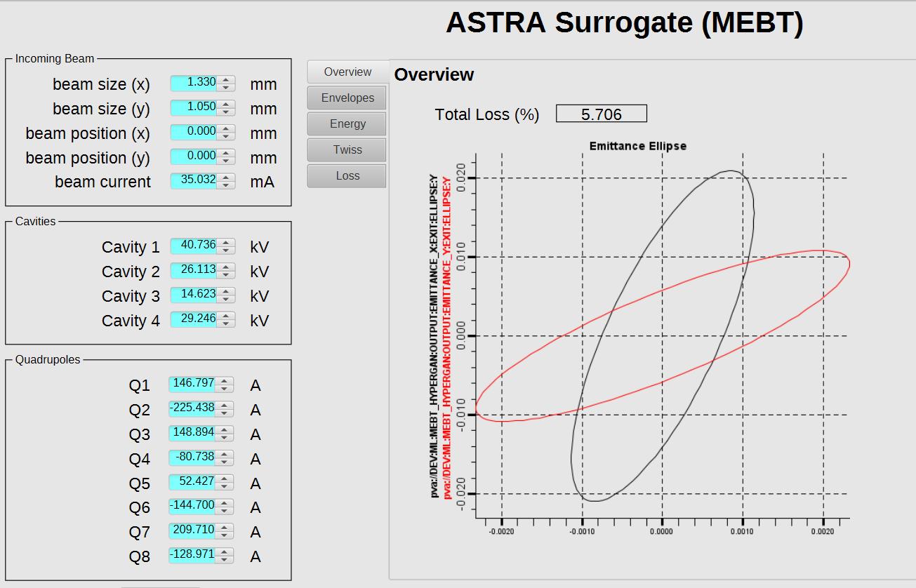




MLOps – Model Deployment into Control System
Model training
Register model
Deploy to Control System
User Feedback
Notes:
One of the big focuses for us is also making sure the models we train are usable by our operators. What’s the point in having an amazing model if the person benefitting from it can’t use it? For this we need to make sure it’s available to users via a GUI where Python experience isn’t a necessity.
For us, we’ve taken the approach of deploying the models directly into the EPICS Control System. This way, we can make GUIs for our users that sit in the same location and use the same tooling as our operators are familiar with. This way we can quickly get feedback about how to improve the models over time and we don’t have to change our existing infrastructure dramatically.

Slide 34
MLOps – Future
Improved organisation!
Model performance tracking
  Continual learning
Multiple deployments
Notes:
In future as the number of ML projects increase we will have to improve the organization of our mlflow instance. In future we also want to automate more of the process to take advantage of continual learning and CI/CD to automatically trigger retraining based on model performance. We would also like to investigate the potential of having the same models deployed in multiple containers so people can interact with their own independent versions of the variables instead of there being only one source of truth in the value of the PVs.

Slide 35
MLOps – Key Points
Moving from individual project-based ML to operational ML can be difficult
Experiment tracking allows us to apply software development good practice for ML training
  Database storage of hyperparameters, models and training artifacts
  Python API for easy use and querying
  Interactive plotting of results
Model version control allows us to apply software development good practice for ML deployment
  Version control for models
  Database storage of model parameters
  Containerization for easy, automated deployment
Models need to be made useful!
  Models need a GUI
  Models need to interact with a control system

Slide 36
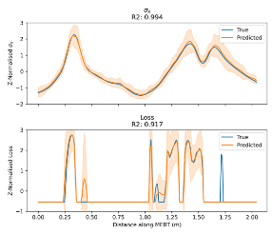
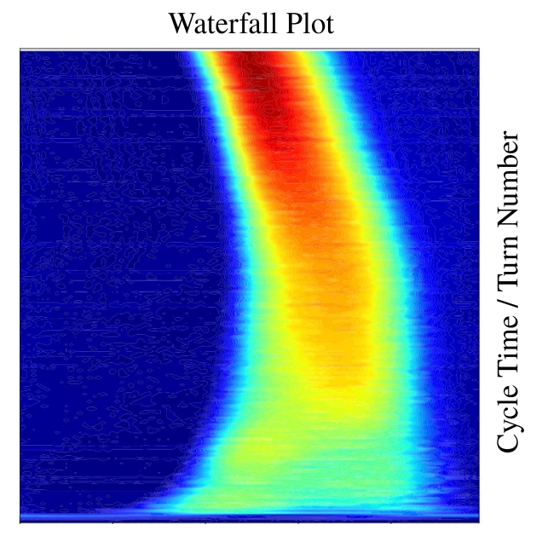
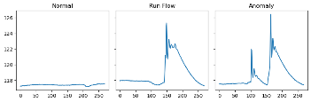
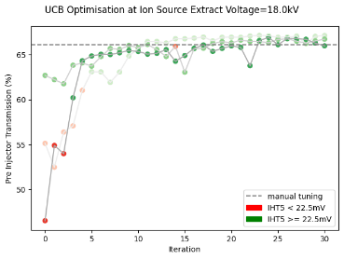
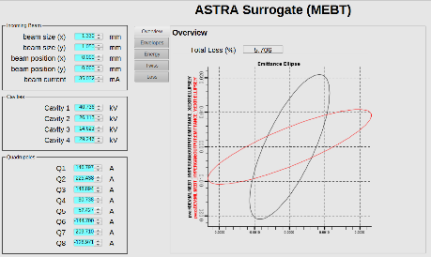

Summary – ML at ISIS
Normal operations
Instability occurs
Identify the cause
Fix it
Highlighted to operator
Anomaly Detection
Surrogate Modelling
Automated Tuning
MLOps

Slide 37
Thank you! Questions?
And thanks to Mihnea Romanovschi, Mateusz Leputa, Raunakk Banerjee, Jaehoon Cha, Xingchi Liu, Hayley Cavanagh
Notes:
Thank you for listening, I’m happy to take any questions you might have

Slide 38
Support Slides

Slide 39
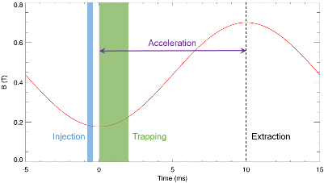
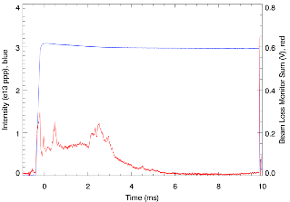
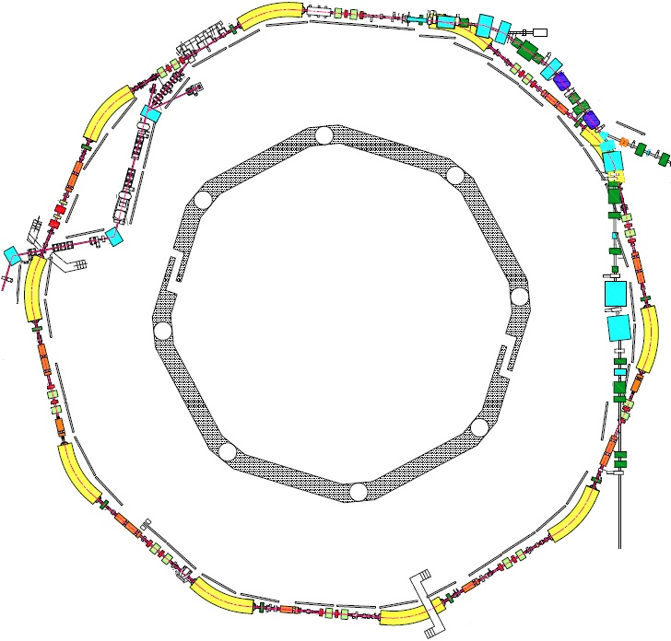
ISIS Parameters
Circumference: 163 m
Energy: 70–800 MeV
Repetition Rate: 50 Hz
Intensity: ~3x10¹³ ppp
Power: ~190 kW
Injection: 220 µs, 130 turn, charge exchange
Extraction: single turn, vertical
Betatron Tunes: (Q_{x}, Q_{y}) = (4.31, 3.83), programmable
Beam-Losses: Injection: 2%, Trapping: <3%,
Acceleration/Extraction: <0.5%
RF System: h=2, 1.3-3.1 MHz, 160 kV/turn
h=4, 2.6-6.2 MHz, 80 KV/turn
Extraction
Injection

