Slide 1
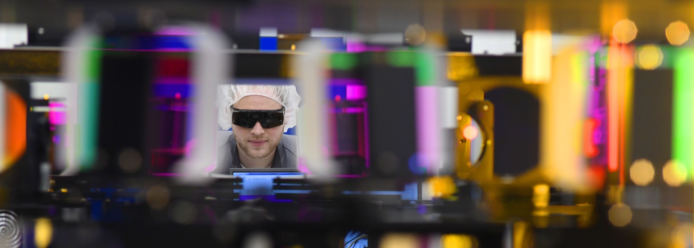
Status of CALA and overview of LMU‘s LWFA-related activities
Stefan Karsch
Ludwig-Maximilians-Universität München/
MPI für Quantenoptik
Garching, Germany

Slide 2
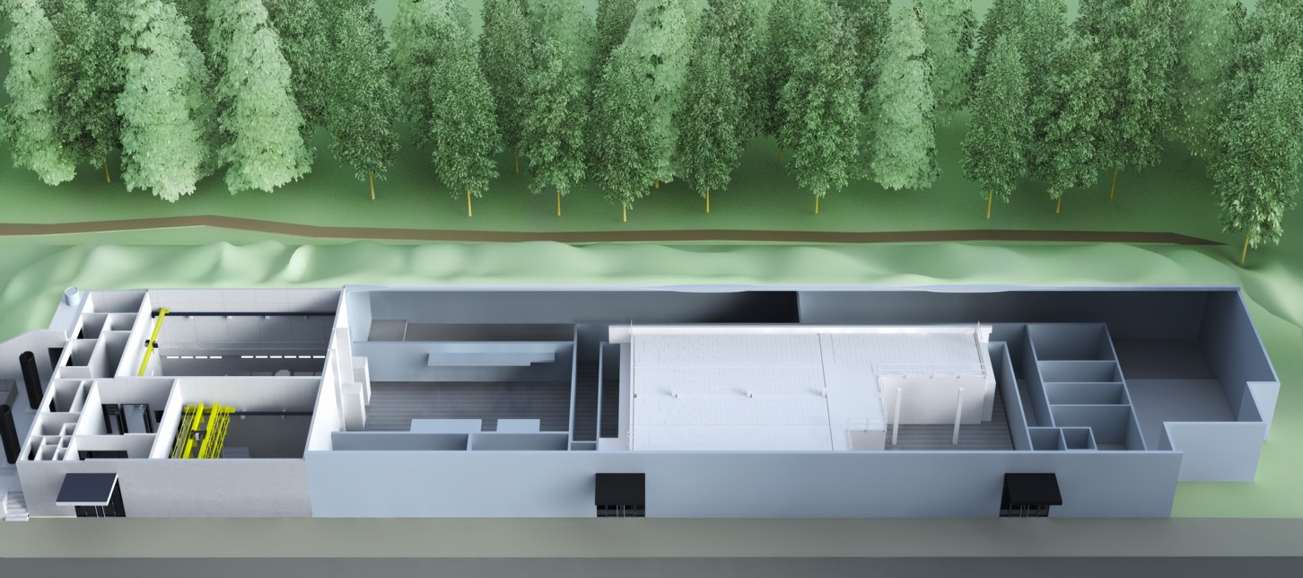

CALA building
Centre for Advanced Laser Applications:
75 M€ institute,
run by Ludwig-Maximilians-Universität München (LMU)

Slide 3
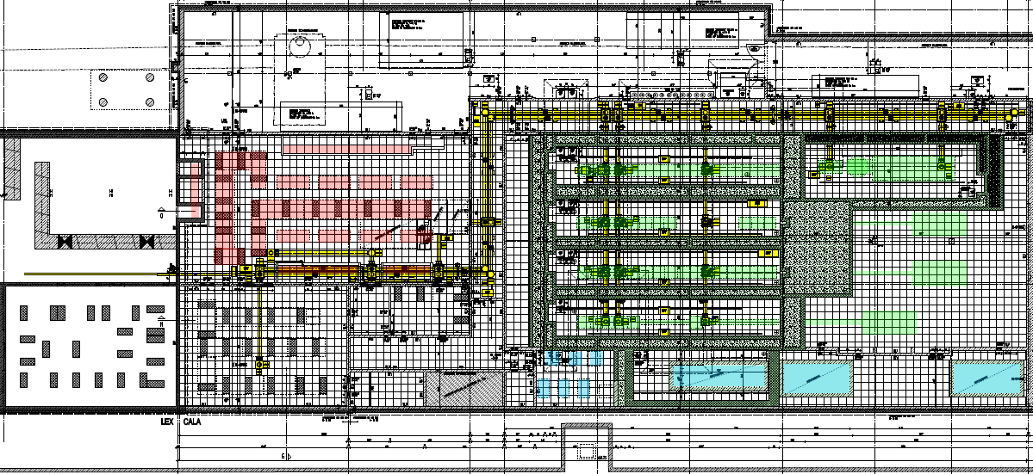
~100 m
LEX Photonics
CALA
Infrared spectroscopy
ATLAS 3000
3 PW Ti:Sa
Laser-ION source
High fields
General purpose electrons
GeV Electron & Thomson
Experimental hall photon application
Laser-Technology development
PFS / PFS-Pro
High power 5 fs
X-ray-Thomson source
Notes:
Within CALA, the Laser system ATLAS3000 will provide laser pulses with up to 3 PW peak power and 1 Hz repetition rate. This can be used in 4 experimental areas, one of which is dedicated to laser-ion (LION) acceleration studies and applications.

Slide 4
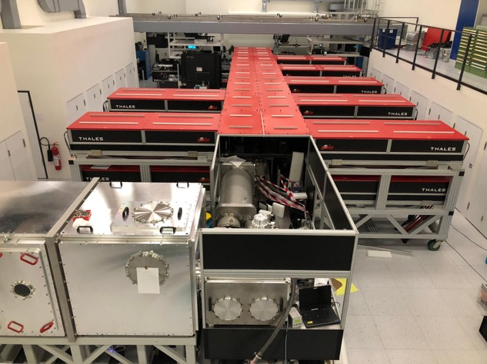
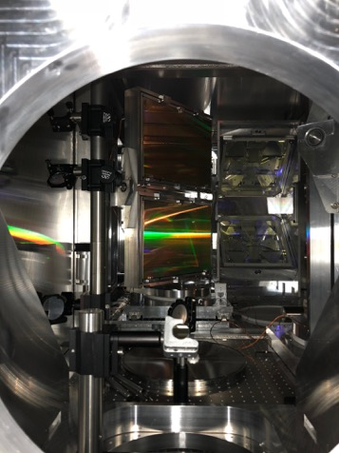
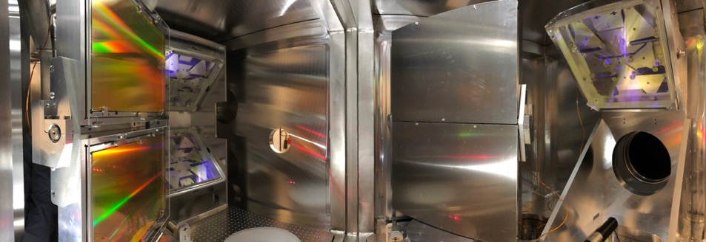
ATLAS-3000 laser room

Slide 5
ATLAS-3000 amplifier performance
nearfield/farfield 90J before compression
far field in ETTF chamber (f/20)
full energy spectra
far field in LION chamber (f/5)
measured focal spot.
1.5 m OAP
Wizzler and Frog trace (inset)
Δt_{FWHM} = 23.4 fs
λ_{mean} = 801.1 nm
Δλ_{FWHM} = 76.0 nm
Δt_{FTL} = 23.2 fs
21.11 fs

Slide 6
No application data from ATLAS-3000 yet –
we have to be content with 100 TW results
However:
Will finally get radiation safety go-ahead for electron acceleration BL by the end of the week

Slide 7
Record charge figures (100TW on target, before laser degradation)
approx 4 J
5mm nozzle
3x10¹⁸ cm⁻³
1.2 nC total
> 500 pC in peak
3 mrad FWHM
charge calibration of scintillation screens
see poster by Thomas Kurz
nC-class quasi-monoenenergetic bunches are within reach!

Slide 8
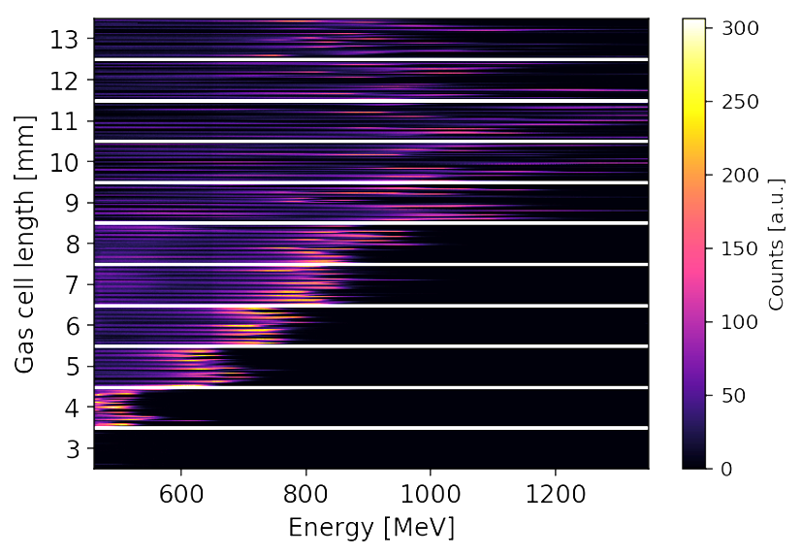
Electrons with 60-100 TW
shock-front injection in a gas jet
tuneable, stable, nC-class electron bunches
highest spectral charge density beams yet
ultrahigh-current (multi-kA)
∼ 250 pC
1 mrad
FWHM
wavebreaking (self-) injection in a gas cell

Slide 9
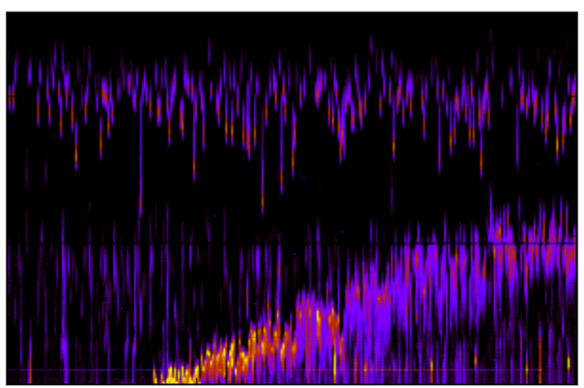
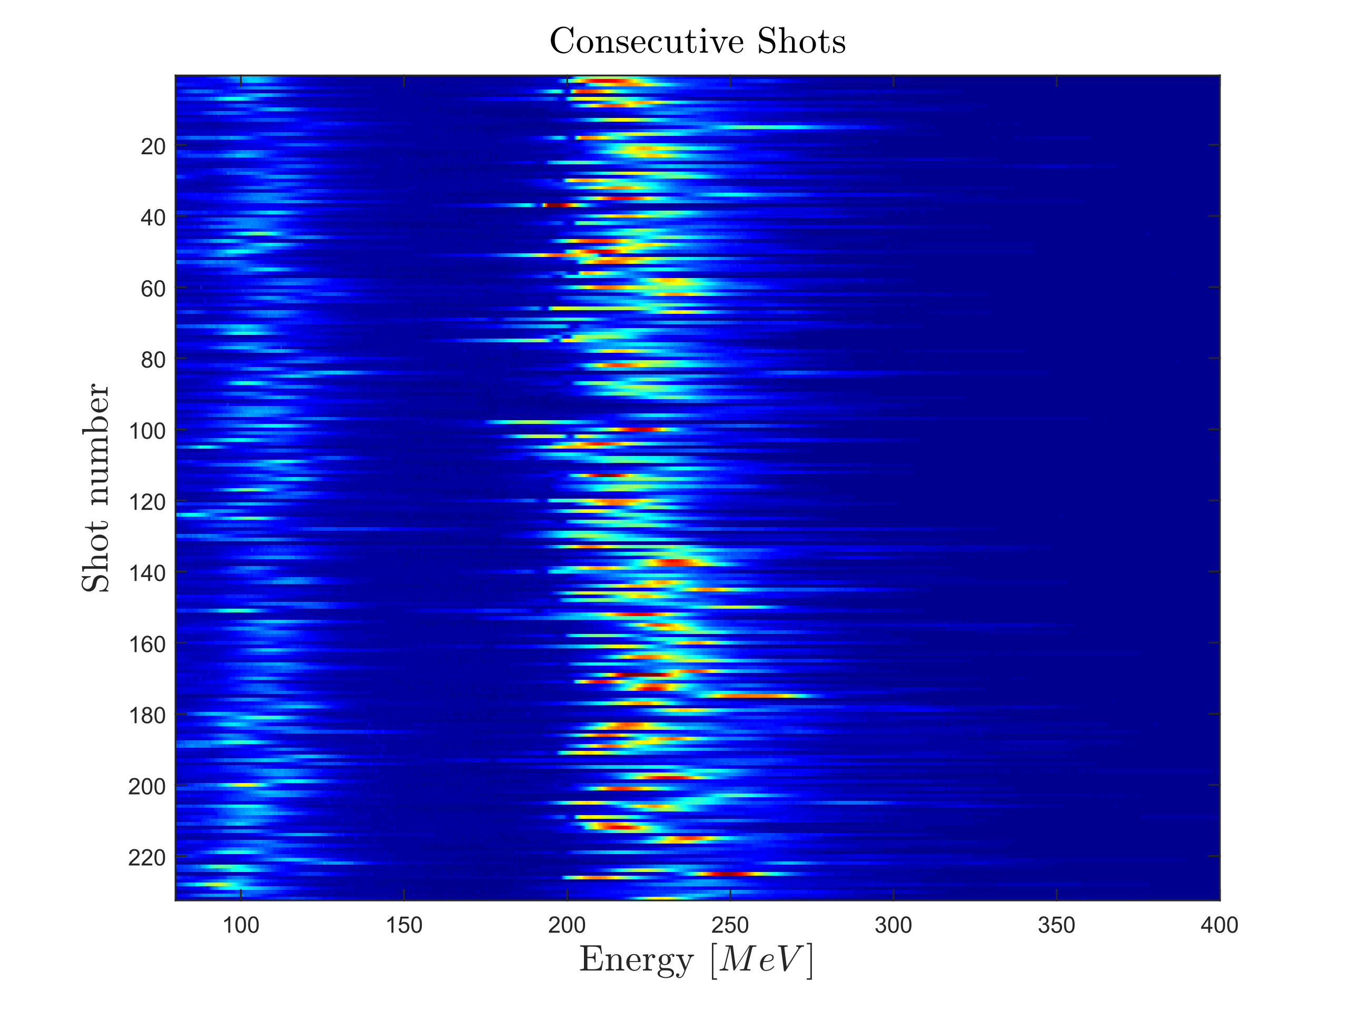
Towards dual color Thomson sources: dual energy electron beams
Shock front & colliding pulse
Shock front alone
400
350
300
250
energy [MeV]
200
150
100
50
0
50
100
150
200
250
300
collider position [a.u.]
electrons from 1st wakefield bucket
electrons from 1st & 2nd wakefield bucket
Wenz et al., Nature Photonics 13, 263-270 (2019)

Slide 10
Emittance control: Hybrid acceleration?
A. Martinez de la Ossa et al.
Wakefield-induced ionization injection

Slide 11
LWFA-beam driven wakefields and externally injected hybrid PWFA
High-charge beams driven wakefields...
... and can accelerate particles
1st jet only
for quantitative wakefield reconstruction:
see poster by Moritz Förster
1st & 2nd jet
energy gain scales with drive bunch charge
Gilljohann et al., Phys. Rev. X 9, 011046 (2019)

Slide 12
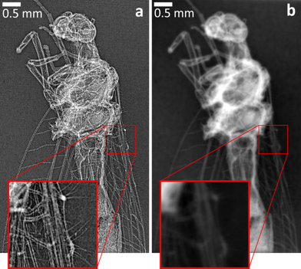
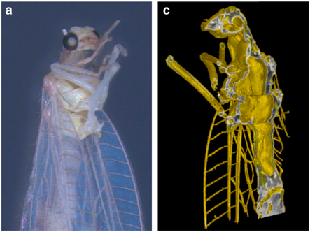
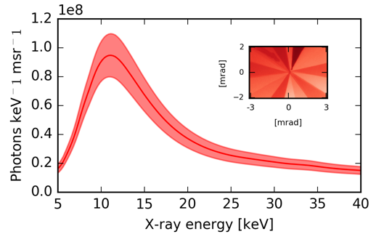
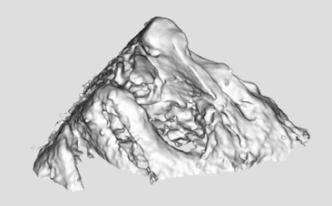
Betatron tomography
2012: Green lacewing, 6keV, 3h acquisition time (0.2 Hz, 10 shots/angle)
J. Wenz et al., Nat. Comm. 6 7568 (2015)
for polarized betatron radiation simulations
see poster by Tim Hager
2016: trabecular bone, 12keV,
3 min acquisition time
(higher electron charge, 1 shot/angle, 1Hz)
A. Döpp et al., Optica 5, 199 (2018)

Slide 13
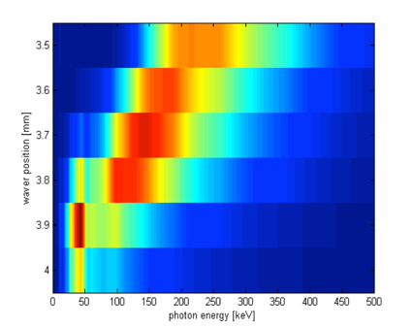
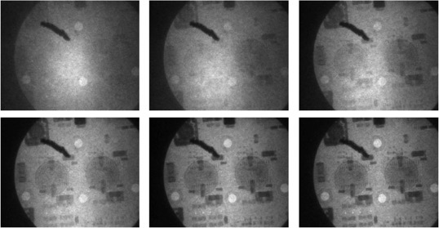
Thomson scattering
Khrennikov et al., PRL 114, 195003 (2015)
DAQ failure
Nonlinear Thomson scattering with 1.2J, 26 fs driver and 0.3J, 26 fs collider.
measured X-ray spectra correspond very well to those predicted from electron spectra
electrons allow to predict X-ray spectrum
Nonlinear Thomson scattering with 2.5J, 28 fs driver, reflected of a tape for collision
different absorption contrast for different photon energies
3.5
S hock position [mm]
3.6
see poster by Sabine Schindler
220 keV
175 keV
150 keV
3.7
3.8
3.9
110 keV
75 keV
45 keV
4
0
50
100
150
200
250
300
350
400
450
500
photon energy [keV]

Slide 14

Towards dual color Thomson sources:
400
350
300
250
energy [MeV]
200
150
100
50
0
50
100
150
200
250
300
collider position [a.u.]
Collider tunable over 50-200 MeV, while shock injection at 350 MeV
Bottom: Thomson source without (left) and with (right) dual beams
Wenz et al., Nature Photonics, DOI: 10.1038/s41566-019-0356-z (2019)
Notes:
The possibility to generate two (and potentially more) independently tunable electron bunches by utilizing shock-front and colliding pulse injection in a supersonic gas jet simultaneously allows the realization of dual-energy photon pulses in a single shot or in an alternating fashion. This indicates the importance for investigating methods for optimized electron bunch control and basic electron acceleration studies.
Top left: Dual-energy pulses from using ATLAS-60 by using a shock-front injector to produce fixed-energy 35-MeV electrons, and a colliding pulse with variable delay to create a second tunable lower-energy bunch. The left three settings place the colliding position before the shock in a steeply rising gradient, so no additional injection is caused by the colliding pulse and only the shock-front injected electrons are detected. The forth position corresponds to the collising point overlapping with the shock, and an enhanced number of electrons injected. Beam loading reduces the energy and energy spread. The remaining positions correspond to a situation where the first injection is made by the shock and a second collision injection takes place in the density plateau behind the shock.
Bottom left: a similar experiment with ATLAS-300 and a longer nozzle produces 350 MeV shock-front electrons and tunable colliding pulse - injected electrons. Scan direction opposite top picture, and overlap region was not measured. More intense colliding pulse lead to more charge in low-energy beam.
Right:
Top row: Calculated dual-energy spectra from measured electron spectrum shown in the inset, for K=0.55 undulator radiation (left) and a0=1..5 Thomson scattering (right)
Bottom row left: X-ray beam after stack of filters with only high-energy bunch (see inset) , Bottom row right: X-ray beam after stack of filters with both bunches (see inset). Although an increase in signal is visible, due to the high energy (several 100 keV) it is hard to derive an X-ray spectrum from the filter transmission for each shot.
Accepted by Nature Photonics with minor revisions (2018)

Slide 15
Theoretical x-ray spectra
measured electron spectrum used as simulation input
angle-resolved VUV spectrum from a magnetic undulator
(K=0.55, λ_{u}=5mm, N_{period} = 60)
angle-resolved x-ray spectrum from Compton-backscattering (a₀=1.5, λ=800 nm, Δt = 30fs)

Slide 16
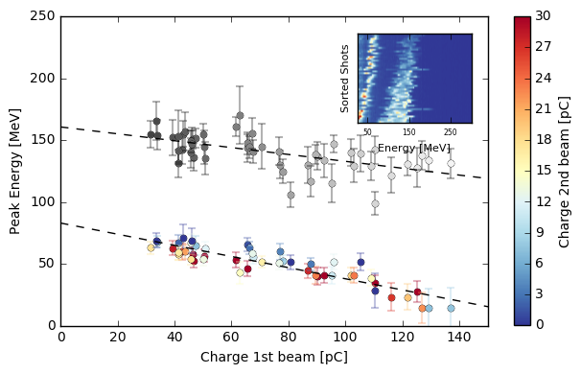
Prospects for multi-colour, controllable delay x-ray pulses
(“x-ray pump, x-ray probe”)
Clear correlation between charge of 1st beam and energy of 2nd beam: both beams sit in the same bubble
Pulse delay given by dephasing between both injection points (down to a few fs!) - obviously coupled to 2nd bunch energy
Very difficult for conventional accelerators!
Thomson scattering or undulator after chicane would allow setting delay

Slide 17
Conclusions:
Electron beams with >0.5nC charge in monoenergetic feature
Injection is key to controlling electron beam charge and energy
Multi-bunch injection can be used to enable multi-color X-ray sources
Hybrid acceleration is studied for better bunch emittance
Scan times for betatron tomography has been reduced by a factor of 50
First tests of multi-energy Thomson radiography
Hope for exciting new parameter regimes with upgraded laser coming up soon.
+ for surface HHG CEP-dependence experiments see poster by Olga Jahn

Slide 18
WG Karsch:
Postdoc:
A. Döpp
PHD candidates:
J. Wenz
M. Heigoldt
K. Khrennikov
M. Gilljohann
H. Ding
S. Schindler
J. Götzfried
M. Foerster
Master students:
C. Lin
T. Hager
Engineers:
G. Schilling
A. Münzer
Credits:
S. Hooker, U Oxford:
S. Bajlekov
N. Bourgeois
G. Cheung
WG Veisz:
PHD candidates:
A. Buck
S.W. Chou
J. Xu
M. Kirchen, Uni Hamburg
F. Pfeiffer, TU München
S. Schleede
M. Bech
P. Thibault
and HYBRID collaboration:
U. Schramm, A. Irman et al. (HZDR)
S. Corde (LOA)
A. Martinez de la Ossa (UHH)
B. Hidding (Strathclyde)

