Slide 1





Simulations of long-term wakefield evolution in a radially bounded plasma
K. V. Lotov,^{1,2} M. C. Downer,³ M.J. Hogan,⁴ V. K. Khudyakov,^{1,2}
T. Silva,⁵ A. Sosedkin,^{1,2} J. Vieira,⁵ V. Yakimenko,⁴ R. Zgadzaj³
¹ Budker Institute of Nuclear Physics SB RAS, Novosibirsk, Russia
² Novosibirsk State University, Novosibirsk, Russia
³ The University of Texas at Austin, Austin, Texas, USA
⁴ SLAC National Accelerator Laboratory, Menlo Park, CA, USA
⁵ Insituto Superior Tecnico, Lisboa, Portugal

Slide 2
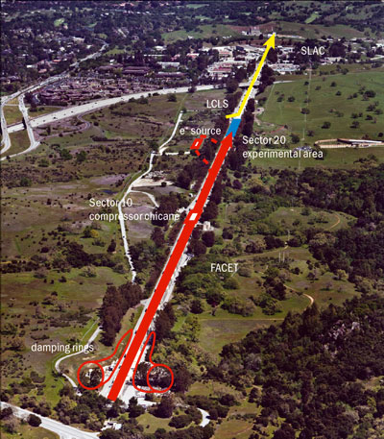
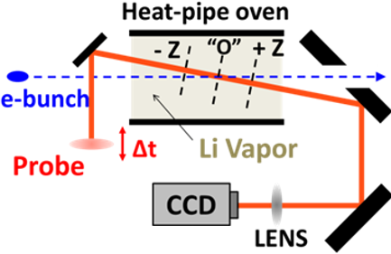
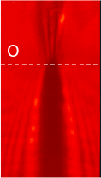
presented by K.Lotov at LPAW-2019, Split, Croatia, 06.05.2019 page 2 of 13
We simulate wakefield evolution at FACET and compare with experiments
e-bunch energy | 20 GeV
e-bunch charge | 2.4 nC
transverse rms e-bunch size | 30 μm
longitudinal rms e-bunch size | 55 μm
laser wavelength | 0.8 μm
laser energy | 1 mJ
laser duration | 0.1 ps
laser FWHM at focus | 0.5 cm
plasma density | 8 10¹⁶ cm⁻³
plasma length | 1.5 m
angle θ | 0.008 rad
[image from CERN Courier]
The electron bunch ionizes the lithium and drives the wakefield
The laser pulse probes the wakefield at variable delay
The lens images the object plane “O” to CCD camera

Slide 3
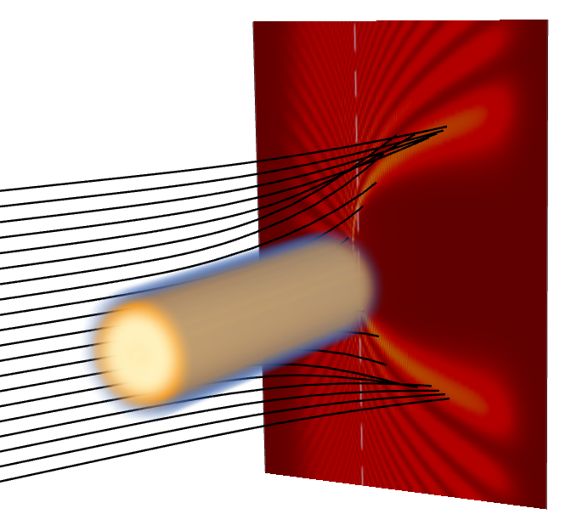
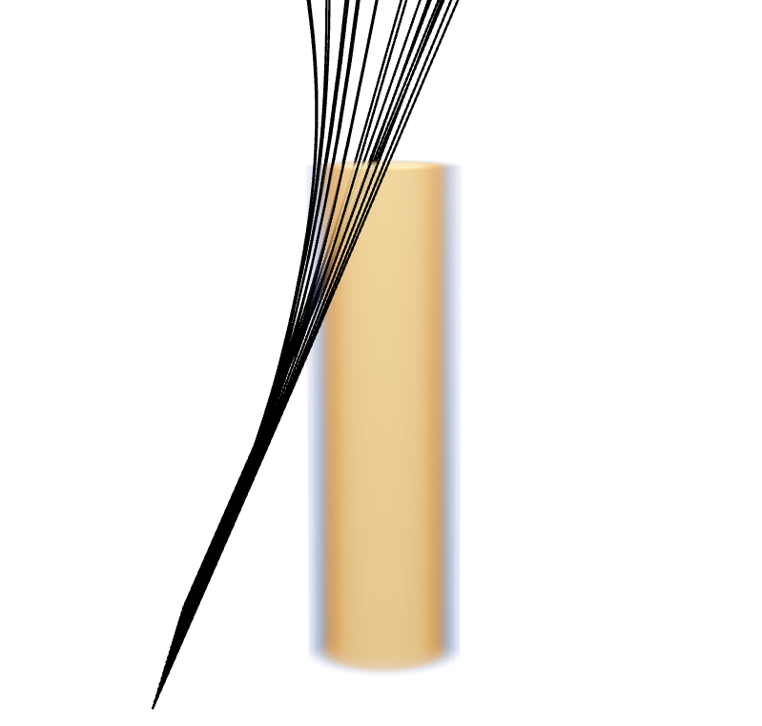
presented by K.Lotov at LPAW-2019, Split, Croatia, 06.05.2019 page 3 of 13
How the image is formed
Because of the shallow angle, the diagnostics is sensitive to small variations of refraction index
Object plane
Rays
θ = 0.008 rad
Plasma column
Important characteristic:
shadow size at the center (shows the plasma size)
e-beam propagation direction

Slide 4
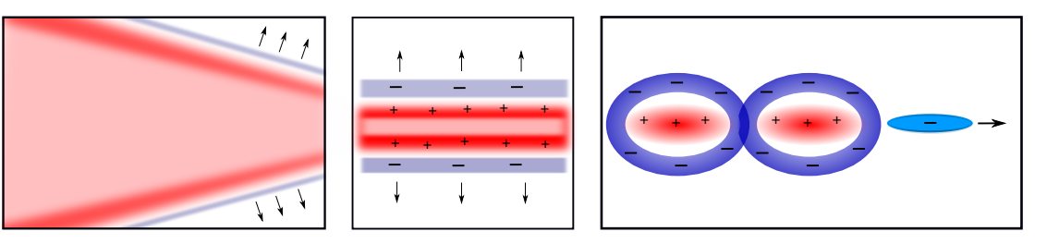
presented by K.Lotov at LPAW-2019, Split, Croatia, 06.05.2019 page 4 of 13
Stages of wake evolution
Plasma expansion
Broken wakefield, charge separation
Wakefield
Electron bunch
t ≤ 1.5 ns
v ~ 10⁶ m/s
t < 40 ps
t ~ 1 ps
The plasma (dark region on the image) expands radially
The wave breaks after few periods, creating high-energy electrons (up to 100s keV) and charge separation fields to keep plasma quasi-neutrality
The electron bunch ionizes the lithium, creates a plasma cylinder (radius ~ 40 μm), and drives the strong wakefield in it
(nearly full blowout)

Slide 5
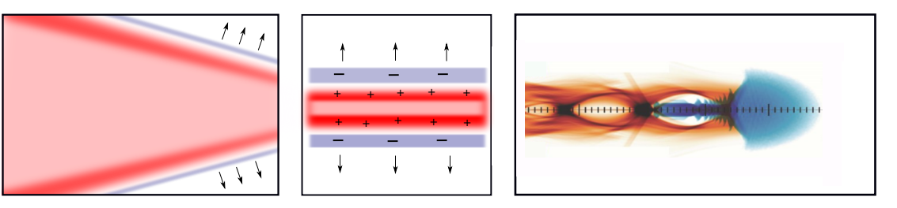
presented by K.Lotov at LPAW-2019, Split, Croatia, 06.05.2019 page 5 of 13
Stages of wake evolution and how we simulate them
Plasma expansion
Broken wakefield, charge separation
Wakefield
Electron bunch
t ≤ 1.5 ns (~4000 periods)
v ~ 10⁶ m/s
t < 40 ps
t ~ 1 ps
The plasma (dark region on the image) expands radially
The wave breaks after few periods, creating high-energy electrons (up to 100s keV) and charge separation fields to keep plasma quasi-neutrality
The electron bunch ionizes the lithium, creates a plasma cylinder (radius ~ 40 μm), and drives the strong wakefield in it
(nearly full blowout)
LCODE (fast, collisions and impact ionization included)
OSIRIS (stationary window)
LCODE (quasistatic)
OSIRIS (ionization, beam evolution, wakefield excitation)
LCODE (no ionization)
agreement
plasma profile,
beam shape
(in-plasma part)

Slide 6
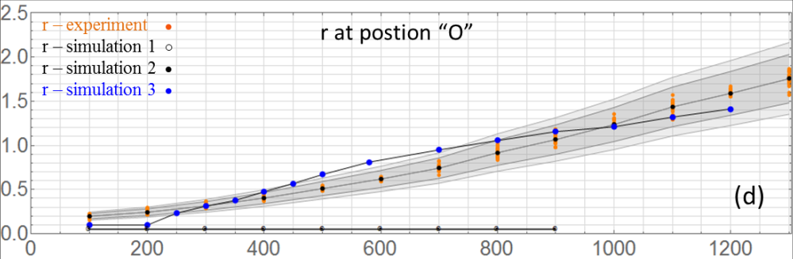
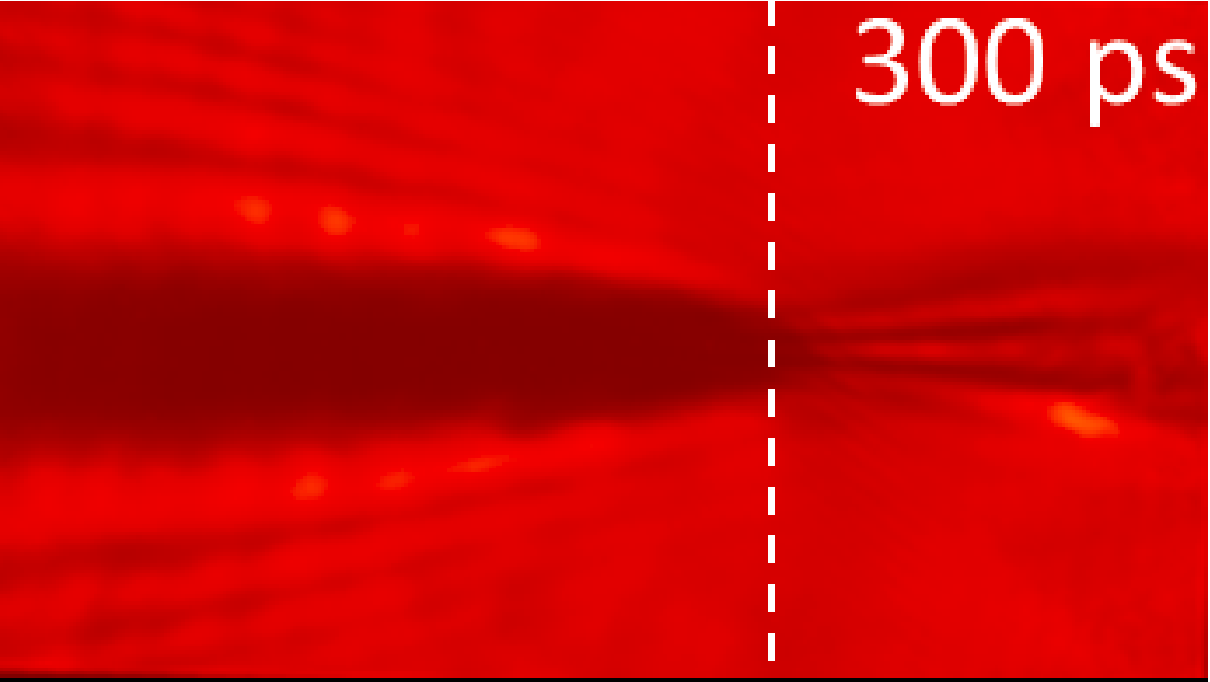
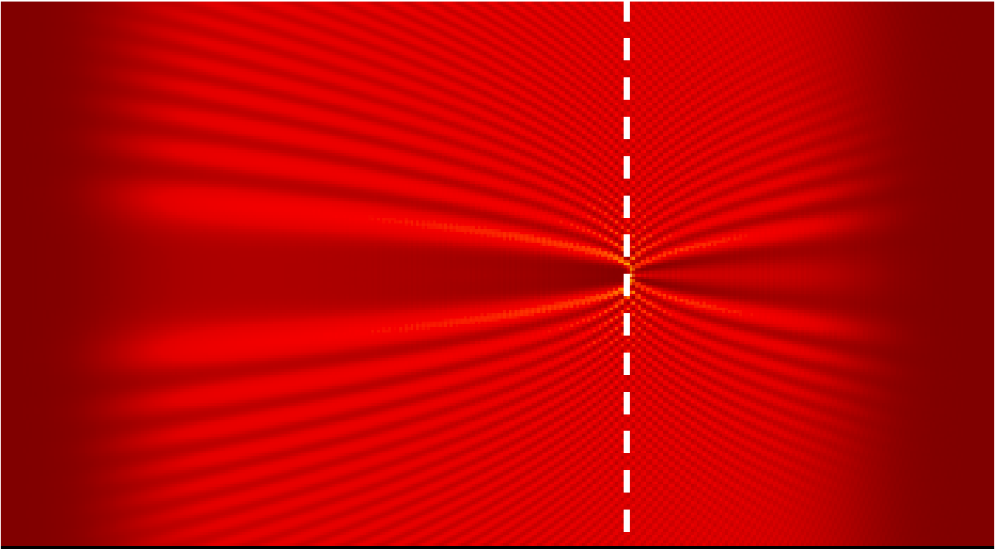
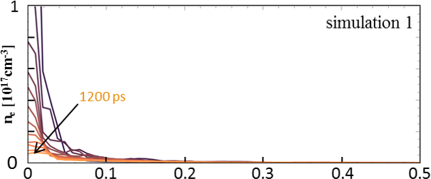
presented by K.Lotov at LPAW-2019, Split, Croatia, 06.05.2019 page 6 of 13
Story of search (trial and error)
Our aim:
shadow half-width at position “O”, mm
“O”
time, ps
Model 1: Plasma dynamics only = not enough plasma for wide shadow
radius, mm

Slide 7
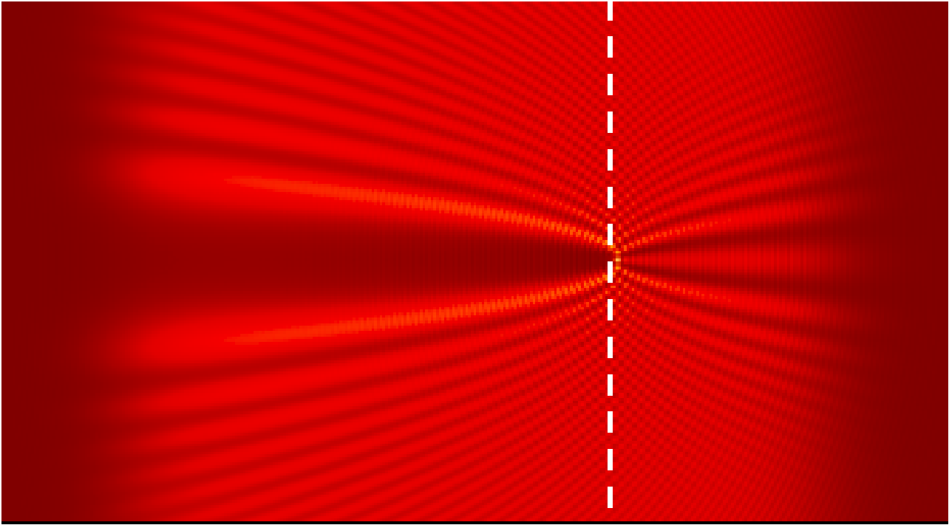
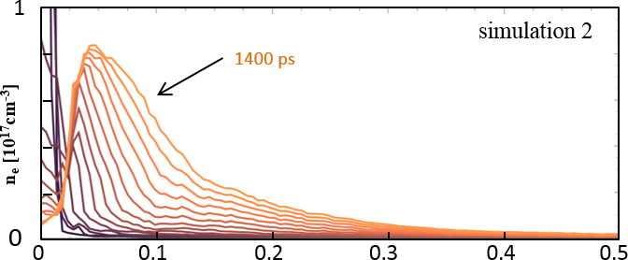
presented by K.Lotov at LPAW-2019, Split, Croatia, 06.05.2019 page 7 of 13
Story of search (trial and error)
Our aim:
shadow half-width at position “O”, mm
time, ps
Model 2: Plasma dynamics + Coulomb collisions + electron impact ionization of
surrounding neutrals (single-step only) + ion impact ionization
= still insufficient amount of plasma
radius, mm

Slide 8
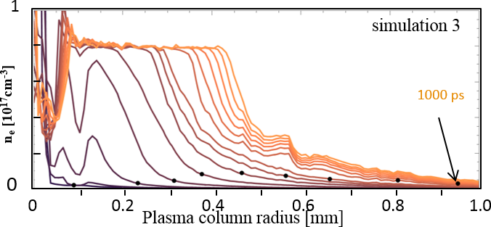
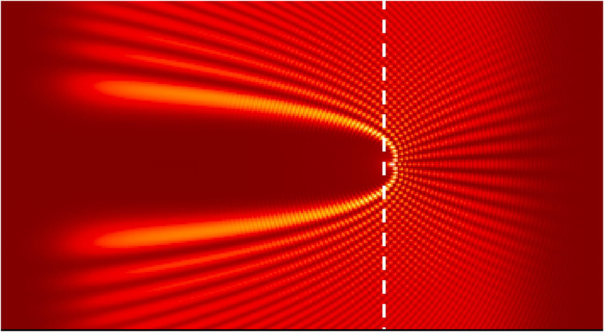
presented by K.Lotov at LPAW-2019, Split, Croatia, 06.05.2019 page 8 of 13
Story of search (trial and error)
Our aim:
shadow half-width at position “O”, mm
time, ps
Model 3: Plasma dynamics + Coulomb collisions + electron impact ionization of
surrounding neutrals (including multi-step) + ion impact ionization
+ effect of excited atoms on refraction index = agreement

Slide 9
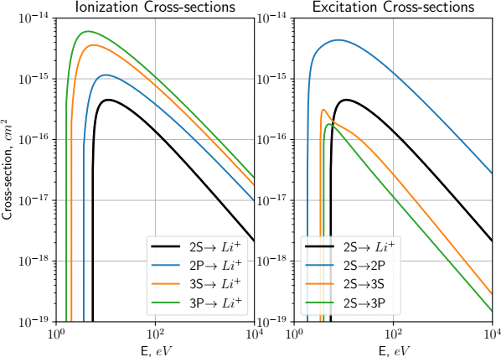
presented by K.Lotov at LPAW-2019, Split, Croatia, 06.05.2019 page 9 of 13
Some technical details
Fields and motion of charged particles: main effect that wakefield codes simulate, always there and well tested
Ionization by the driver: Ammosov-Delone-Krainov (ADK) model [Sov. Phys. JETP 64, 1191 (1986)].
Coulomb collisions: Takizuka-Abe model
[J. Comp. Phys. 25, 205 (1977)]
modified to include relativistic particles
[F. Perez, et al., Phys. Plasmas 19, 083104 (2012)].
Impact ionization and excitation by plasma particles: cross-sections from IAEA Aladdin database for electron impact and from theoretical model [I. D. Kaganovich, et al., New J. Phys. 8, 278 (2006)] for ion impact.
cell
particles in a cell grouped in pairs and scatter on the partners
Plasma
particle
Neutral
from ground state
ionization
Probability
w = σ(E_{p}) v_{p} n_{a} Δt
E_{p},v_{p}
Spontaneous emission time ~ nanoseconds, neglected

Slide 10
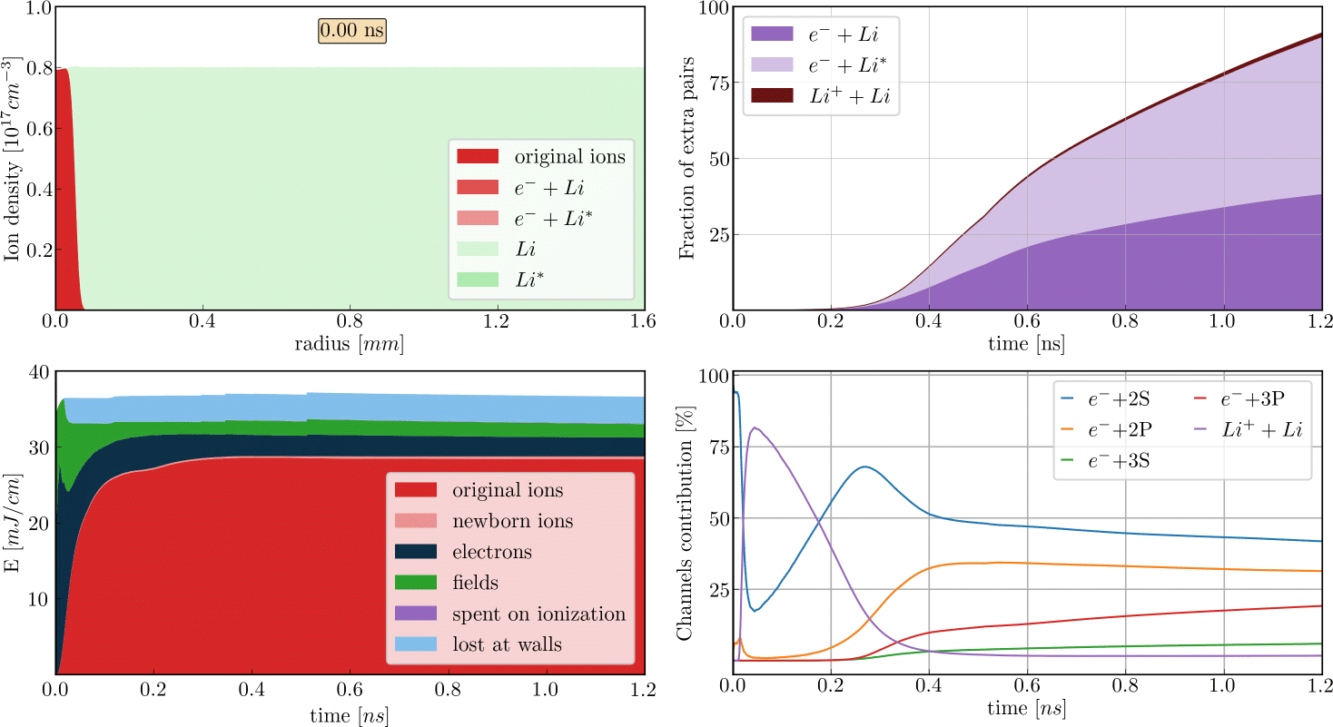
presented by K.Lotov at LPAW-2019, Split, Croatia, 06.05.2019 page 10 of 13
Physics of long-term wake evolution

Slide 11
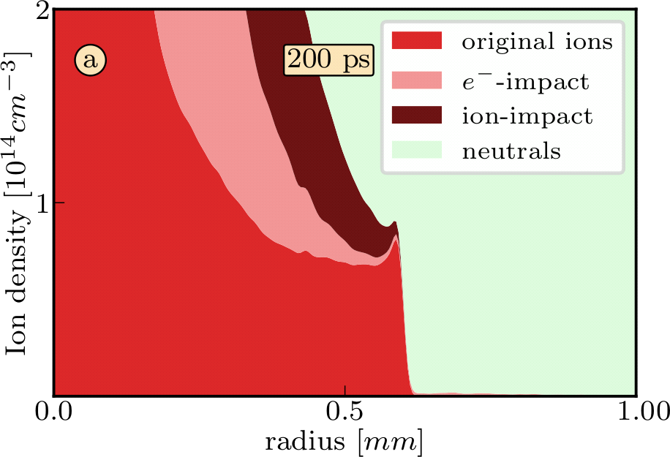
presented by K.Lotov at LPAW-2019, Split, Croatia, 06.05.2019 page 11 of 13
Initial ionization
2. Original ions are accelerated to multi-keV energies and efficiently ionize neutrals (many new ions per original ion).
A moving front of fast ions creates more ions than it has.
1. High-energy electrons, which enter the surrounding gas first, ionize inefficiently, as their density is low and ionization cross-section is small because of a high energy.
moving
4. Growth of electron population triggers near-exponential plasma density growth.
3. Once ions appear at a given location, more electrons come, including lower-energy plasma electrons with large impact-ionization cross sections, and speed-up ionization.

Slide 12
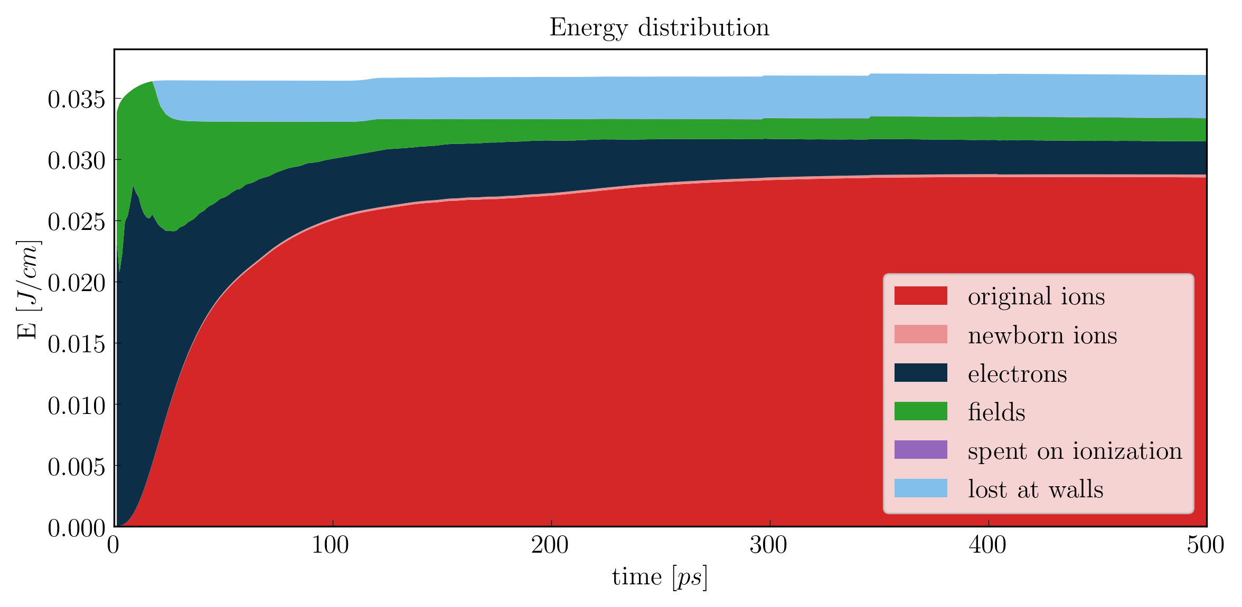
presented by K.Lotov at LPAW-2019, Split, Croatia, 06.05.2019 page 12 of 13
Energy balance
Fastest electrons reach the wall (at 5.6 mm)
Most of the energy is
in original ions moving radially
Initial wakefield energy is in fields and in electron motion
Charge-separation field comes to equilibrium with electron distribution (energies equal), ions accelerated)
The wave breaks, most of the energy is in hot electrons

Slide 13
presented by K.Lotov at LPAW-2019, Split, Croatia, 06.05.2019 page 13 of 13
Highlights
Numerical simulations quantitatively agree with results of optical shadowgraphy measurements and can be used to understand the process.
After passage of the driver, the plasma radius greatly increases due to ionization of the surrounding neutral gas.
High-energy electrons, charge separation fields, electron and ion impact ionization, lithium excitation are important parts of the process.
The major fraction of the released energy finally comes to radially moving plasma ions.
Thank you

