Slide 1





Ballistic Injection and Acceleration of Positrons in the Bubble Regime
Z. Y. Xu¹, C. F. Xiao¹, H. Y. Lu^{1,2,}*
R. H. Hu¹, J. Q. Yu¹, Z. Gong¹, Y. R. Shou¹, J. X. Liu¹, C. Z. Xie¹, S. Y. Chen
C. E. Chen¹, and X. Q. Yan^{1,2}
¹SKL of Nuclear Physics and Technology, Peking University, China
²Collaborative Innovation Center of Extreme Optics, Shanxi University, China
Collaborators:
Ruxin Li
N. Hafz
P. P. Rajeev
D. Neely
Z. Najmudin
LPAW2019 2019.5.9

Slide 2
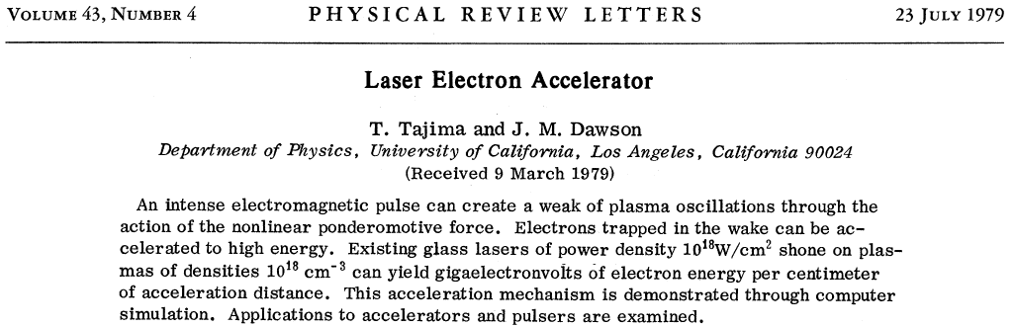

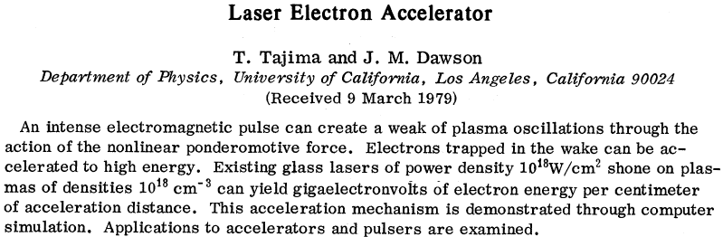



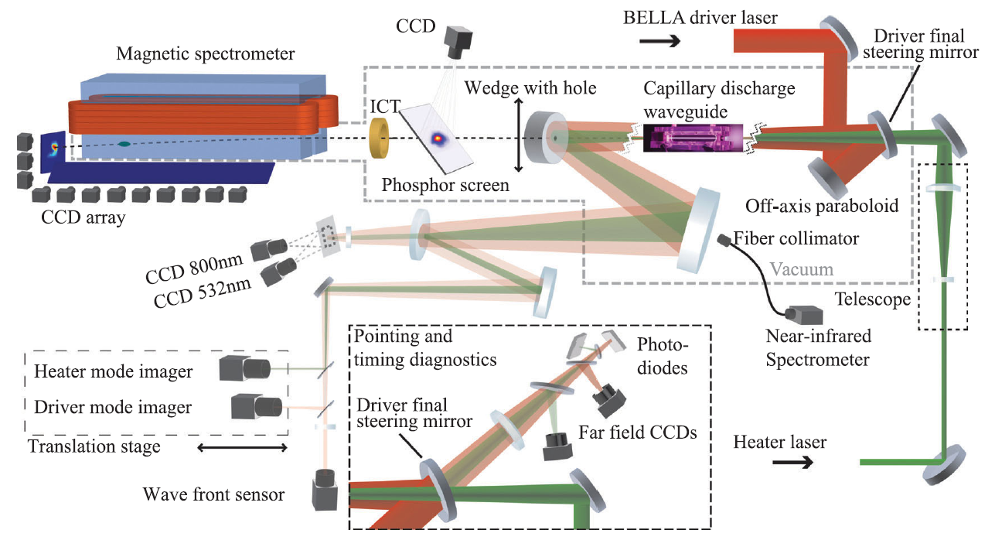
Background – Concept of LEA
LWFA:
Theoretical Works:
Tajima, T. & Dawson, J. M. PRL 43, 267 (1979).
Rosenzweig, J. B. et al., PRA 44, R6189 (1991).
Pukhov, A. et al., PPCF 46, B179 (2004).
Lu, W. et al., PRL 96, 165002 (2006).
Huang, C. et al., PRL 99, 255001 (2007).
Tzoufras, M. et al., PRL 101, 145002 (2008).
...... ......
John M Dawson (1930-2001)
Experimental Works：
Malka, V. et al., Science 298, 1596 (2002).
“Dream beam”:
  Mangles, S. P. D. et al., Nature 431, 535 (2004).
  Geddes, C. G. R. et al., Nature 431, 538 (2004).
  Faure, J. et al., Nature 431, 541 (2004).
Capillary discharge waveguides:
  Leemans, W. P. et al., Nat. Phys. 2, 696 (2006).
  Kameshima, T. et al., APE 1, 066001 (2008)
  Lu, H. et al., APL 99, 091502 (2011).
  Leemans, W. P. et al., PRL 113, 245002 (2014).
  Gonsalves, A. J. et al., PRL 122, 084801 (2019).
Faure, J. et al., Nature 444, 737 (2006).
Hafz, N. et al., Nat. Phys. 2, 571 (2008).
Kneip, S. et al., PRL 103, 035002 (2009).
Clayton, C. E. et al., PRL 105, 105003 (2010).
Liu, J. S. et al., PRL 107, 035001 (2011).
Wang, X. M. et al., Nat. Commun. 4, 1988 (2013).
...... ......
Toshiki Tajima
Maximum wakefield:
E_{max} [V/cm] = 0.96 n_{e}^{1/2} [cm⁻³]
e.g. n_{e} = 10¹⁸ cm⁻³, E_{max} ~ 1GV/cm
Conventional Accelerator:
E_{max} ~ 1 MV/cm
LBNL achievement:
85 MeV by gas jet in 2004
1 GeV by 3.3-cm capillary in 2006
4.2 GeV by 9-cm capillary in 2014
7.8 GeV by 20-cm capillary in 2019

Slide 3
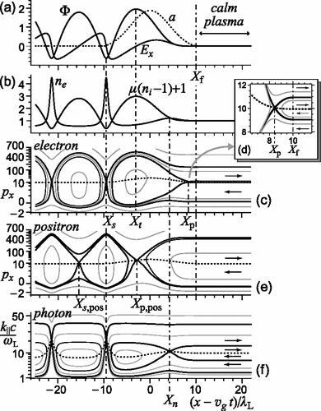
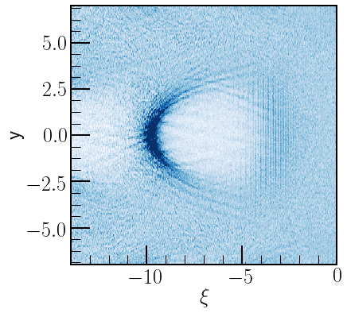
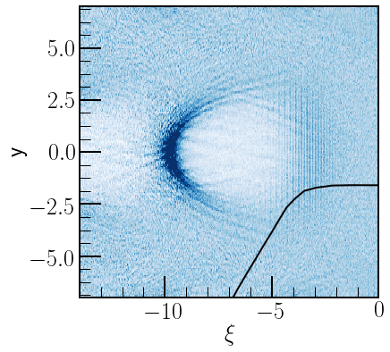


Challenges for Positron Injection In LWFA
Positrons needs to be externally provided or created by laser-plasma interaction;
The wakefield electrostatic force and the laser ponderomotive force both repel positrons.
Different orbits for positrons than electrons.
(c)
(b)
(a)
Esirkepov, T. et al. Phys. Rev. Lett. 96, 014803 (2006).

Slide 4
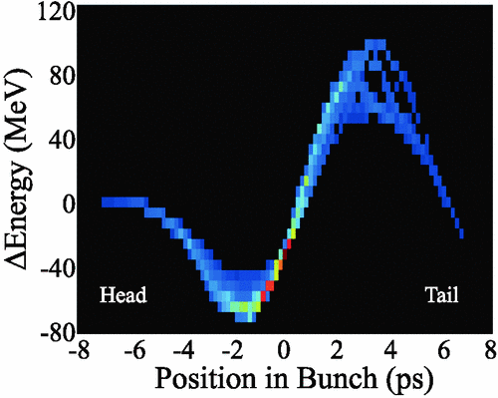
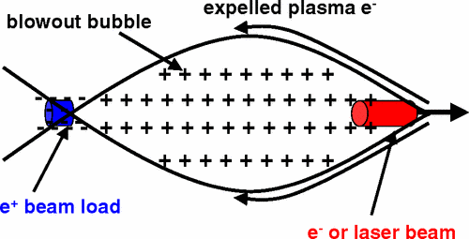
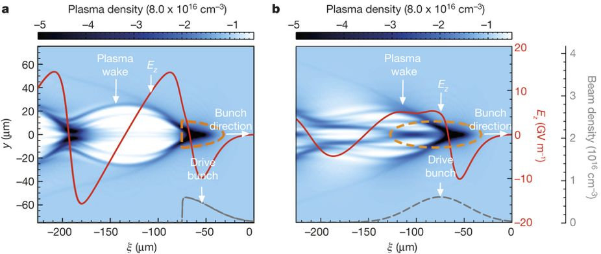
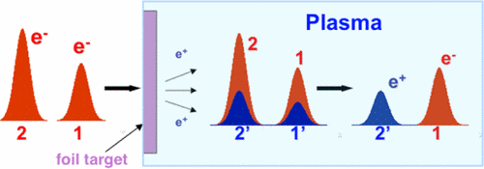
PWFA of Positrons
SLAC experiments:
28.5GeV positron beam, 79MeV energy gain (2003);
20.35GeV positron beam, 3-10GeV energy gain (2015).
Positron acceleration in the second cycle of bubble.
Blue, B. E. et al. Phys. Rev. Lett. 90, 214801 (2003).
Wang, X. et al. Phys. Rev. Lett. 101, 124801 (2008).
Corde, S. et al. Nature 524, 442 (2015).

Slide 5
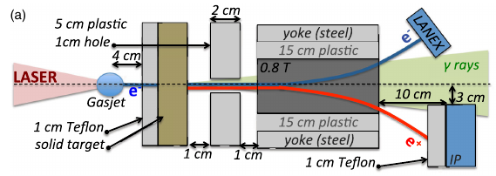
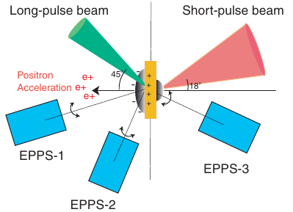
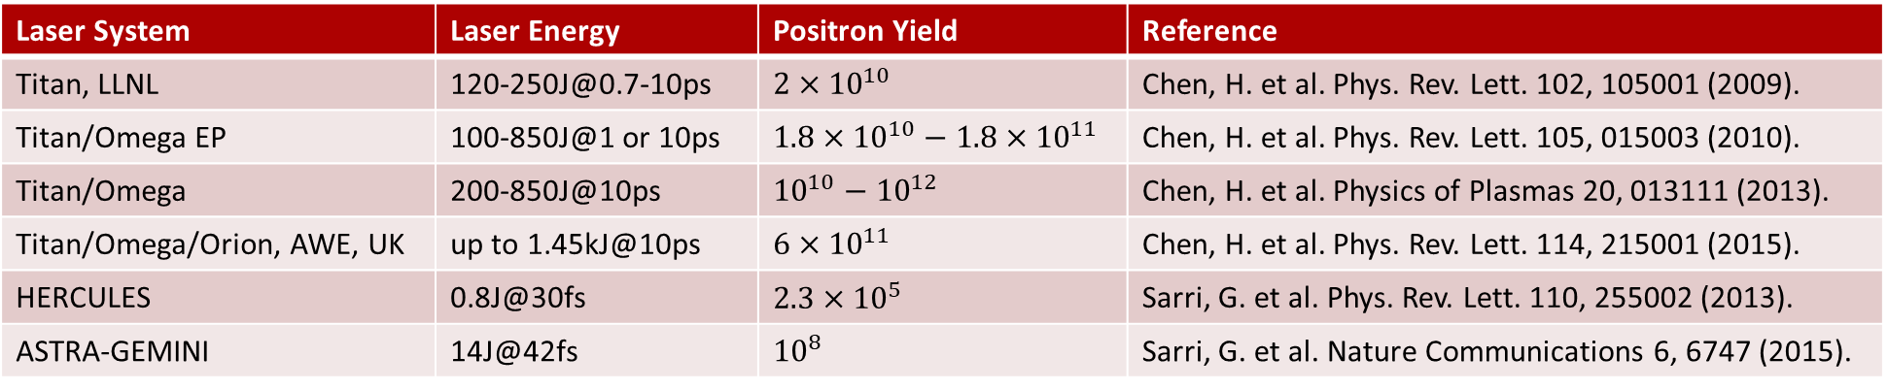
Positron Generation by Laser
Laser System | Laser Energy | Positron Yield | Reference
Titan, LLNL | 120-250J@0.7-10ps | $${2×10}^{10}$$ | Chen, H. et al. Phys. Rev. Lett. 102, 105001 (2009).
Titan/Omega EP | 100-850J@1 or 10ps | $${1.8×10}^{10}−{1.8×10}^{11}$$ | Chen, H. et al. Phys. Rev. Lett. 105, 015003 (2010).
Titan/Omega | 200-850J@10ps | $${{10}^{10}−10}^{12}$$ | Chen, H. et al. Physics of Plasmas 20, 013111 (2013).
Titan/Omega/Orion, AWE, UK | up to 1.45kJ@10ps | $${6×10}^{11}$$ | Chen, H. et al. Phys. Rev. Lett. 114, 215001 (2015).
HERCULES | 0.8J@30fs | $${2.3×10}^{5}$$ | Sarri, G. et al. Phys. Rev. Lett. 110, 255002 (2013).
ASTRA-GEMINI | 14J@42fs | $${10}^{8}$$ | Sarri, G. et al. Nature Communications 6, 6747 (2015).
Sarri, G. et al. Phys. Rev. Lett. 110, 255002 (2013).
Chen, H. et al. Phys. Rev. Lett. 105, 015003 (2010).

Slide 6
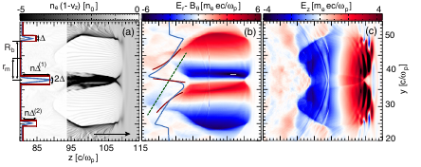
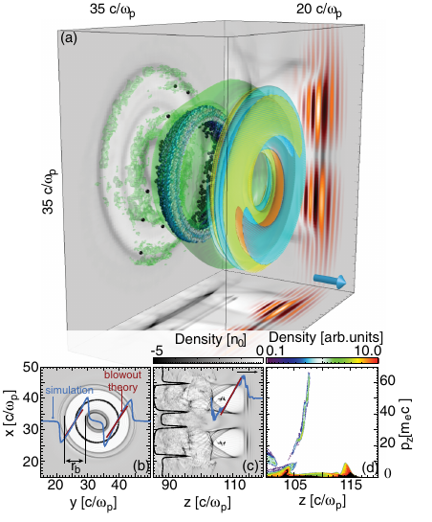
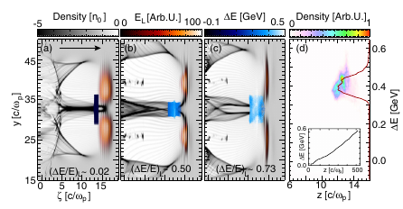
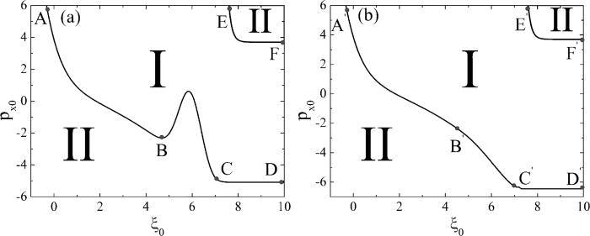
LWFA of Positrons
Driven by ring-shaped beam:
Laser
Generate
√
Inject ?
Accelerate
√
Positrons
Driven by Gaussian beam:
Positrons:
Direclty placed inside the bubbles.
400MeV energy gain.
J. Vieira & J. T. Mendonça. Phys. Rev. Lett. 112, 215001 (2014).
Hou, Y.-J. et al. Physics of Plasmas (1994-present) 23, 013105 (2016).

Slide 7
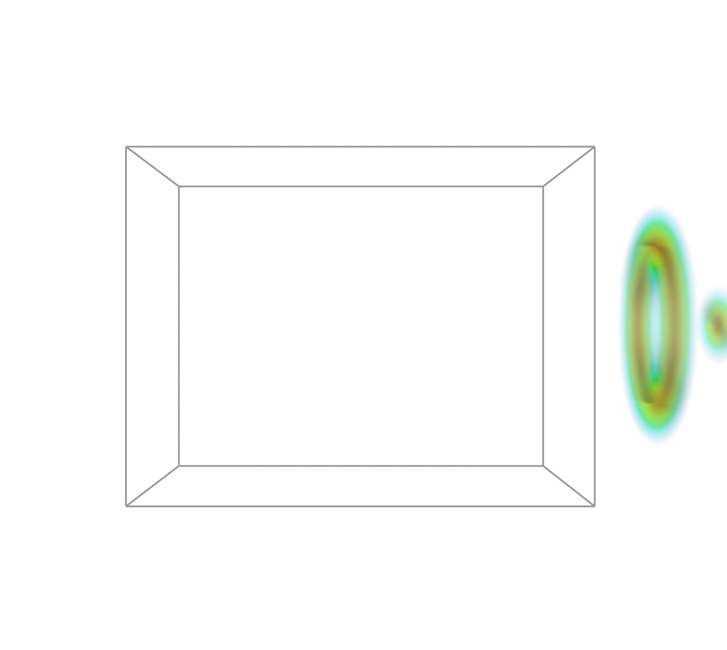
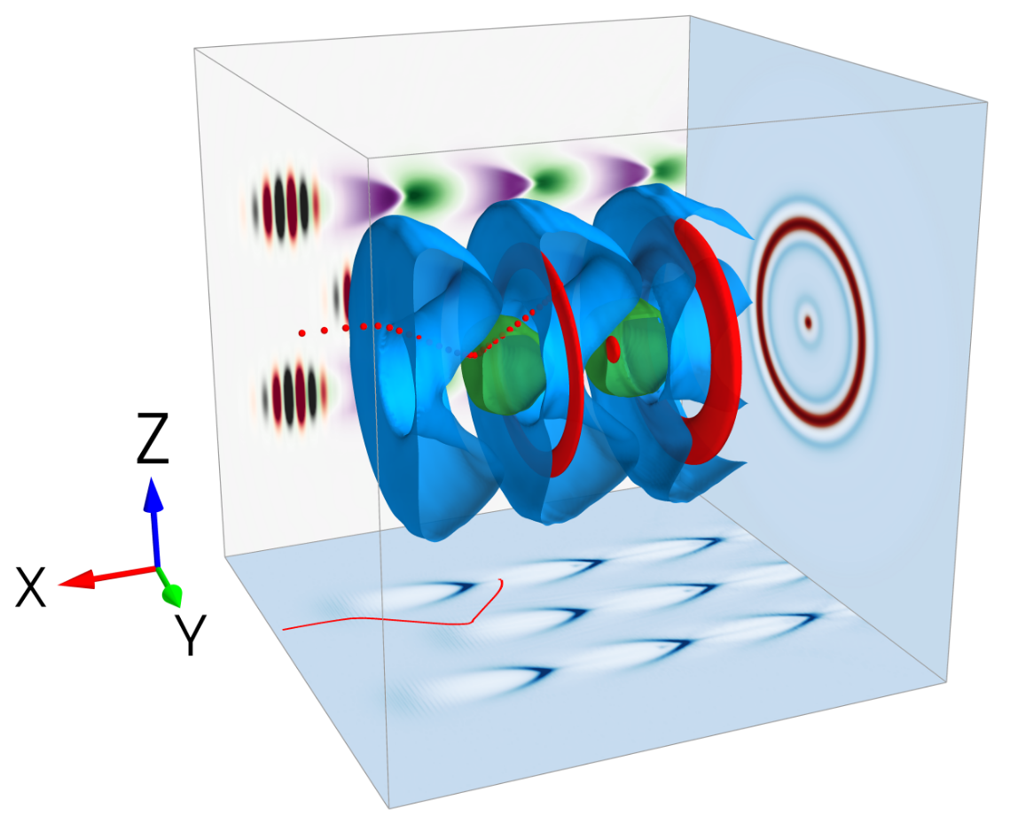
Ballistic Injection Scheme
Plasma region: filled with externally provided uniform low-density positrons.
Two co-axis laser beams: one Gaussian beam, one ring-shaped beam.
Two beams have a delay τ, normalized to the length of one plasma period.
Blue/Green Colors: Contour surfaces of electrons
Red colors: contour surfaces of positrons
x-y plane: slice of electron density
x-z plane: slice of E_{x} and laser fields
y-z plane: projection of electron and positron density
red spheres: trajectory of an injected positron

Slide 8
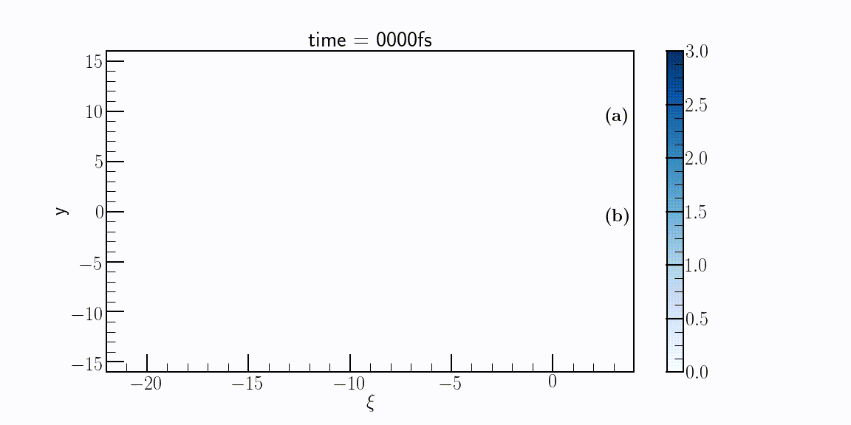

Trajectories of Sampled Positrons
Positron (a) corresponds to the trajectroy earlier and enters the second donut bubble.
Positron (b) enters the third donut bubble.
Positrons with different starting positions may experience different scattering forces and have different trajectories.
Multi-bunch with different (ring/ellipsoid) shape

Slide 9
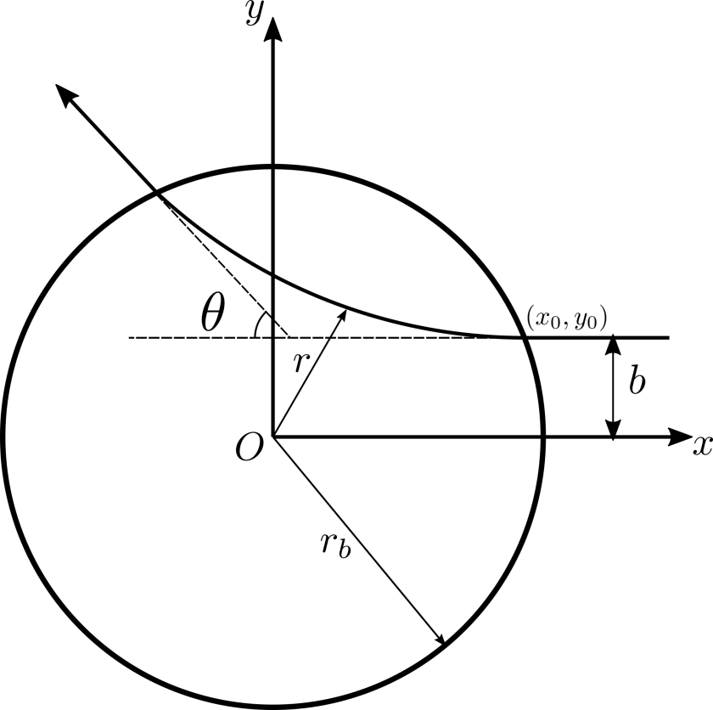
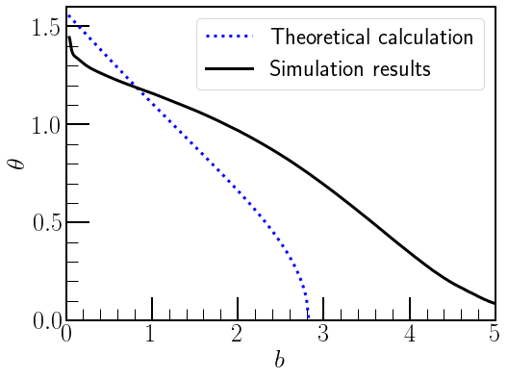
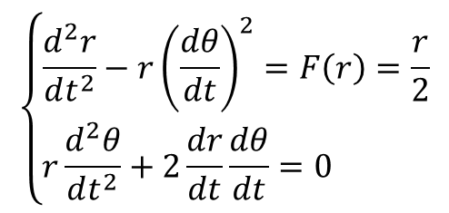
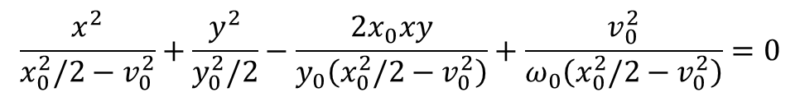
Scattering Model of Electron Bubble on Positrons
Scattering trajectory is a hyperbola (assume elastic).
$$\frac{x^{2}}{x_{0}^{2}/2−v_{0}^{2}}+\frac{y^{2}}{y_{0}^{2}/2}−\frac{2x_{0}xy}{y_{0}\left(x_{0}^{2}/2−v_{0}^{2}\right)}+\frac{v_{0}^{2}}{ω_{0}\left(x_{0}^{2}/2−v_{0}^{2}\right)}=0$$
$$\left\{\begin{matrix}\frac{d^{2}r}{dt^{2}}−r{\left(\frac{dθ}{dt}\right)}^{2}=F\left(r\right)=\frac{r}{2} \\ r\frac{d^{2}θ}{dt^{2}}+2\frac{dr}{dt}\frac{dθ}{dt}=0 \end{matrix}\right.$$
[1]
(a₀=2, r_{b}=2.83)
1.Kostyukov, I., Pukhov, A. & Kiselev, S. Phys. Plasmas 11, 5256 (2004).

Slide 10
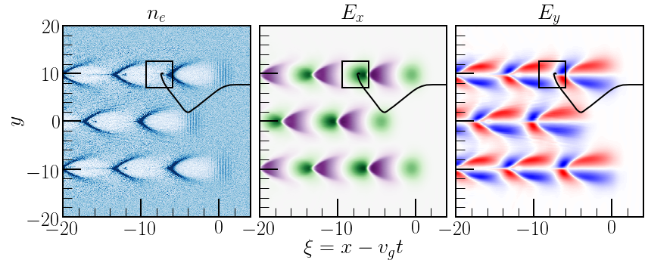
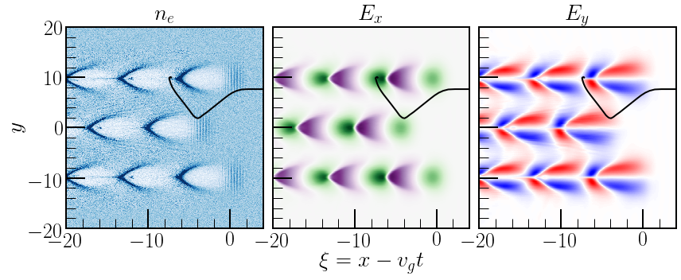

Injection Dynamics
Positive E_{x} (Black rectangle): accelerates positrons so they can catch up;
Negative E_{y} gradient (Orange rectangle): restricts transverse movement;
Overlapping region: capture zones for positrons, at the front of each period.

Slide 11
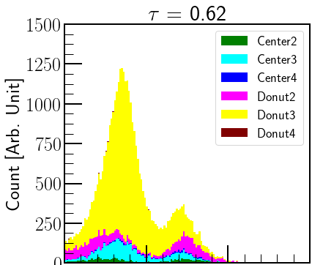
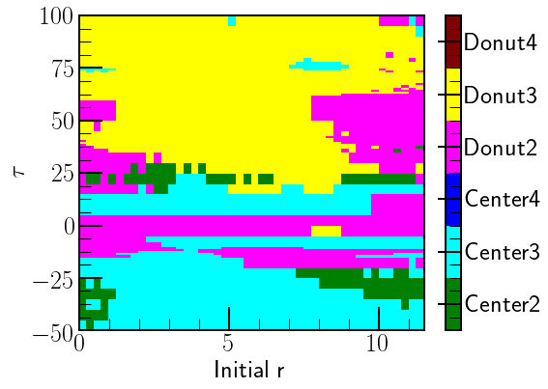
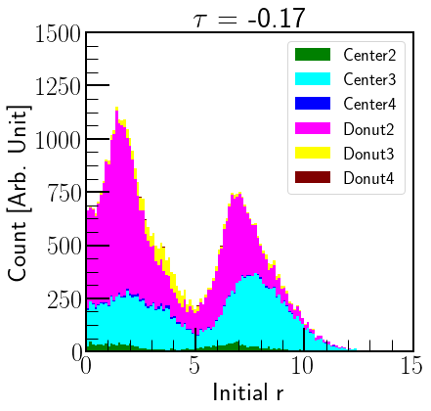
Spatial Distribution of Injected Positrons
With different τ, positrons with same starting position may enter different bubbles.

Slide 12
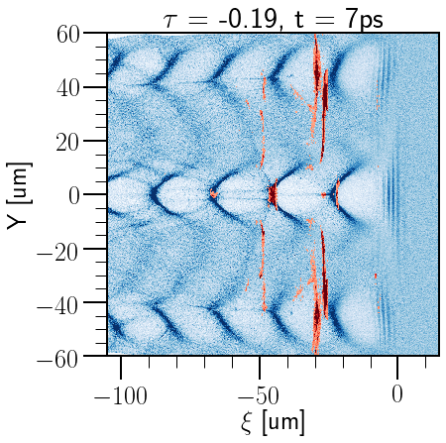
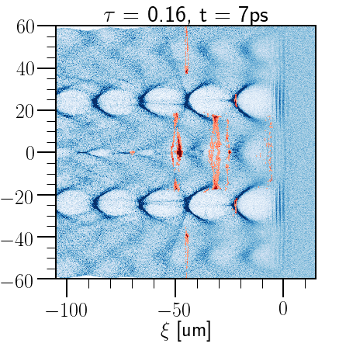
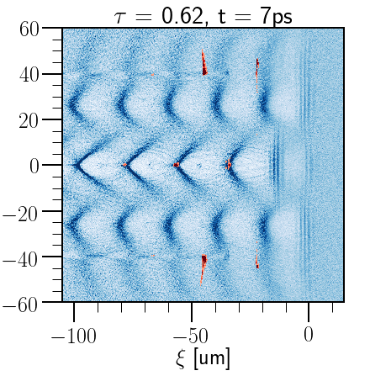
Positron Acceleration – Accelerated
Different wakefield structure/bubble order
Different final positions for positrons.
Different delay τ

Slide 13
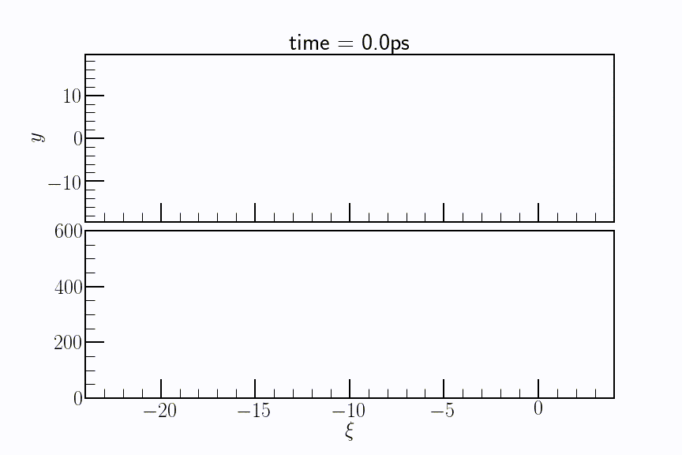
Positron Acceleration - Phase Dynamics
Laser diffraction
+
Dephasing
Limiting energy gain
Infinite positron region length.
Wide energy spread for each peak
Continuous injection.

Slide 14
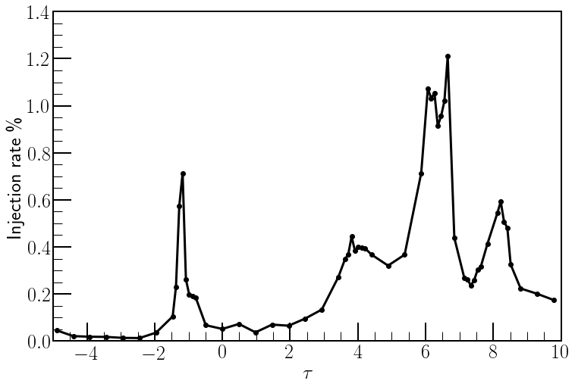
Dynamic Injection Control Through τ
Injection rate of different τ for positron energy > 80MeV
positron region length: 100um
Different delay:
different positron
spatial distribution
charge and spectrum

Slide 15
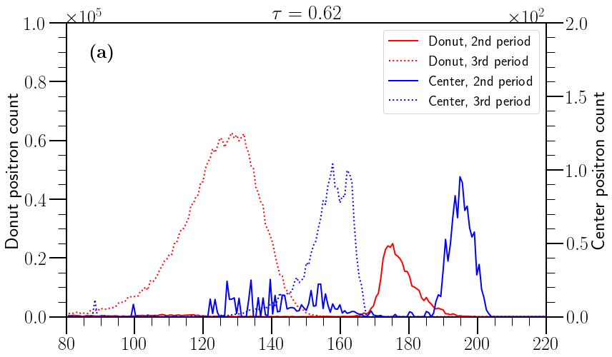
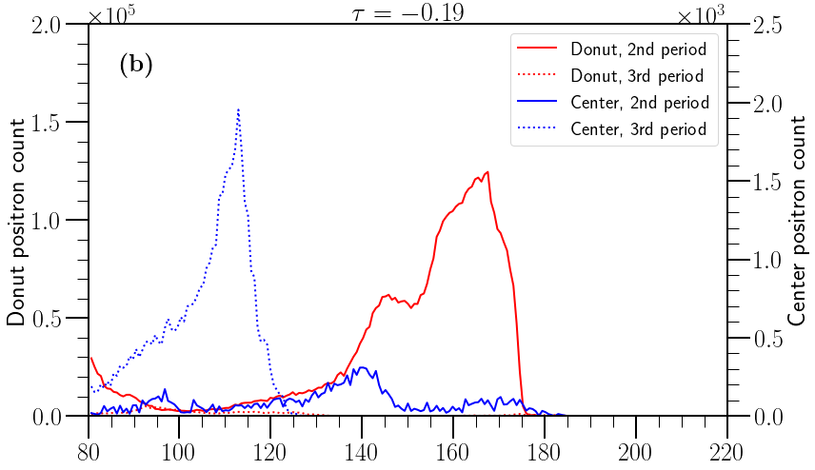
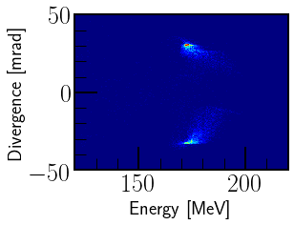
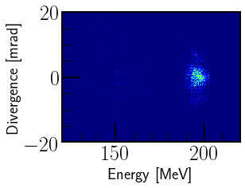
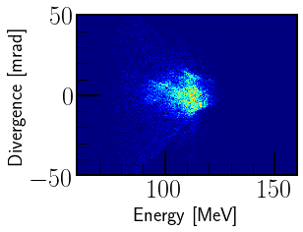
Positron Acceleration - Spectra
Injection rate: 0.54%
Donut ratio: 95.4%
Injection rate: 0.46%
Donut ratio: 99.8%

Slide 16
Conclusion
A “ballistic” injection scheme was proposed.
Co-axis Gaussian and ring-shaped laser beams can provide transverse momenta for positron injection;
The injection process is affected by positron initial positions, and can be controlled by laser and plasma parameters;
Positrons can be accelerated with a accelerating gradient up to 100GV/m;
Energy gain is larger than 200MeV in the simulation.

Slide 17
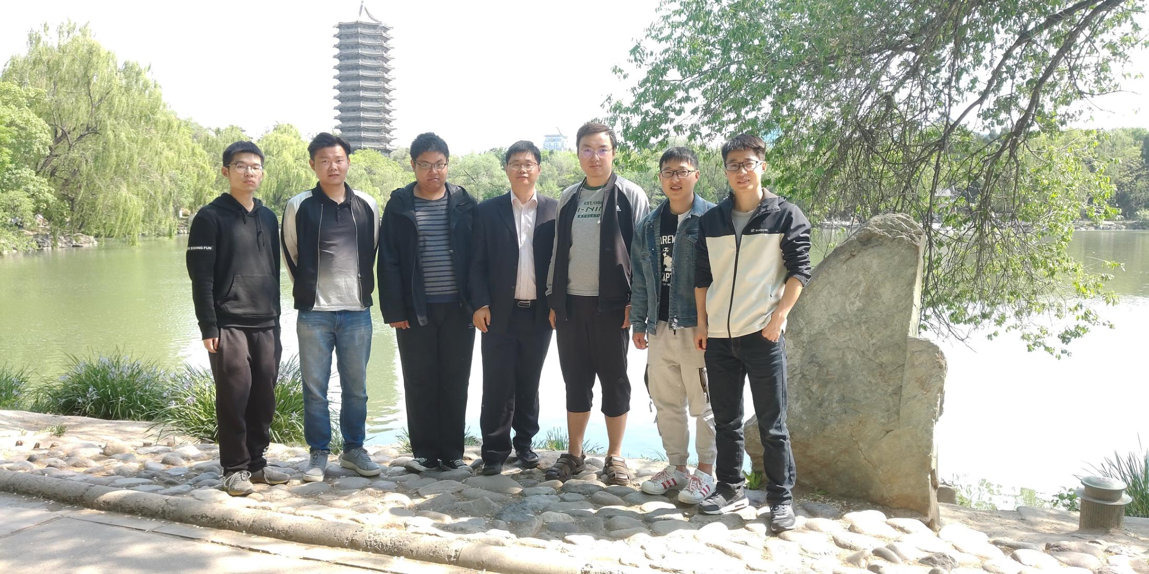
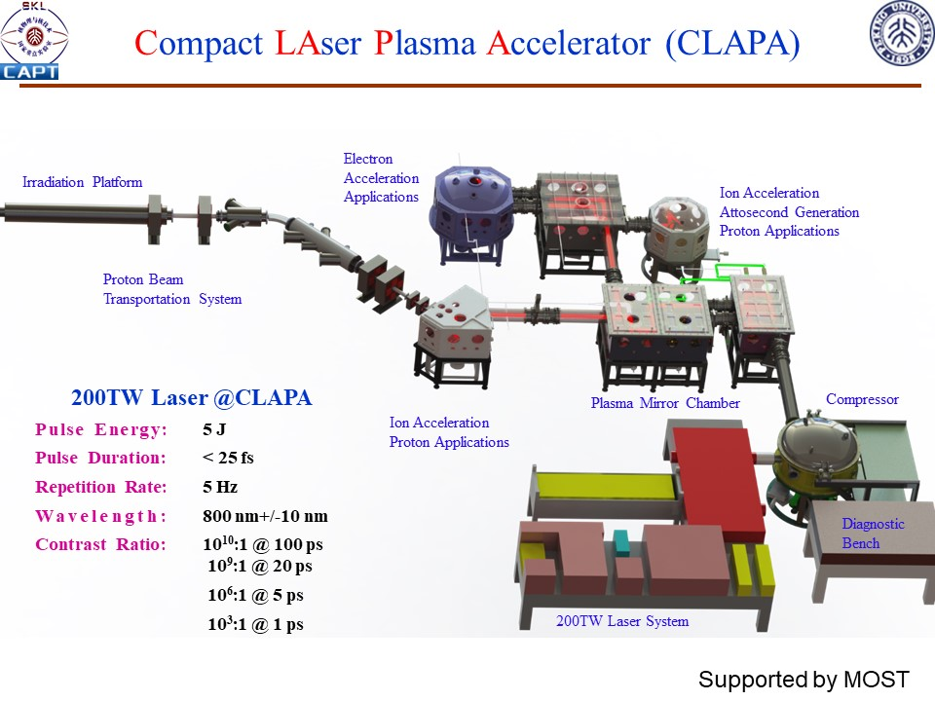


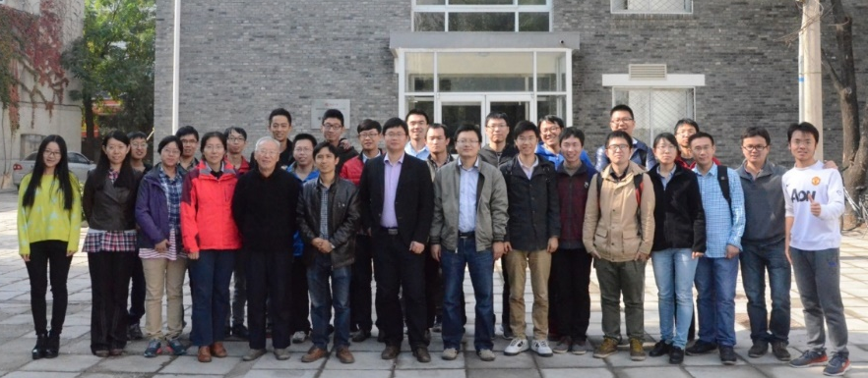
LEAX Team at PKU
Thanks for Attention!
CLAPA layout
CLAPA Lab
Under Construction
Beijing Laser Acceleration Innovation Center
CLAPA Team (2017)
Welcome to
PKU!
Contact:
Prof. Haiyang Lu
hylu@pku.edu.cn

