Slide 1
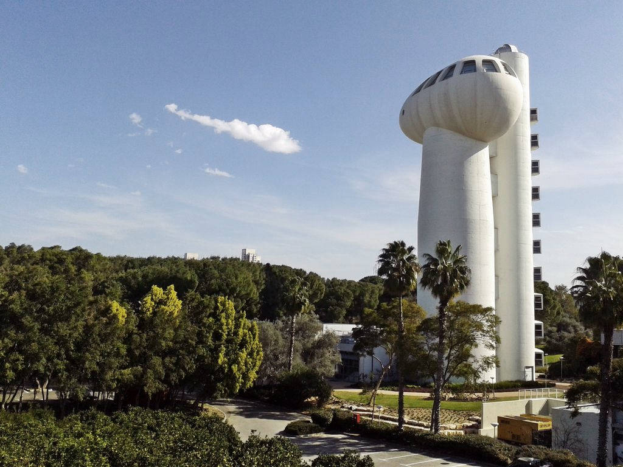

Key Physics Study of Laser Plasma based Ion Acceleration
Yang Wan
Weizmann Institute of Science
LPAW 2019
MedILS, May 5-10, 2019

Slide 2



Major Collaborators
Tsinghua
  Jianfei Hua, Chi-Hao Pai and Wei Lu
WIS
  Igor Andriyash and Victor Malka
UCLA
  Warren Mori and Chan Joshi
IST
  Luis O Silva

Slide 3
Outline
Major challenges for laser ion acceleration
Key physics study of laser driven ion acceleration
  Transverse instability in laser pressure ion acceleration process
  New ion acceleration schemes
Short summary

Slide 4
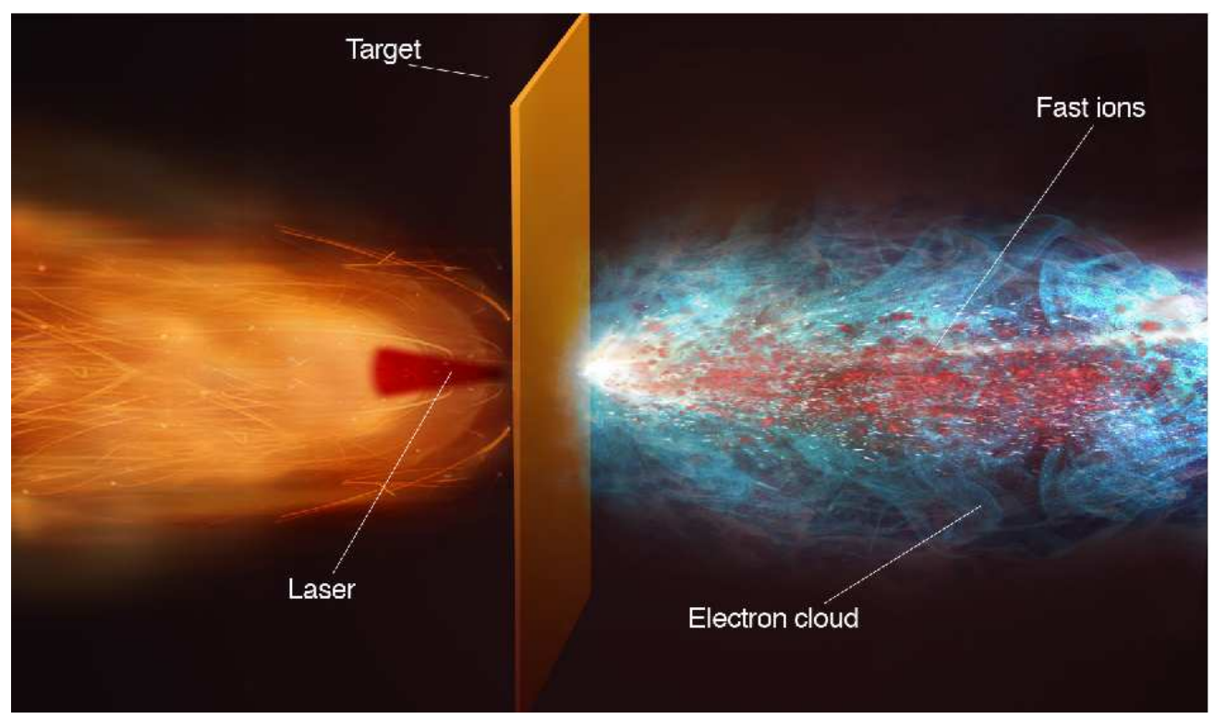
Laser Plasma based Ion Acceleration
A. Macchi, et al., Rev. Mod. Phys 85, 751 (2013)
Laser
ions
electrons
Laser ion acceleration has become a very active topic since 2000, and significant progress has been achieved
R. A. Snavely, et al., PRL (2000). B. M. Hegelich, et al., Nature (2006). H. Schwoerer, et al., Nature (2006).
T. Toncian, et al., Science (2006) . D. Haberberger, et al., NP (2012), F. Wagner, et al., PRL(2016),
A. Higginson, et al., NC (2018), M. Nakatsutsumi, et al., NC (2018) and many other work

Slide 5
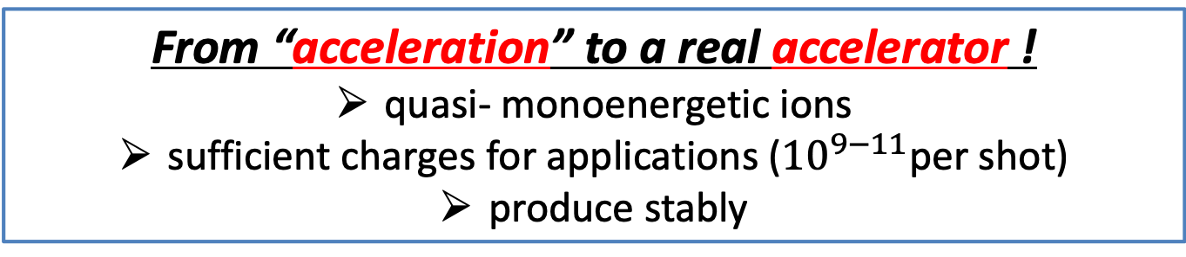
A Major Challenge for Laser Ion Acceleration
From “acceleration” to a real accelerator !
quasi- monoenergetic ions
sufficient charges for applications (${10}^{9−11}$per shot)
produce stably
Many schemes have been proposed
  TNSA, CSA, RPA-HB, RPA-LS, BOA …
Light Sail (LS) seems to be a good choice
  A nano-foil is pushed by the laser pressure
  Almost perfect in 1D concept
  Reduce heating by using CP laser
  Monoenergetic spectra
  High efficiency
Esirkepov, et al., PRL 2004
A.Macchi, et al, PRL 2005
X. Zhang et al., PoP 2007
X.Q. Yan et al., PRL 2008
A. P. L. Robinson et al., NJP 2008
O. Klimo et al., PRSTAB 2008
A. Macchi et al, PRL 2009

Slide 6
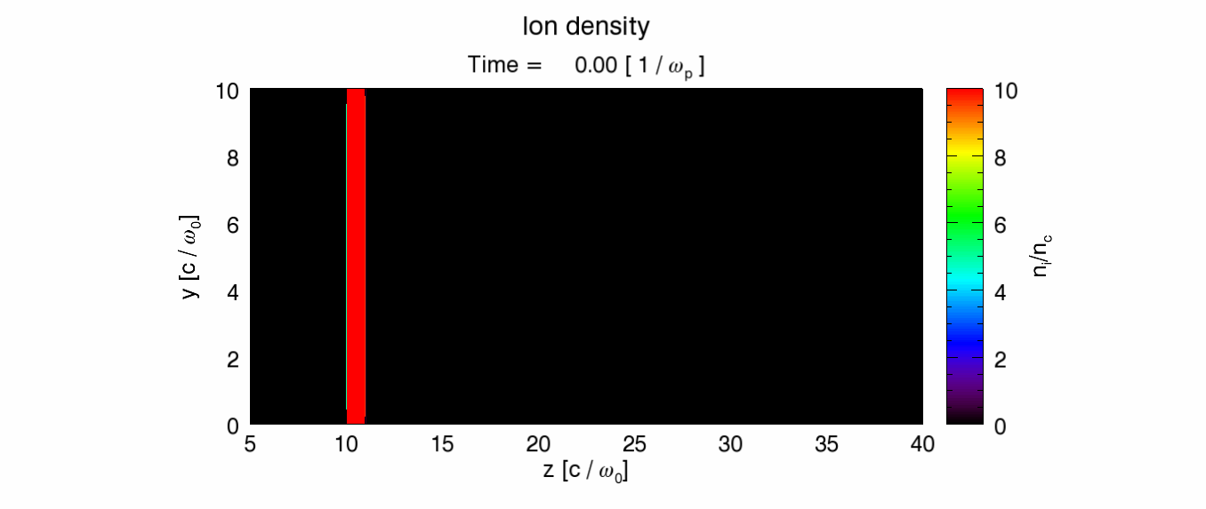
Transverse Instability in LS process
Transverse instability is a crucial problem of LS in 2/3D geometry
When laser pushes the foil, surface transverse ripples appear and grow very fast.
They quickly destroy the target even before LS finishes.
Laser

Slide 7
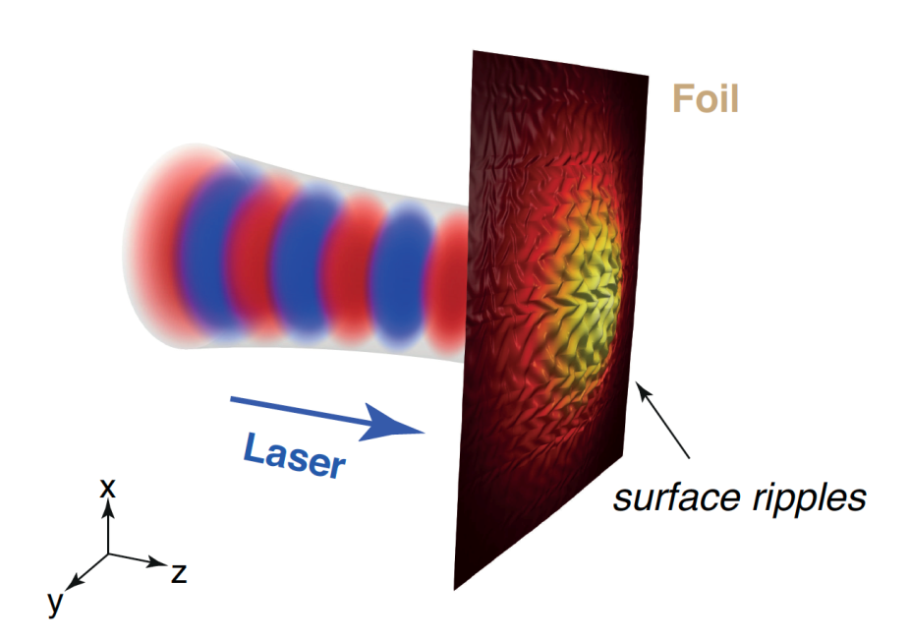
What is the origin of such instability?
The mechanism of transverse instability was actively studied for decades
Until now, such instability was mainly attributed to the Raleigh-Taylor (RT) Iike instability
Ott, PRL 1972
Pegoraro and Bulanov, PRL 2007
Klimo, PRSTAB 2008
Palmer, et al., PRL 2012
Wu, et al., PRE 2014
Eliasson, NJP 2015
Sgattoni, et al., PRE 2015
…

Slide 8

RT like instability?
Basic physical explanation
  Target shape distortions make laser pressure has transverse component, which in turn enhances such distortion
Single fluid dynamics
Electrons and ions are considered together
laser
Simulations show that instability modes vary for different laser plasma parameters!
Classic theory:
Instability grows faster for bigger k mode ($γ∝\sqrt{kg}$)
Modified theory:
Scale of instability close to laser wavelength ($k≈k_{0}$)
Ott, PRL 1972
Pegoraro and Bulanov, PRL 2007
Eliasson, NJP 2015 Sgattoni, et al., PRE 2015

Slide 9
More need to be considered…
Density modulations are significant
The dynamics of electrons and ions are different, and need to be treated separately.
Our recent work indicated a strong coupling between oscillating electrons and quasi-static ions plays a crucial role in the instability growth
A 3D theory containing all possible effects is required !
Y. Wan, et al., PRL 117, 234801 (2016)
Y. Wan, et al., PRE 98, 013202 (2018)

Slide 10
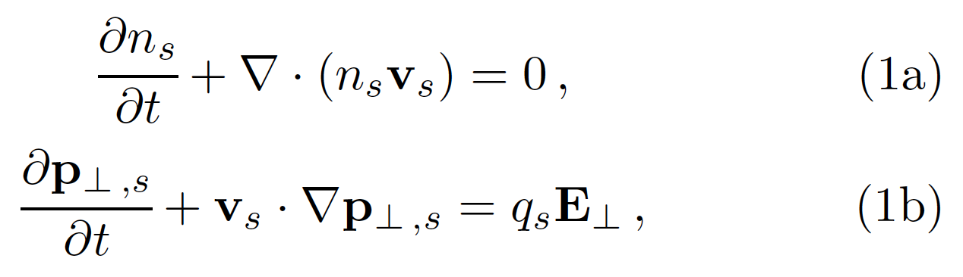


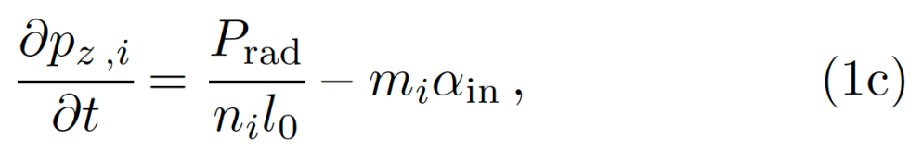
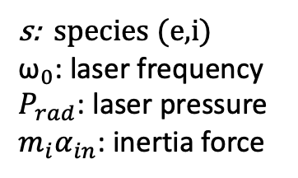
The 3D theory of instability in LS
For a ultrathin nano-foil, both shape distortion and density modulation are considered.
Relativistic cold two-fluid (electron/ion) equations
  In the co-moving frame of the compressed foil
  only electrostatic fluctuations considered at first place.
s: species (e,i)
${\text{ω}}_{0}$: laser frequency
$P_{rad}$: laser pressure
$m_{i}α_{in}$: inertia force
Y. Wan, et al., arXiv:1903.11354

Slide 11
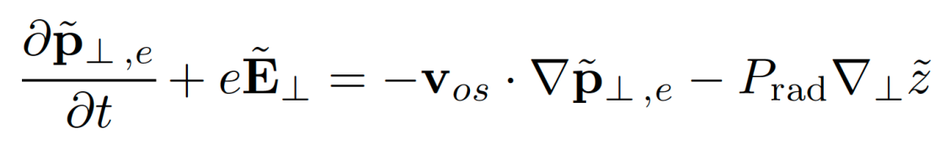

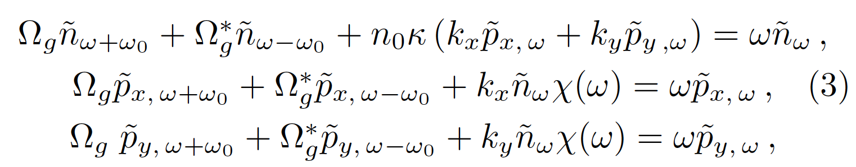
Linearization
We divide all quantities into zero- and first- order parts
Standard 2D Fourier Transformation
First-order of transverse motion equation
Electron-ion coupling via
ponderomotive force
Transverse component of laser pressure
(RT effect)

Slide 12

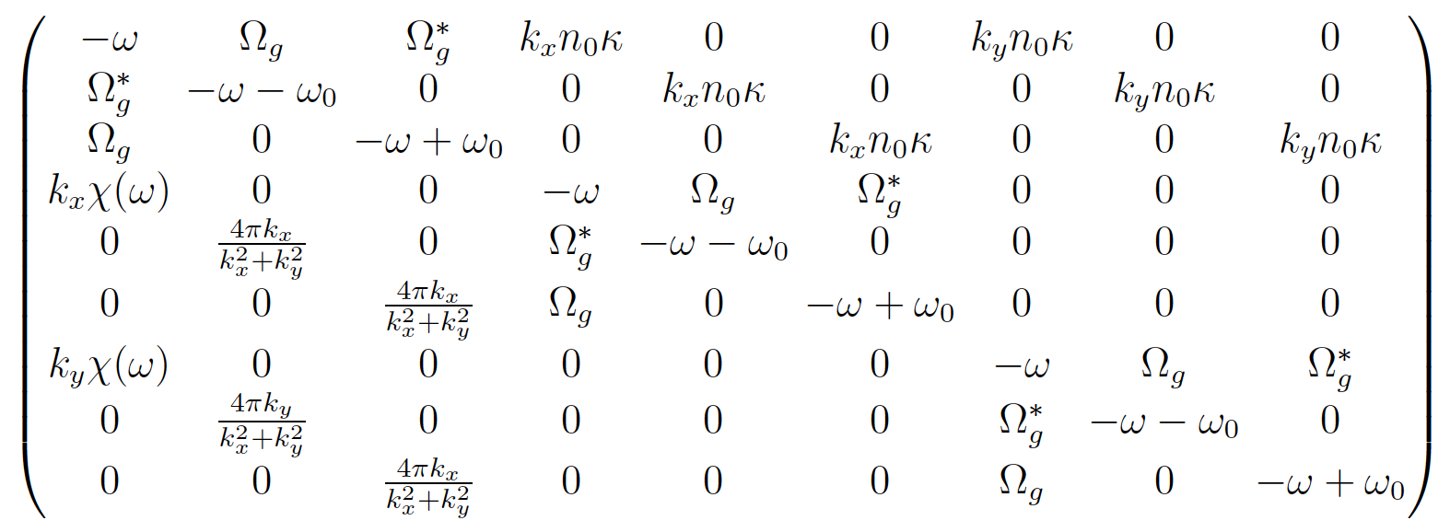
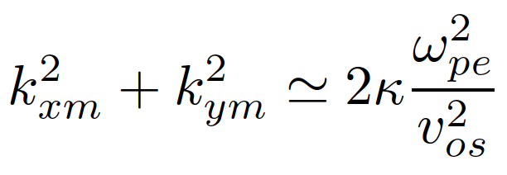
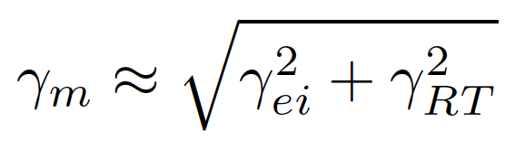
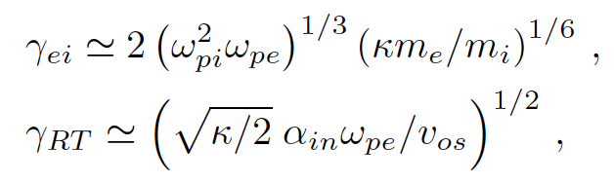

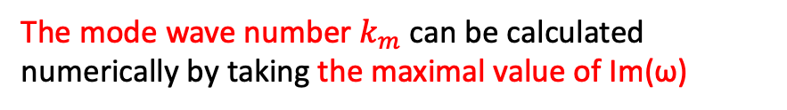
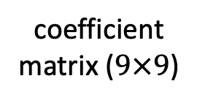
Dispersion relation and mode structure
  Replace ω with ω$±{\text{ω}}_{0}$, and ignore of 2${\text{ω}}_{0}$ ,
  A close set of 9 equations obtained.
coefficient matrix ($9×9$)
The mode wave number$k_{m}$ can be calculated numerically by taking the maximal value of Im(ω)
Electron-ion coupling effect
Raleigh-Taylor effect

Slide 13
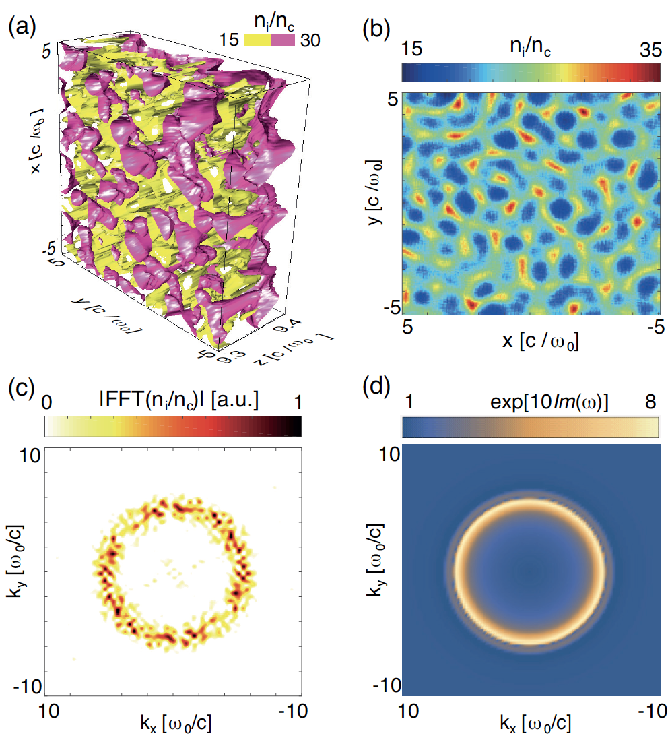
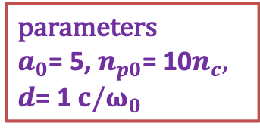
3D PIC simulation demonstration (OSIRIS)
simulation
simulation
parameters
$a_{0}$= 5, $n_{p0}$= 10$n_{c},$
$d$= 1 ${c/ω}_{0}$
3D ion density distribution
Transverse averaged ion density profile
2D FFT of (b)
From theory
simulation
theory
Similar ring structures appear in both simulation and theory !

Slide 14
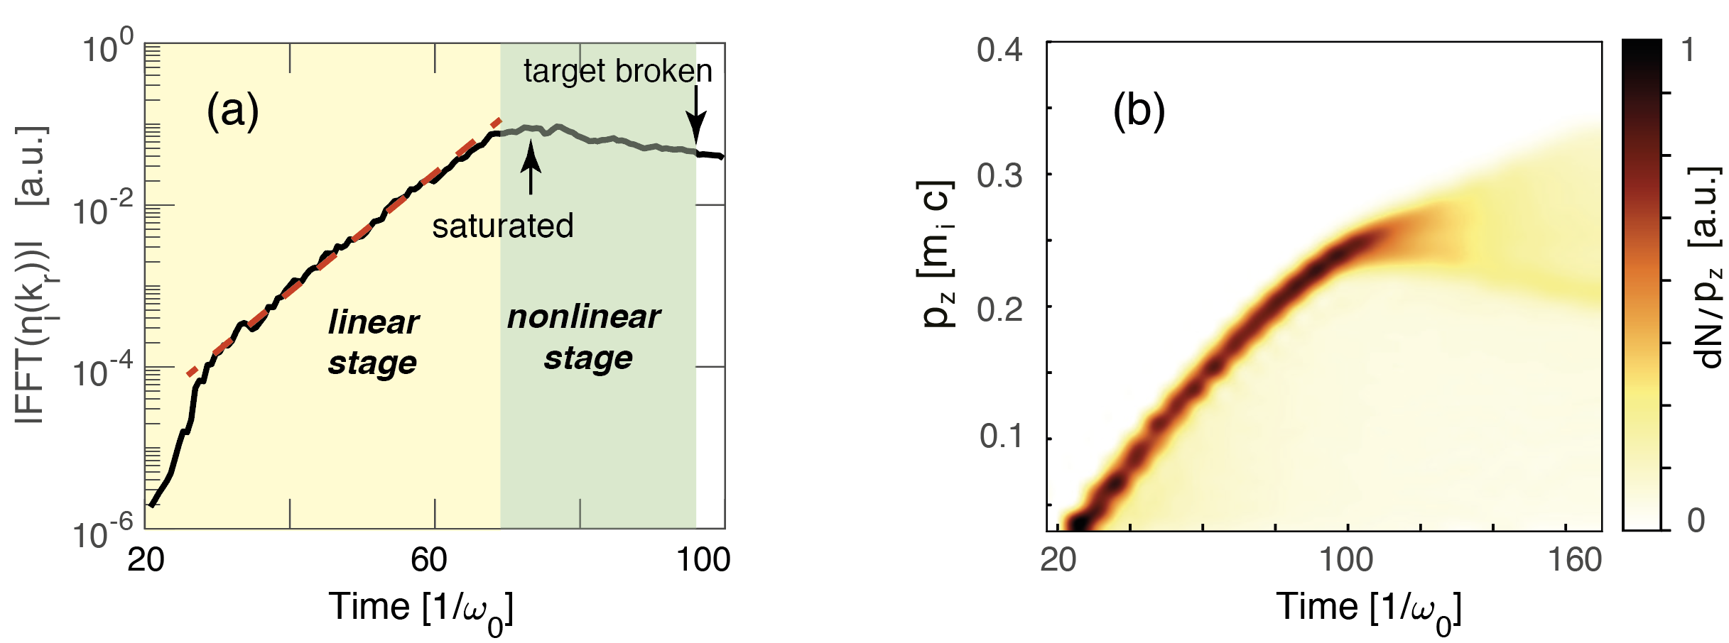
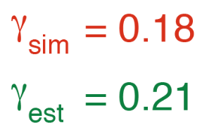

Temporal evolution and target breaking
Evolution of ion density fluctuations
Evolution of ion momentum distributions
Before target breaking, spectra peak is maintained.
For a 800nm laser, effective acceleration time around 40 fs
$$γ_{ei}≫γ_{RT}$$
Electron-ion coupling dominates
Instability growth includes linear and nonlinear stages.

Slide 15
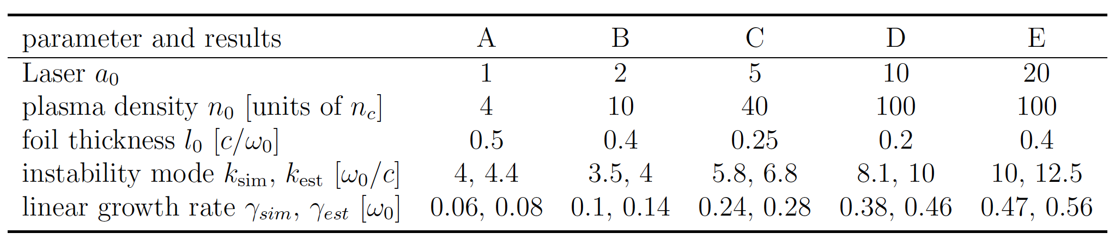
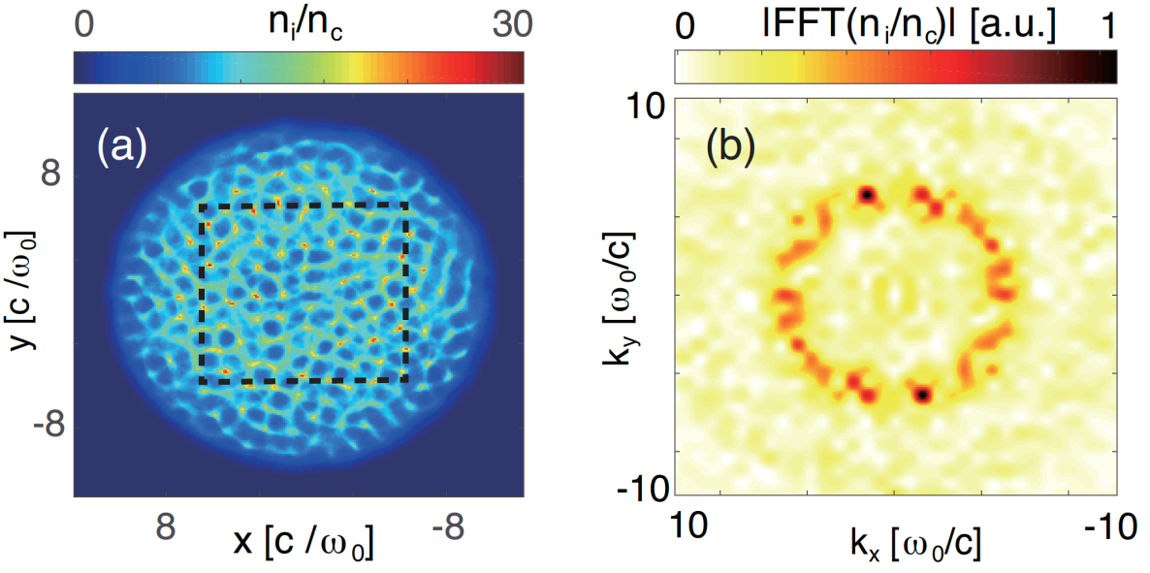
Parametric scanning (3D simulations)
Different laser plasma parameters
Laser with transverse Gaussian profile
Similar ring structures observed in the central region !
Y. Wan, et al., arXiv:1903.11354

Slide 16
New laser ion acceleration schemes
From “acceleration” to a real accelerator !
quasi- monoenergetic ions
sufficient charges for applications (${10}^{9−11}$per shot)
produce stably
    Two-frequency laser tweezer acceleration
    Y. Wan, et al., submitted (arXiv:1707.07290)
    Self-generated high quality laser proton acceleration using a tailored density plasma
    Y. Wan, et al., PRAB 22, 021301 (2019)
    Tri-stage acceleration from a multi-species thick target
    Y. Wan, et al., PoP 25, 073105 (2018)

Slide 17
How to stably accelerate ions?
We have already known, the transverse instability is mainly induced from the electron-ion coupling.
If physically, one can separate electrons and ions, such instability will be totally avoided !
Then, how to do it?

Slide 18
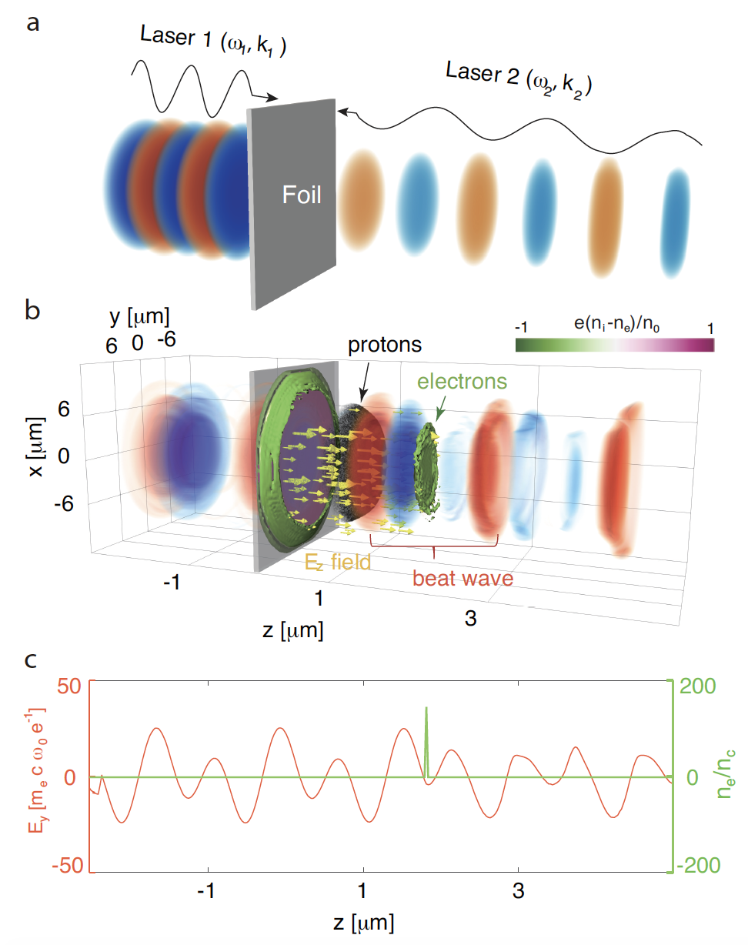
Two-frequency laser tweezer
3D simulation
Two lasers of different colors collide on a nano-foil
Electron sheet is fully dragged out by the formed “tweezer” (beat wave)
Instability-free
Electrons are trapped and moving stably with a constant velocity

Slide 19








Electron dynamics
In a co-moving frame with the velocity $v_{tw}$, two color lasers would have the same frequency
How a single electron with initial $v_{tw}$ get trapped by a CP standing wave ?
$$ω_{tw}=\sqrt{{ω_{1}ω}_{2}}$$
A moving beat wave -> a static standing wave !
Ponderomotive force
Trapping condition
    Y. Wan, et al., PPCF 60, 044016 (2018)

Slide 20

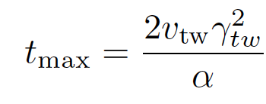

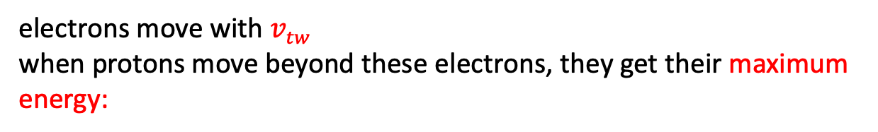
Proton acceleration
proton
n0: initial plasma density
l0: initial thickness
heave ions at rest
trapped electrons
electrons move with $v_{tw}$
when protons move beyond these electrons, they get their maximum energy:

Slide 21

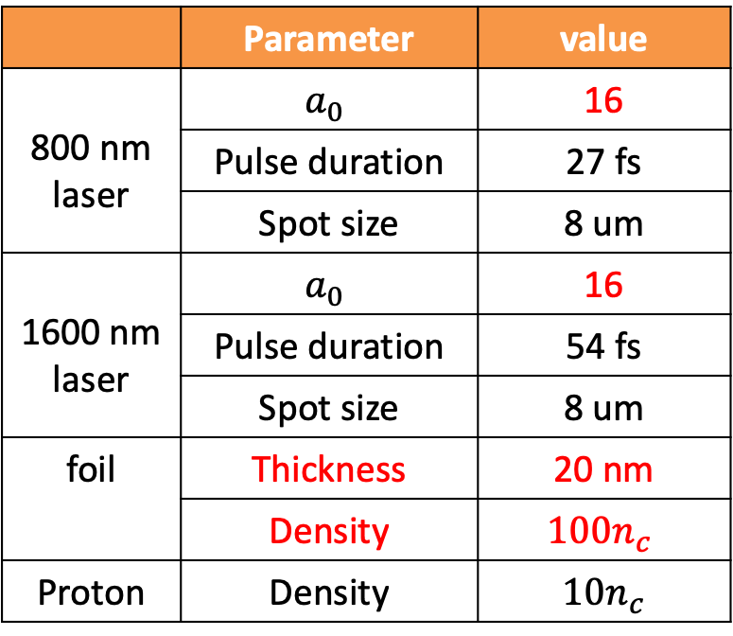

3D PIC simulation
z: longitudinal direction; x, y: transverse direction
$$∆z=3 nm, ∆y=∆x=\text{10} nm$$
 | Parameter | value
800 nm laser | $$a_{0}$$ | 16
 | Pulse duration | 27 fs
 | Spot size | 8 um
1600 nm laser | $$a_{0}$$ | 16
 | Pulse duration | 54 fs
 | Spot size | 8 um
foil | Thickness | 20 nm
 | Density | $${100n}_{c}$$
Proton | Density | $${10n}_{c}$$

Slide 22
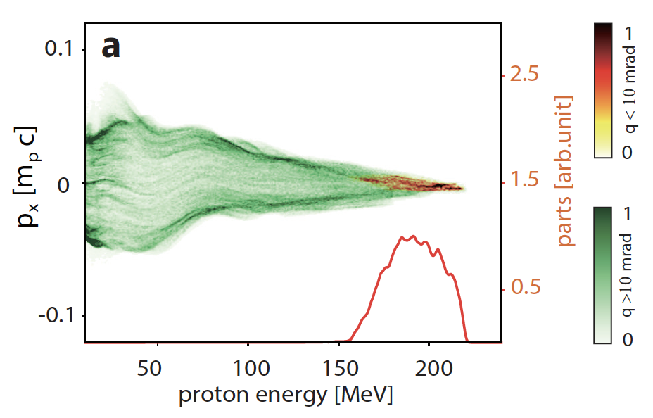

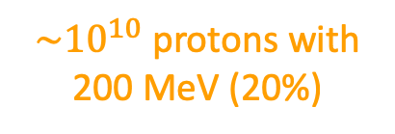
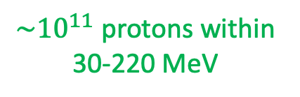

Proton phase space and energy spectra
$$θ_{x,y}>10 \text{mrad}$$
$$θ_{x,y}≤\text{10} \text{mrad}$$
$\sim {10}^{11}$ protons within 30-220 MeV
$\sim {10}^{10}$ protons with 200 MeV (20%)

Slide 23
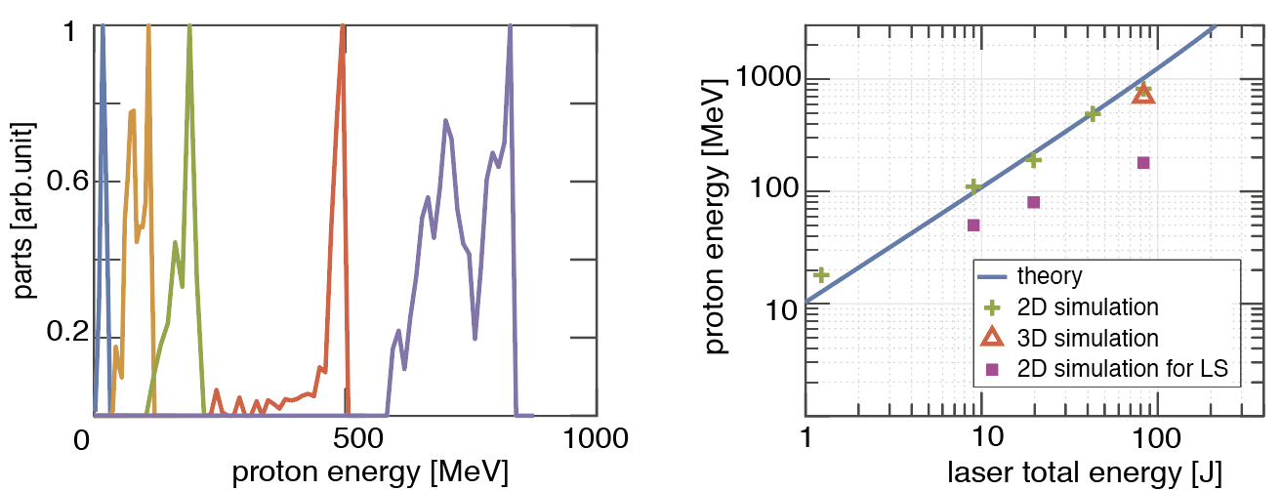
A favorable energy scaling
For 1-80J lasers, proton energy increases from 20-1000 MeV with energy spread only 4% to 20%
Hints:
Transverse instability is avoided
Proton energy are 2-5 times higher than standard LS scheme
Y. Wan, et al., arXiv:1707.07290

Slide 24
Summary
Plenty of interesting physics are not yet well understood in the field of laser ion acceleration
We began with an important fundamental problem – the mechanism of transverse instability - during my PhD studies
The developed 3D model clearly clarifies the origin of such instability, and kind of closes this long-standing controversy in laser plasma physics.
We also proposed several new schemes to obtain high quality ion beams.
One of them is two-frequency laser tweezer, which avoids such instability by separating electron and ions, and shows good acceleration feature (stable, monoenergetic, sufficient charges)

Slide 25
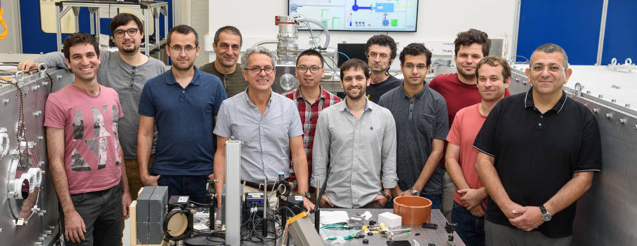

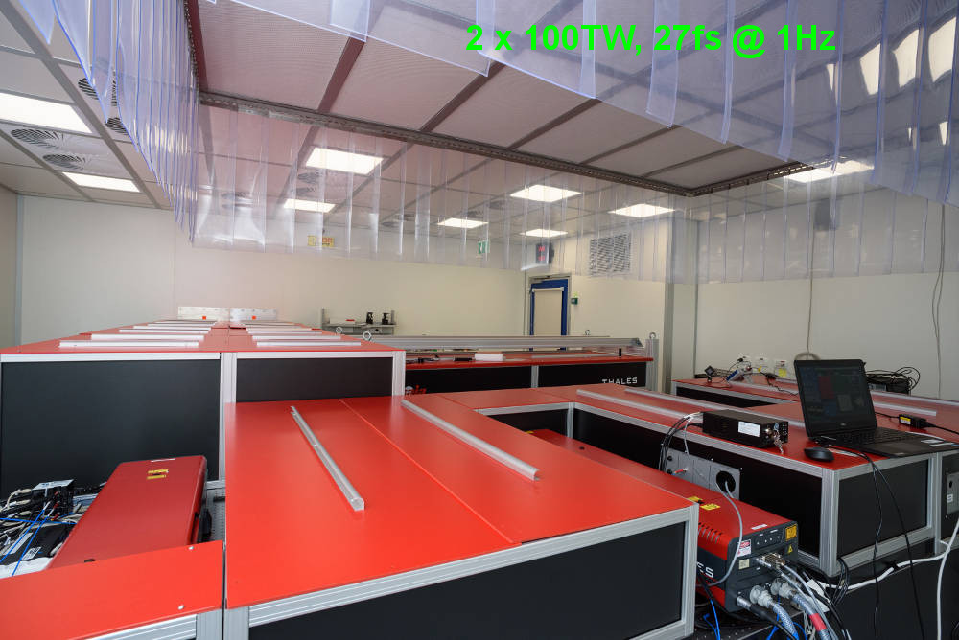
Our Lab at WIS
3 staff scientists
2 post-doc fellows
2 engineers
4 PhD students
Group Leader
Victor Malka

Slide 26
Thank you for your attention

