Slide 1
Transverse electron probing
of interactions of long CO2 laser pulse
with plasma at ATF

Slide 2
￼

Slide 3
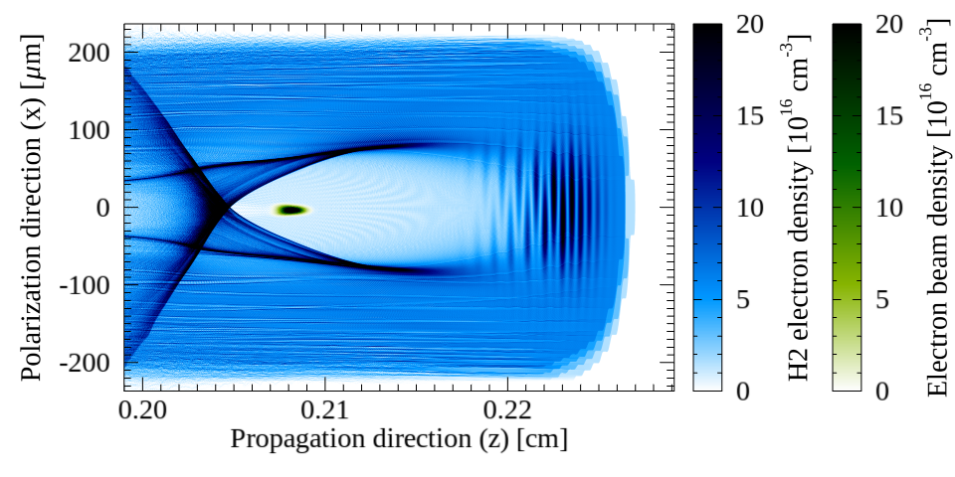
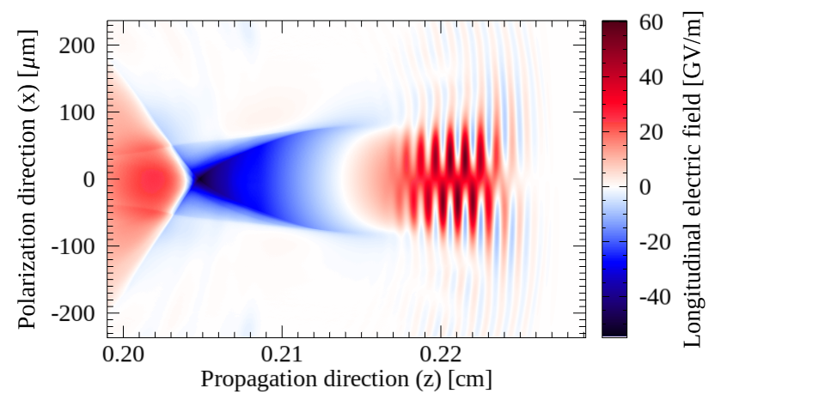

Bubbles driven by CO2 laser (~10µm λ0) are ≈170µm long
Unique ATF’s CO2 laser system has λ0≈10 µm and TW-class pulses
If compressed to ≈200 fs, it will drive plasma wakefields with bubbles as long as 170µm
Enabling external injection of ATF’s e⁻ beam into accelerating phase with ≈25 GeV/m
Plasma electrons
e⁻ beam
Bubble
￼
Notes:
ATF is a very unique facility that produces both CO2 laser and electron beams
Ultimate goal of the collaboration is to reach bubble regime

Slide 4
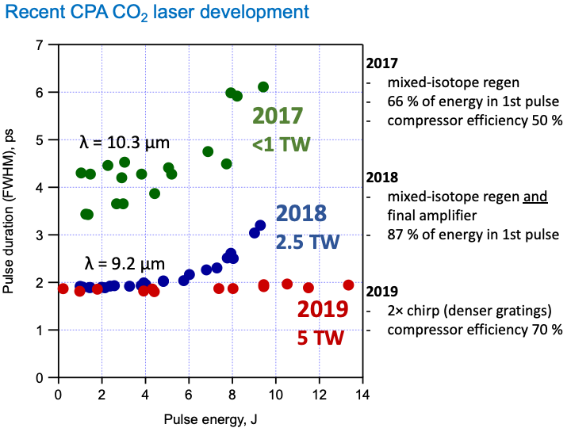
Towards Sub-ps CO2 Pulses at ATF
￼
Notes:
Curve shows the improvements from <1 TW 5 ps in 2017 to 5 TW at 2 ps in 2019

Slide 5
Currently, ATF CO2 laser encompasses ≈44 plasma wavelengths
 | W0 | λ0 | τ (FWHM) | En | ZR | a0
CO2 | 20 µm | 9.2 µm | 2ps | 4J | 0,012cm | 4.3
 | n0 (ions/e⁻s) | Skin depth c/ωp | Particles per cell
H2 plasma | 7.5x10¹⁷ cm⁻³ | 6.14 µm | 2 x 2
CO2
pulse
Hydrogen
plasma
dt = 0.03
Simulation done in 2D geometry
With ADK model of ionization with mobile ions
Moving window (0.21cm long / 0.36cm wide)
0.0
0.22
0.27
0.47
0.52
Propagation direction [cm]
Longitudinally:
9400 cells
(60 per λ0)
Transversely:
5500 cells
(30 per W0)
￼

Slide 6
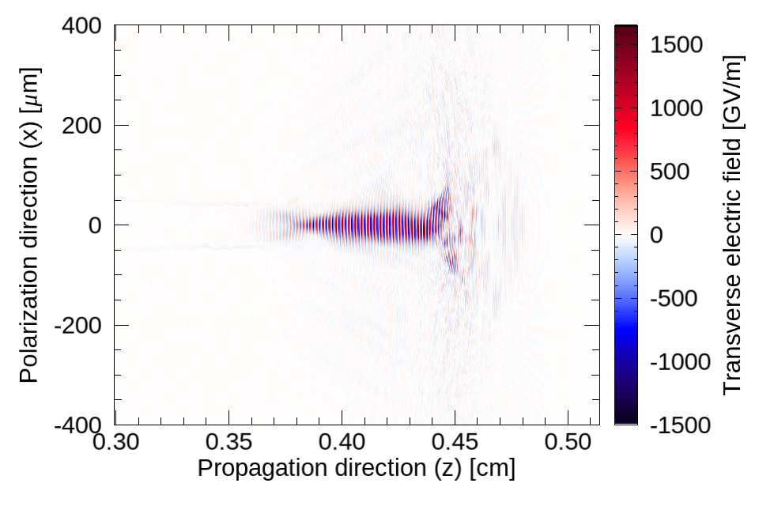
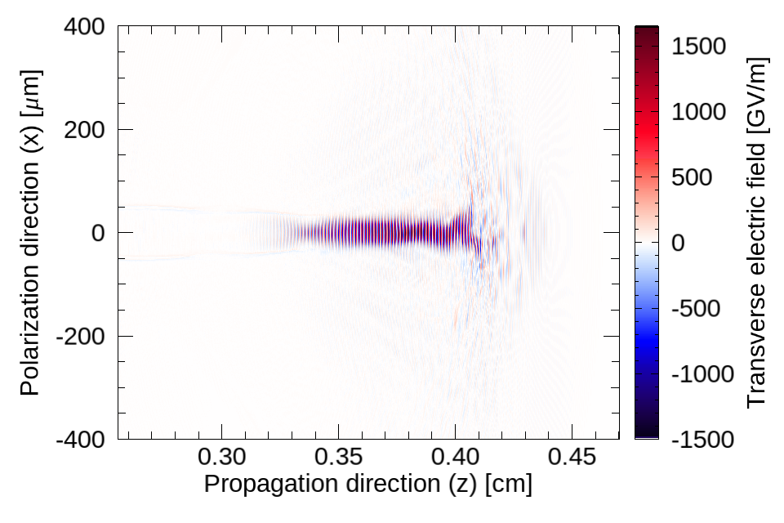
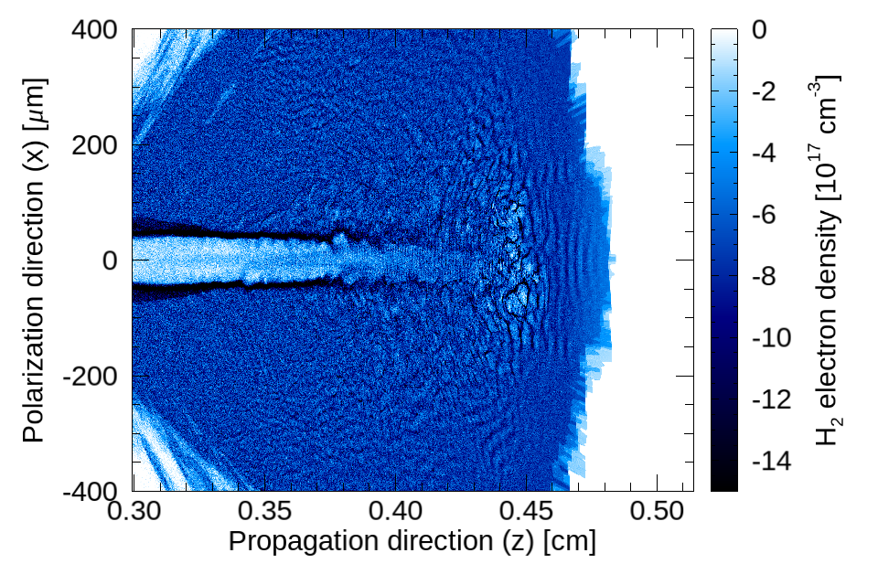
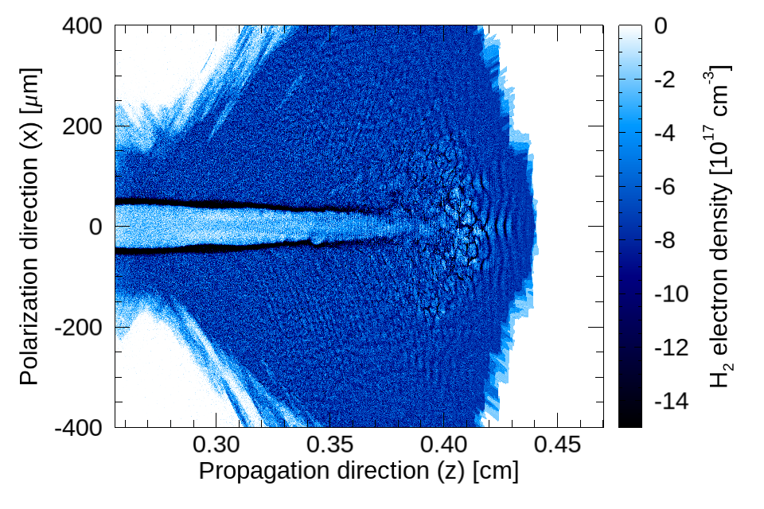
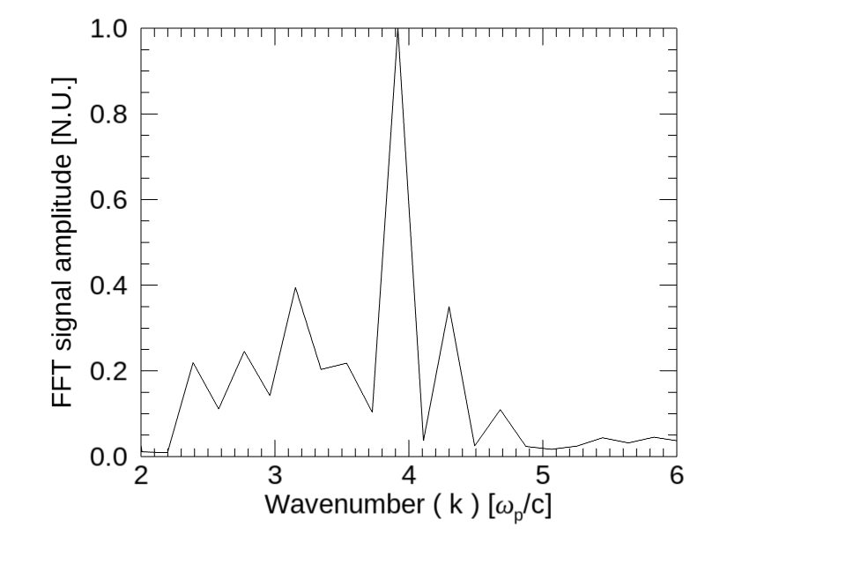
Self-modulation stokes shift appears in field spectra
Electric field in transverse
(polarization) direction
(Spectra of the field in polarization direction taken for each transverse slice, ri, and then averaged over ri, within black box region)
Fundamental | Stokes | Anti-stokes
k0 | k0 - kp | k0 + kp
4.2 kp | 4.2 kp | 5.2 kp
Plasma electron density
￼
 | 5/9/19 | SBU

Slide 7
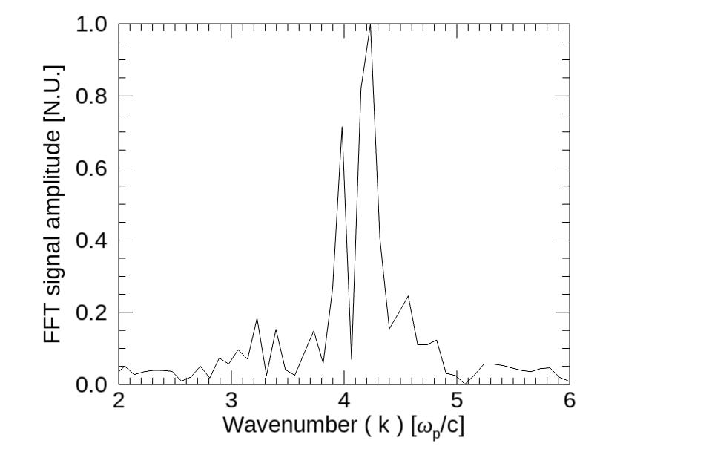
Self-modulation is followed by non-linear “hosing-like” phenomena
Electric field in transverse
(polarization) direction
The “hosing-like” phenomena contributed to peaks between fundamental and stokes/anti-stokes shifts (clearer at end of run)
Fundamental | Stokes | Anti-stokes
k0 | k0 - kp | k0 + kp
4.2 kp | 4.2 kp | 5.2 kp
Plasma electron density
J. Yan et al. IEEE proceedings AAC 2018
￼
 | 5/9/19 | SBU

Slide 8
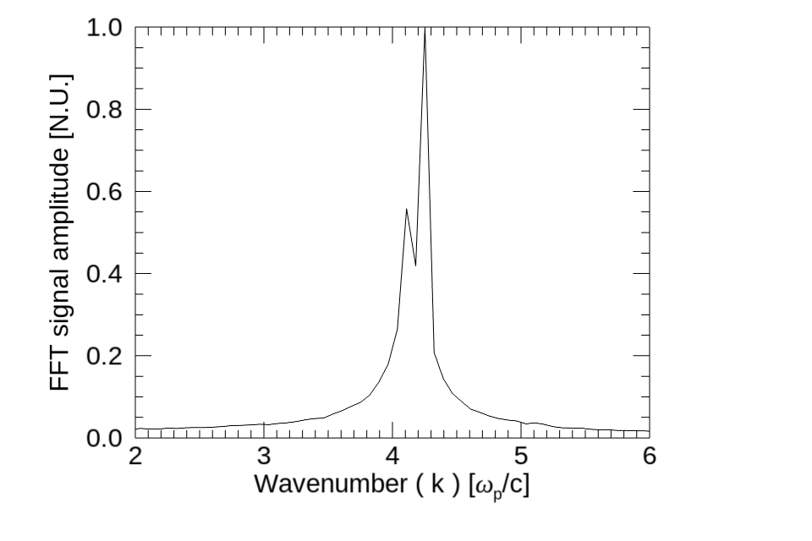
Back of laser is guided in plasma depleted channel
Electric field in transverse
(polarization) direction
Inside the plasma channel depleted of ions and e⁻s the laser wavenumber shifts are small
Fundamental | Stokes | Anti-stokes
k0 | k0 - kp | k0 + kp
4.2 kp | 4.2 kp | 5.2 kp
Plasma electron density
Channel
￼
 | 5/9/19 | SBU

Slide 9
ATF e⁻ beam can be used as probe
 | W0 | λ0 | τ (FWHM) | En | ZR | a0
CO2 | 20 µm | 9.2 µm | 2ps | 4J | 0,012cm | 4.3
 | n0b | Q | σz | σx/σy | En | ppc
e⁻ beam | 4.4x10¹³cm⁻³ | 1nC | 30fs | 1mm | 60 MeV | 2x2
CO2
pulse
Hydrogen
plasma
 | n0 (ions/e⁻s) | Skin depth c/ωp | Particles per cell
H2 plasma | 7.5x10¹⁷ cm⁻³ | 6.14 µm | 2 x 2
0.0
0.22
0.27
0.47
0.52
Propagation direction [cm]
Time step: dt = 0.03
Simulation done in 2D geometry
With ADK model of ionization with mobile ions
Moving window (0.21cm long / 0.36cm wide)
Electron beam probe
Longitudinally:
9400 cells
(60 per λ0)
Transversely:
5500 cells
(30 per W0)
￼

Slide 10
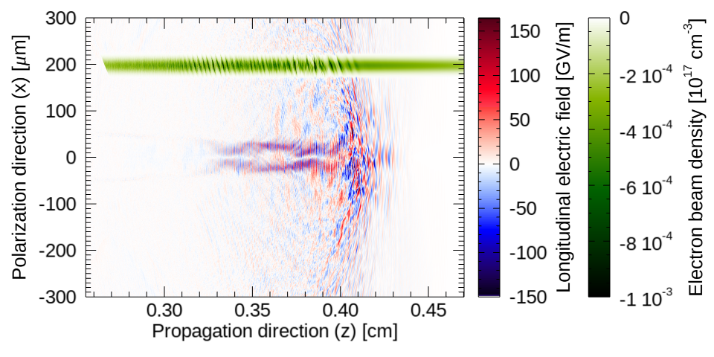
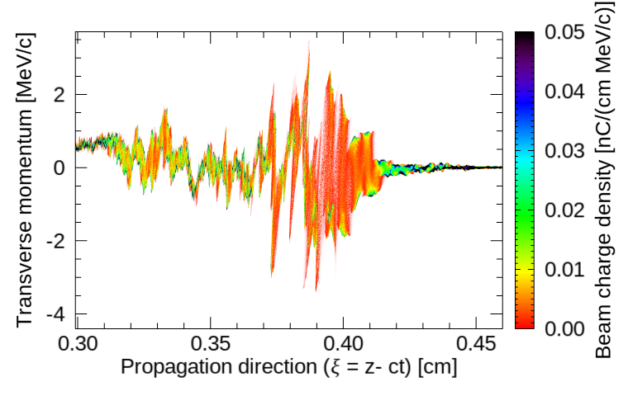
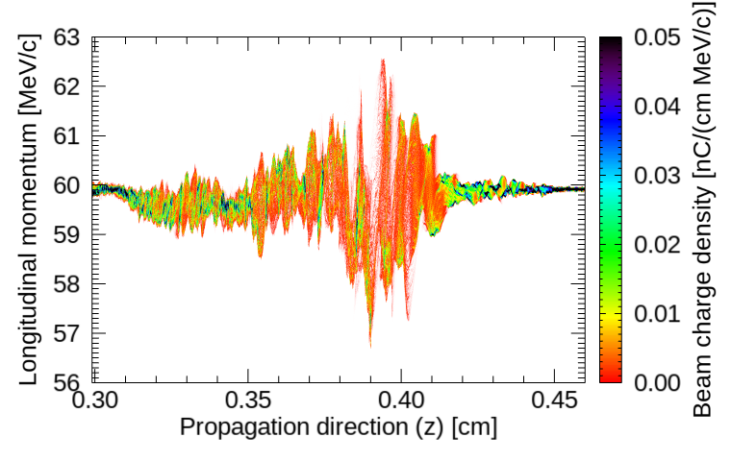
e⁻ beam modulations are characteristic of each interaction regime
e⁻ beam probe
A
In region of laser self-modulation e-beam shows structures at ≈ λp
B
“hosing-like” interaction leads to irregular beam perturbations, as hosing evolves in time and along the laser (from wave-breaking slice towards laser tail)
C
B
A
C
Probe beam is modulated at ≈ λ0
C
B
A
C
B
A
J. Yan et al. IEEE proceedings AAC 2018
￼

Slide 11
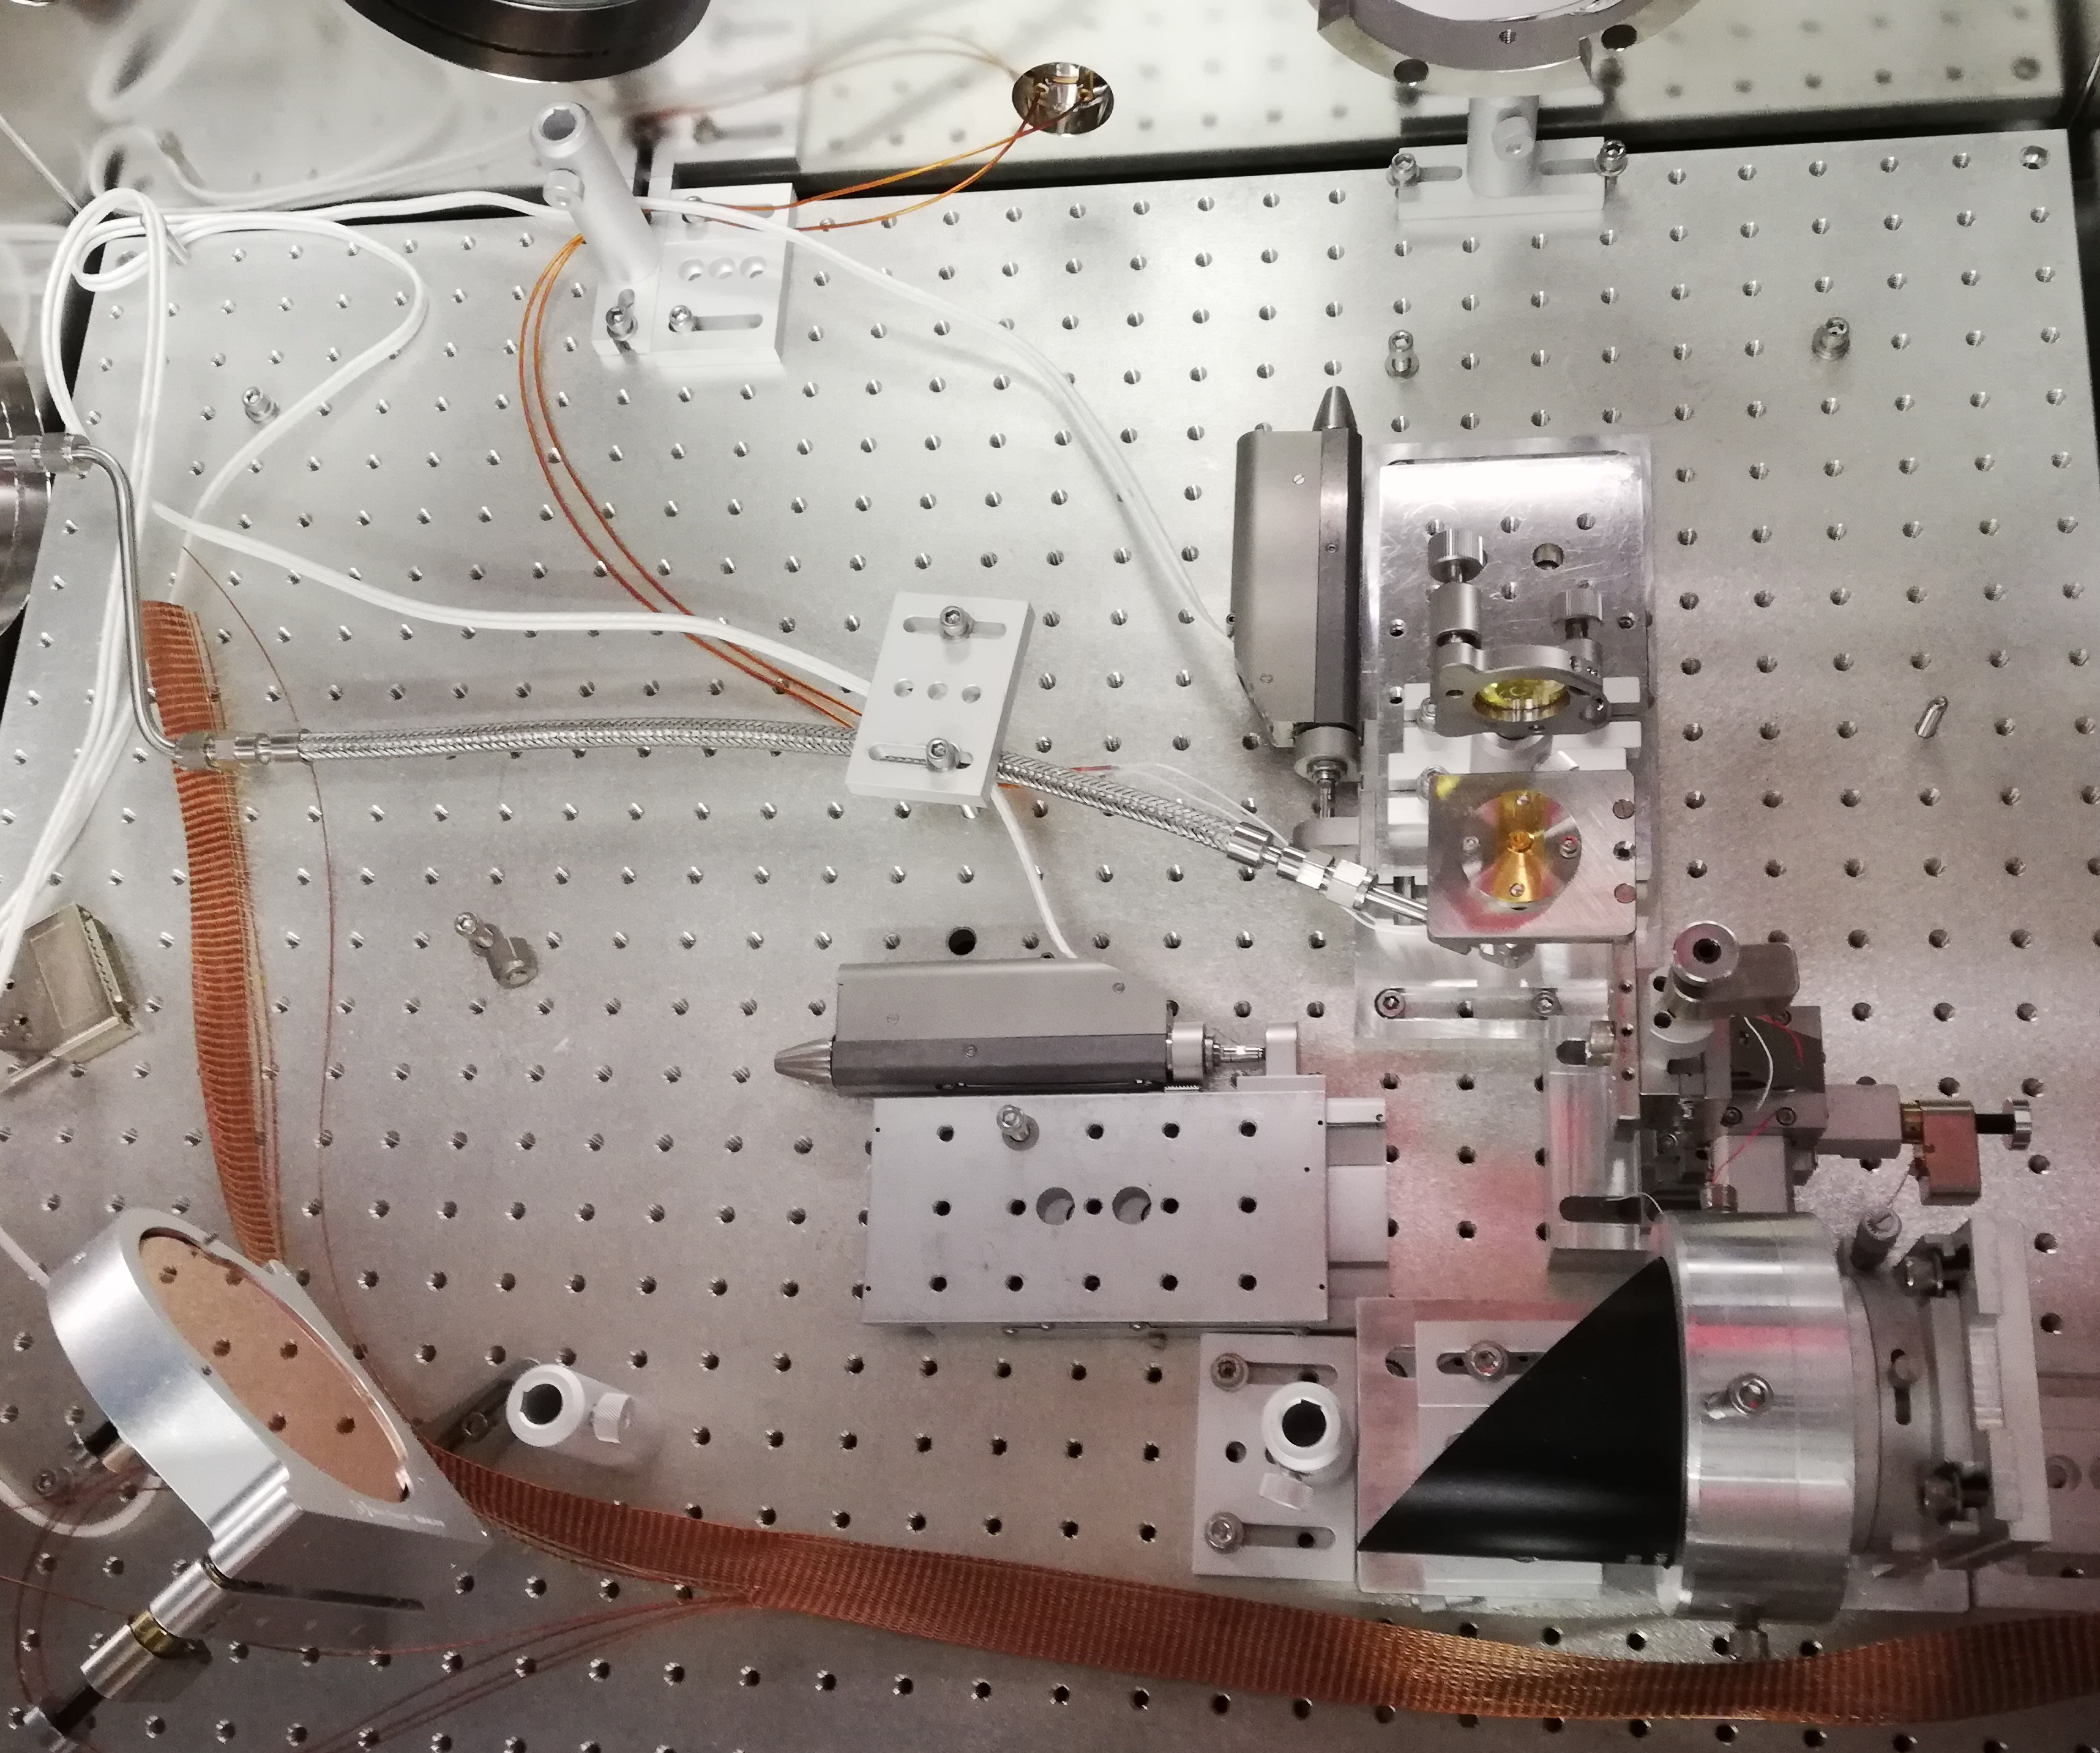
Experimental Layout
CO2
Diagnostics
Spectrometer
BPM
Spectrometer
Electron beam
probe
CO2
parabola
CO2
mirror
Green
Probe
￼

Slide 12
Status of the Experimental Preparation
Primary systems enabling the experiment have been completed:
Gas delivery system — Complete and Tested
Differential Pumping — Complete and Tested
CO2 Laser Delivery — Complete
Radiation Safety Study of the Experiment — Complete
Systems required for data acquisition are currently being tested and set up:
BPM Systems and Imaging —To be tested
YAG Transport Path — To be completed
We are almost there!
￼

Slide 13
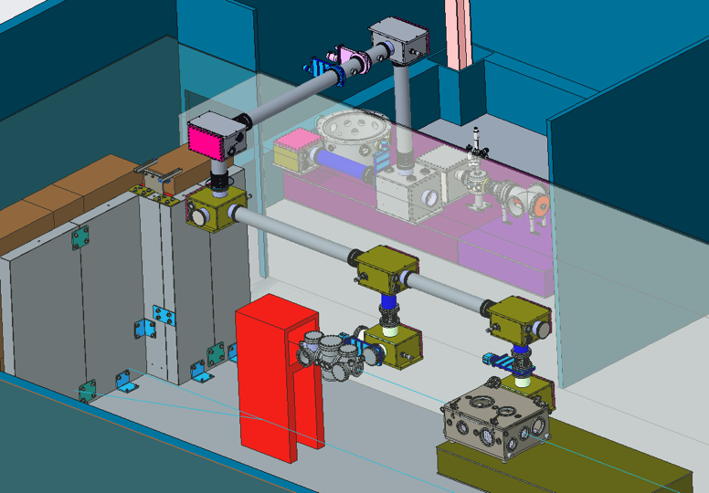
Enabling Laser e-beam Integration: Laser Transport
LWFA Chamber
￼

Slide 14
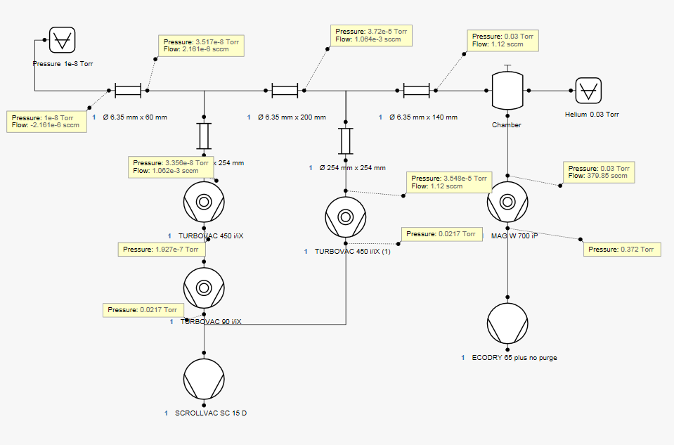




Enabling Laser e-beam Integration: Differential Pumping
Electron Beamline: 1e-8 Torr
P= 3.7e-5 Torr
P= 0.03 Torr
P= 3.5e-8 Torr
Chamber:Helium 0.03 Torr
P= 1e-8
φ 6.35x60 mm
φ 6.35x200 mm
φ 6.35x140 mm
P= 3.4e-8 Torr
P= 0.03 Torr
P= 3.7e-5 Torr
P= 0.02 Torr
Simulation results courtesy of Leybold
￼

Slide 15
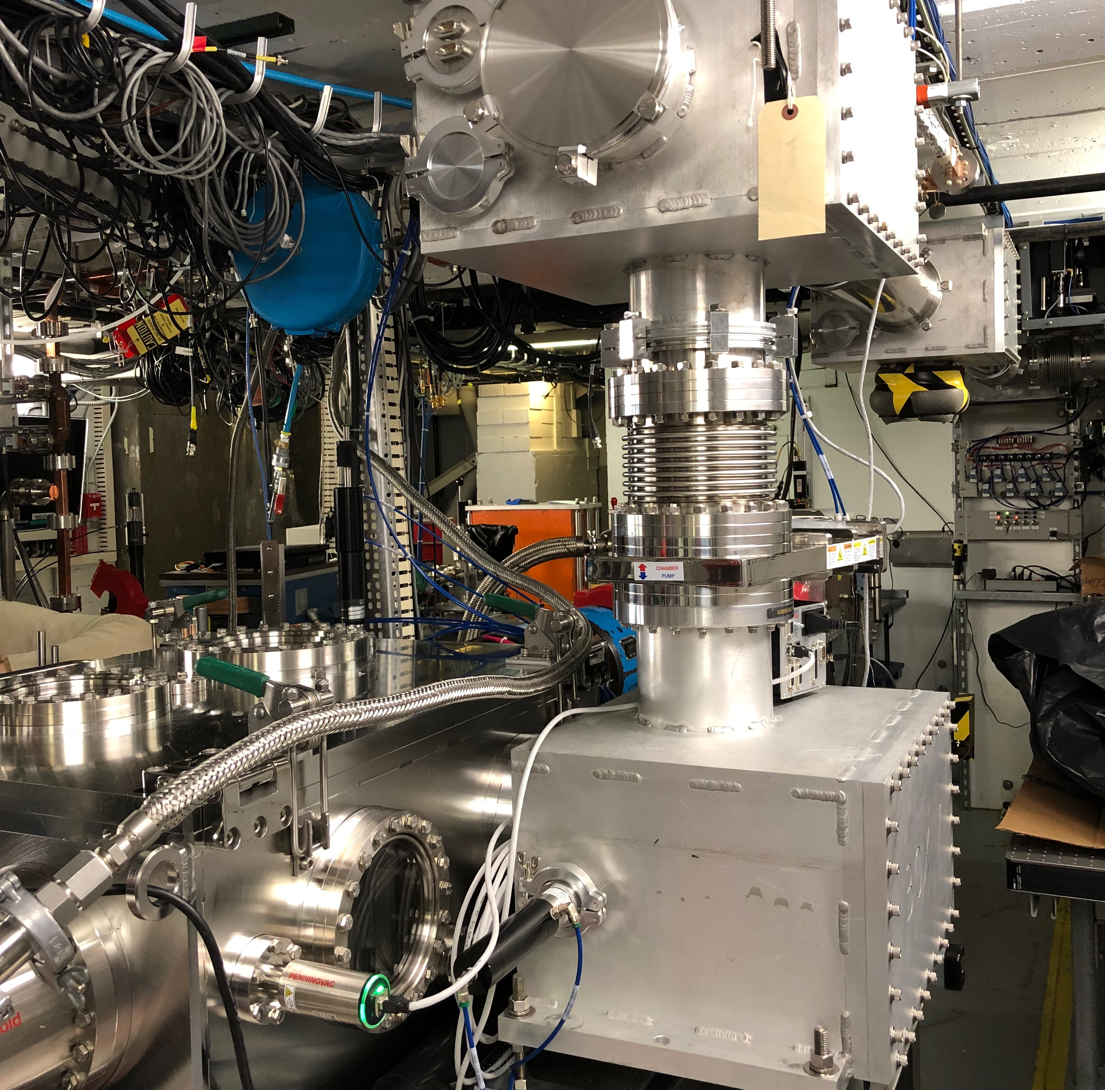
LWFA Experimental Chamber
BPM 3
BPM 2
e-beam
CO2 In
CO2 Out
￼

Slide 16
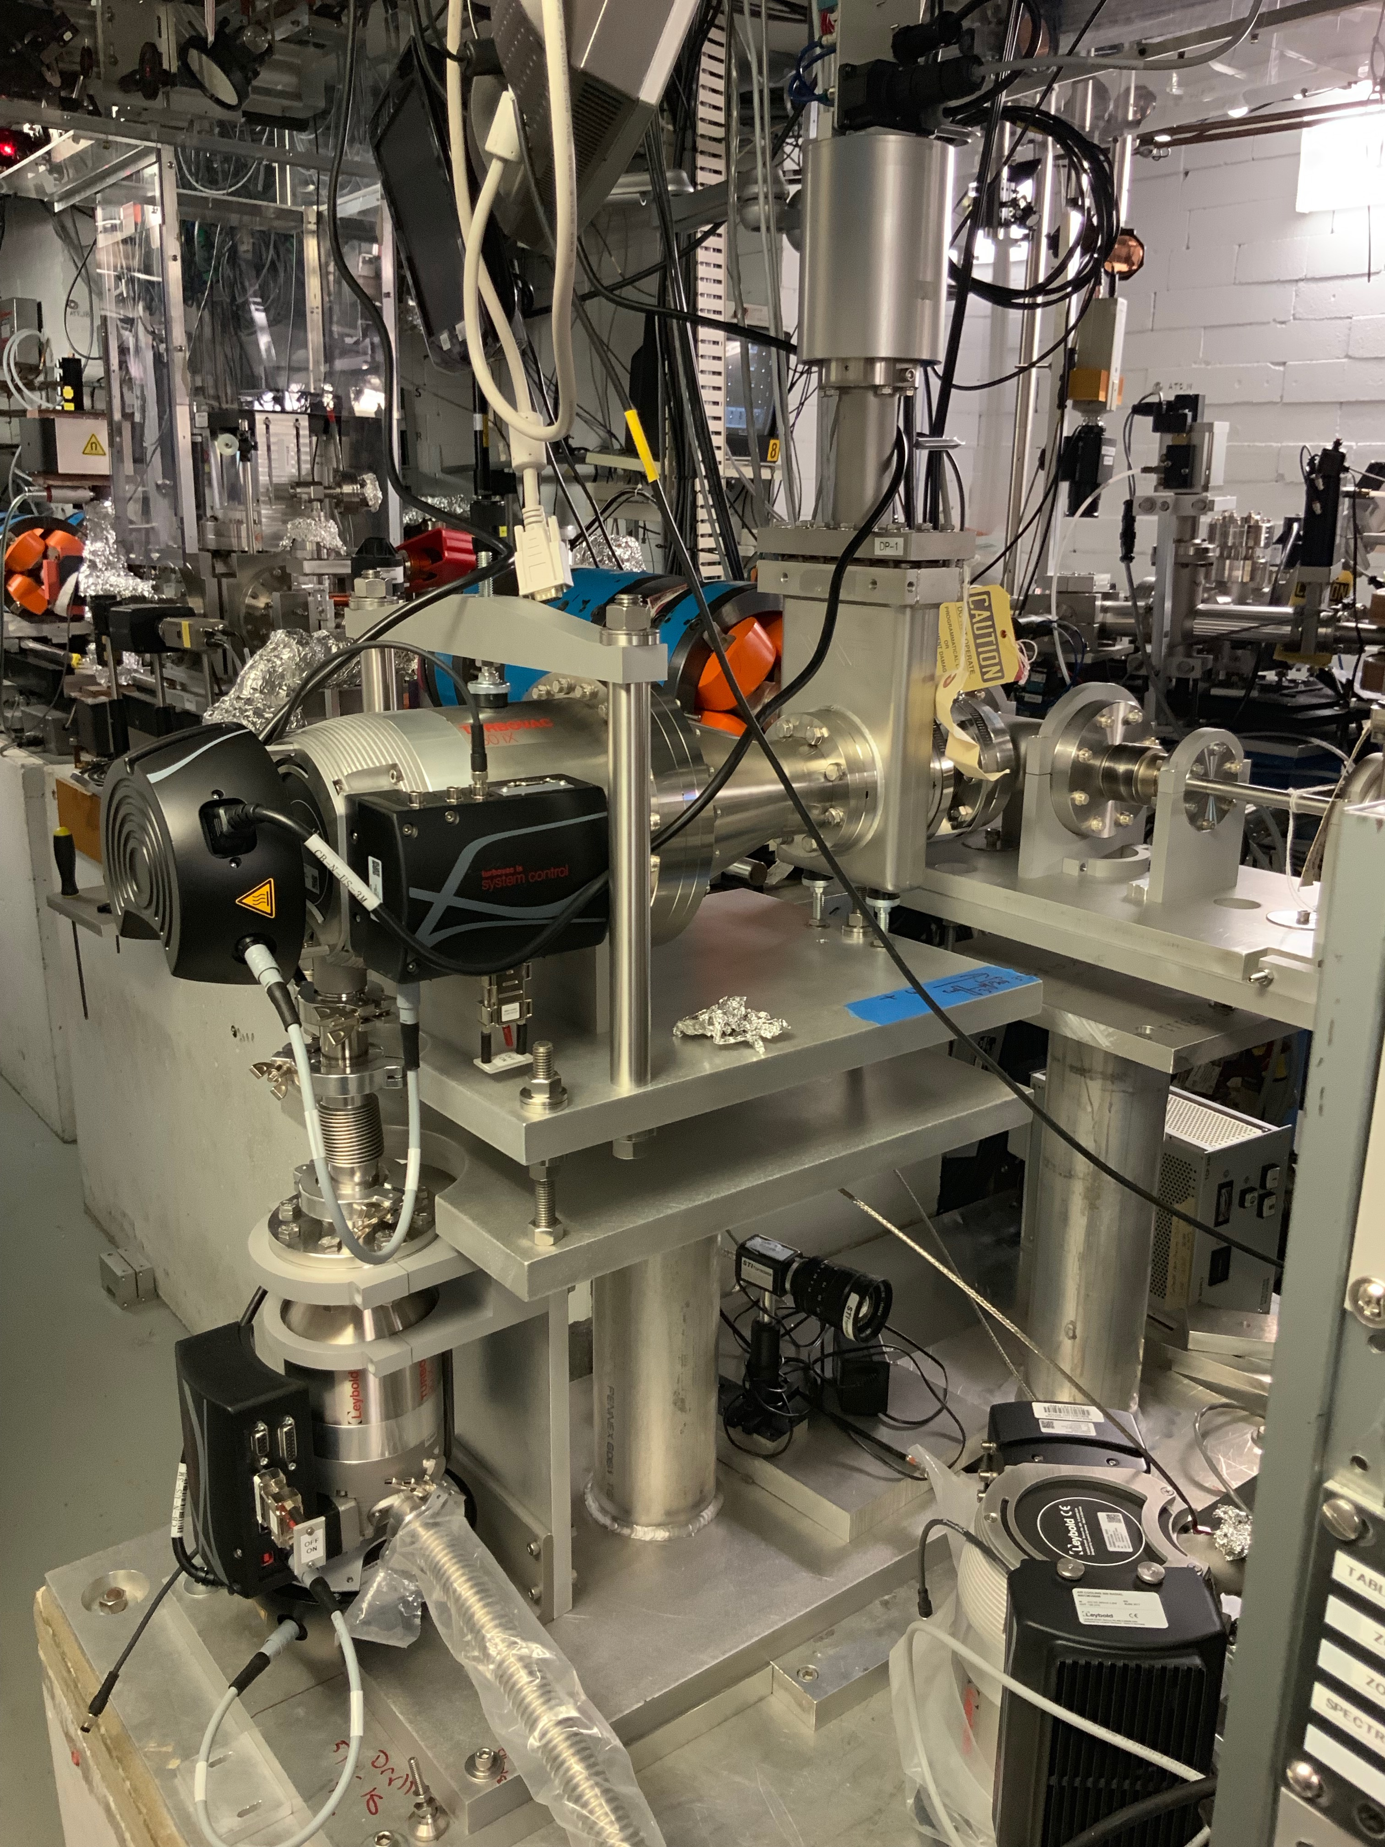
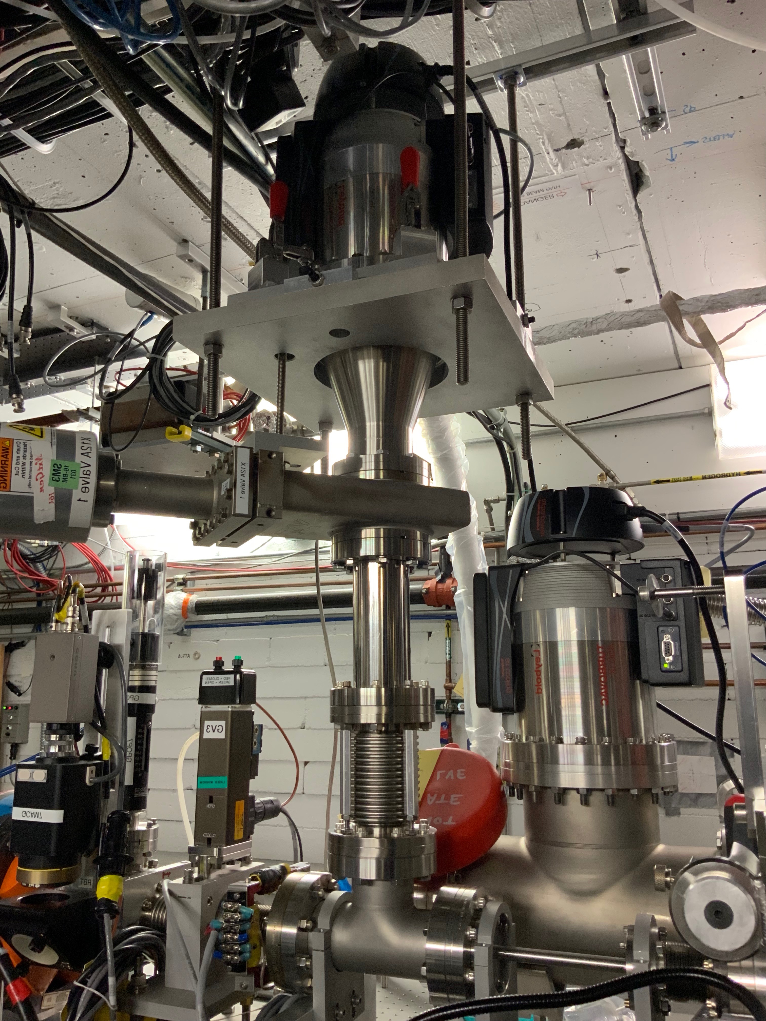
Differential Pumping Stages
Stage 2
Stage 1
Pump 1
Beam line
Pump 2
Pump 3
Beam line
￼

Slide 17
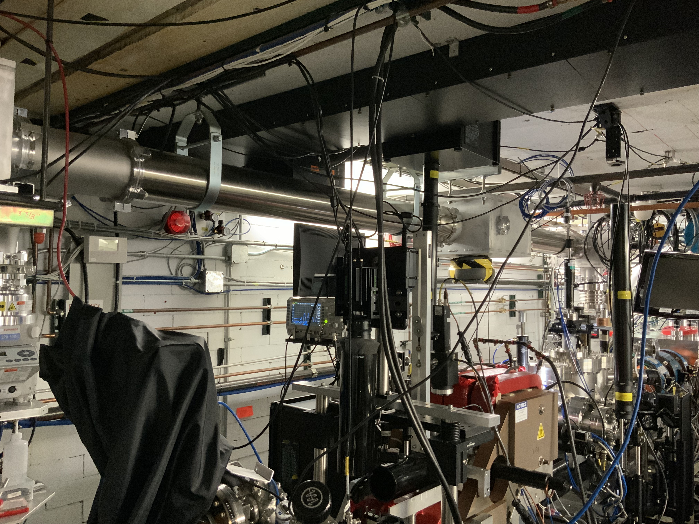
Experimental Hall
Laser Transport
￼

Slide 18
￼

Slide 19
￼

Slide 20
￼

Slide 21
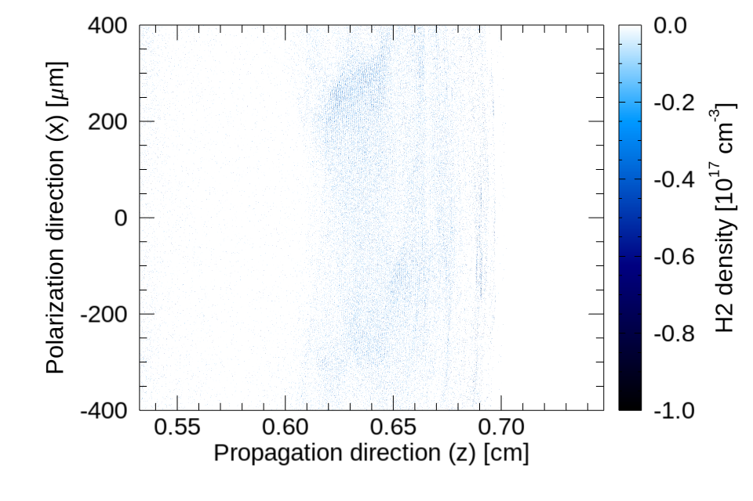
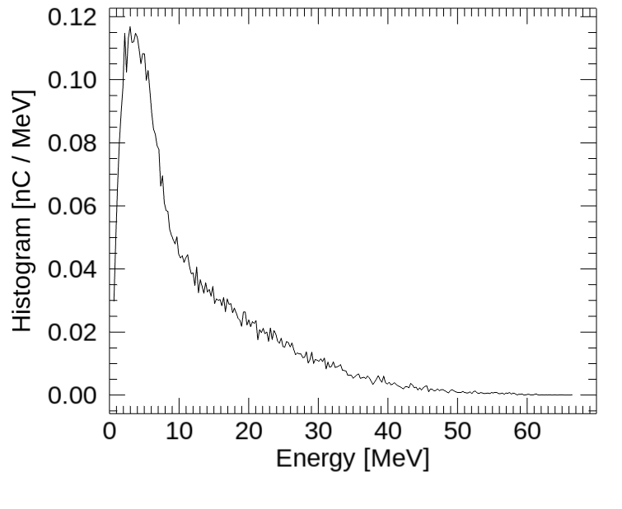
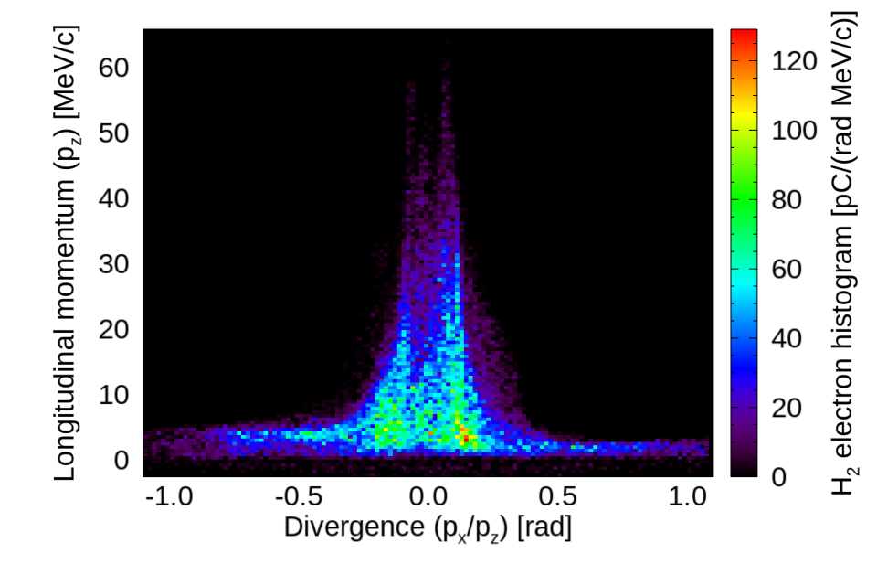
Self-trapped plasma electrons reach 60 MeV
Accelerated electrons
Peak around 4 MeV
￼

Slide 22
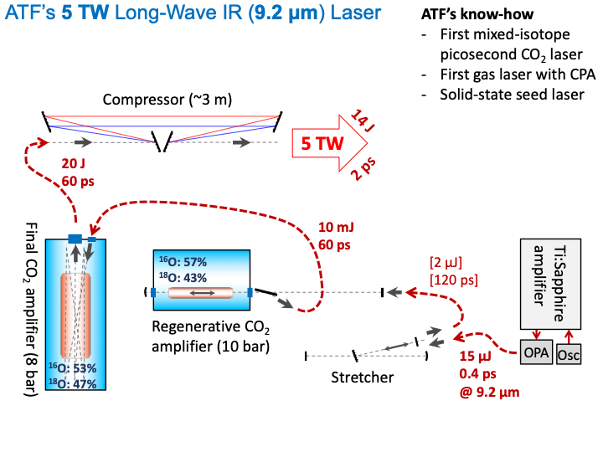
￼

Slide 23
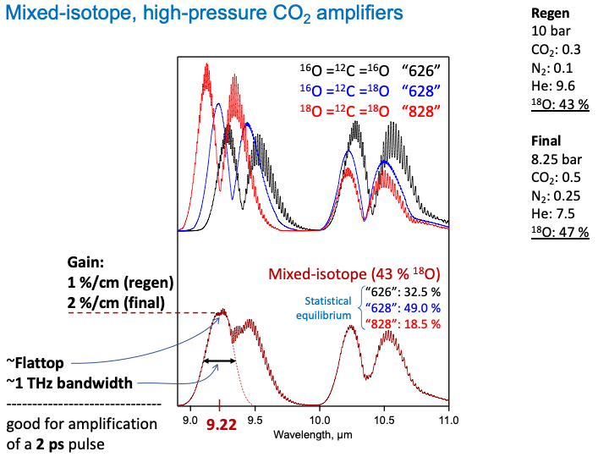
￼

Slide 24
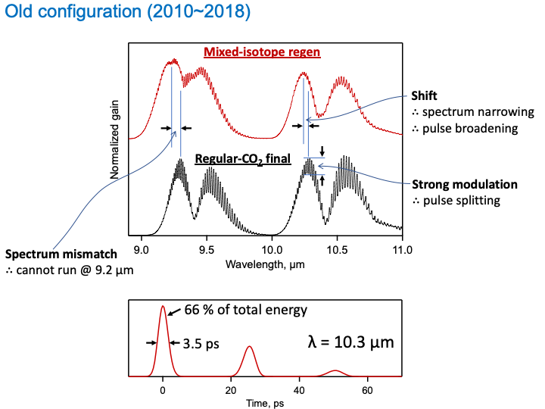
￼

Slide 25
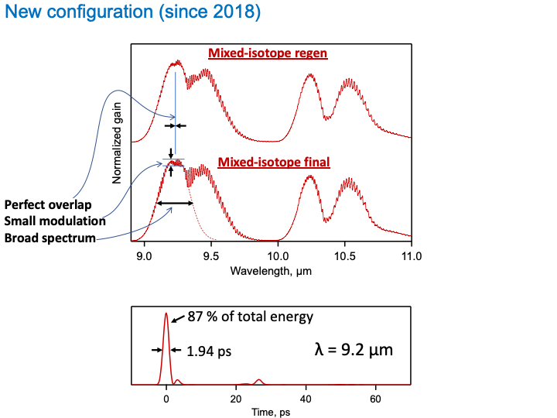
￼

Slide 26



