Slide 1
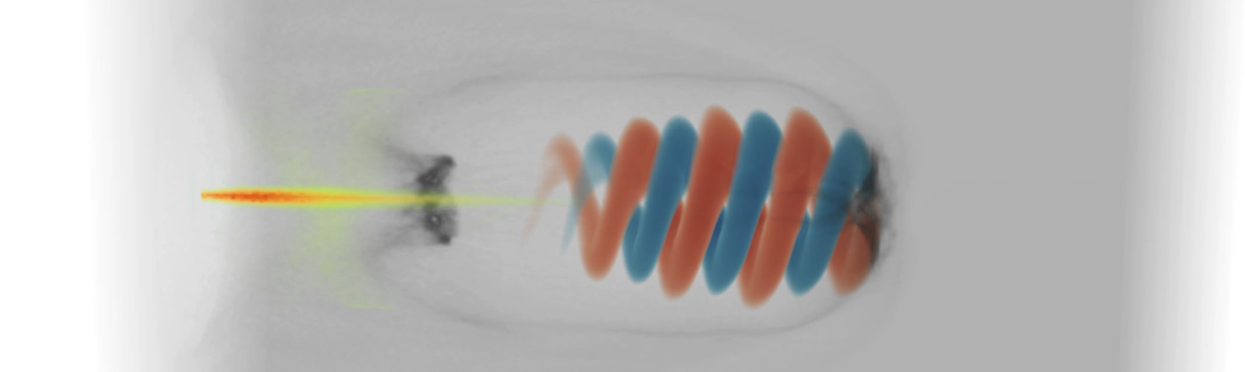

Spin-polarized particle beams from plasma-based accelerators
20.06.25 I Lars Reichwein, Alexander Pukhov & Markus Büscher

Slide 2
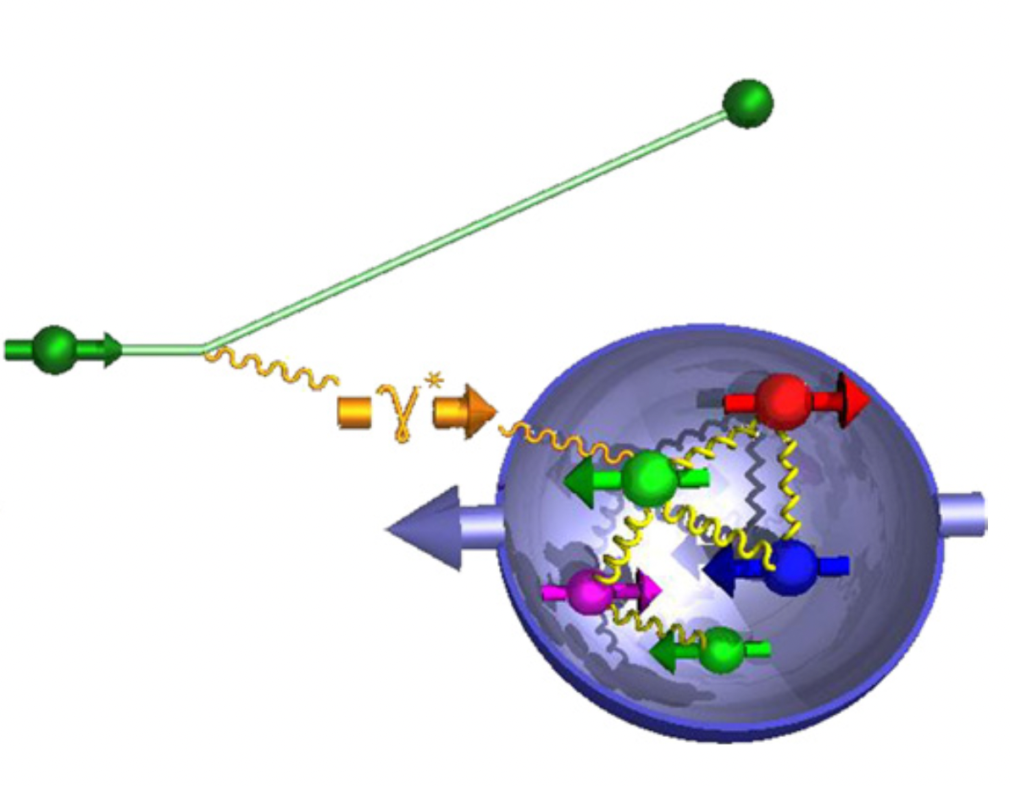
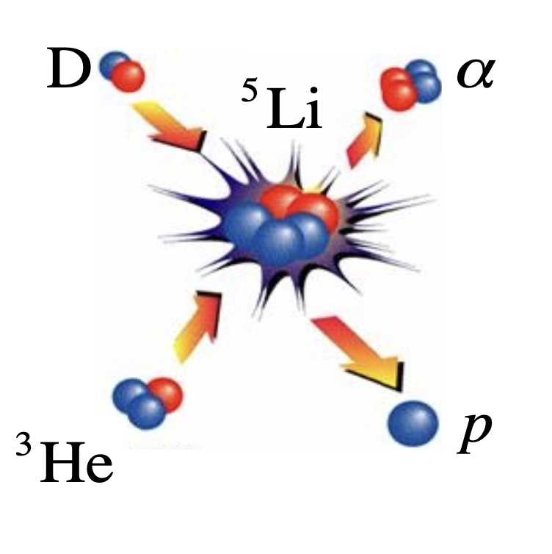
Applications of polarized particle beams
Deep-inelastic scattering
Polarized nuclear fusion
M Burkardt, Rep. Prog. Phys. 73, 016201 (2010)
RM Kulsrud, PRL 49, 1248 (1982)

Slide 3





Collaborations on polarized beams
A. Pukhov
Theory (PIC)
L.L. Ji
…
L. Reichwein
Theory
Long-standing collaborations
M. Büscher
Experiments
T.P. Rakitzis
D. Sofikitis
A. Diallo
(currently building up collaboration for pol. fusion)

Slide 4
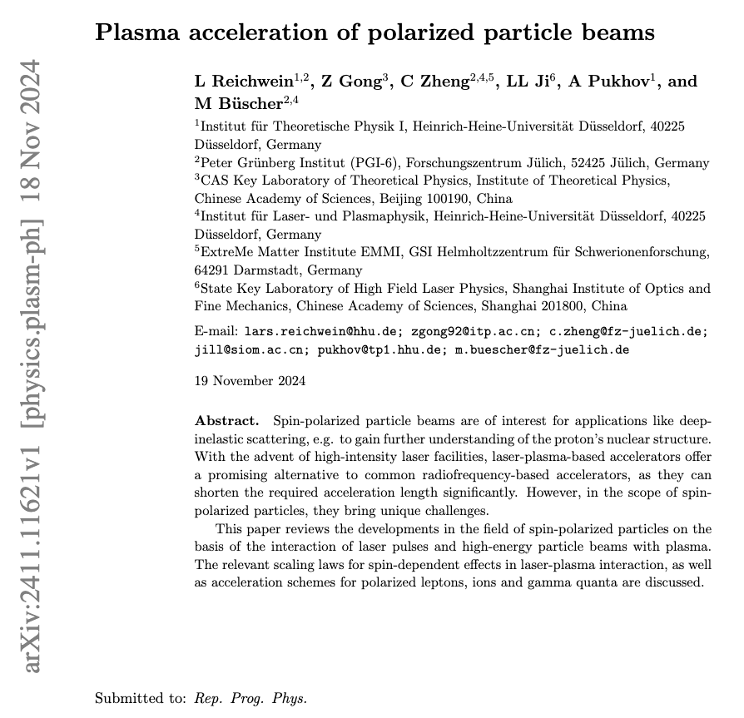

Review Paper on polarized beams
Submitted to Rep. Prog. Phys.
Covering the following topics:
  Experimental techniques (targets & polarimetry)
  Pol. electrons & positrons
  Pol. ions
  Pol. gamma quanta (incl. vortex states)

Slide 5
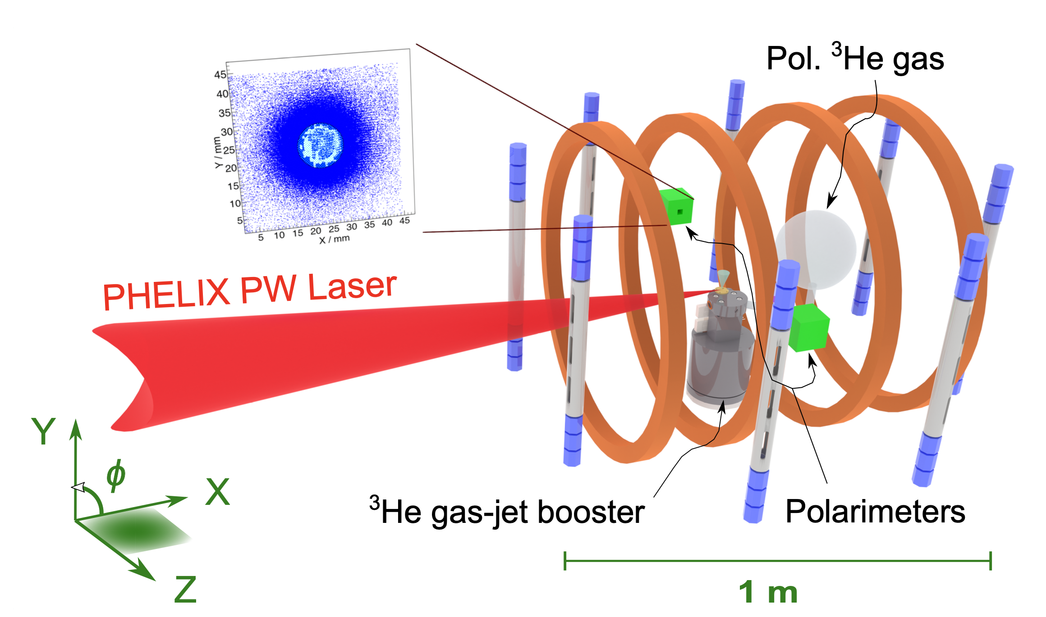
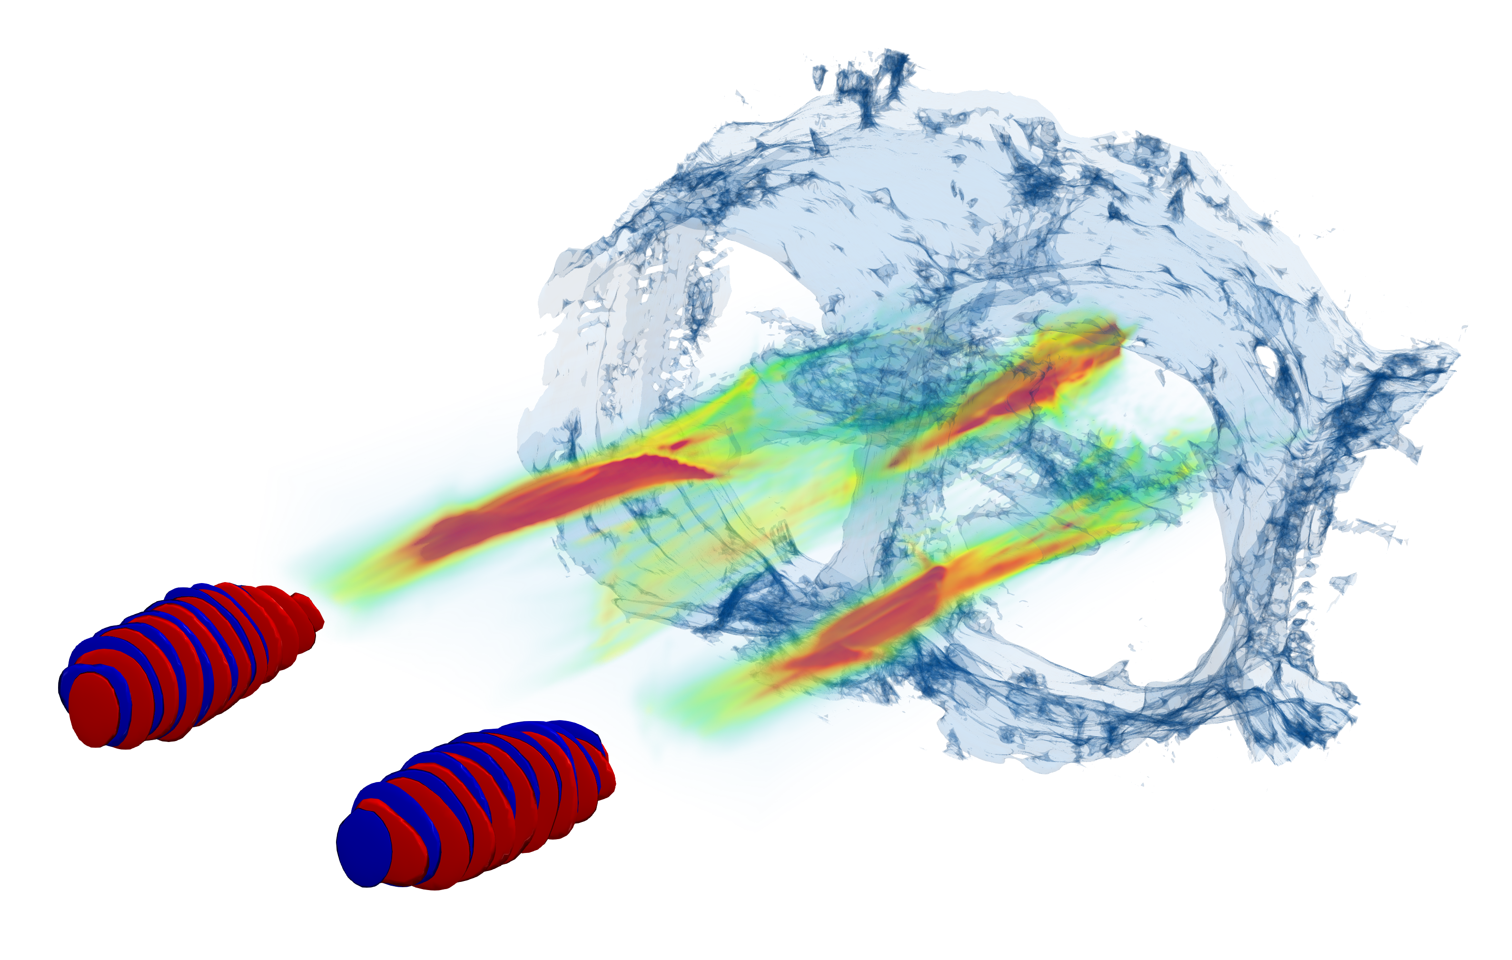
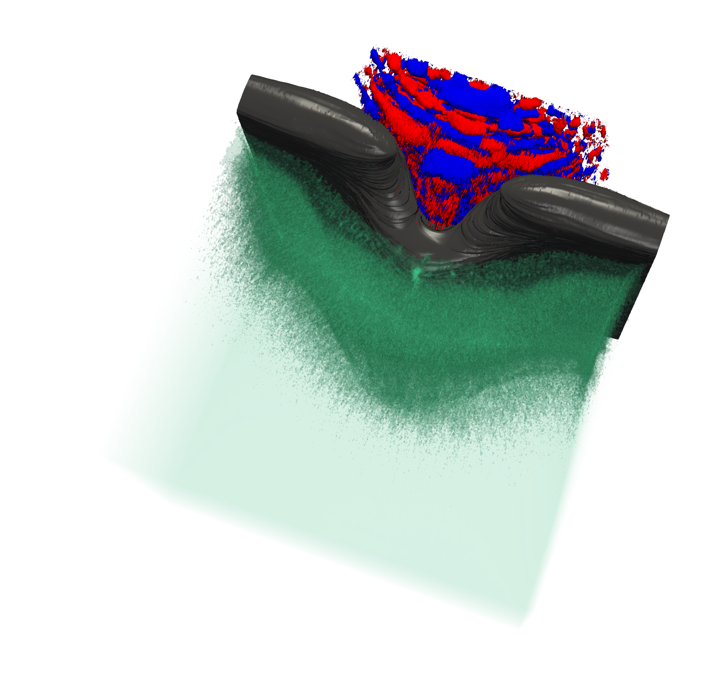
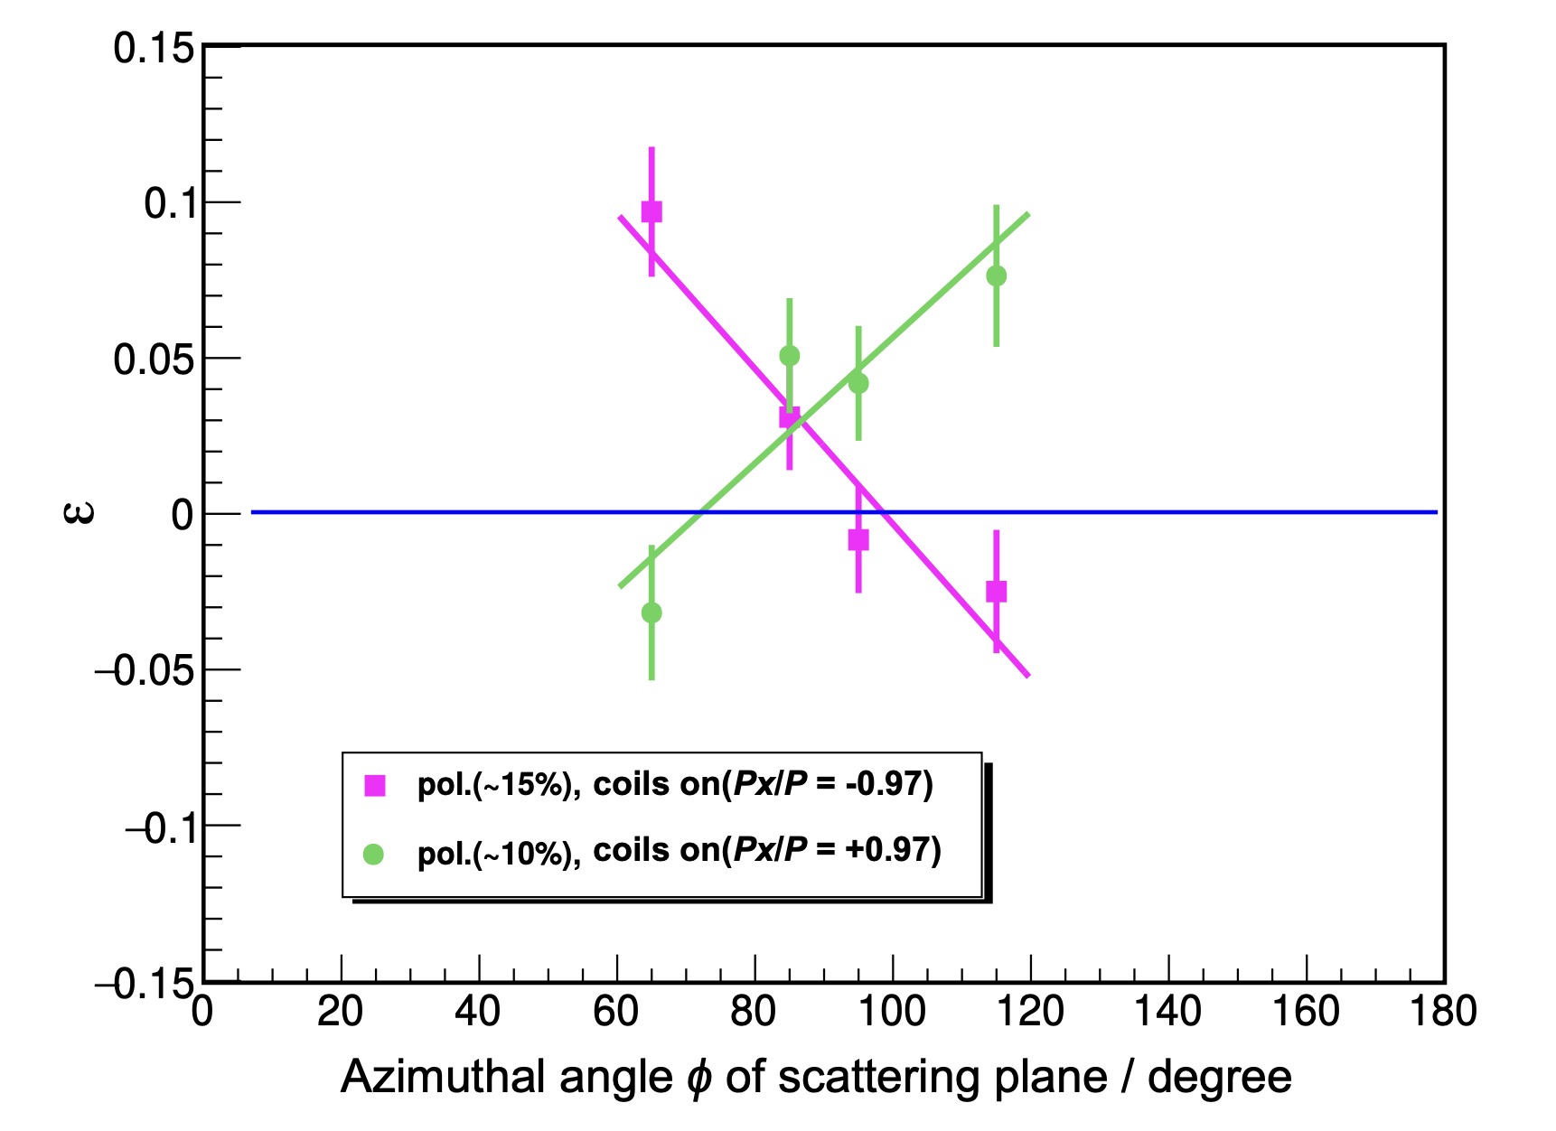
Polarized ions
Proof-of-principle acceleration of pol. ³He at PHELIX
Further studies
on ion acceleration
C Zheng, arXiv:2310.04184v2 (2024)
L Reichwein, PRAB 25, 081001 (2022)
L Reichwein, PPCF 66, 055002 (2024)

Slide 6
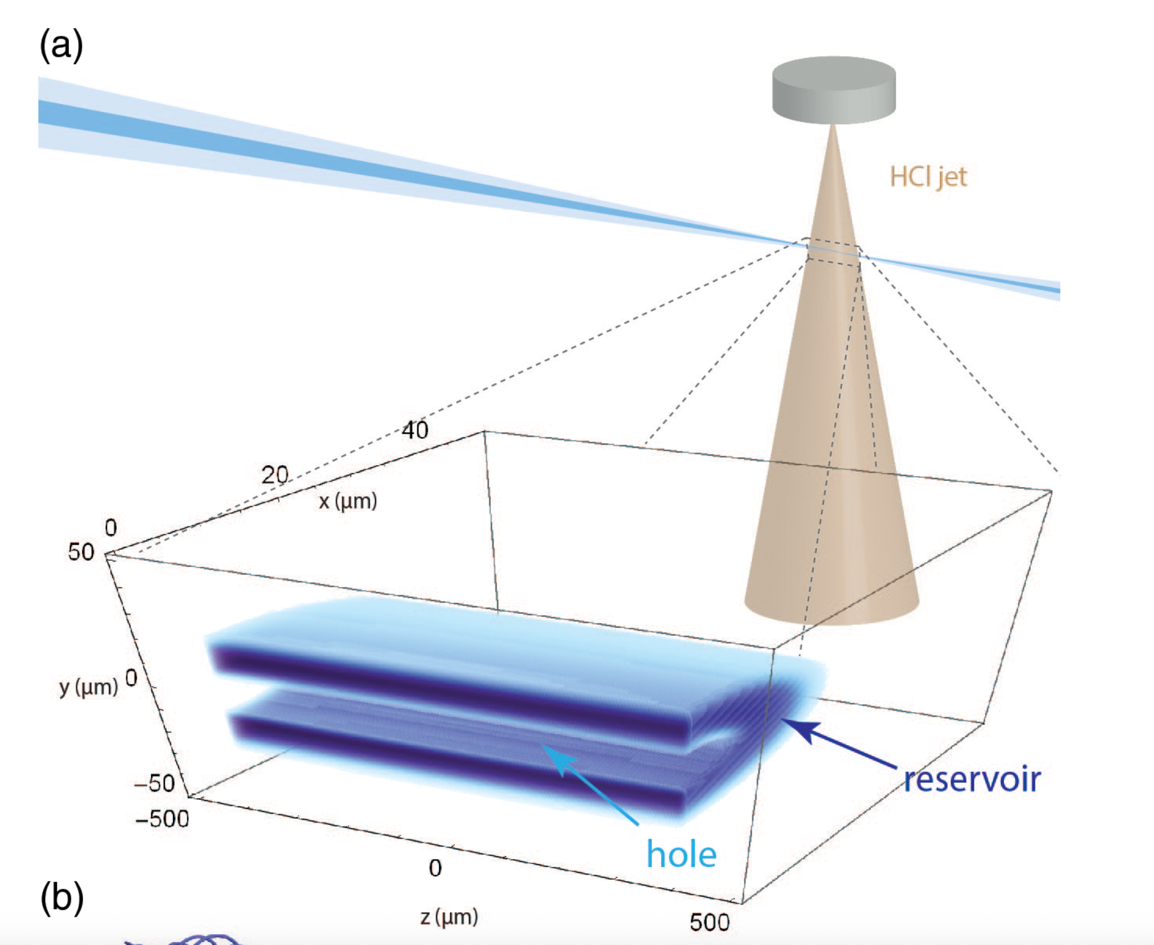
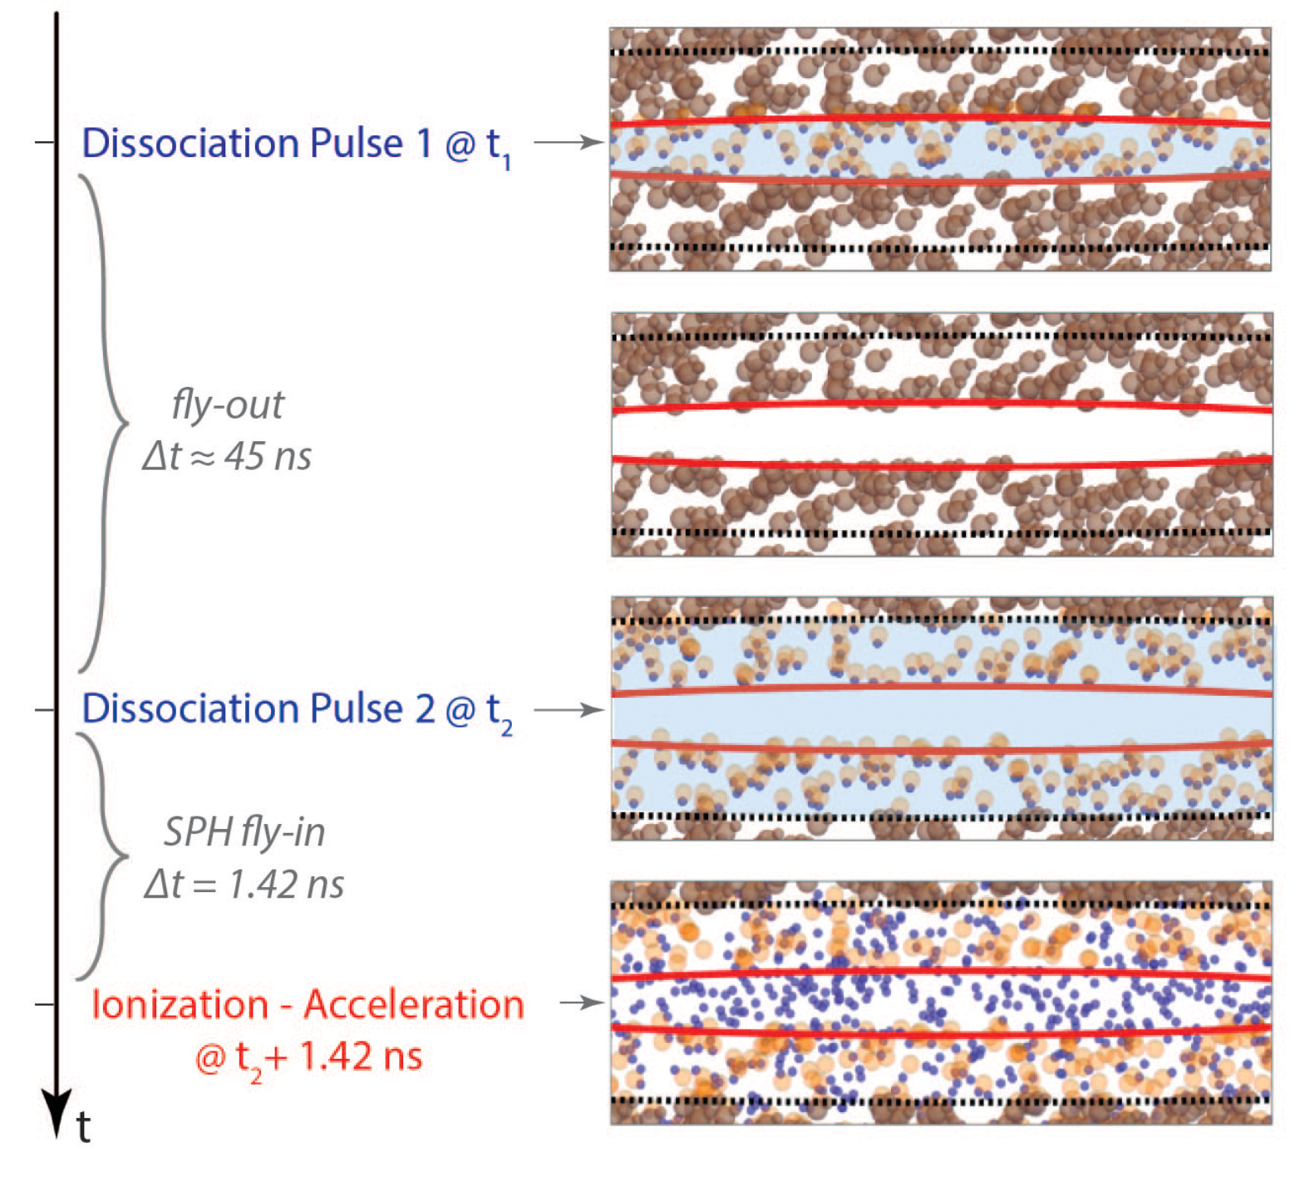
Polarized electrons
Hydrogen halides as possible sources of pol. electrons
D Sofikitis, PRA 111, 053119 (2025)

Slide 7
Particle-in-Cell Code VLPL
Developed by Alexander Pukhov
Fully electromagnetic 3D-PIC code
  Quasi-static variant qv3d → AWAKE collaboration
Extensively benchmarked against experimental data
Modules for collisions, QED, …
X-dispersionless „RIP“ Maxwell solver
Yee solver
RIP solver
A Pukhov, JPP 61, 425 (1999)
A Pukhov, JCP 418, 109622 (2020)

Slide 8
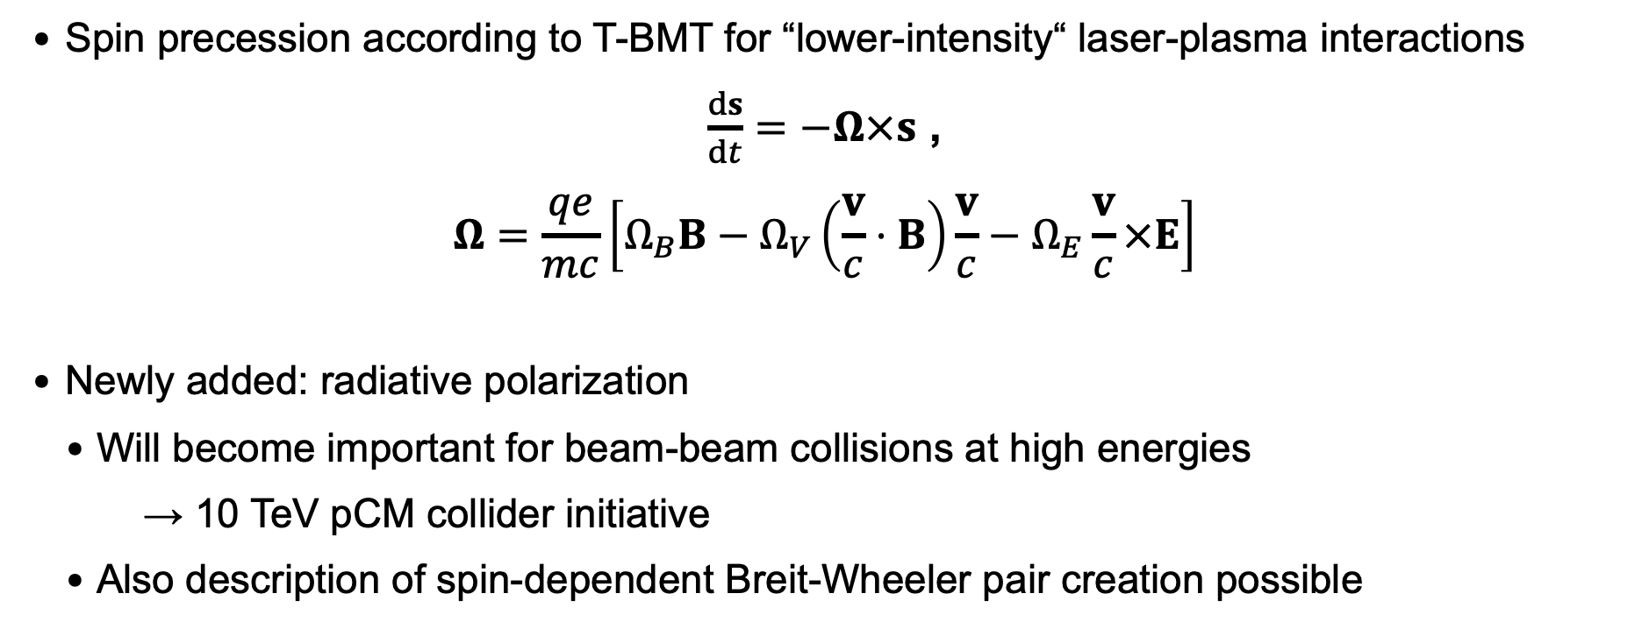
Spin effects in PIC-Code VLPL
  Spin precession according to T-BMT for “lower-intensity“ laser-plasma interactions
$\frac{ds}{dt}=−Ω×s$ ,
$$Ω=\frac{qe}{mc}\left[Ω_{B}B−Ω_{V}\left(\frac{v}{c}⋅B\right)\frac{v}{c}−Ω_{E}\frac{v}{c}×E\right]$$
  Newly added: radiative polarization
    Will become important for beam-beam collisions at high energies
      → 10 TeV pCM collider initiative
    Also description of spin-dependent Breit-Wheeler pair creation possible

