Slide 1
Magneto-hydrodynamics in collisional plasma
Improved transport coefficients
James Sadler
(james4sadler@lanl.gov)
Hui Li
Brian Haines
Los Alamos National Laboratory
Chris Walsh
Lawrence Livermore National Laboratory

Slide 2
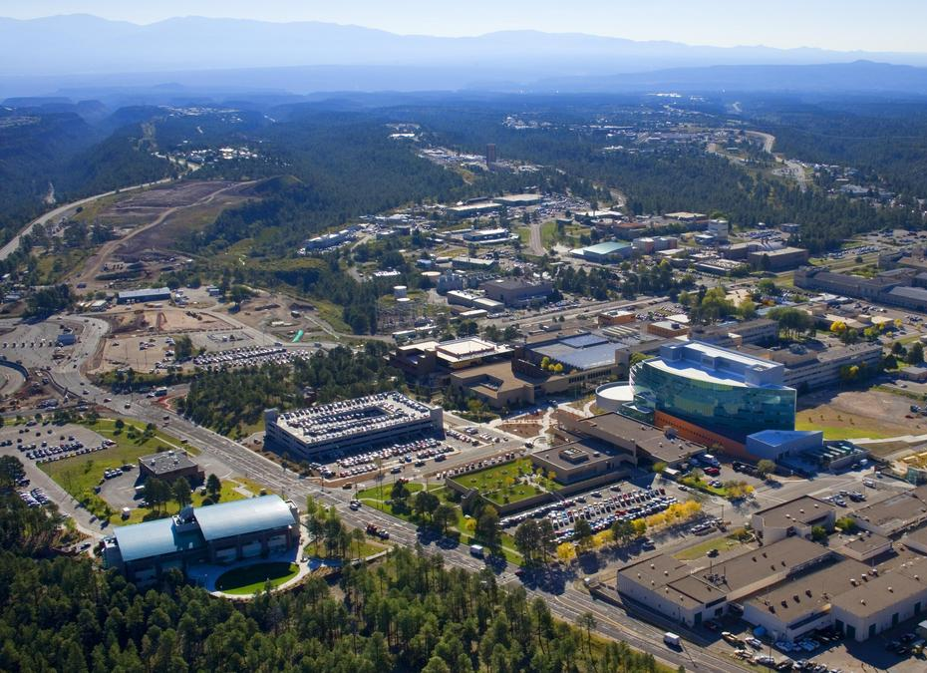
Los Alamos
Founded for Manhattan project
50,000 CPU supercomputer (for open science)
Expertise in hydro codes

Slide 3
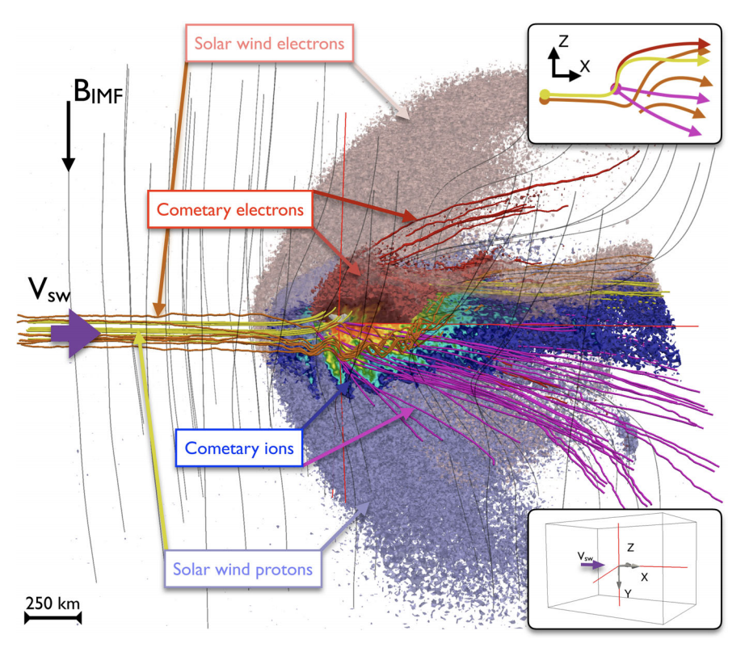
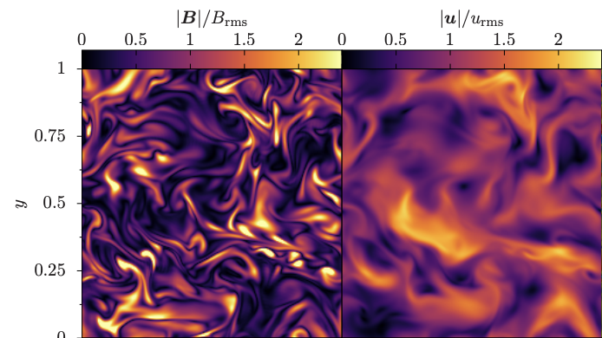
Magneto-hydrodynamics
MHD is a successful theory of magnetic transport in fluids
  Fusion devices
  Solar wind
  Laser plasmas
D. A. St-Onge et al., arXiv 2003.09760 (2020)
Jan Deca et al., PRL 118 205101 (2017)

Slide 4

Ideal magneto-hydrodynamics
Assume E=0 in fluid frame
  Relativistic transform of field: E = -u x B
Field is just advected with the fluid flow
  If we compress a plasma, B goes up

Slide 5
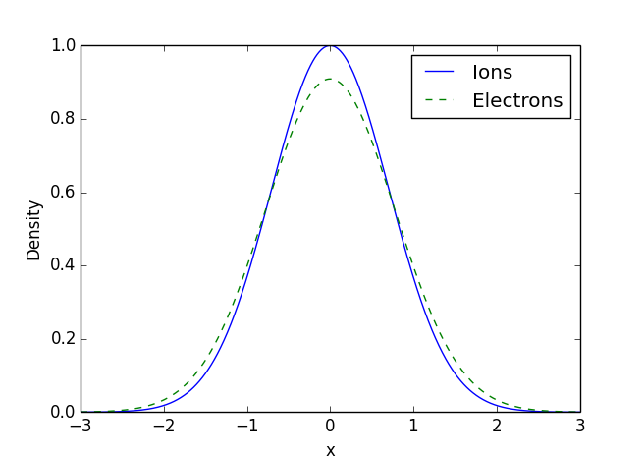
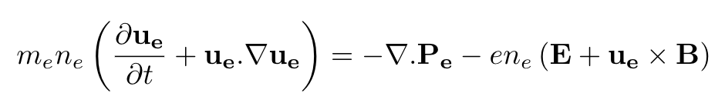
More detailed version - MHD sheath
Electron pressure also contributes
Electrons form a Debye sheath around ion fluid

Slide 6
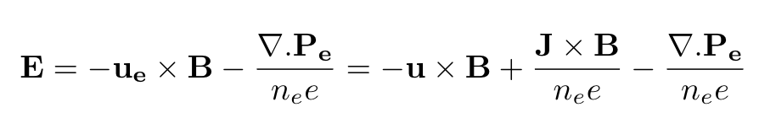
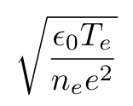
More detailed version - MHD sheath
Electron pressure also contributes
Electrons form a Debye sheath around ion fluid
Debye Length

Slide 7

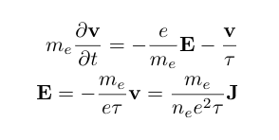
Plasma resistance
Plasma is not a perfect conductor
Electrons scattering timescale:
  <1ns in laser plasmas
  Less than experiment timescale
+
J
E
Spitzer Resistivity
Actually there should be an order 1 ‘transport coefficient’ here

Slide 8
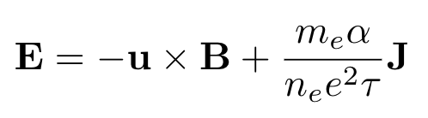

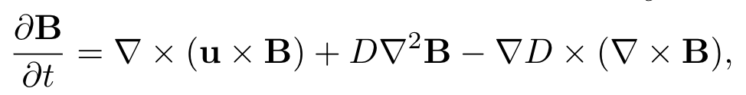
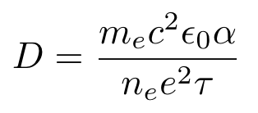
Resistive magneto-hydrodynamics
Include the Coulomb resistance
Now B field also diffuses as it flows with the fluid

Slide 9
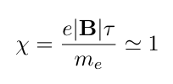





Things are even more complicated…
Strong B field affects the resistance - extended MHD
Resistance depends on direction of B
B
B
J
E
E
J
J is deflected away from direction of E

Slide 10
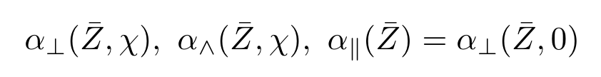
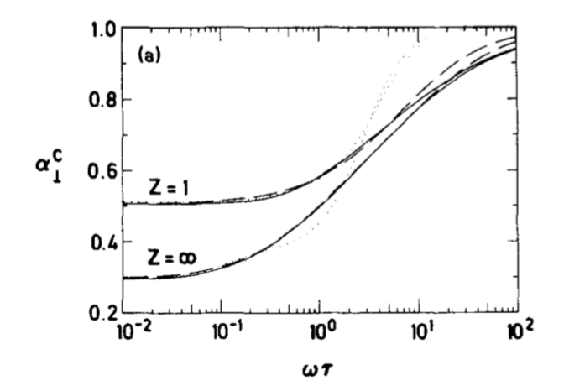
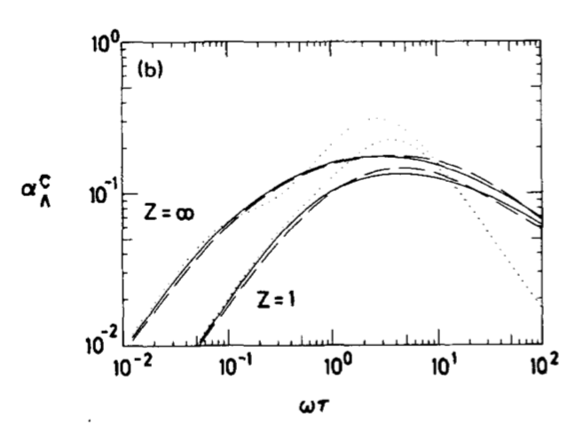
Decompose into basis - transport coefficients
B
J
Epperlein+Haines, Phys. Fluids 29, 1029 (1986)

Slide 11
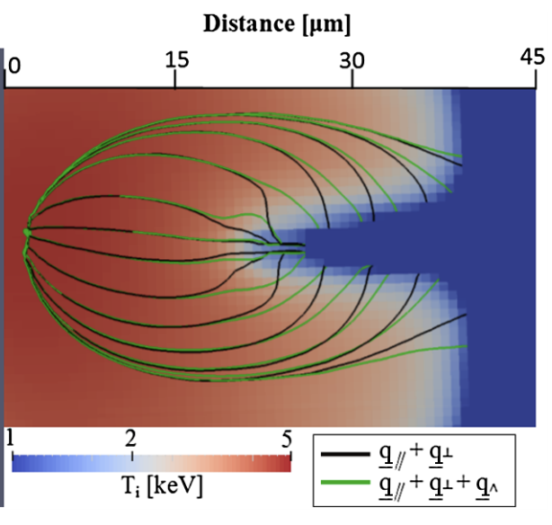
Electron heat flux is also affected
B field insulates and deflects the heat flow
This means even weak B fields can indirectly affect hydrodynamics
C. Walsh et al. Phys. Rev. Lett. 118, 155001 (2017)

Slide 12


The final jigsaw piece - Thermoelectric term
Coulomb collisions lead to an additional thermoelectric term
Faster electrons from hot region are less collisional

Slide 13
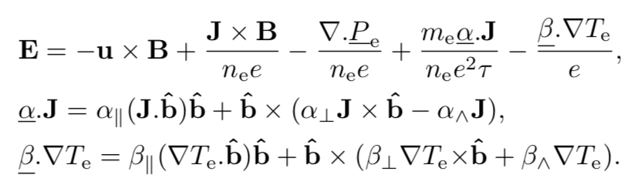
Full Ohm’s law – Pulling everything together

Slide 14
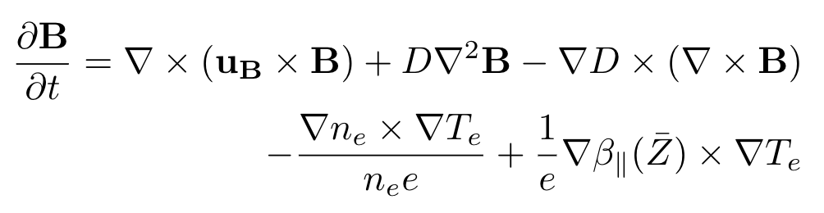
Don’t panic! It can be written in an (almost) simple form
Advection of B with a modified velocity
Resistive diffusion of B
Resistivity gradient term
Pressure term leads to Biermann source term
Thermoelectric gives a new Z-gradient source term
C. Walsh et al. Phys. Plasmas 27, 022103 (2020)
J. Sadler et al. Phys. Plasmas 27, 072707 (2020)

Slide 15
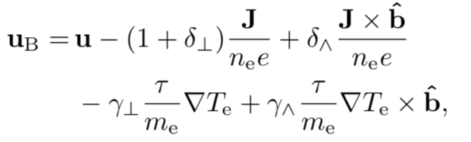
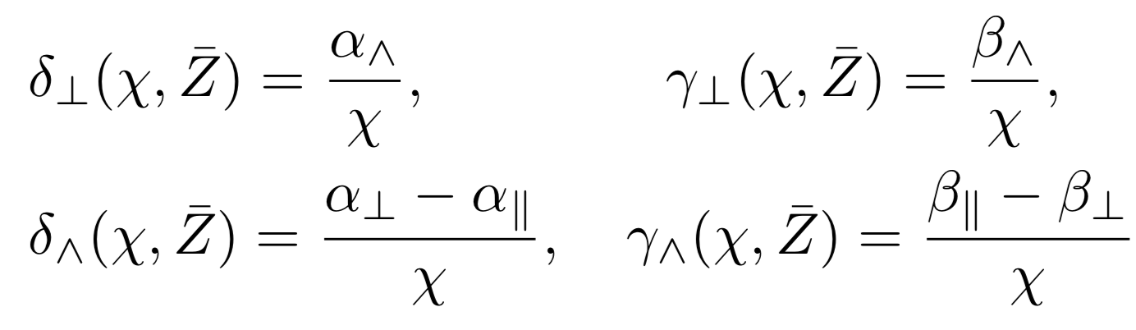
All of the difficult Braginskii terms just modify the B field advection velocity
Ideal advection
Collisions modify Hall term
Also now a cross-Hall term
Also a cross-Nernst term along isotherms
B advected down Temperature gradients
(Nernst Advection)
Getting to this simple new form requires defining new transport coefficients:

Slide 16
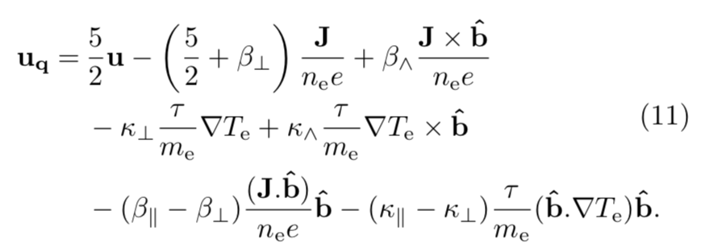
Insight from new form of the equations
B field advection is identical to electron heat transport
After replacing for the new coefficients, the equations are almost identical

Slide 17
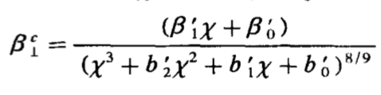
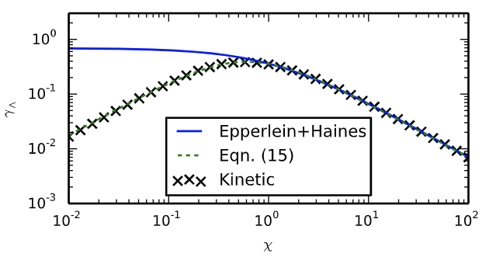


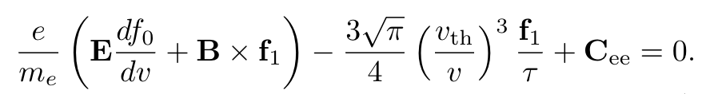
Problem with the existing transport coefficients
Many ExMHD codes (Hydra, Gorgon etc.) use transport coefficients from Epperlein + Haines, Phys. Fluids 29, 1029 (1986)
We tried to calculate the new coefficients using their fits
  We compared the results to full kinetic
  Although is accurate, it cannot be used to calculate
This means many ExMHD simulations have unknowingly hugely over-estimated the cross-Nernst advection

Slide 18
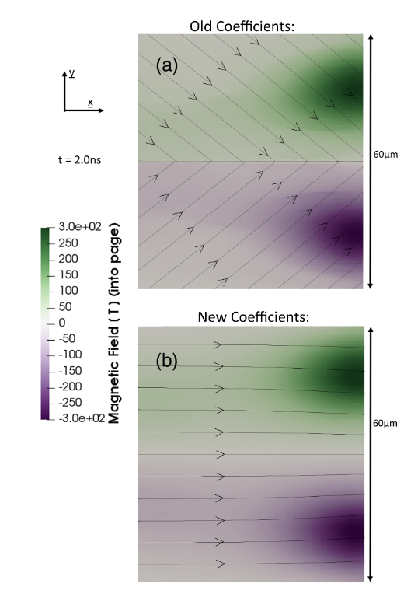
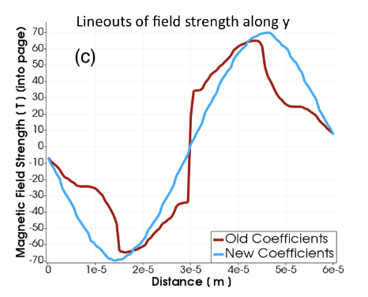
Effect of the new fit functions in 2D Gorgon simulations
Using Epperlein + Haines coefficient fits, |B| was out by factor ~ 2 or more in some regions!!
Their relative error for was low, but their functional form was wrong.

Slide 19

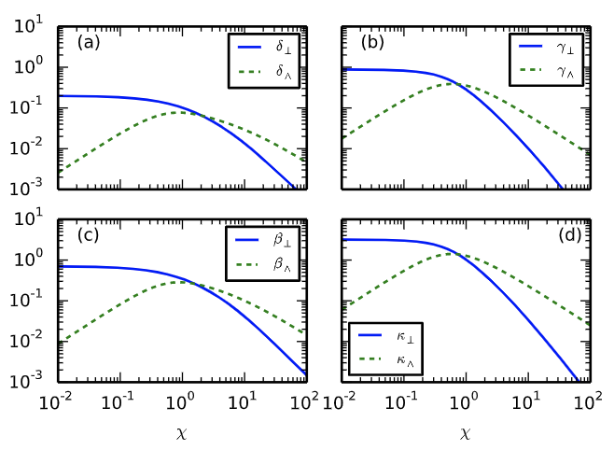
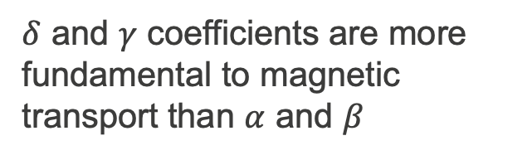
Newly defined coefficients create a symmetric set
Defining the new coefficients makes the set symmetric
Compare to Braginskii’s coefficient. It has totally different behavior to all the others
$δ$ and $γ$ coefficients are more fundamental to magnetic transport than $α$ and $β$

Slide 20
B field post-processing of xRAGE hydro code - ICF

Slide 21
B field post-processing of xRAGE hydro code - ICF

Slide 22
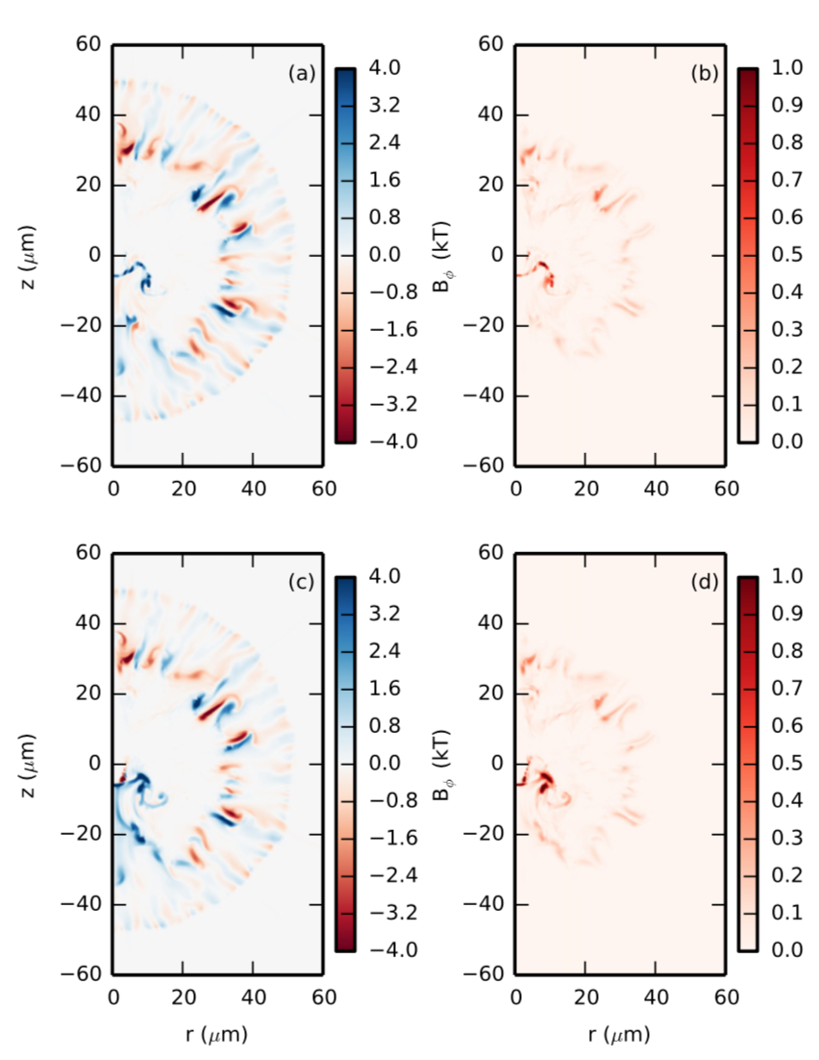
The new Z gradient source term makes a difference
Biermann + Z gradient
Biermann only

Slide 23
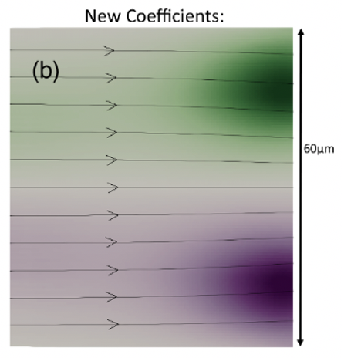
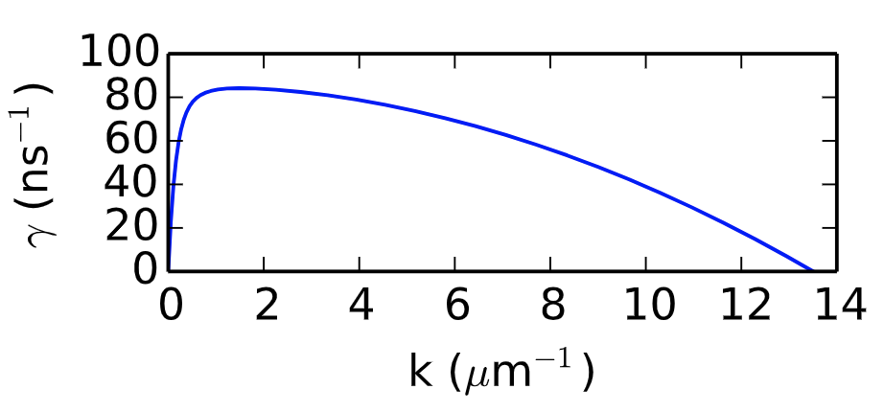
New thermomagnetic instability
By re-casting these equations, we also found a previously unknown ExMHD instability
Opposing Z gradients and T gradients create B field
  This B field then deflects the heat flow, reinforcing the T perturbation
B field due to transverse T perturbation and Z gradient
Heat deflection due to B
Growth in ICF fusion plasma
James Sadler et al., Phys. Plasmas ( Submitted 2020 )

Slide 24
New thermomagnetic instability - Simulations
We setup 2D ExMHD code with anti-parallel T, Z gradients
It seems like in practice, the Nernst advection stabilizes it

Slide 25
Conclusions
The Epperlein+Haines transport coefficients have a subtle problem that causes major errors in B field transport
  Although the relative error is small, their functional dependence is wrong
  Gives artificial discontinuities and dissipation
  Our new fits fix these problems: arXiv:2009.04562
The coefficients can be re-cast into a symmetric set that relates to magnetic transport, rather than electric fields
There is a new Z-gradient magnetic source term
  It leads to a new thermomagnetic instability – but Nernst stabilizes it

